Slide 1
Progress update of the VGOS radio telescope at the Metsähovi Geodetic Research Station
Guifré Molera Calvés
Nataliya Zubko, Jyri Näränen, Markku Poutanen

Slide 2
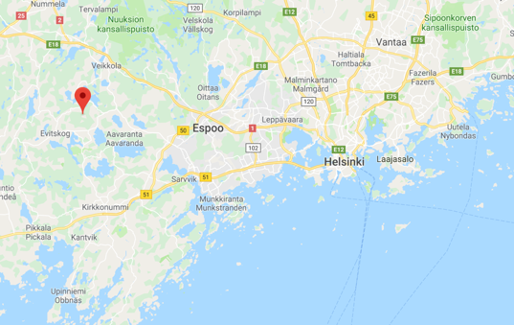
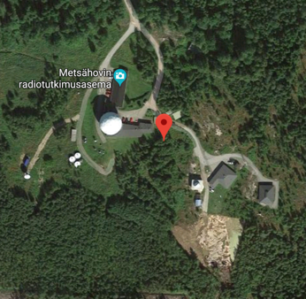
VLBI site in Finland
Metsähovi Geodetic Research Station:
VLBI
SLR
GNSS
DORIS
Gravimeters

Slide 3
VLBI Global Observing System
VGOS technical and observational concept was developed by VLBI2010 Committee
1‐mm position accuracy (on 24‐hour observation)
VGOS
goals
Continuous measures of station position and EOP
Turnaround time to initial products < 24‐hours
Notes:
VGOS goals:
1‐mm position accuracy (based on a 24‐hour observation)

Slide 4
VGOS design aspects
 | Current | VGOS
Antenna size | 5-100 m dish | ~13 m dish
Slew speed | ~20-200 deg/min | >=720 deg/min
Sensitivity | 200-15000 SEFD | <=2500 SEFD
Frequency range | S/X band | 2-14 GHz
Recording rate | 128, 256 Mbps | 8-16 Gbps
Data transfer | Usually ships disks, some e-transfer | e-transfer
8.10.2018
4

Slide 5
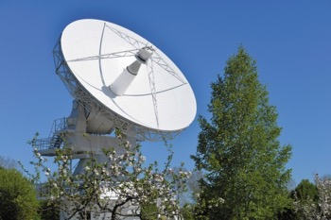
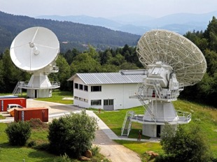
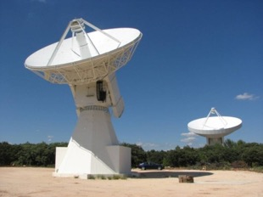
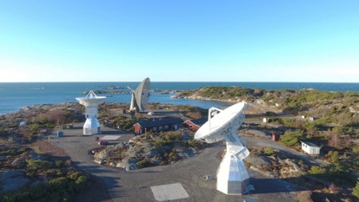
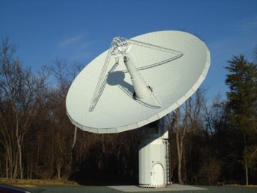
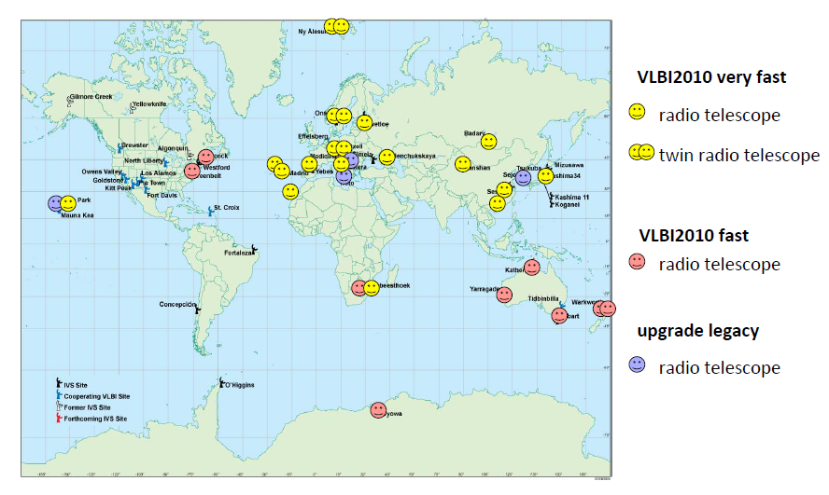
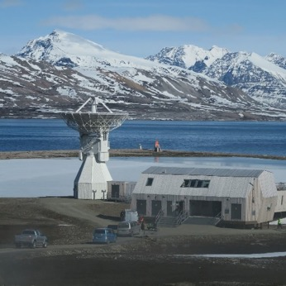
VGOS network
Zelenchukskaya
Wettzell
Yebes
Onsala
Kokee
Ishioka
Ny-Alesund
5

Slide 6
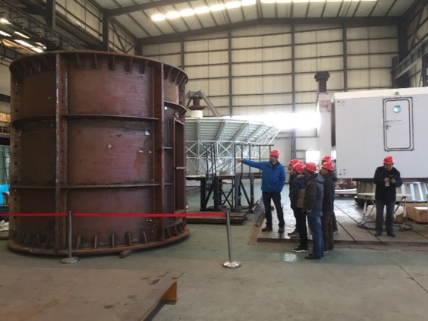
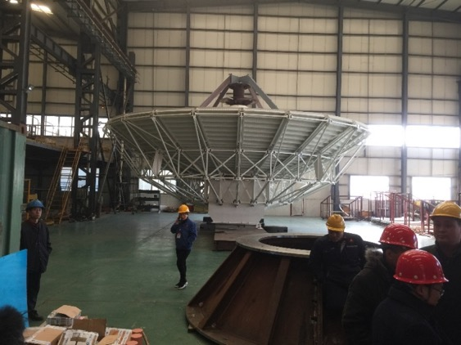
Project overview
2009-2015- Search of funding
November 2015 – Proof of funding for the VGOS project by Finnish Ministry of Forestry and Agriculture
January 2016 - Start of the project
March-November 2016 –tendering of radio telescope
April 2017-February 2018- manufacturing of the radio telescope

Slide 7
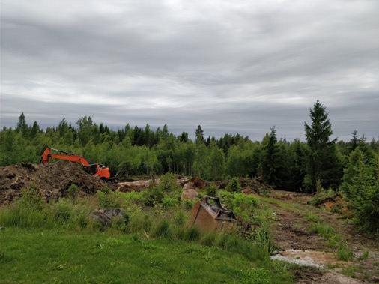
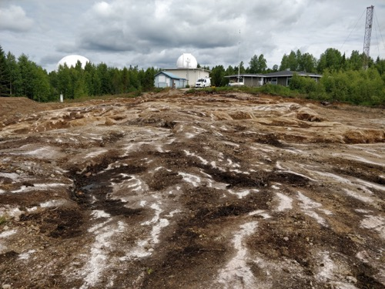
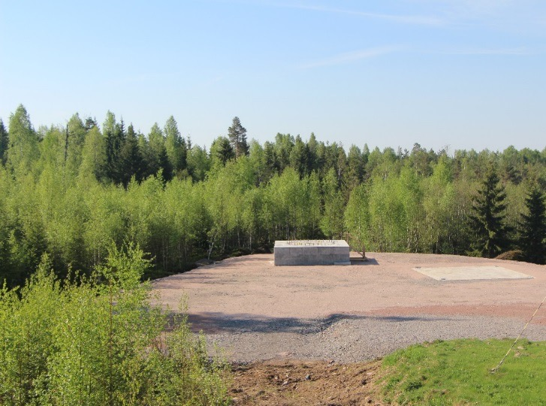
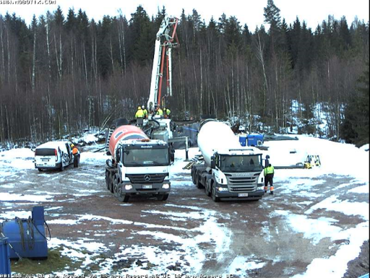
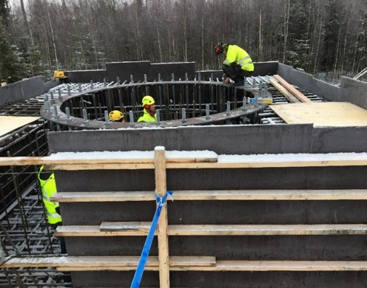
Project overview
May 2017- December 2017 - Site preparation

Slide 8
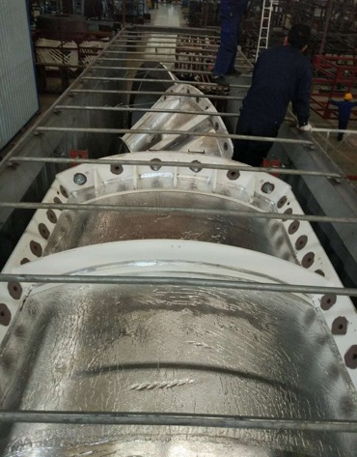
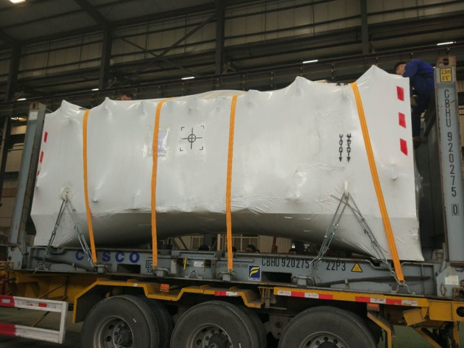
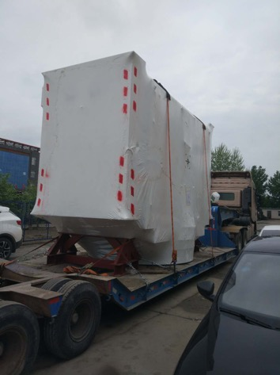
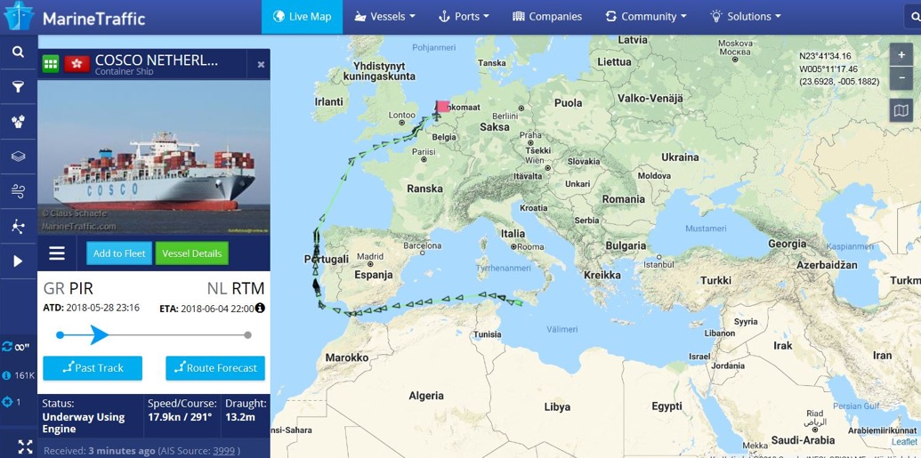
Telescope shipment
Telescope shipped from China on 25th of April
Arrives to Metsähovi on 25th of June 2018

Slide 9
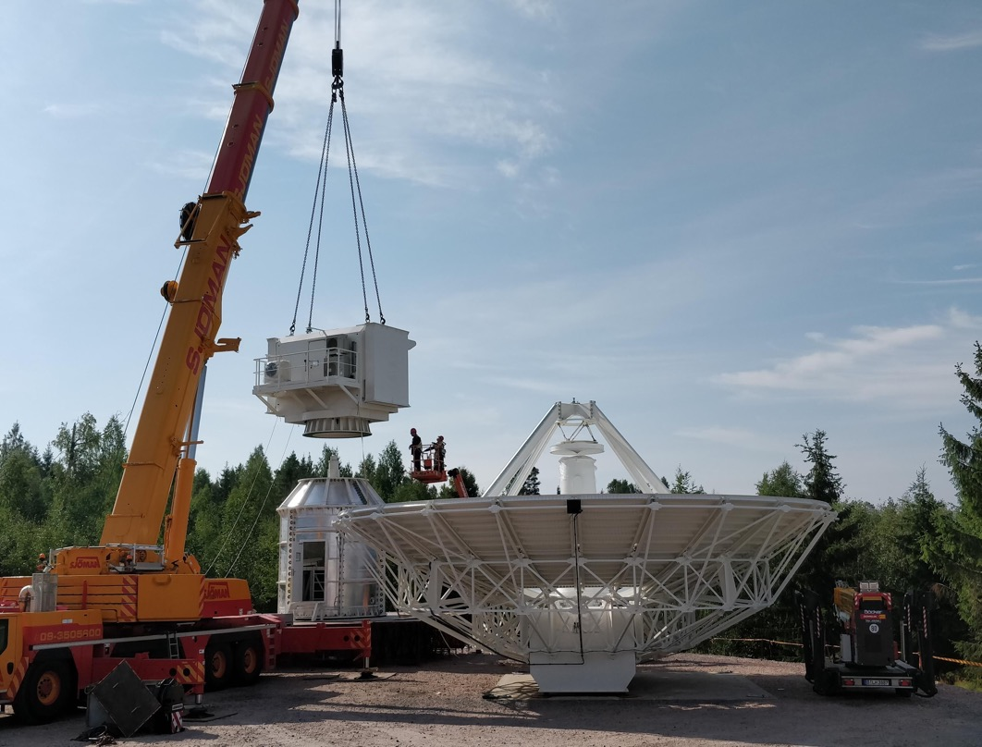
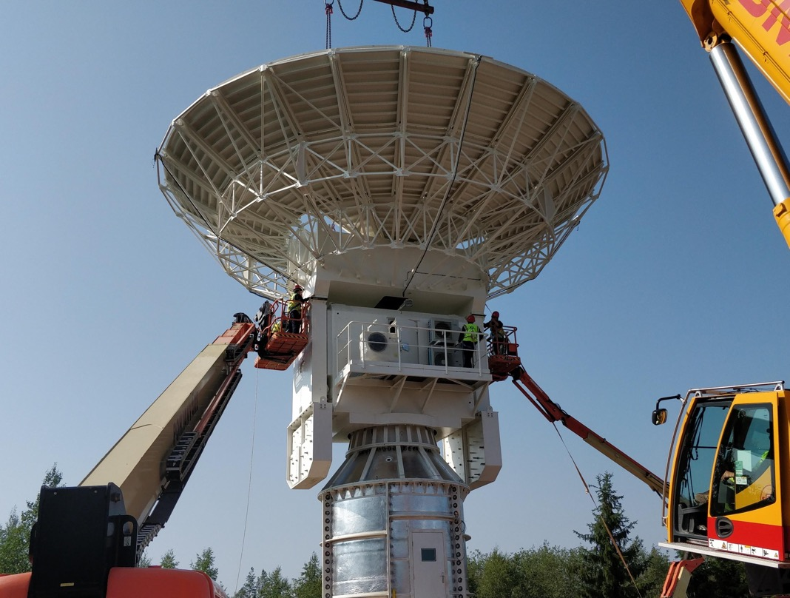
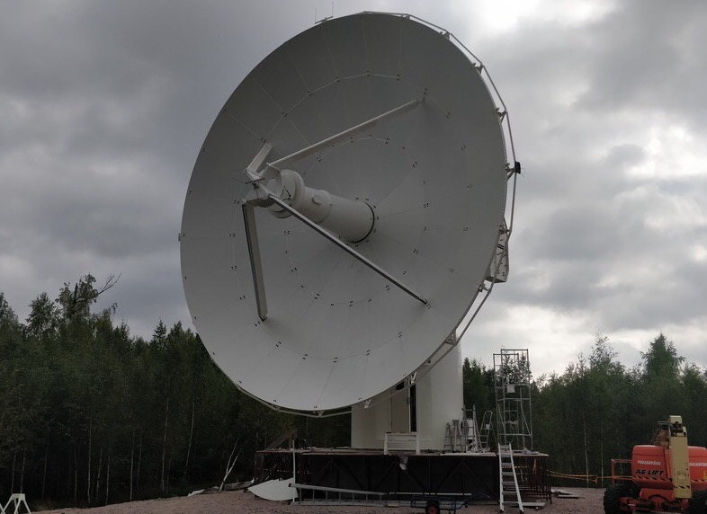
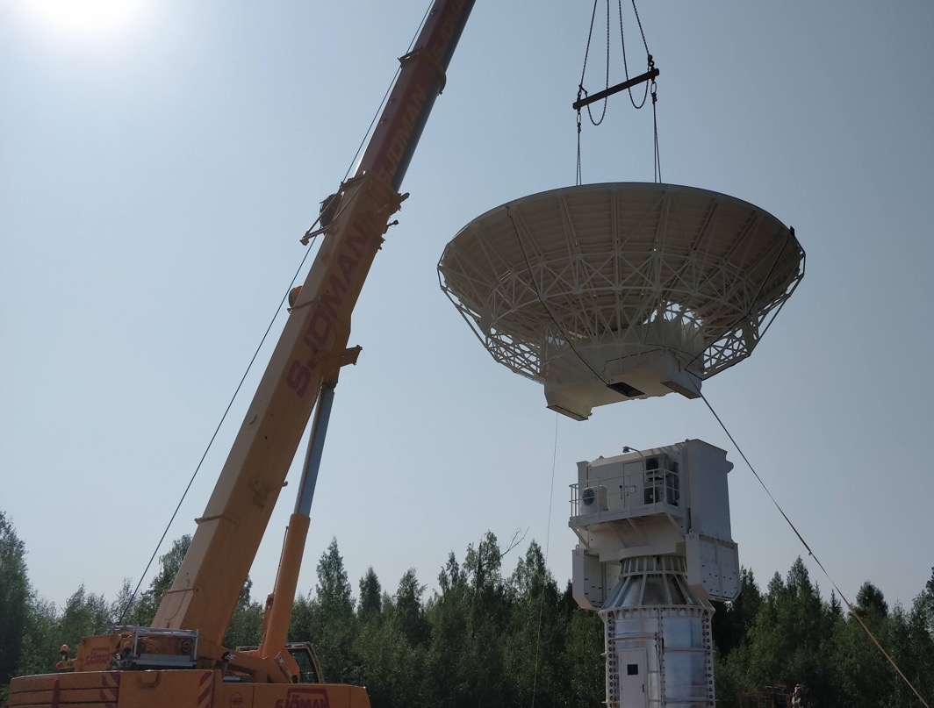
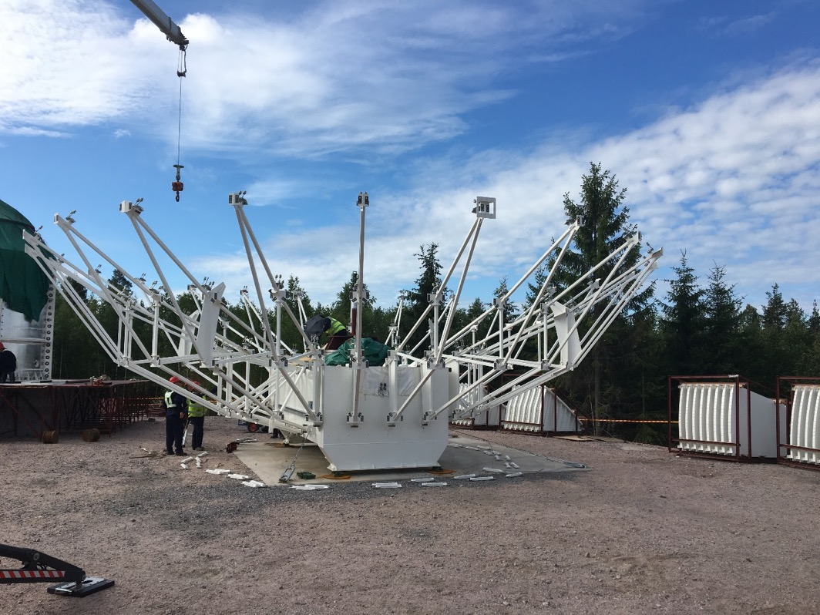
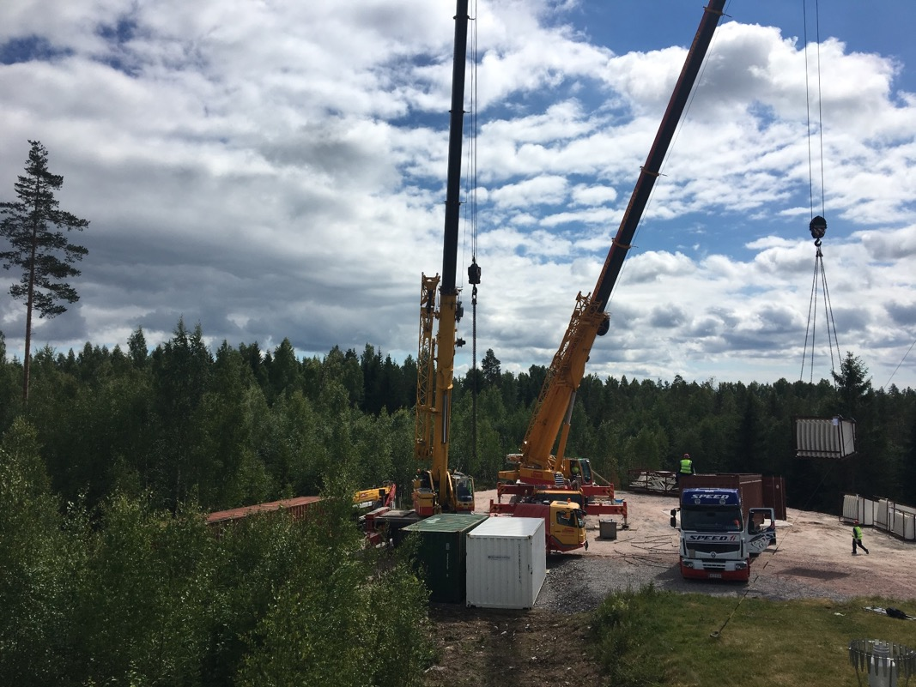
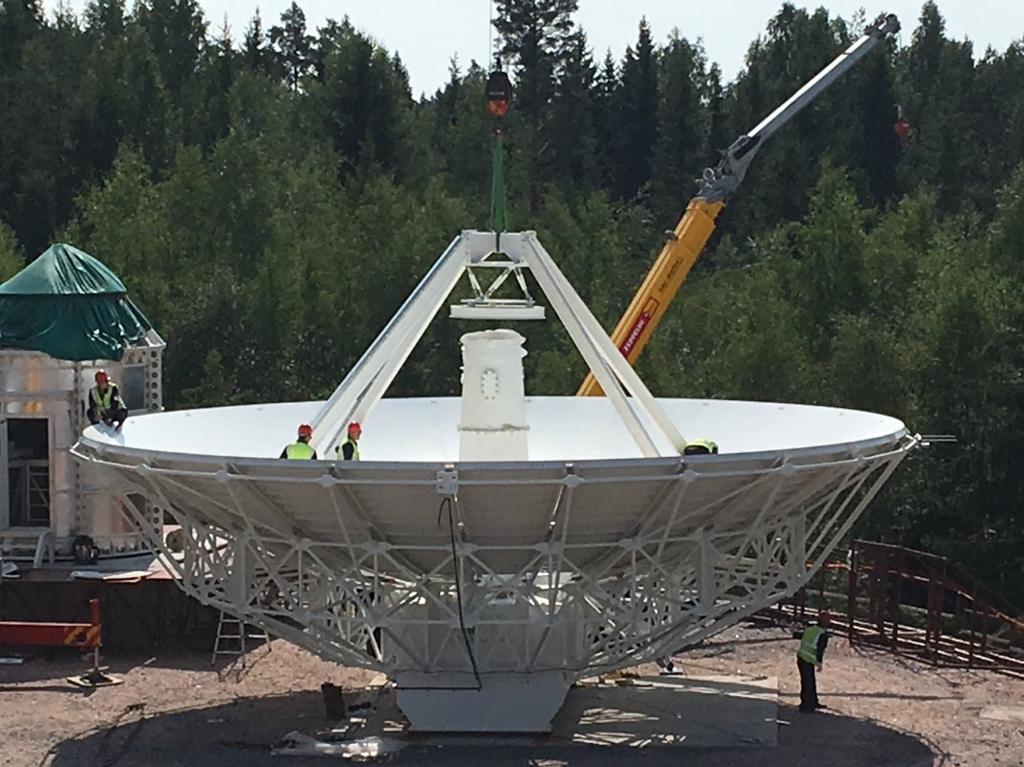
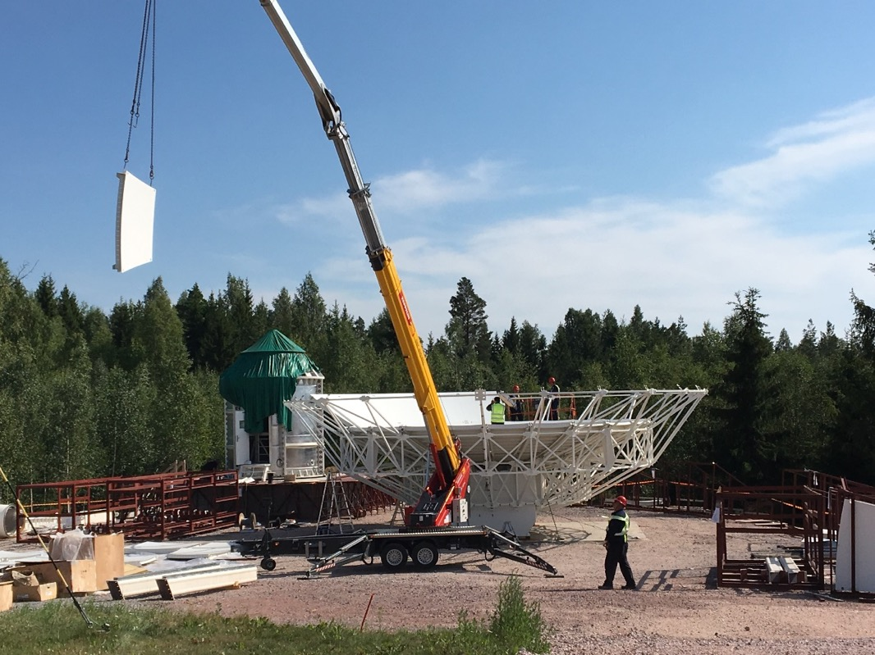
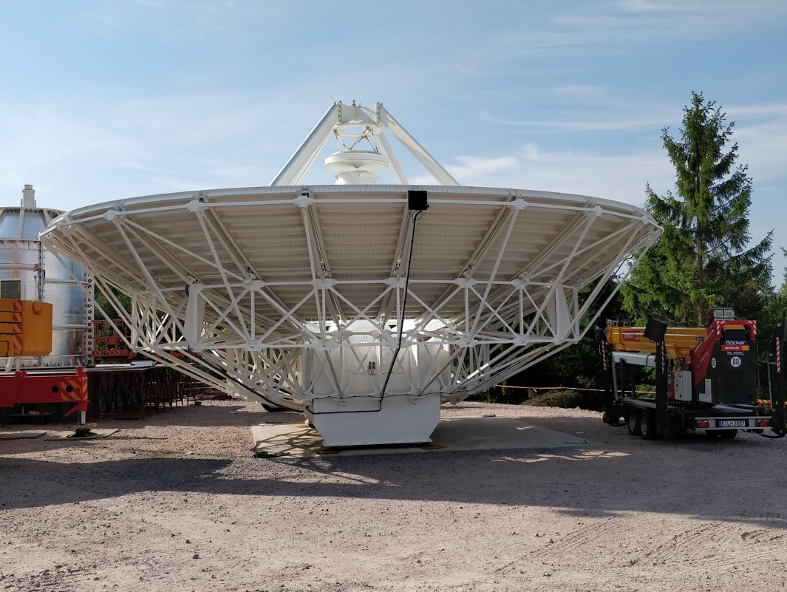
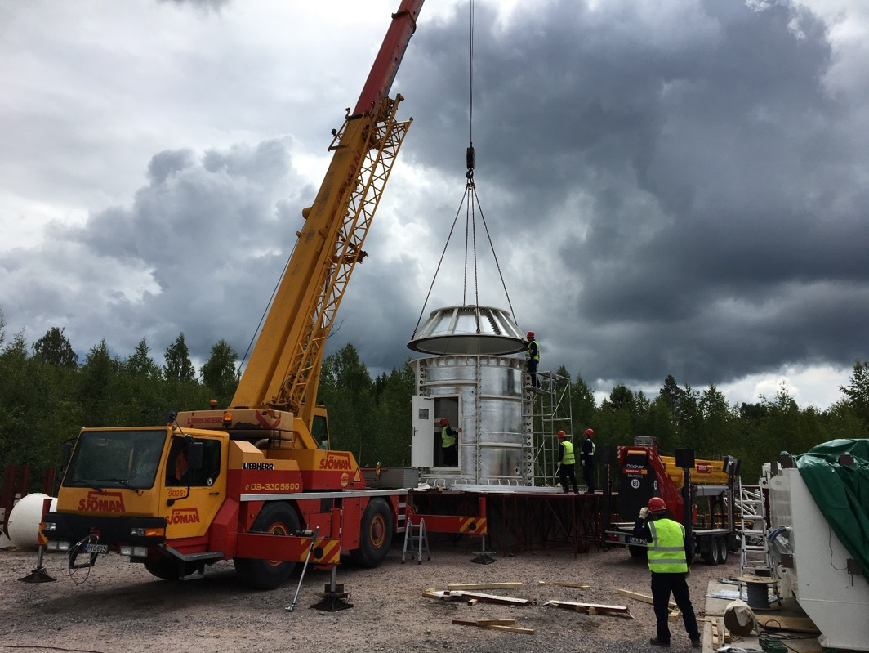
Telescope assembly

Slide 10
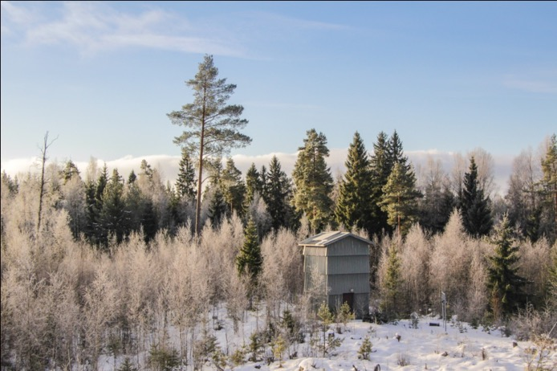
September 2018
March 2016

Slide 11
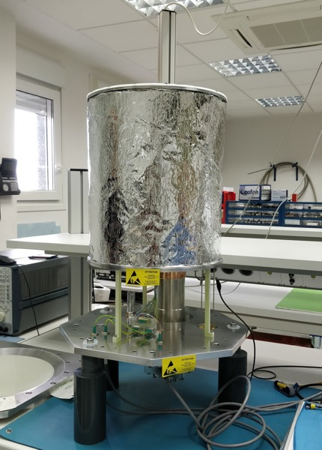
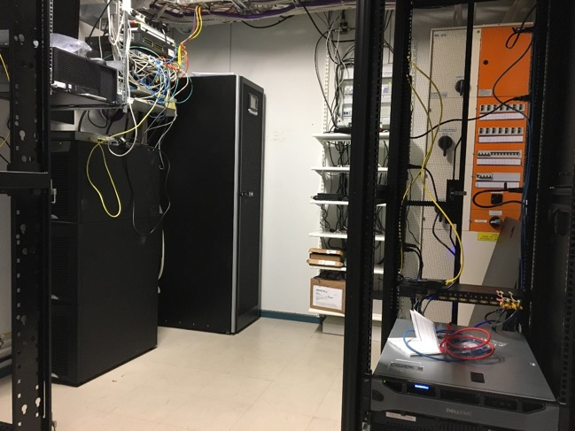
Signal chain
Broadband receiver (2-14 GHz) two polarisations and QRFH feed being built by IGN (Spain, Yebes)
2 polarisations High and Low RF bands to Optics to link RT to CR.
Backend – DBBC3 full VGOS capable of eight 4 GHz
Recording system – Flexbuff of 480 TB
GPS receiver and prisms for local ties
Receiver 04.10
Control Room

Slide 12
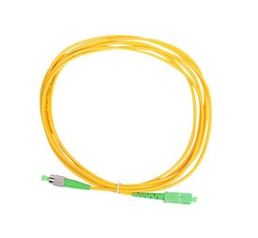
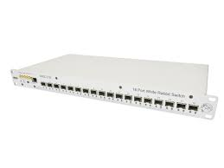
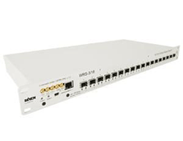
Distribution of Time & Frequency
No Hydrogen maser!
km distances
1 pps
5 MHz
Finnish Metrology Institute VTT/MIKES
White Rabbit Switch CERN + www.sevensols.com

Slide 13
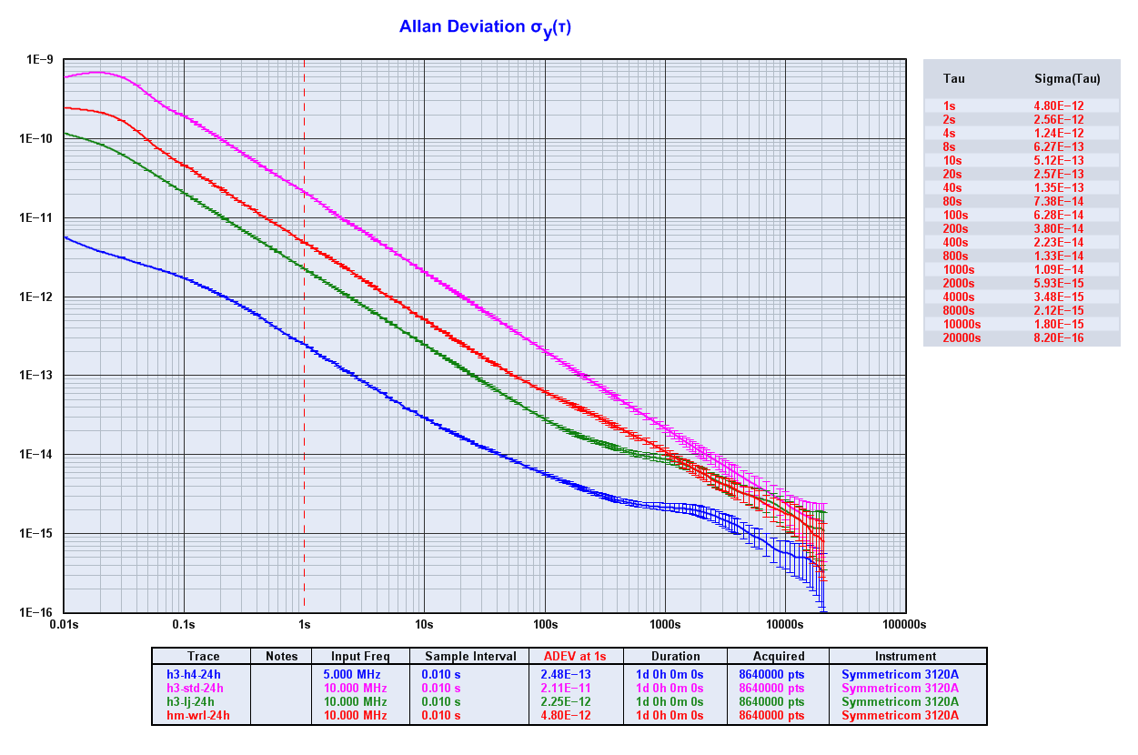
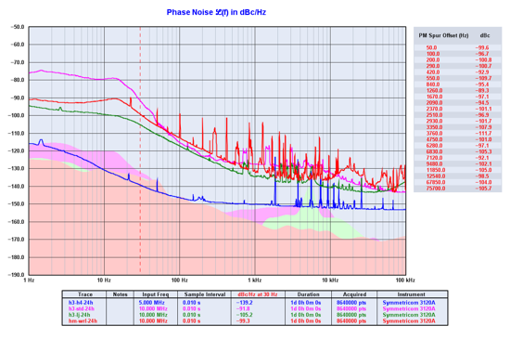
Distribution of Time & Frequency
Extensive tests have been carried out since 2017.
Comparing WRS signal vs Aalto’s Metsähovi H-maser.
WRS can provide a good enough 1 pps and 5 MHz signals to fulfill VGOS requirements.

Slide 14
Future timeline
Sep - Oct 2018 – Telescope commissioning
Dec – Site acceptance test
Feb - Apr 2019 – Installation of the signal chain components
2019 – Testing of the complete telescope system
2020 – Start regular observations

