Slide 1
Investigating Black hole formation using VLBI
Pikky Atri
James Miller-Jones
Richard Plotkin
Arash Bahramian

Slide 2
Black hole birth
Supernova explosion
Direct Collapse
Credit NASA
Adams et al. 2017
Notes:
The other theory is that the massive star just implodes and vanished without any SN explosion into a BH.
Earlier belief was that the more massive stars because they are gravitationally strong, won’t let the outer layers of the star to escape. But recent simulation work has suggested that
The situation is more complicated than there just being a direct mass relation.

Slide 3
Black hole X-ray binary
Binary system of a stellar mass black hole and a star
Galactic systems
Notes:
Accretion
Companion star

Slide 4
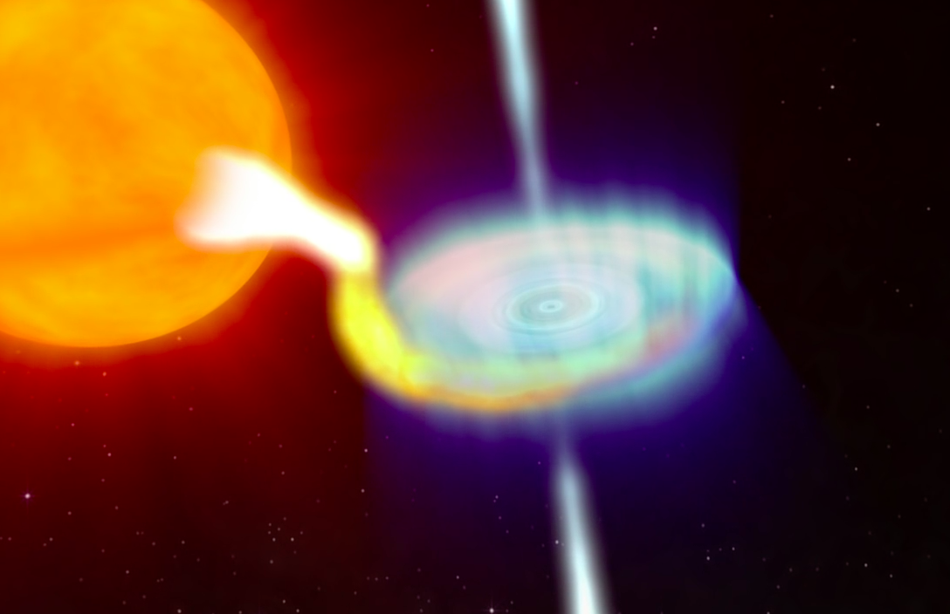
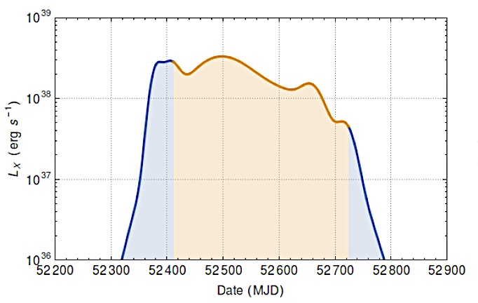
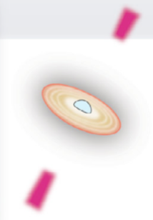
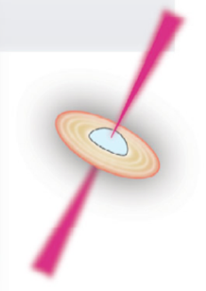
Compact Radio Jets
Compact radio jets
Accretion flow
X-rays
X– ray luminosity (erg s⁻¹)
Fender and Munoz-Darias, 2016
Notes:
Explain hard states
Add the figure about Cyg X-1 with resolved jets in hard state
Add an image of an unresolved source to talk about it being point source
Ideal for astrometry

Slide 5
Natal kicks
Compact objects receive a kick when born with a SN.
Reasons –
Sudden mass loss (recoil kick)
Asymmetries in the SN explosion
Animation credits - Mirabel
Notes:
Few tens of km/s due to symmetric sudden mass loss

Slide 6
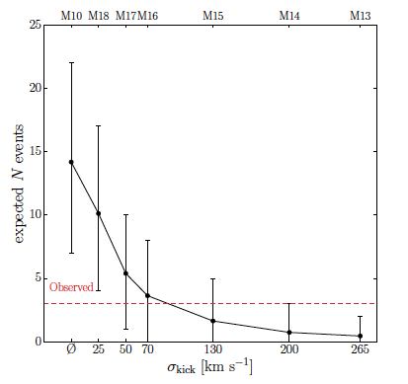
Natal kick importance
Differentiate between two birth pathways
Birth pathway related to mass of BH?
Influence on binary stellar evolution
Impact on BH-BH merger rates
Wysocki et al. 2017
Notes:
Add plot of natal kick controlling BH merger rates
BH-BH can form if two primordial BHs find each other
Natal kick mean BHs gets kicked out of GCs before they can form binary
Natal kick can lead to unbinding of BH binary.
Also controls stellar evolution

Slide 7
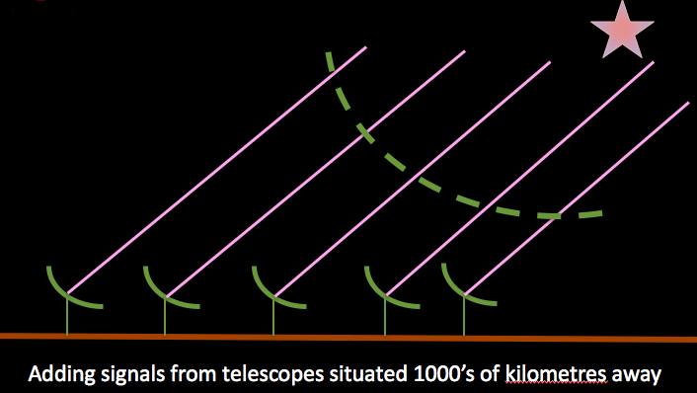
Measuring natal kicks
Measure Space velocity
Proper motion (Radio VLBI)
Space velocity
Radial velocity (optical)
Notes:
Gaia cannot measure proper motion because of outbursting timing
And because the systems are in Bulge or towards galactic plane so the extinction does not allow the measurement at all

Slide 8
Measuring natal kick
Measure Space velocity
+Distance (parallax)
Trace the Galactocentric orbit
Velocity at plane crossing is potential natal kick
P($v$|$μα,μδ,α,δ,π,vr$)
Notes:
Mention we assume that stars form in Galactic plane because high stellar density
Add a plot

Slide 9
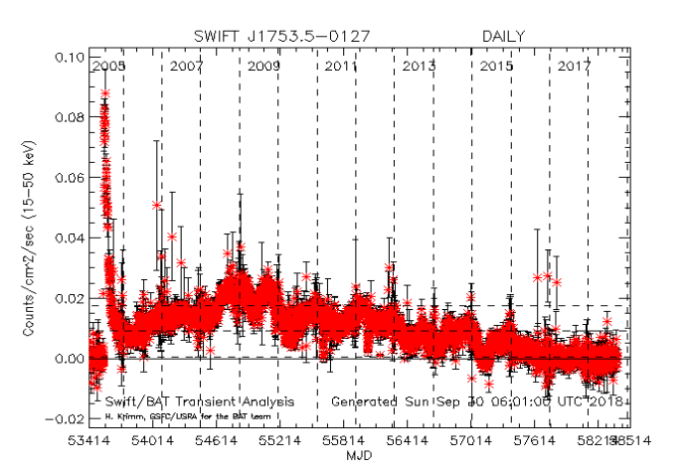
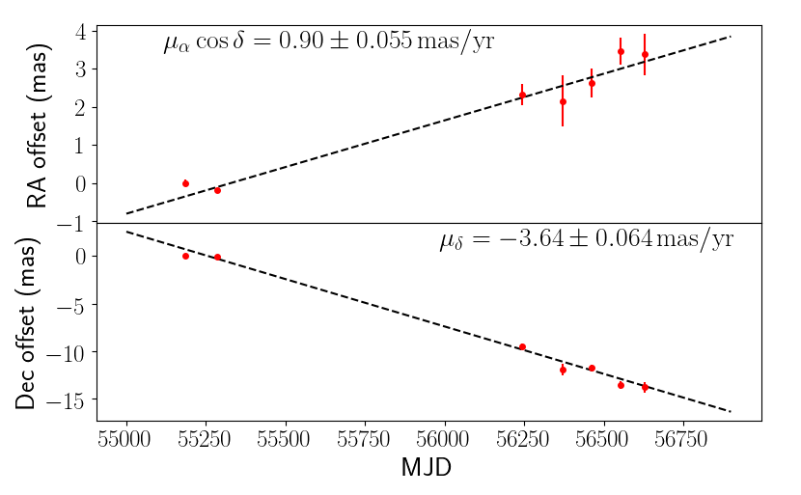
Swift J1753.5-0127 proper motion
Swift/BAT X-ray light curve
VLBI proper motion measurement
VLBA epochs
EVN epochs
Atri et al. 2018 – in prep.
Time baseline – 4 years
Proper motion in RA $0.90±0.055$ mas yr⁻¹
Proper motion in Declination $−3.64±0.064$ mas yr⁻¹
Radial velocity $110$ km s⁻¹ (Torres et al. 2005)

Slide 10
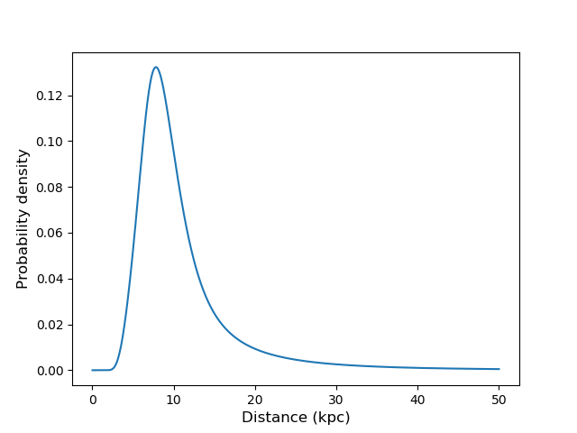
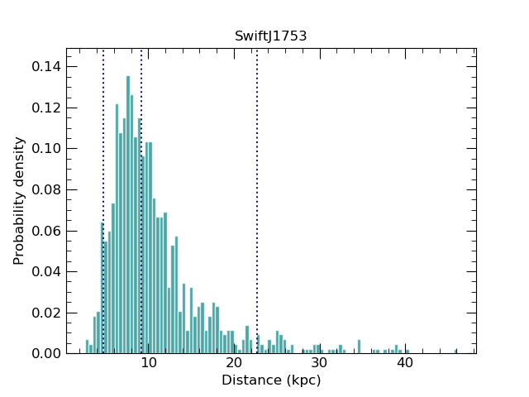
Distance
Gaia measured a parallax of $−0.01±0.13$
Distance = 1/parallax
Posterior probability = Likelihood $×$ Prior
Gaussian measurement $×$
Low mass X-ray binary Galactic density distribution
Atri et al. 2018 – in prep.
Notes:
Gaia measured the parallax for this system in its second data release. Distance is the inverse of parallax, but that can work when there are no errors involved with the measurement, which is not the case here.
So instead of just using the inverse, we used Bayesian inference statistics. In that we infer what the distribution of the parameter we are interested in is (in this case the distance), by assuming that the observed quantity i.e parallax is a gaussian distribution and

Slide 11
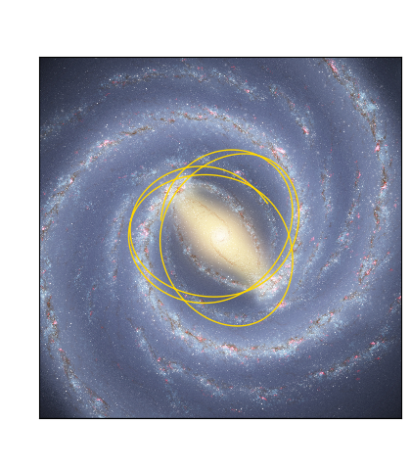
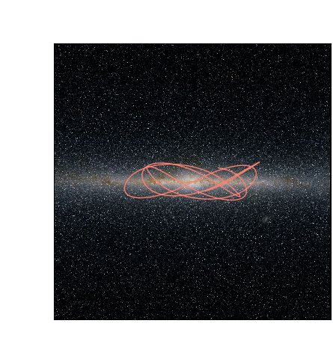
Galactocentric Orbits
Distance from Galactic centre, y (kpc)
Height above Galactic plane, z (kpc)
Distance from Galactic centre, x (kpc)
Distance from Galactic centre x(kpc)
Atri et al. 2018 – in prep.

Slide 12
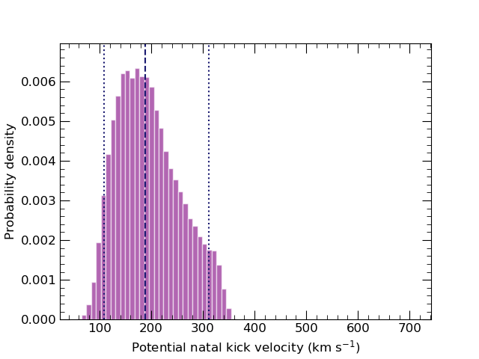
Natal kick distribution
Natal kick median = 190 km/s
Stellar dispersion ~50 km/s
Atri et al. 2018 – in prep.
Notes:
Even in 5000 instances, not even a single kick below 50 km/s

Slide 13
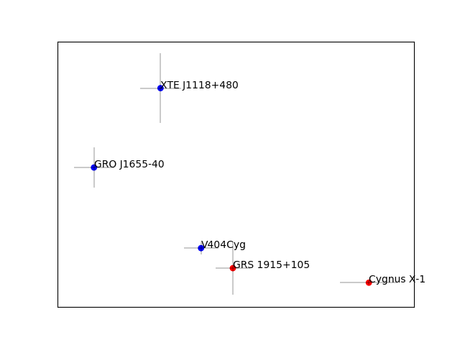
Peculiar velocity constraints
SN birth – XTE J1118+480 (Fragos et al. 2009)
GRO J1655-40 (Willems et al. 2005)
V404 Cyg (Miller-Jones et al. 2009)
Direct Collapse – GRS 1915+105 (Dhawan et al. 2007)
Cygnus X-1 (Mirabel & Rodrigues 2003)

Slide 14
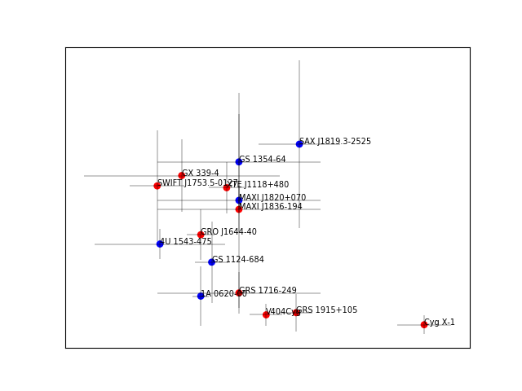
10 new systems
VLBI proper motion
Gaia DR2 proper motion
Atri et al. 2018 – in prep.
Notes:
Make all VLBI plot points red
Mention LBA for the two observations you did

Slide 15
Summary
VLBI playing a key role in proper motion measurements.
Natal kick distribution of 15 systems.
Looking to increase the number further to sample a range of BH masses
Error propagation from measured quantities to estimated natal kick.
Code to determine natal kick distributions will be available on github soon.

Slide 16
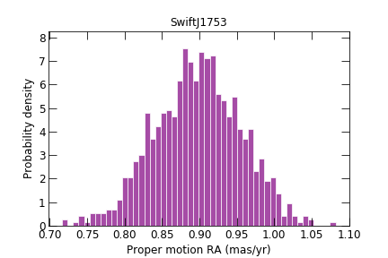
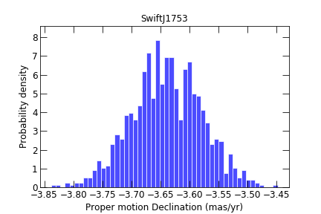
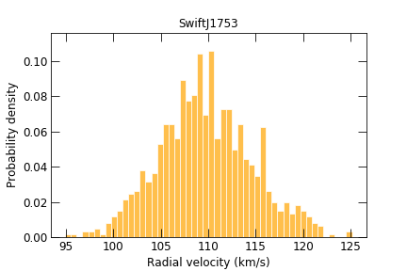
Distributions for galpy

