Slide 1
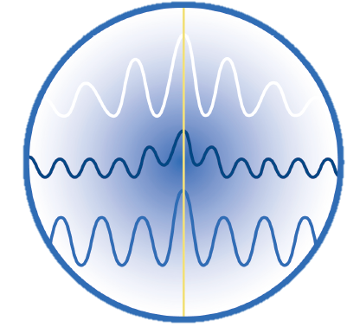
CASA VLBI tutorial
Ilse van Bemmel
(JIVE)
Notes:
Contact info: bemmel@jive.eu

Slide 2
Part 1. A brief introduction to CASA

Slide 3
Once upon a time…
Late 1990: AIPS++ (glish based)
Since 2004: Common Astronomy Software Applications
Post processing of radio data: JVLA & ALMA
C++ libraries with iPython interface
MS data format
Current release 5.3 & 5.4
New releases every ~6 months, next up: CASA 5.5
CASA 6 will be Python 3 based, planned for May 2019

Slide 4
CASA 5.4
This is the current release and recommended for use in the tutorial.
CASA 5.3 has a bug in plotms which causes problems with some of the tutorial plots
CASA 5.4 supports plotting calibration tables in plotms, this is a new feature, still to be included in the tutorial. CASA 5.3 uses the plotcal task for this, which will be deprecated.

Slide 5
Interface
Look and feel very AIPS-like
Python functions
Scripting in Python
Automatic session logging

Slide 6
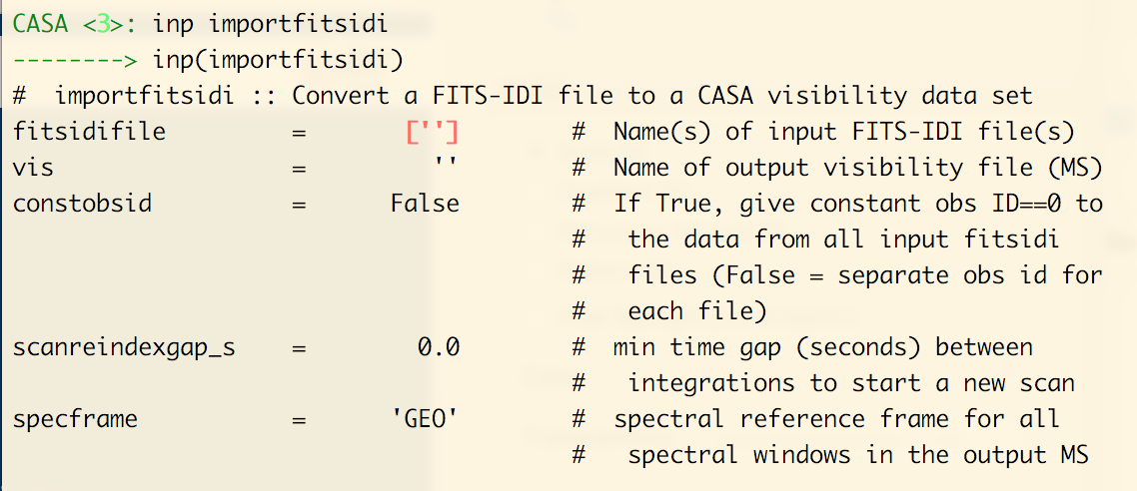
Interface
Look and feel very AIPS-like
Python functions
Scripting in Python
Automatic session logging

Slide 7
CASA tasks
High level functionality: call from python as functions
Access to parameters
Parameter checking by colour
Expandable parameters e.g. selectdata
Help: moving from inline to HTML
Notes:
High level functionality: call from python as functions, and use python libraries like glob (see example below)
Access to parameters by calling inp <task>
Parameter checking by colour: red means the parameter is set to non-valid value
(Note that for files they must be present in the working directory or any of the PATH settings that CASA uses)
Expandable parameters like selectdata.
Help: moving from inline to HTML

Slide 8
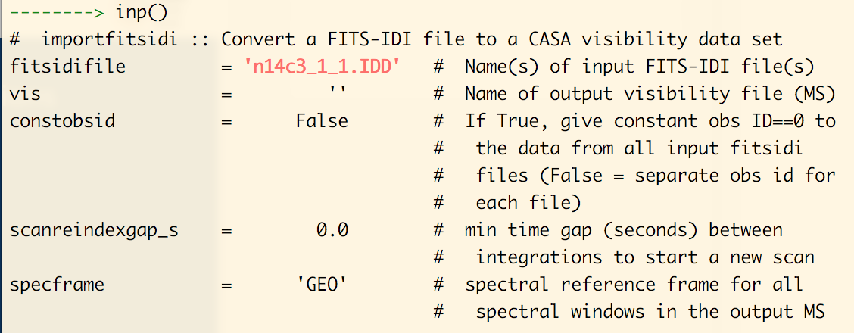
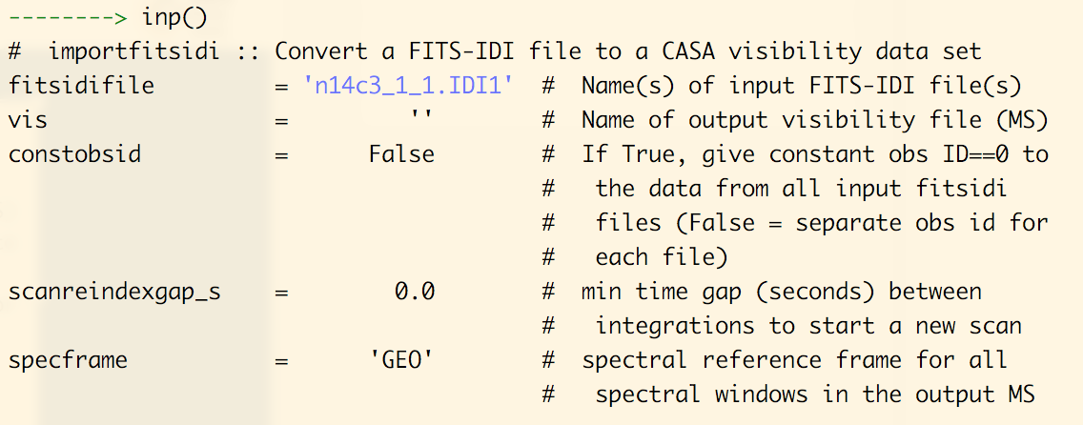
Notes:
Demo of the inp <task> method and colour coding of the parameters

Slide 9
Fundamental difference
Calibration tables are separate entities
CALIB → SN table: gencal or gaincal make calibration table
CLCAL → CL table: applycal produces CORRECTED_DATA inside MS
Apply multiple calibration tables at once in pre-determined order

Slide 10
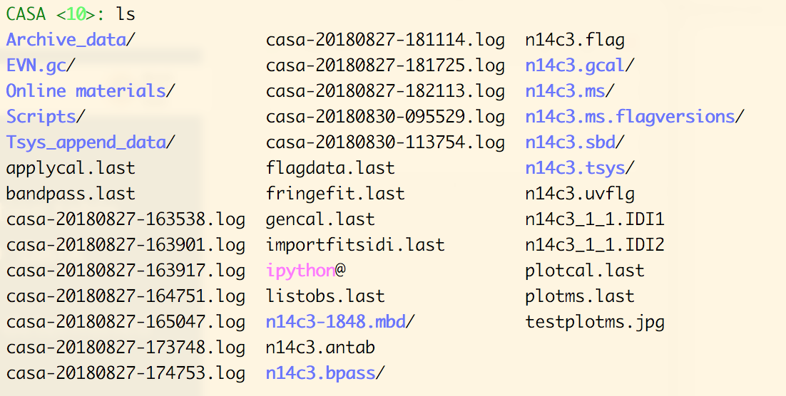
Fundamental difference
Calibration tables are separate entities
CALIB → SN table: gencal or gaincal make calibration table
CLCAL → CL table: applycal produces CORRECTED_DATA inside MS
Apply multiple calibration tables at once in pre-determined order
Notes:
Example of a directory containing CASA products:
The calibration tables, e.g. n14c3.gcal and n14c3.tsys
CASA log files: casa-<date-time>.log
CASA task input: plotms.last and plotcal.last. These can be used to restore the settings of the last run of this task (equivalent of aips tget)

Slide 11
Tools in CASA
Toolkit e.g. cb (calibration), tb (tables)
Call from command line as <tool>.<method>
Tab-completion lists available methods
Notes:
Try playing with this:
tb.open(tablename)
tb.colnames()
tb.getcol(‘ANTENNA1’)
tb.getcol(‘CPARAM’)
tb.browse()

Slide 12
Other online resources
AIPS – CASA cheat sheet
CASA Cookbook
CASA guides: online tutorials
Check the date and CASA version!

Slide 13
Any questions so far?

Slide 14
Part 2. Tutorial walk-through
NOTE: these slides are for illustration only. It is strongly recommended from here on to only use the online tutorial:
Link to detailed information on tutorial and preparation
The slides mix experiments N14C2 and N14C3
Always use just ONE experiment consistently
In case of inconsistencies the online tutorial is leading

Slide 15
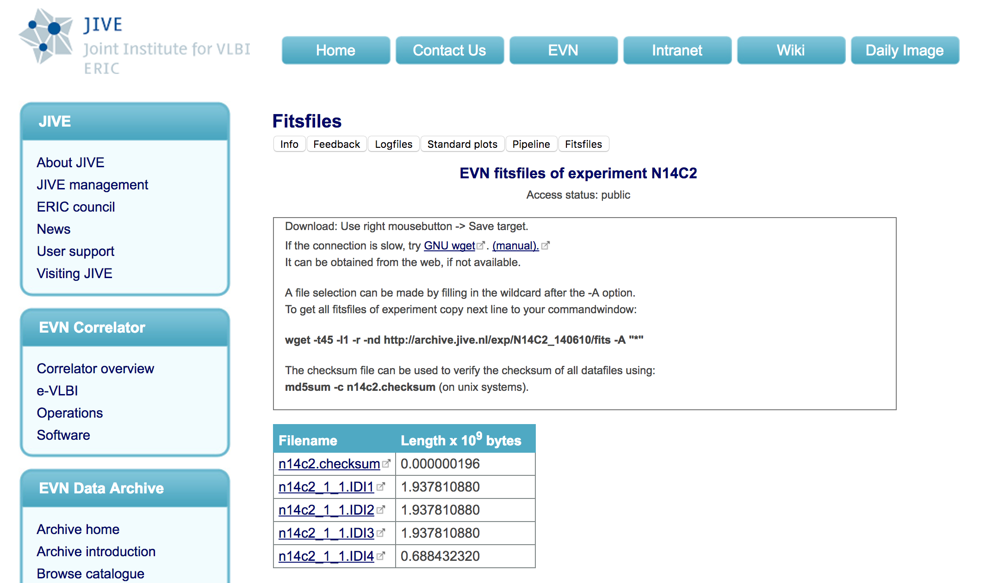
Get your data
Notes:
Note that in some slides I use N14C2

Slide 16
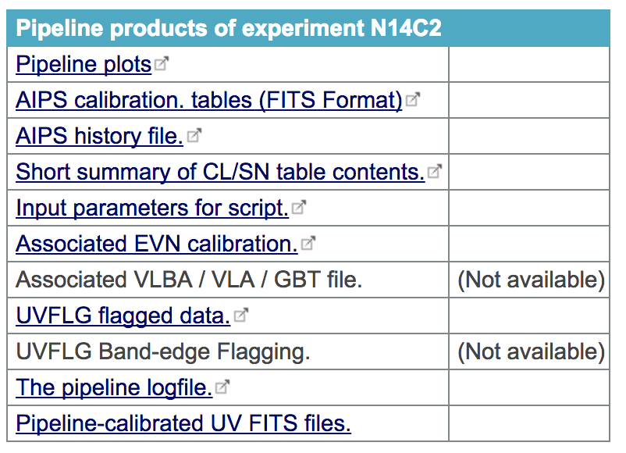
Auxiliary data

Slide 17
Data in your directory
ANTAB file: n14c3.antab
Flag file: n14c3.uvflg
IDI files: n14c3_1_1.IDI1 & n14c3_1_1.IDI2

Slide 18
Supporting scripts
Scripts: append_tsys.py, flag.py, gc.py, (key.py)
Call with python 2.7 (in CASA)
Do append_tsys only once
Some output on screen, tasks can take a while
Notes:
On some platforms (typically MacOS) the CASA path settings do not find the PyFITS libraries. A quick work-around is to run from the terminal command line:
> pip install pyfits This will point your python to an old pyfits library, the script will run with a warning that the pyfits distribution is deprecated. That is no problem.

Slide 19
Make flag file
Script: flag.py
Call with python:
python ~/Scripts/flag.py n14c3.uvflag n14c3_1_1.IDI1 > n14c3.flag
CASA & human readable flag file, look inside
No output on screen

Slide 20
System temperature
Script: append_tsys.py
Call with CASA
casa --nogui –c ~/Scripts/append_tsys.py n14c3.antab n14c3_1_1.IDI*
Launches a temporary CASA session
No output on screen
Takes a few minutes
Do this only once! (there should be a warning about this now)
NOTE: --nogui before –c option
Notes:
Running the append_tsys.py script twice on the same data will cause problems later. There should now be a warning when the script is run on data files that already have the Tsys appended.

Slide 21
Generate a gain curve
Script: gc.py
Call with CASA
casa --nogui –c ~/Scripts/gc.py n14c3.antab EVN.gc
Generates a directory ‘EVN.gc’ with the gain curve info
Notes:
Note that you can give the gain curve directory any name you like, but bookkeeping matters! Also, the gain curve from one experiment should not be applied to another.

Slide 22
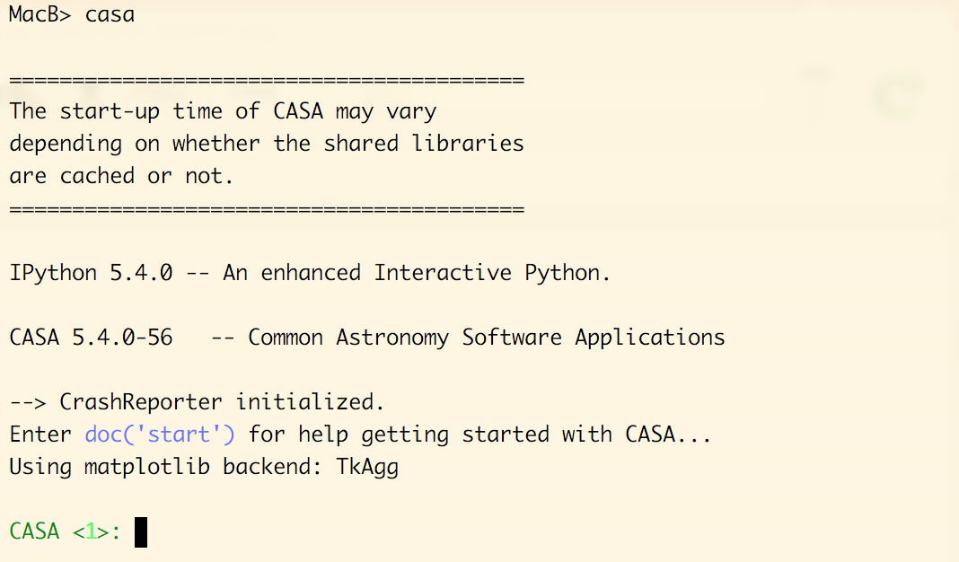
Launch CASA

Slide 23
Import the FITS-IDI
Two ways to call tasks:
inp – go: AIPS-like look and feel
taskname(parameters): ideal for scripting
Notes:
Another demo on how to use CASA tasks in two different ways. Note that you do not have colour coding of the parameters in the scripted method. Here the colours are classical syntax highlighting: red-brown colour indicates a string, and green is a boolean or number.

Slide 24
Import the FITS-IDI files
Output in the CASA logger and command window
Notes:
After this it is adviced to make a list of the observations using listobs task (the tutorial does this step).

Slide 25
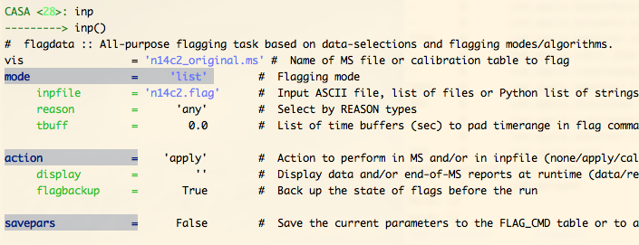
Read the flag data
Task: flagdata
Tons of output in CASA logger

Slide 26
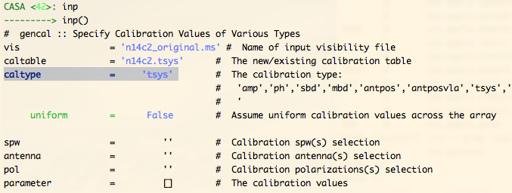
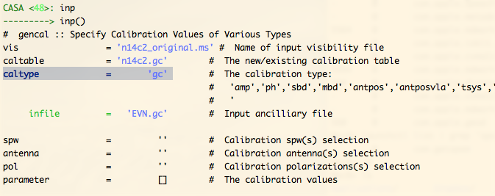
Create a-priori calibration tables
Task: gencal
Notes:
Note that CASA has two task to make calibration tables:
gencal: creates antenna based calibration tables based on meta-data
gaincal: creates complex gain calibration tables based on the visibilities

Slide 27
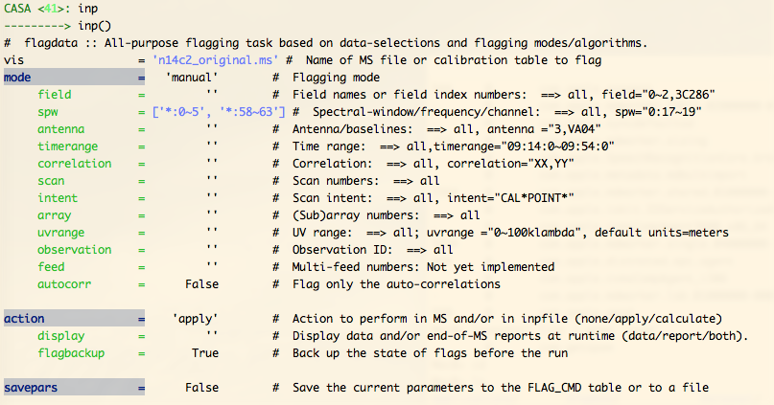
Flag edge channels
Task: flagdata

Slide 28
Let’s take a look. You have:
Data in MS format
Two amplitude calibration tables: gain and tsys
Flag table
Optional: list of scans (listobs task)
Work with full MS
Notes:
One of the main hurdles in CASA is that is works with the full MS by default. This implies that for the full calibration a copy is made of the dataset, and on disk the file size doubles. For quick tests it is recommended to use a small dataset, or split of a small section to work with.

Slide 29
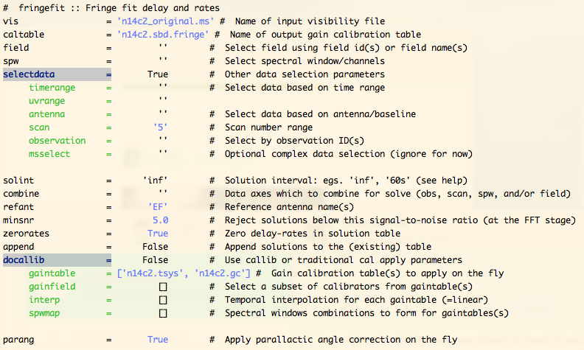
Ready for phase calibration
Task: fringefit
Notes:
Another fundamental difference between CASA and AIPS is the use of

Slide 30
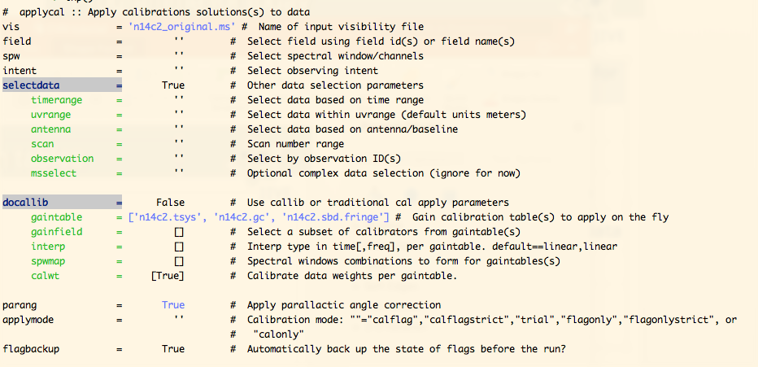
Apply the calibration tables
Task: applycal

Slide 31
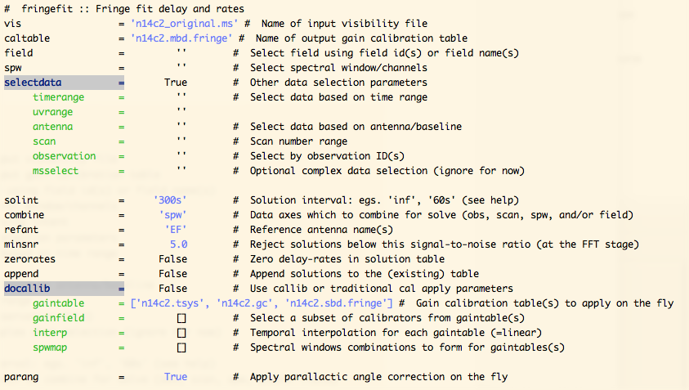
Multi-band delay
Task fringefit
Parameter: combine

Slide 32
Bandpass calibration
Task: bpass
Notes:
The tutorial shows how to perform some sanity checks on the calibration steps. Here I skip these step. It is strongly recommended to do some verification on the calibration tables and corrected data.

Slide 33
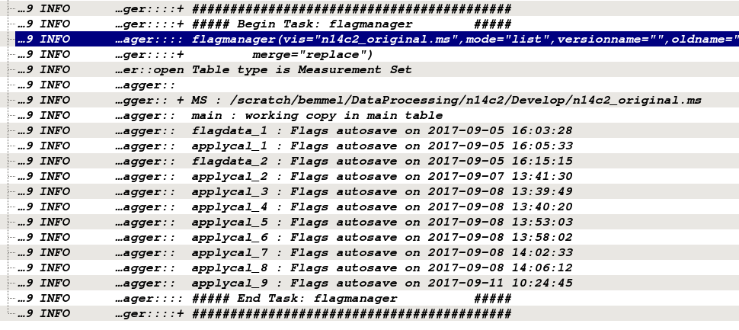
Managing flags
Task: flagmanager
Notes:
Have a very good look at what you can do with flagmanager: * list the flag tables, these are stored on disk in <name>.ms.flagversions
* Rename flag tables to sensible things
The flag tables store flag settings *prior* to running a task, e.g. applycal_1 are the flags *before* the applycal task was run for the first time
Applycal flags data for which there are no solutions in the calibration tables. If you continue calibration after an applycal run just to inspect your data, you will want to restore your flags.

Slide 34
Managing flags
Re-running applycal: reset your flagtable
Notes:
Another reminder: restore a good flag table if you have run applycal and are either not happy with the results or just inspecting the impact of your calibration. Flag sticking around for further processing can cause big problems, like flagging all data.

Slide 35
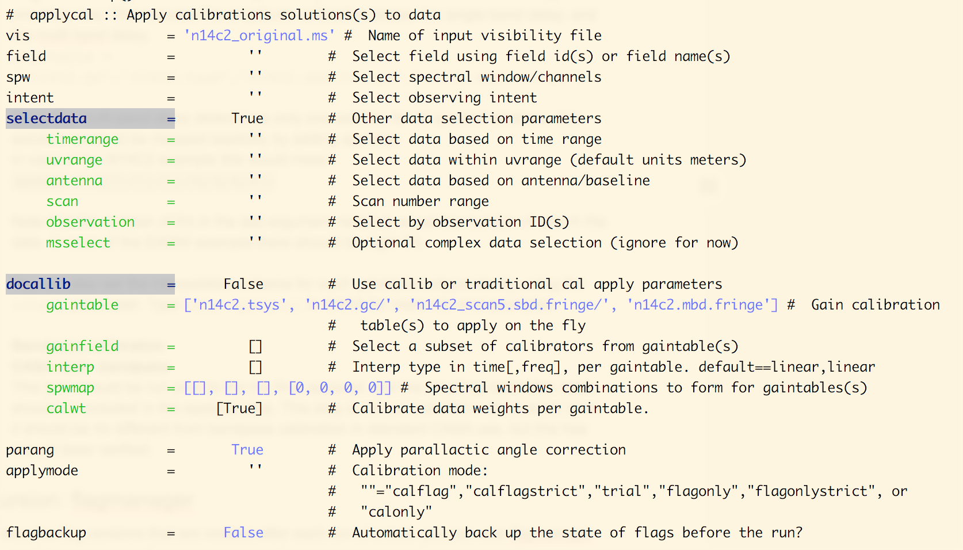
Completed all calibration
Apply all calibration tables in one go
Task applycal
Notes:
The parameter spwmap is critical in running applycal. It tells CASA how to map the solutions from the calibration tables to the spectral windows. If a calibration table has a solution per spectral window, you can leave this empty. If a calibration table has one solution for all spectral windows, you need to tell CASA to use that solution on all spectral windows. The first number [0] is then mapped to all four spectral windows. This is the case for the multi-band fringe fit table.

Slide 36
Bugs or problems
Script
Logfile
Dataset (as small as possible)
Contact us!

Slide 37
Questions?

