Slide 1







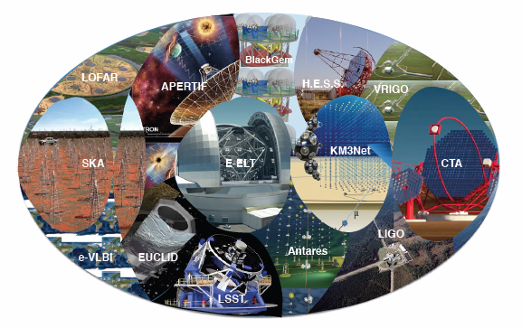

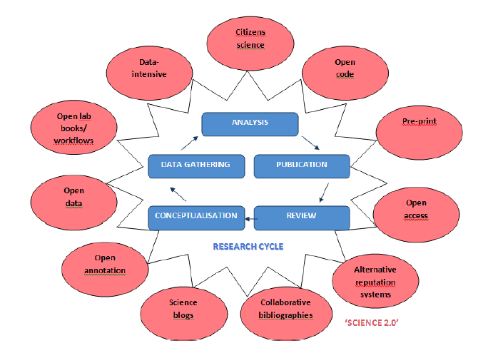
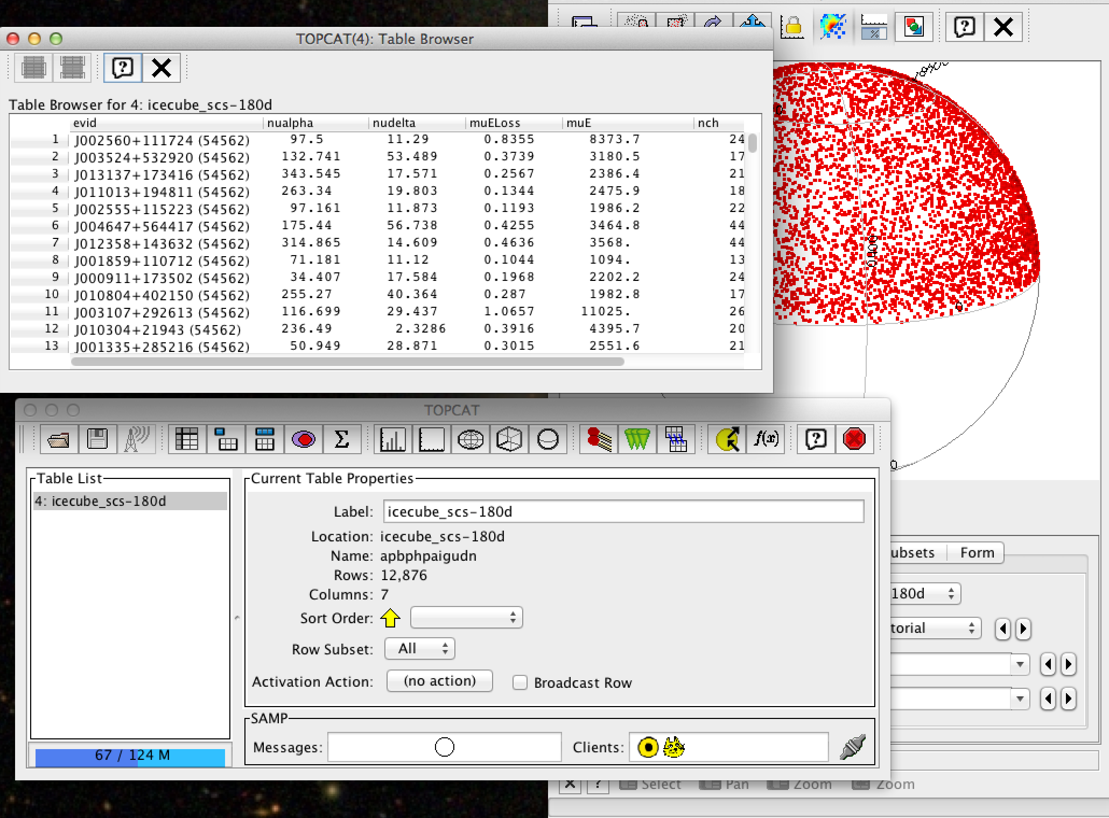
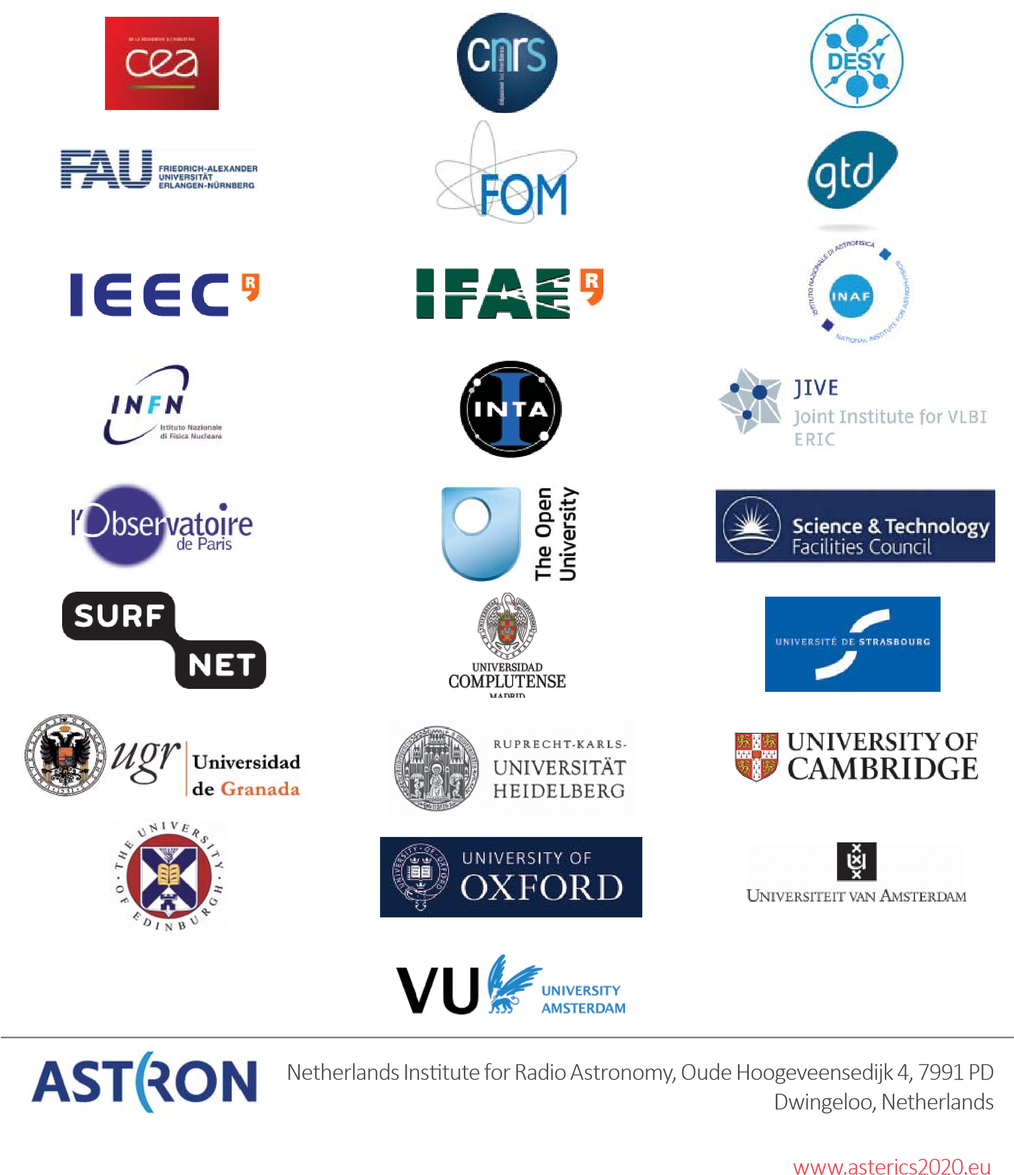
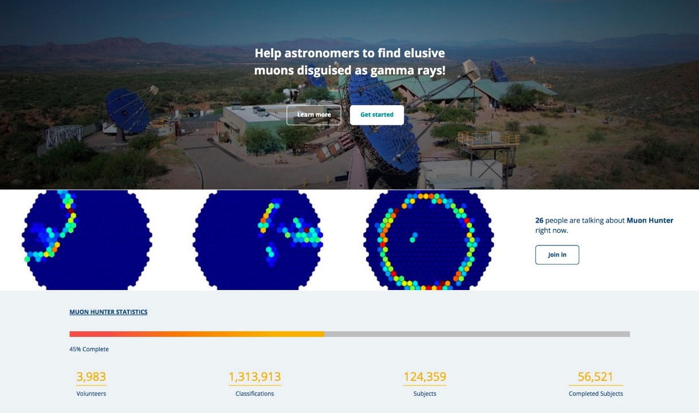
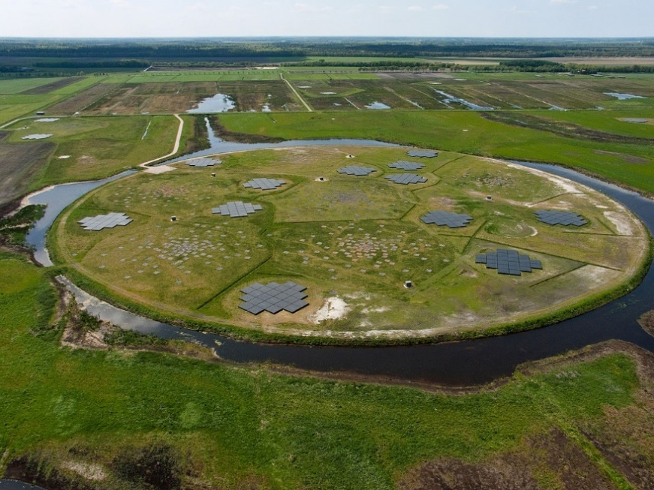

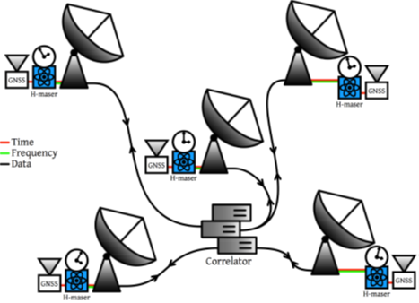
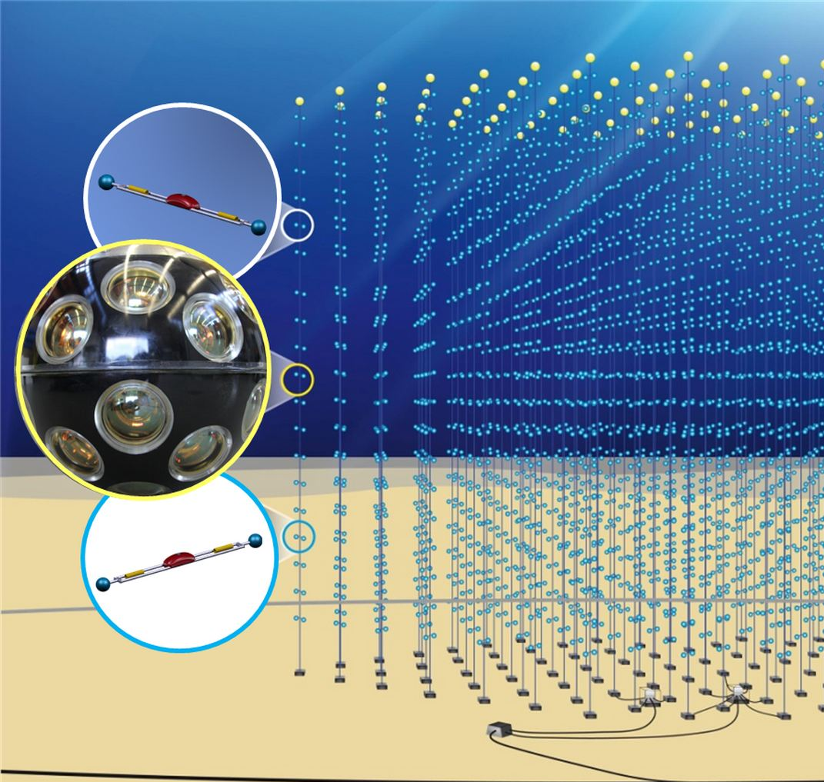
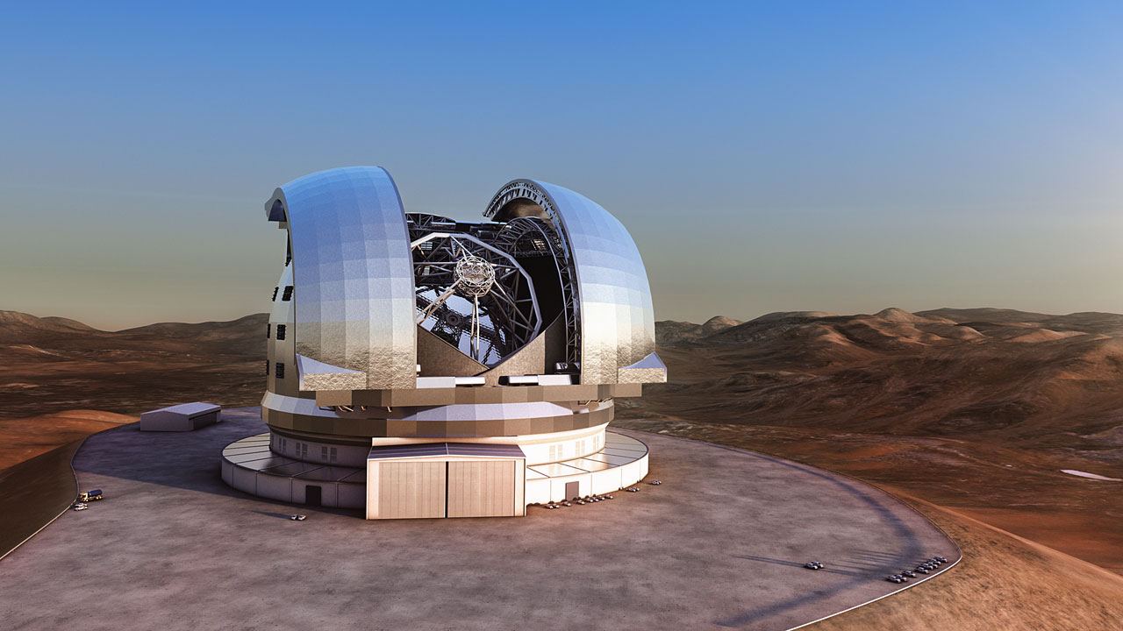
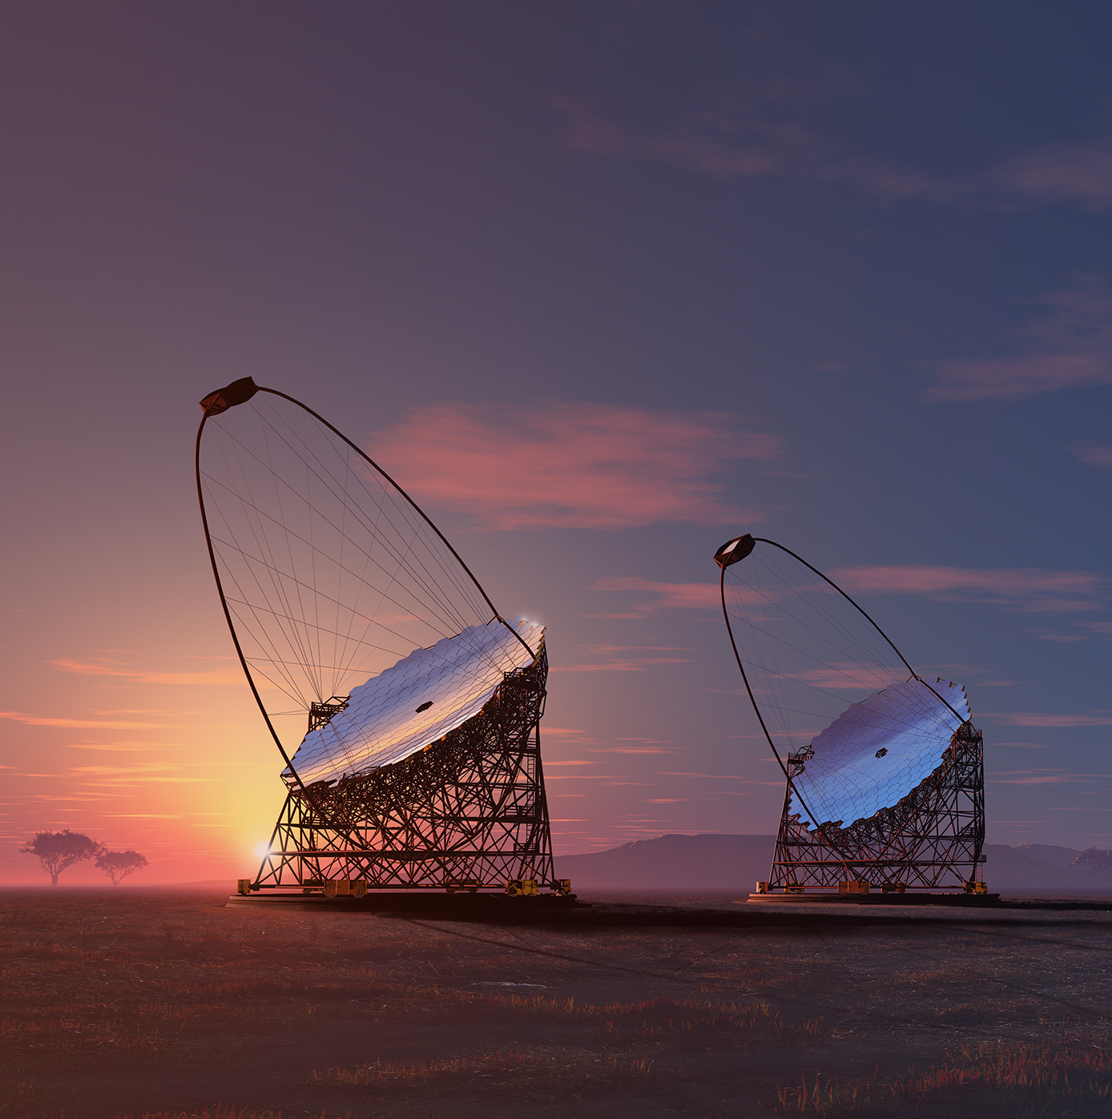
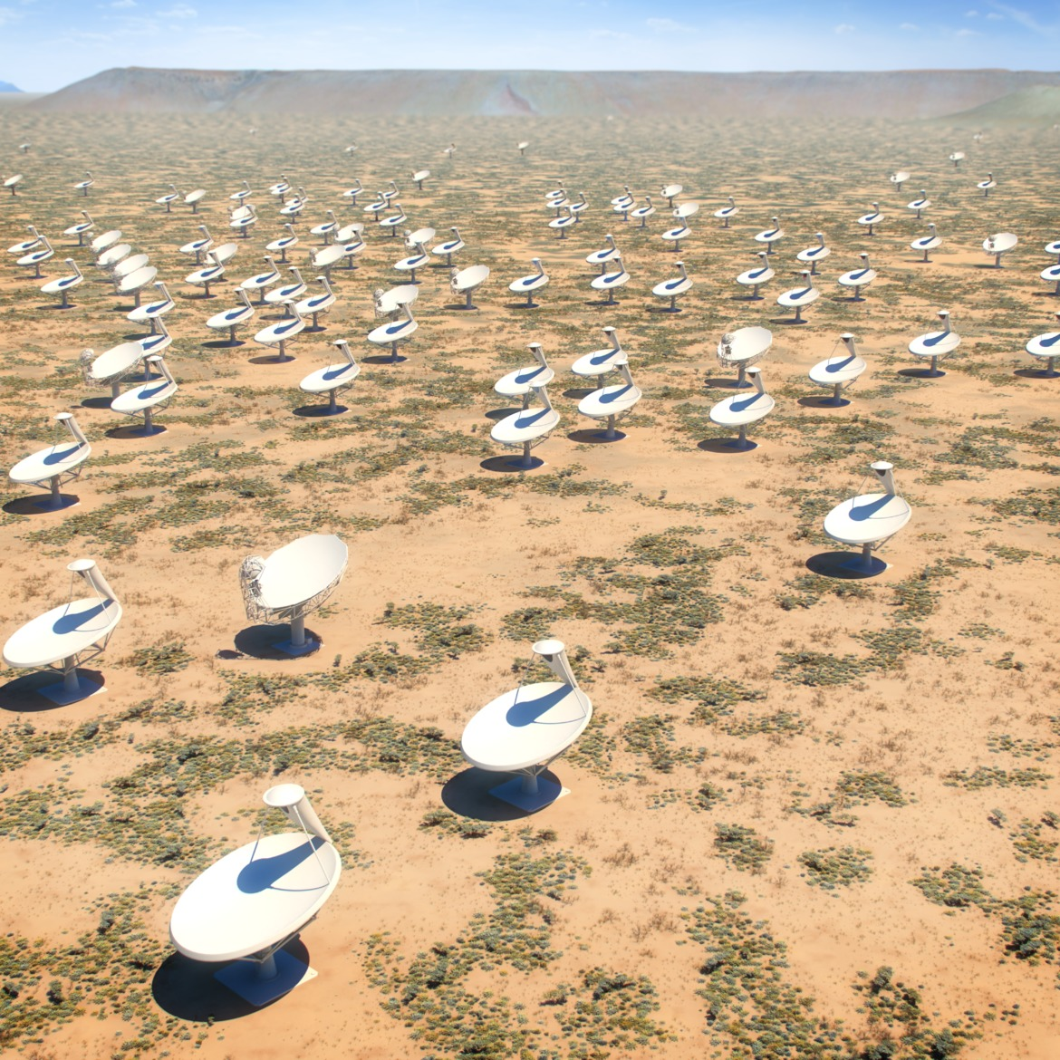
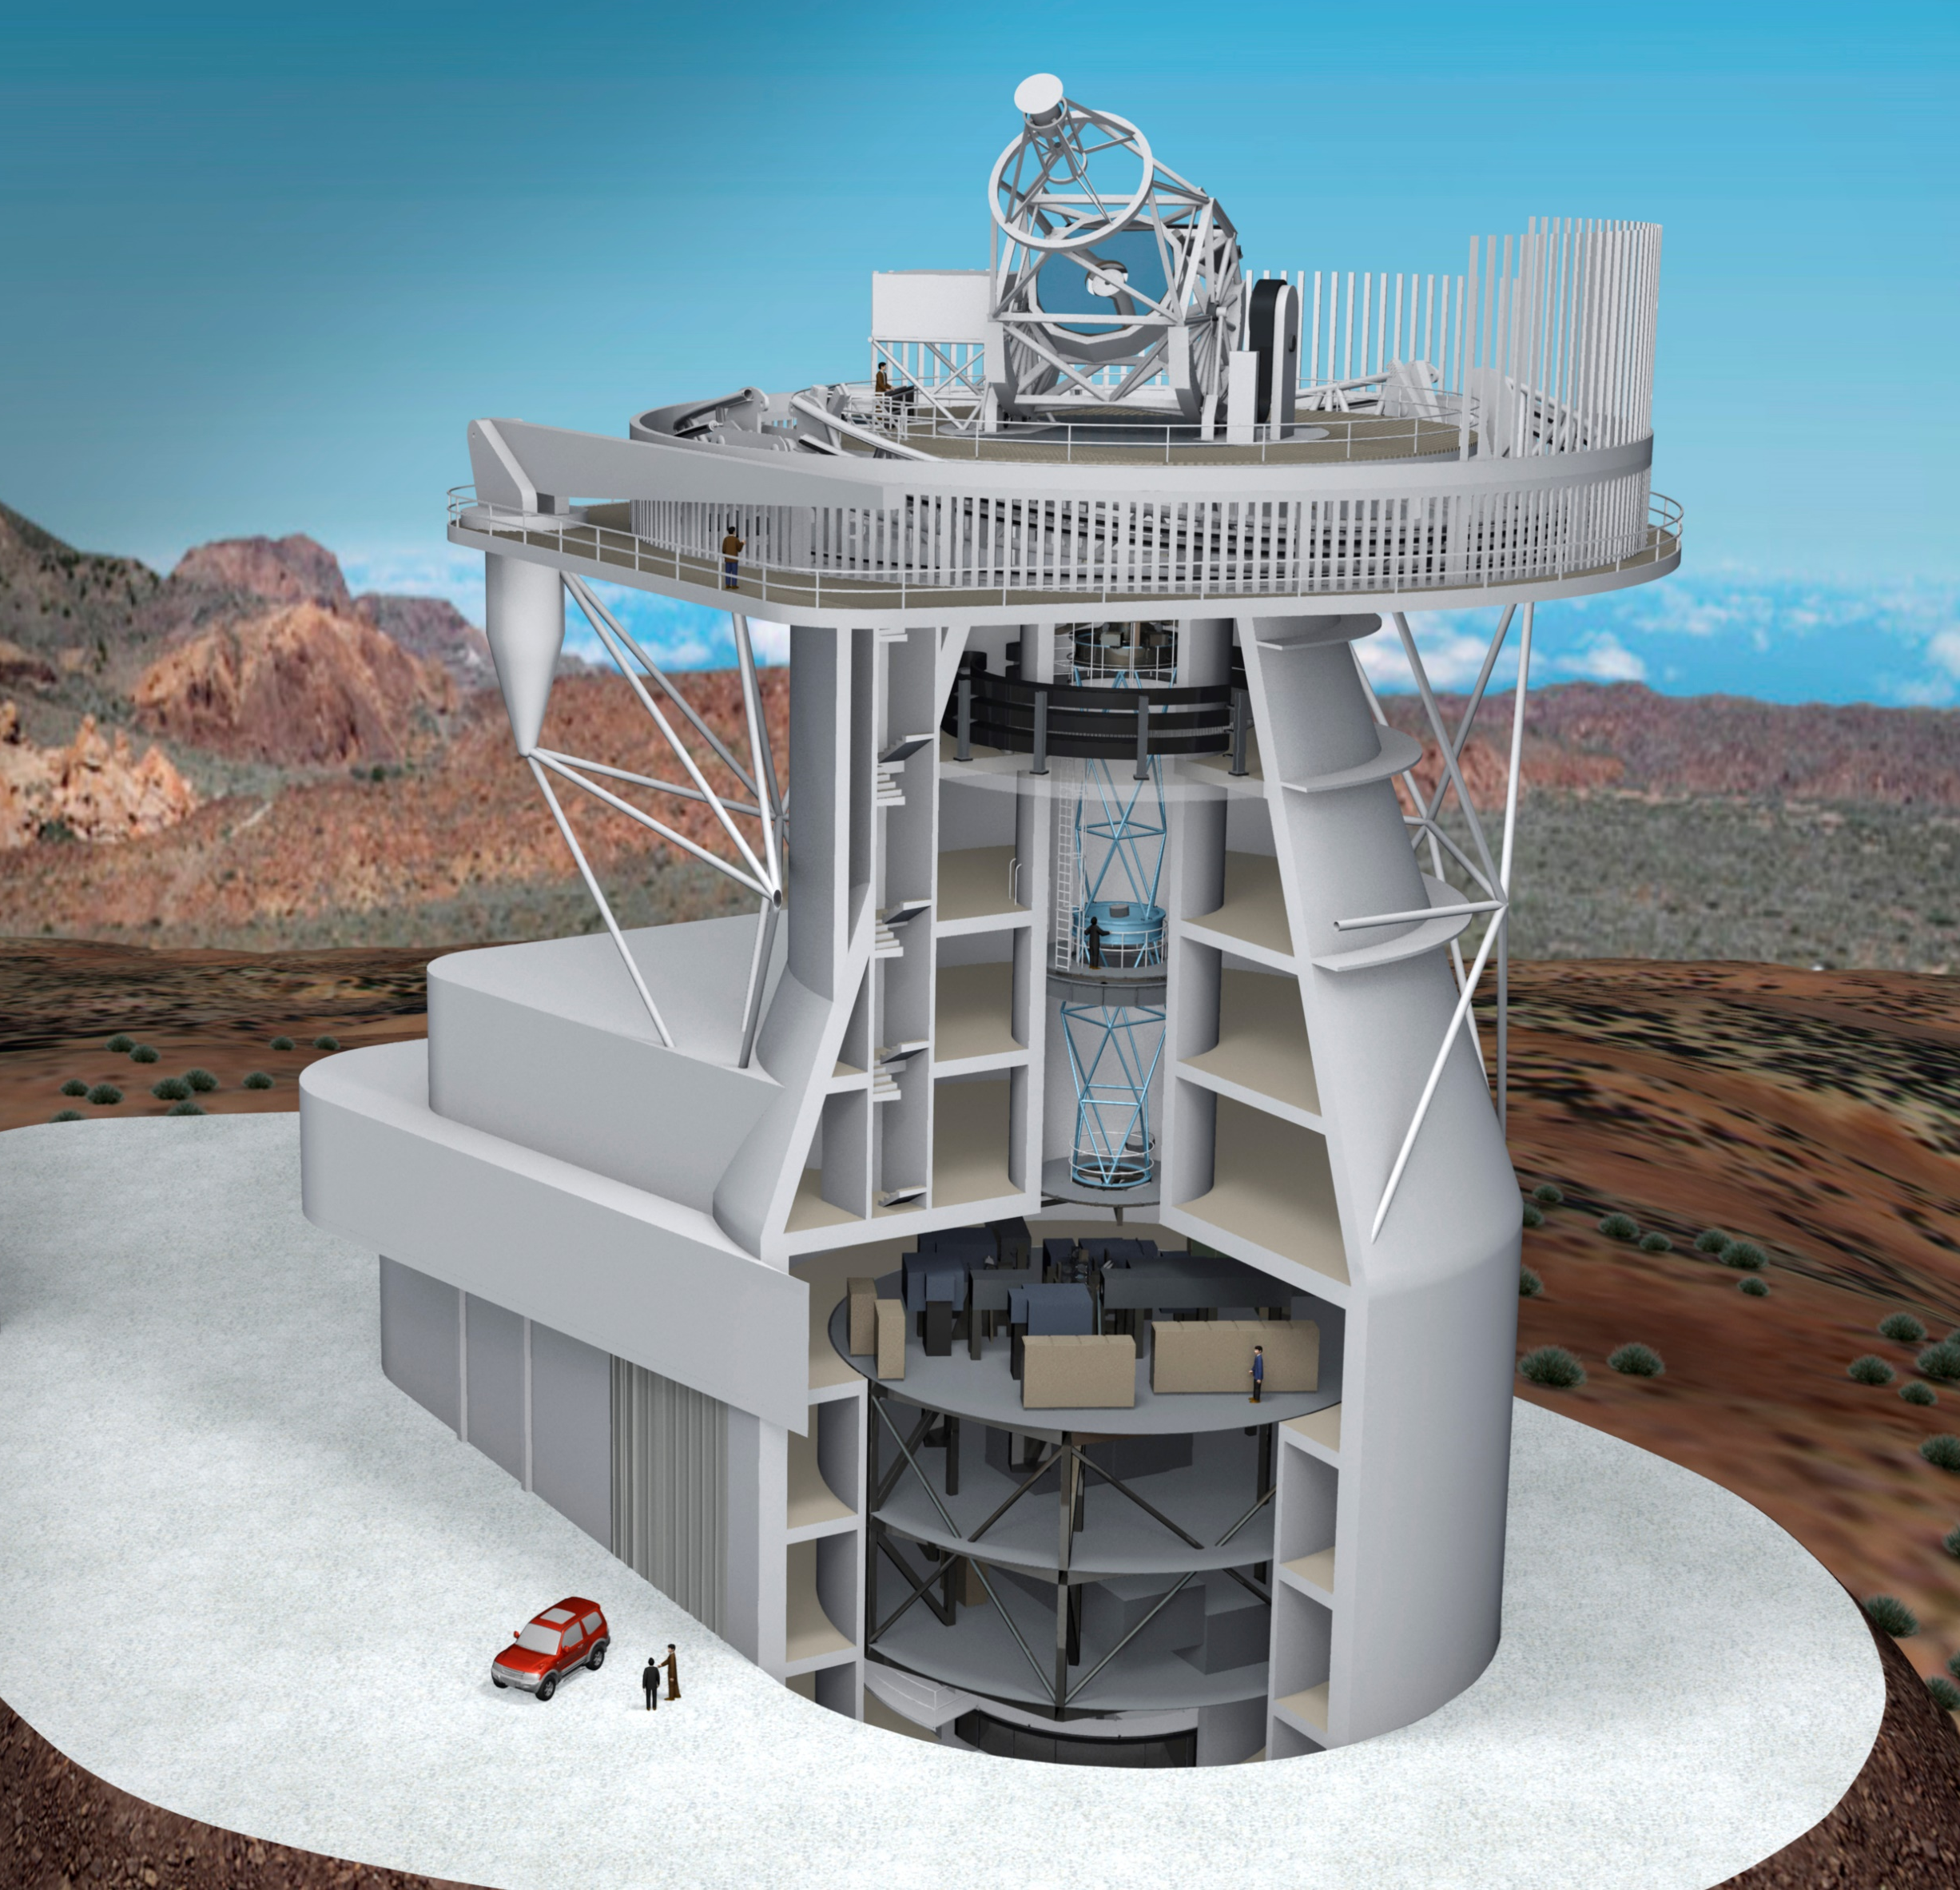

ASTERICS
Astronomy ESFRI and Research Infrastructure Cluster
www.asterics2020.eu
ASTERICS connects communities:
            astronomy
            astrophysics
            particle astrophysics
            research infrastructures
            ESFRI pathfinders
            industry
            SMEs
Supporting organizations
and networks
Together, the ESFRI projects open new windows on the universe, significantly extending our observational capabilities across the electromagnetic spectrum, in addition to neutrino detectors and gravitational waves.
Society at large
Open Science
Citizen Science applications
Ambitious programme of
Public engagement
Education
Research communities
Common tools
Data discovery
Data usage and interoperability
Virtual Observatory
Connecting
view
table
sky plot
GWsky: Skymap Viewer and VO tools
Handling gravitational-wave sky maps for EM follow-up observations
IceCube-40 String data
12,877 candidate neutrino events
Greco et al. (INFN + ASTERICS support)
database
loaded into
Topcat
1.3 million classifications in the first five days!
Tutorial at the second ASTERICS Virtual Observatory School
Open innovation
environments
Open standards
Advanced analysis algorithms
Software libraries for
multi-wavelength and
multi-messenger
Common solutions
Streaming data processing
Extremely large databases
Quality control
Scheduling and
Cross-facility coordination
Observatories
and Industry
Modern communication
Fast connectivity
Synchronization
Synergetic observations
Fast and reliable large data streams
White Rabbit Ethernet
(CERN, based on IEEE Precision Time Protocol)
• Time, frequency, and 1 Gb/s data in one
• 1 PPS, 10 – 125 MHz
• Designed for 1 ns timing
over distances <10 km (LHC, CERN)
• Commercially available
IACT telescope of the TAIGA project
Credits: E-ELT/ESO, KM3NeT, IFAE/CTA, SKA, EST
ASTERICS is a project supported by the European Commission Framework Programme Horizon 2020
Research and Innovation action under grant agreement n. 653477

