Slide 1
EVN VISION Discussion
The VLBI Future
A roadmap for the next decade
T. Venturi (INAF), M. Lindqvist (OSO), Z. Paragi (JIVE)
14th EVN Sympoisum – Granada, 9 October 2018

Slide 2
OUTLINE
Background and “actors”
The task and the implementation plan
Current Stage
Purpose of this discussion
14th EVN Sympoisum – Granada, 9 October 2018

Slide 3
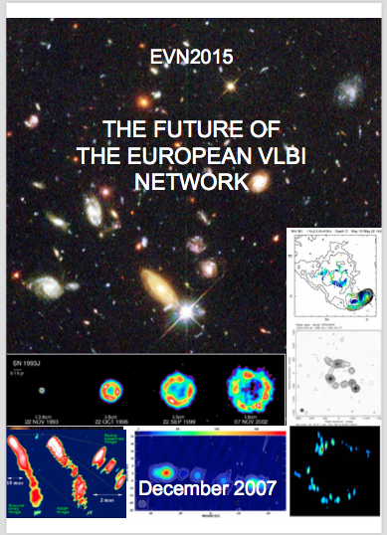
BACKGROUND AND “ACTORS”
As highlighted by the EVN CBD in 2016: it is time to revise the VLBI Science case for seveal reasons
Role and potentials of VLBI in the new astrophysical challenges
Role, potentials and added value of VLBI in the SKA era
Define key science areas and observational needs to have a roadmap for the technological development
White book in support of funding requests to national agencies and ministries
14th EVN Sympoisum – Granada, 9 October 2018

Slide 4
BACKGROUND AND “ACTORS”
Objectives for WP7 as in the JUMPING JIVE proposal
Because of the progress in the field of astrophysics and the changes in the radio astronomy landscape it is timely to revisit the EVN science case. In consultation with the user community and global partners we will define the most important science areas for future VLBI array.
One task: VLBI Science case
One main deliverable: a white paper setting the future priorities of VLBI science capabilities
14th EVN Sympoisum – Granada, 9 October 2018

Slide 5
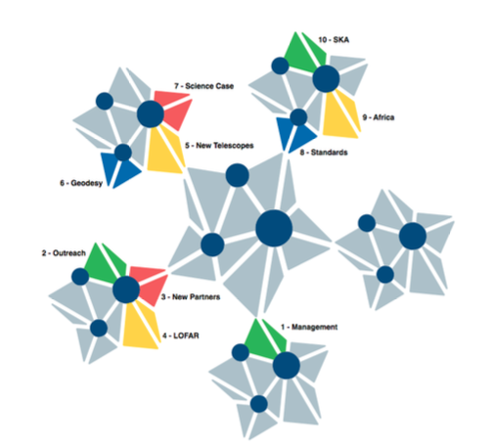
Relations to other WPs in the project
Capacity for doing science
WP10 – VLBI with the SKA
WP9 – Capacity for VLBI in Africa
WP6 – Geodetic capabilities
14th EVN Sympoisum – Granada, 9 October 2018

Slide 6
THE PROCESS
WP7
WP6
Team of selected experts
Users community
WP9
WP10
Consultation with EVN CBD
Final document
14th EVN Sympoisum – Granada, 9 October 2018

Slide 7
IMPLEMENTATION PLAN AND STATUS
Core team of max 10 experts identifies key science areas and experts for the various sections/chapters
Core team and experts meet in a 1-2 day brainstorming meeting:
to identify key science areas and technological developments;
to discuss how to involve the community at large
The write up of the document starts
DONE
R. Beswick, T. Bogdanovic, W. Brisken, P.Charlot, M. Lindqvist, A. Lobanov, Z. Paragi, A. Szomoru, L. Testi, T. Venturi
DONE
14th EVN Sympoisum – Granada, 9 October 2018

Slide 8
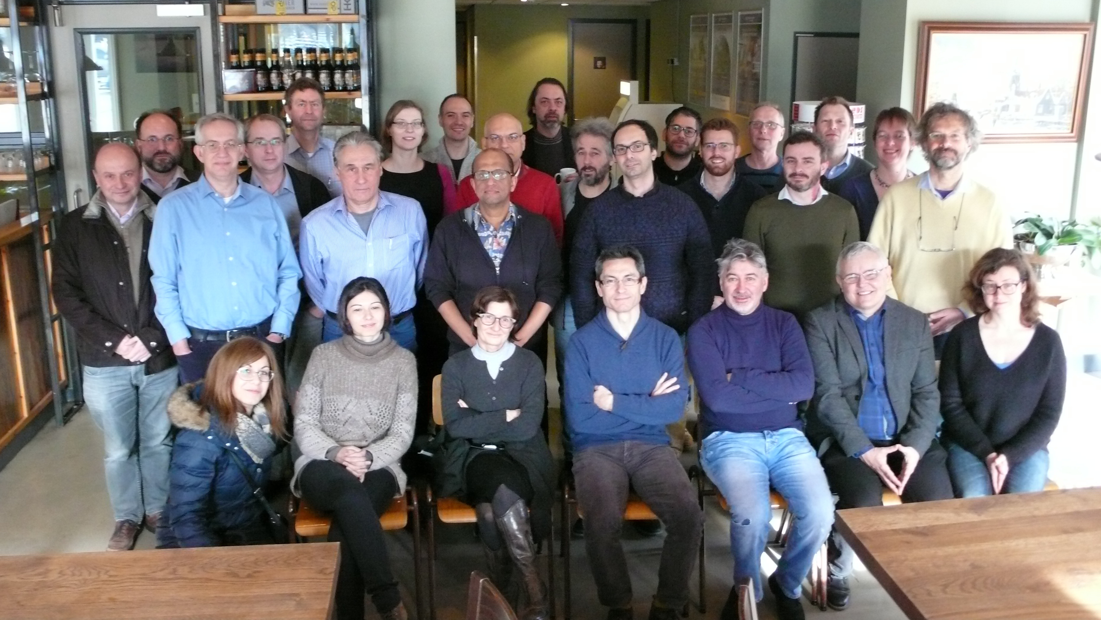
The F2F Meeting
Zaandam (NL), 28/2-1/3/18
1.5 day meeting
Scientific presentations on: cosmology, galaxy formation & AGN feedback, AGN and inner jets, stellar evolution, astrometry and geodesy, transient science
34 participants (four connected remotely)
Lively and productive discussion
Chapter coordinators identified
14th EVN Sympoisum – Granada, 9 October 2018

Slide 9
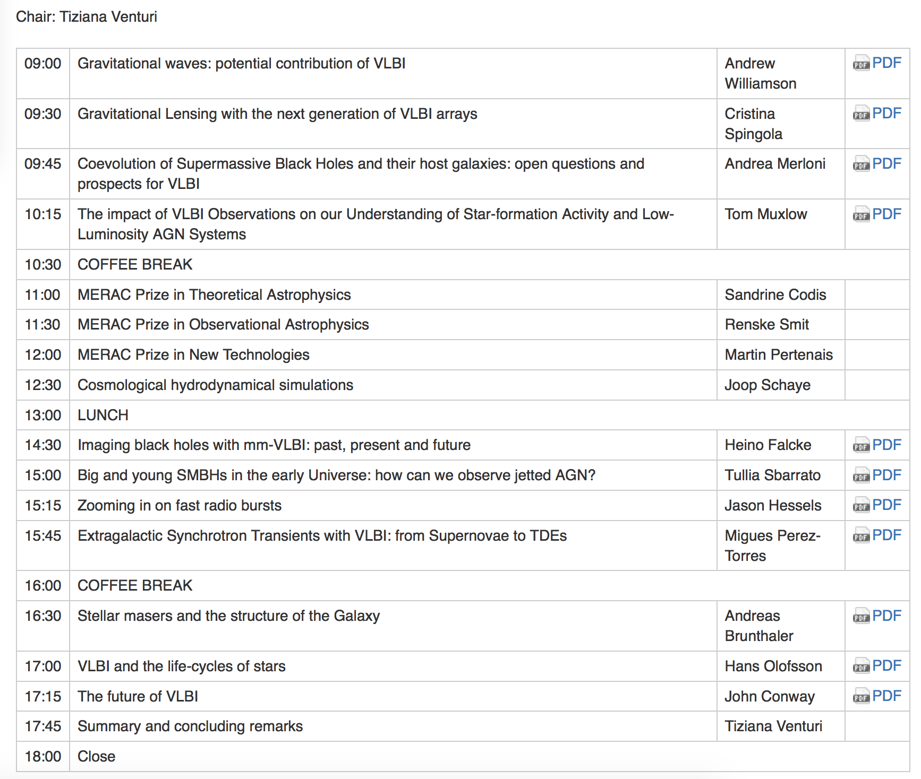
SS11 @EWASS – A European Vision for then future of VLBI
SS11 @ EWASS 2018
Liverpool (UK) 04/04/2018
http://www.jive.eu/jumpingjive/doku.php?id=vlbi_future:meetings:ewass18
14th EVN Sympoisum – Granada, 9 October 2018

Slide 10
The VLBI Science Vision Document
Approach - The document is not a wishlist, but rather includes:
a selection of open questions in astrophysics where VLBI can provide unique answers
a selection of science areas which can make considerable progress thanks to VLBI
envisaged accessible and feasible developments to address the science
14th EVN Sympoisum – Granada, 9 October 2018

Slide 11
Current stage
Preliminary draft of chapters and coordinators
Coordinator W. Brisken
Present and future VLBI arrays and other radio facilities – EVN and JIVE; eMERLIN; CVN; EAVN; JVLA; VLBA; LBA; LOFAR
The multi-messenger landscape – ALMA and E-ELT; CTA
Coordinator J. McKean
Cosmology – Review of current state-of-play; Dark matter: lensing on various scales; Dark energy; Masers: geometric distance and high-z; Lenses: time-delay distances; FRBs: geometric distances
14th EVN Sympoisum – Granada, 9 October 2018

Slide 12
Current stage
Preliminary draft of chapters and coordinators
Coordinators: Muxlow/Morganti
Galaxy Formation and AGN Feedback – Galaxy formation; Faint radio population; AGN vs star formation; faint radio-loud AGN; star formation and accretion in the local Universe; signposts of accretion and feedback; star formation processes; feedback through spectral line VLBI of HI
Coordinator: S. Frey
High-redshift AGNs and SMBH – AGNs in the early Universe; Blazars as tracers of high-z jetted AGNs; High-z observations with VLBI
Coordinator: A. Lobanov
The inner core regions and mm-VLBI
14th EVN Sympoisum – Granada, 9 October 2018

Slide 13
Current stage
Preliminary draft of chapters and coordinators
Coordinators: Perez-Torres & Paragi
Transient Phenomena – Slow transients: BHs and neutron X-ray binary stars, thermonucear runaway supernovae, CCSNs and long GRBs, TDEs, NS and black home mergers, GW; Fast transients: FRBs, NS and pulsars
Coordinators: Bartkiewicz & Rygl
Galactic Masers – Masers in star forming regions; Masers around evolved stars; Maser astrometry
Coordinator: J.C. Guirado
Stellar evolution and planetary systems – VLBI astrometry; Pre-main sequence stars: protoplanetary disks, clusters and star forming regions, calibration of PMS evolutionary; Main sequence stars: Flares/coronal mass ejection, ultracool dwarfs, exoplanets; Evolved stars: mass loss/stellar winds, star spots, colliding winds
14th EVN Sympoisum – Granada, 9 October 2018

Slide 14
Current stage
Preliminary draft of chapters and coordinators
Coordinators: P. Charlot
Astrometry, Earth and Celestrial Reference Frames
Coordinator: L. Gurvits
Space Science– Spacecraft as a VLBI target; near-field VLBI
Coordinators: A. Szomoru & P. de Vicente
Technological developments
14th EVN Sympoisum – Granada, 9 October 2018

Slide 15
PURPOSE OF THIS DISCUSSION
WP7
WP6
Team of selected experts
Users community
WP9
WP10
Consultation with EVN CBD
Final document
14th EVN Sympoisum – Granada, 9 October 2018

Slide 16
PURPOSE OF THIS DISCUSSION
WP7
DONE
NOW
F2F meeting
Users community
Discussion with the EVN/Users community at large
SS11 @ EWASS
14th EVN Sympoisum – Granada, 9 October 2018

Slide 17
PURPOSE OF THIS DISCUSSION
Comments/suggestions?
Is there anything major missing from the broad list of topics we have selected?
The process is still open and contributions are welcome
Get in touch with the chapter coordinator of the topic you may wish to contribute to
14th EVN Sympoisum – Granada, 9 October 2018

Slide 18
THANK YOU FOR YOUR ATTENTION
14th EVN Sympoisum – Granada, 9 October 2018

