Slide 1
General remarks
The range of things we do is incredible!
Confidence boost for our vision exercise
We know how to give good talks
I could recommend to be careful with authorship and citing own/other work
Parallel sessions? Good idea when used sensibly
But if there are posters, there should be a session
Sorry if I missed your contribution
Or did not see the point
Or report on old results
Also a measure of how well I keep up with literature
BTW, good pictures will get noticed!
/01

Slide 2
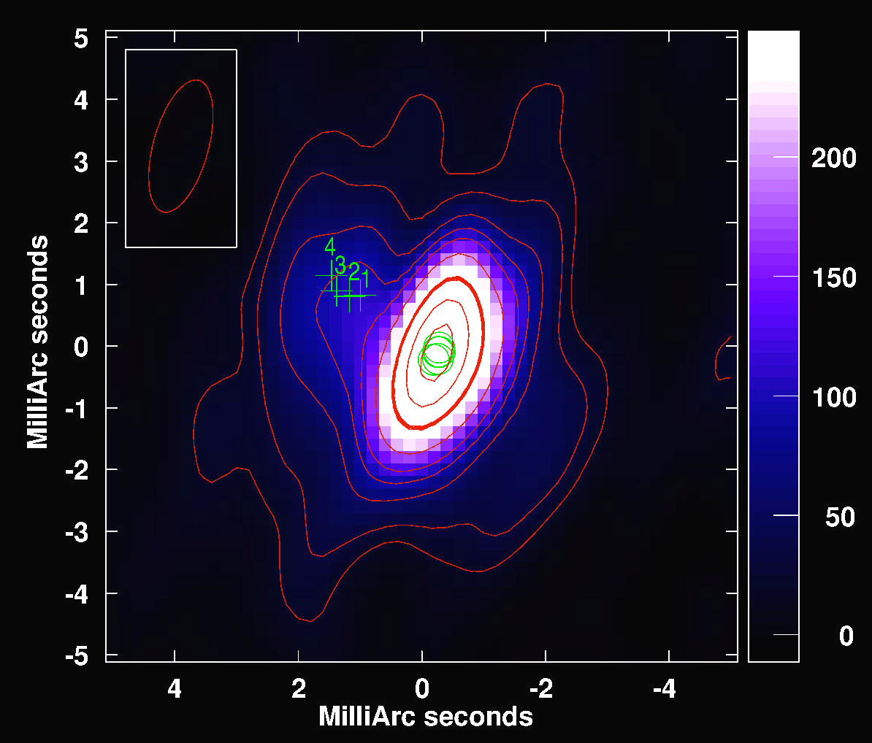
Lets start with a bang
"Recent VLBI Results on SN 1986J and the Possibility of FRBs Originating from Inside the Expanding Ejecta of Supernovae", M. Bietenholz
"Unravelling pulsar scattering through VLBI", D. Simard
"Pulsar scintillometry on the Vela pulsar with the LBA", F. Kirsten
/55

Slide 3
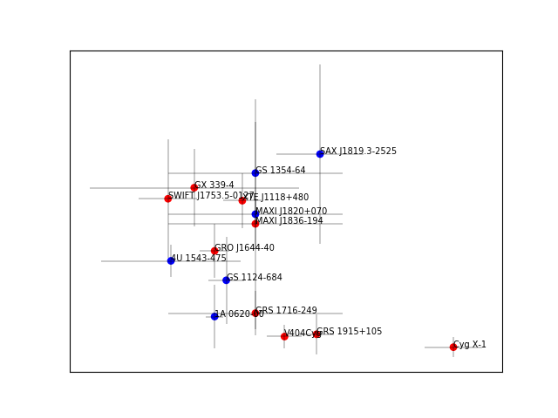
Ultimately there is no problem in astrophysics that you cannot solve with astrometry…
Only 1 FRB talk…
"Investigating Black hole formation using VLBI", P. Atri
/55

Slide 4
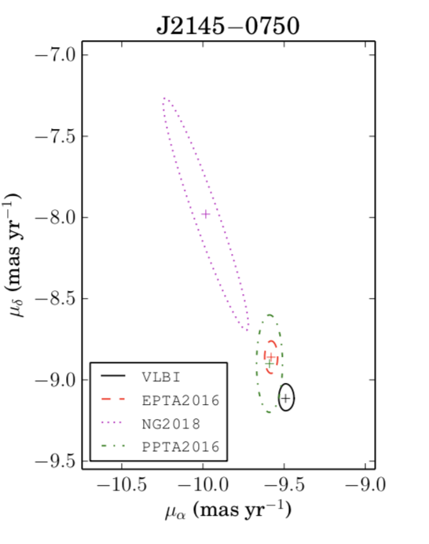
Astrometry: VLBI@SKA
Be careful with Gaia
"Precise Astrometry today and tomorrow, with Next-generation Observatories", M. Rioja
Current
Instruments:
(per measurement)
100 μas
SKA-VLBI
with MV
thermal
systematic
10 μas
thermal
systematic
Important for pulsars (too)
/55

Slide 5
Stars of the SKA will be the stars…
"COBRaS: The e-MERLIN 21cm Legacy Survey of Cygnus OB2", D. Fenech
"Radio emission in ultracool dwarfs: the nearby triple system VHS 1256 − 1257", J. Climent (but this is the detection of AB Dor C
/55

Slide 6
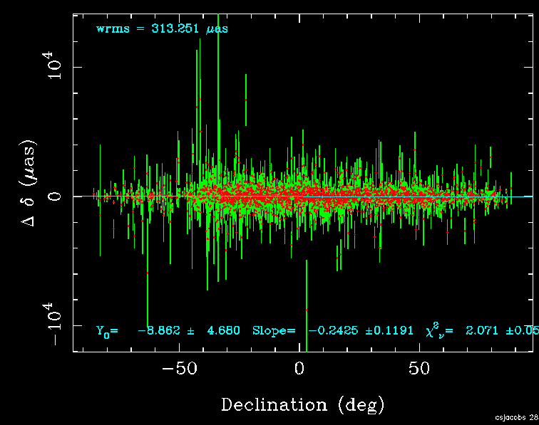
Gaia and the reference frame(s)
"Tying multiple Radio Wavelength Celestial Frames to the Gaia Optical Frame", C, Jacobs
"Sensing the astrophysical influence within VLBI astrometric measurements of extragalactic radio-sources", C. Gattano
/55

Slide 7
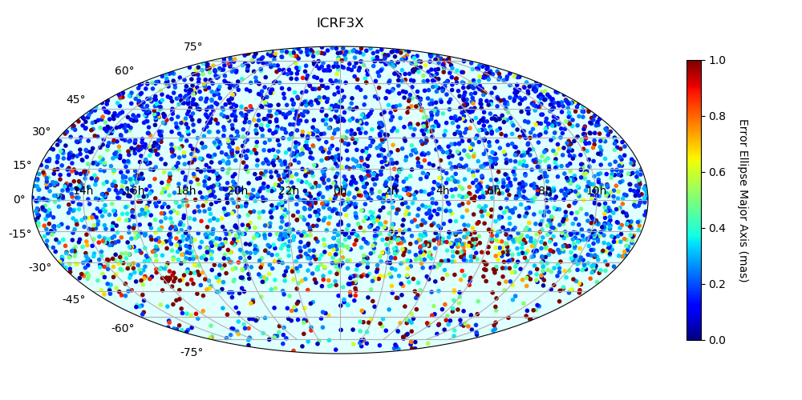
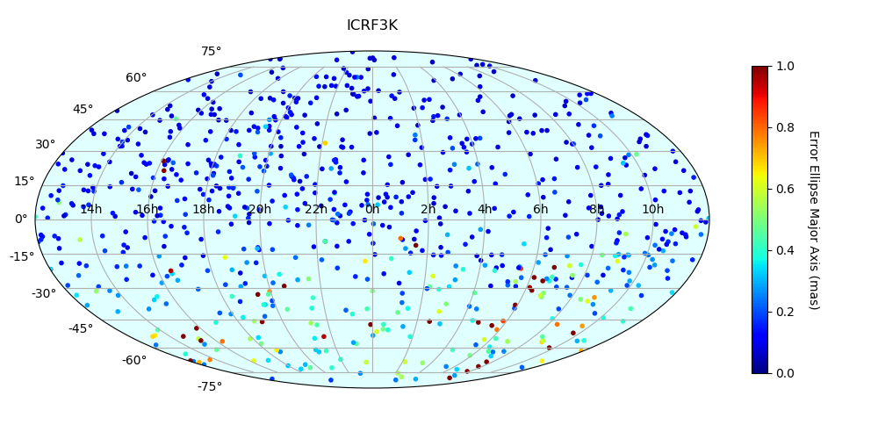
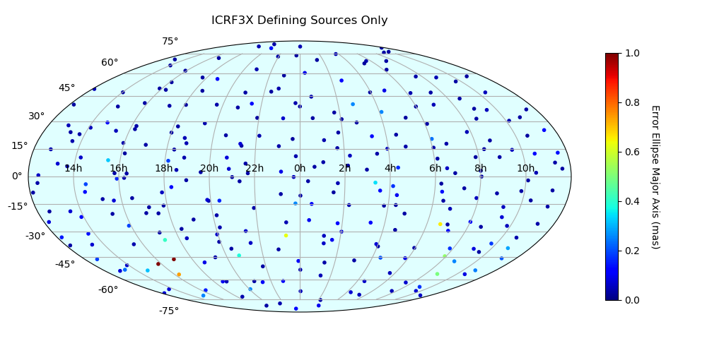
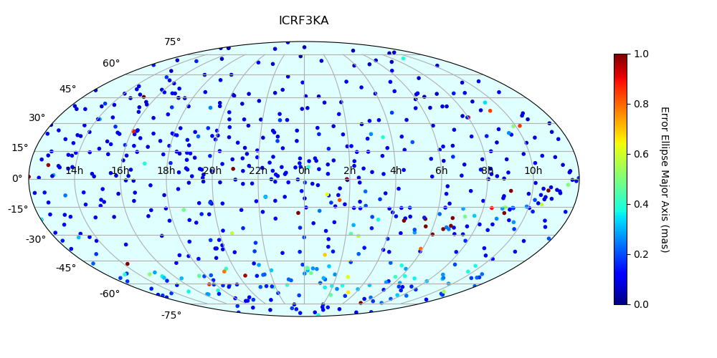
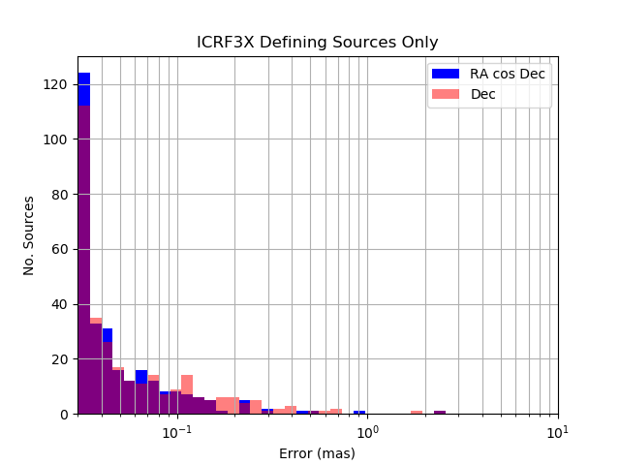
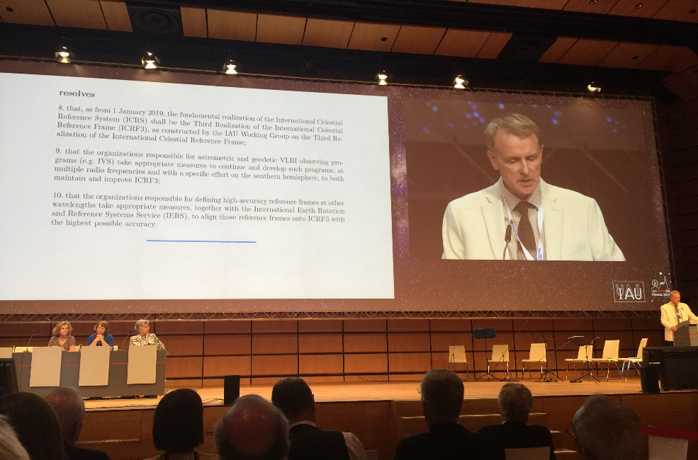
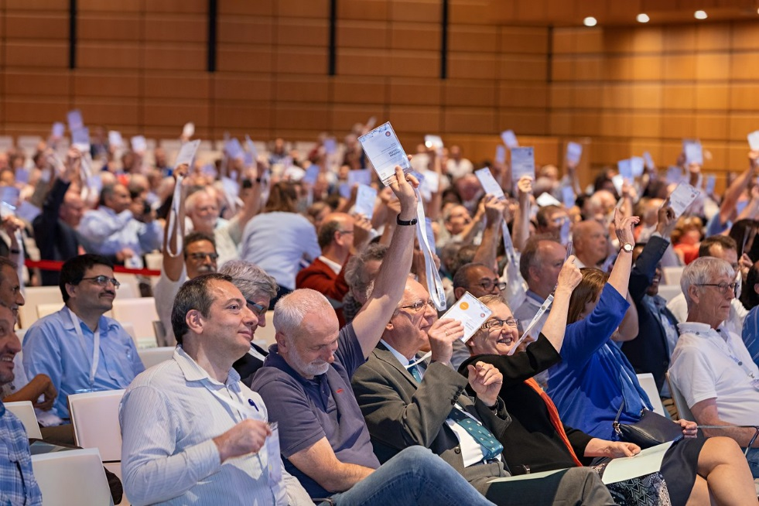
ICRF3 is here, hurray!
"ICRF3, the new realization of the International Celestial Reference Frame", P. Charlot
/55

Slide 8
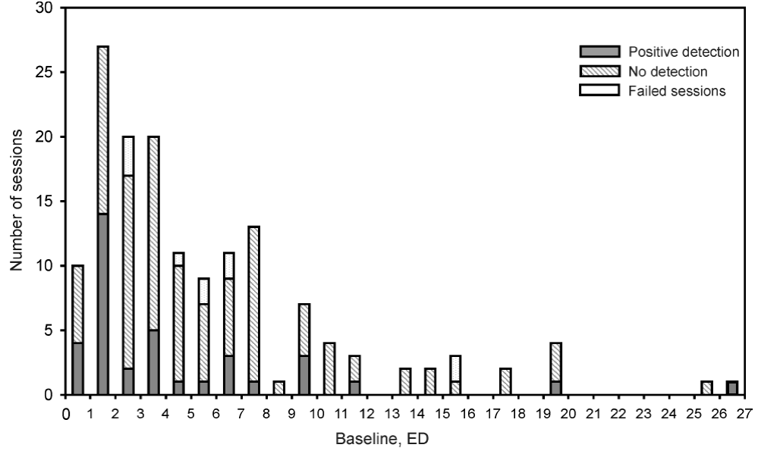
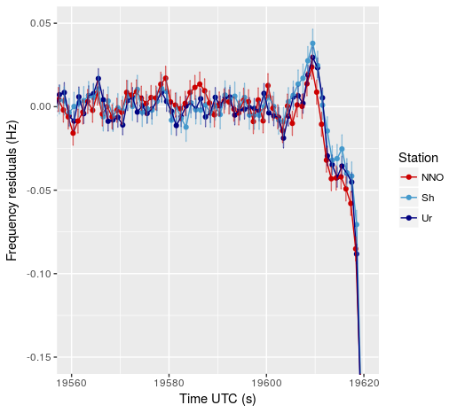
We do spacecraft…
"Studies of galactic masers in RadioAstron space VLBI mission", A. Sovolev
"Einstein Equivalence Principle test with RadioAstron: preliminary results", D. Litvinov
"VLBI and Doppler tracking of spacecraft for planetary atmospheric studies", T. Bocanegra
/55

Slide 9
Maser astrometry: spiral arm motions?
Parallaxes and proper motions of star-forming regions in the Sagittarius spiral arm", K. Rygl
Where are you, Scutum? Tracking down a spiral arm with maser astrometry", K. Immer
/55

Slide 10
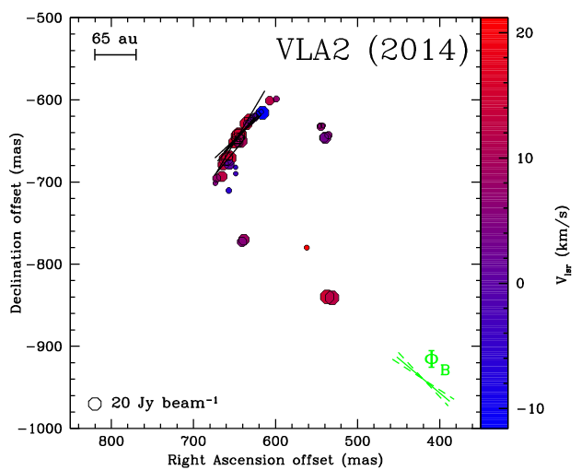
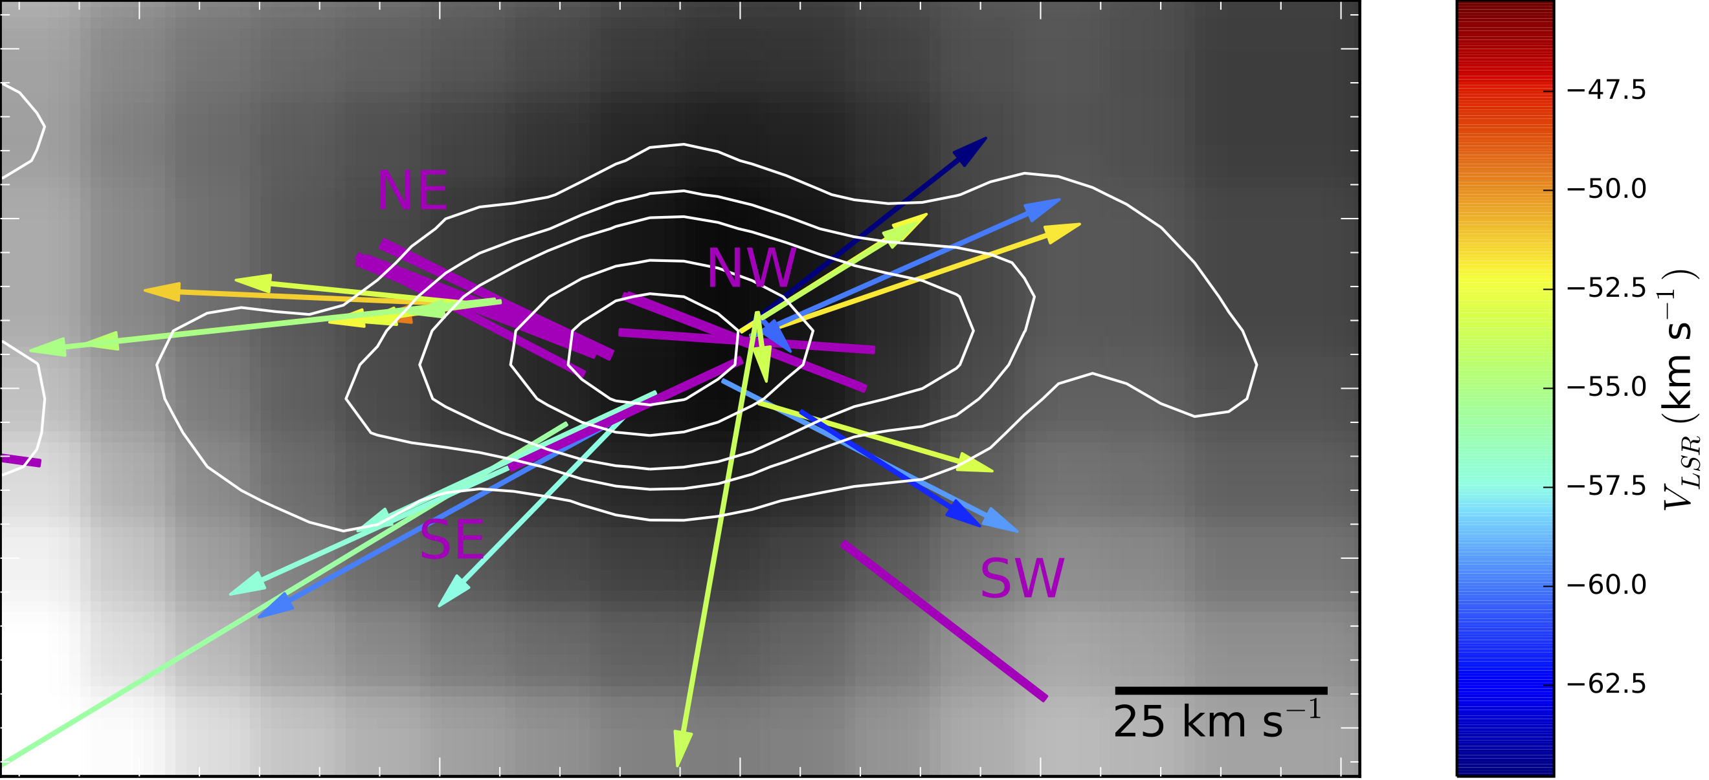
Masers for pol at the relevant scales!
"Magnetic field measurements around massive young stellar objects with the EVN", G. Surcis
"Revealing magnetic fields towards massive protostars: a multi-wavelength approach using masers and dust", D. Dall'Olio
"Measuring Magnetic Fields from Water Masers in the Synchrotron Protostellar Jet in W3(H2O)", C. Goddi
/55

Slide 11
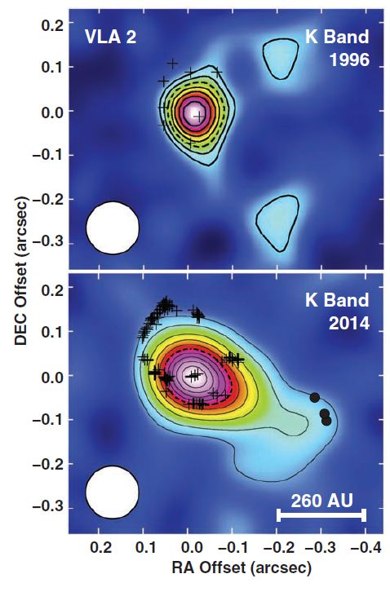
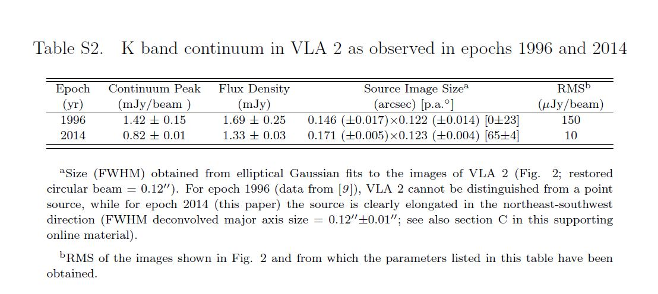
Extra Slide 10
Carrasco-González, C. et al. 2015, SCIENCE, 348, 114
14th EVN Symposium – Granada 8-11 October 2018 Gabriele Surcis - 8th October 2018

Slide 12
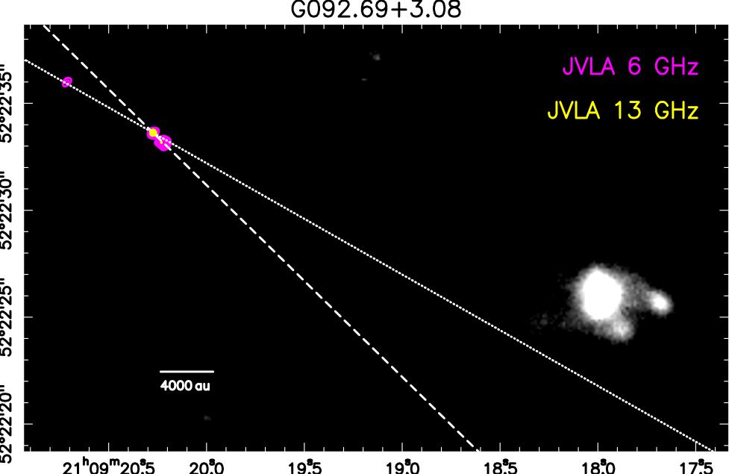
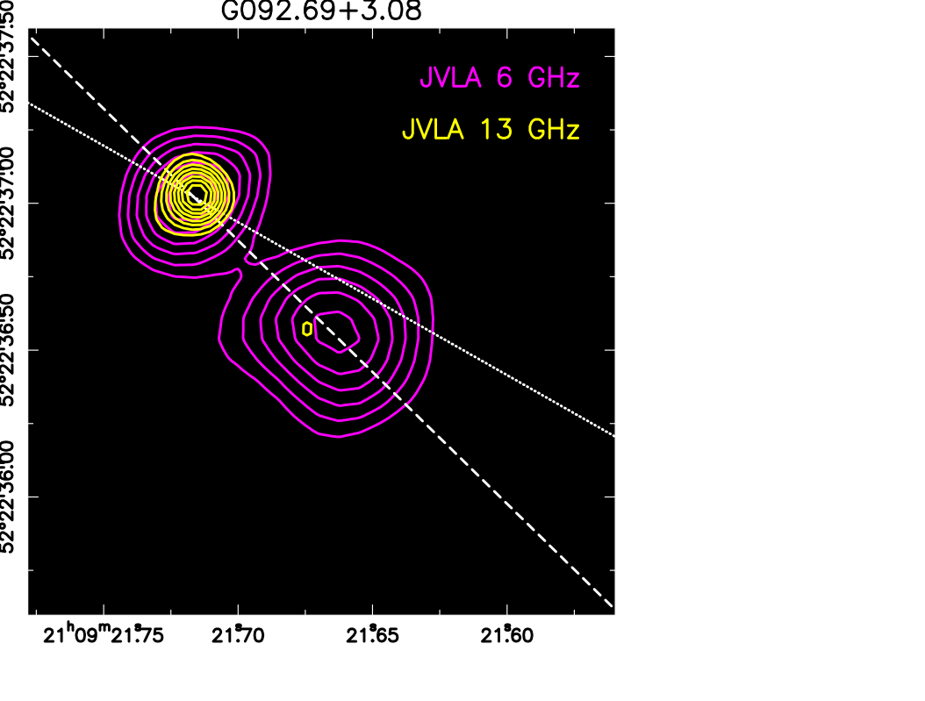
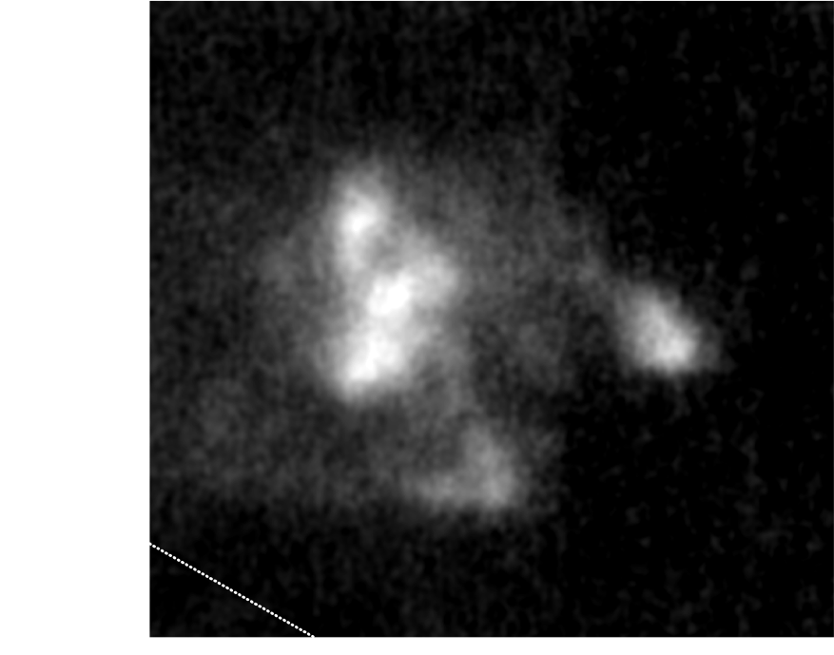
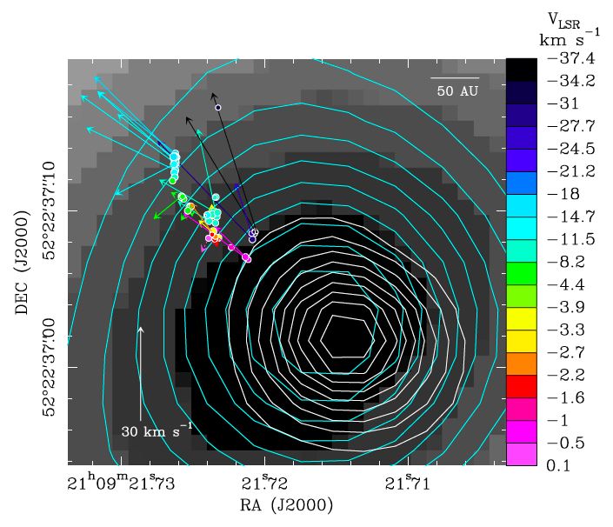
In synergy with ALMA: disks and outflows
G092.69+3.08
/55

Slide 13
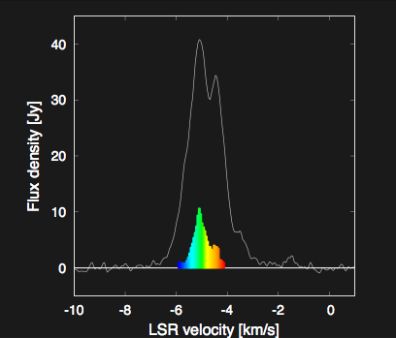
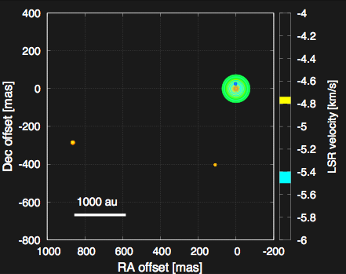
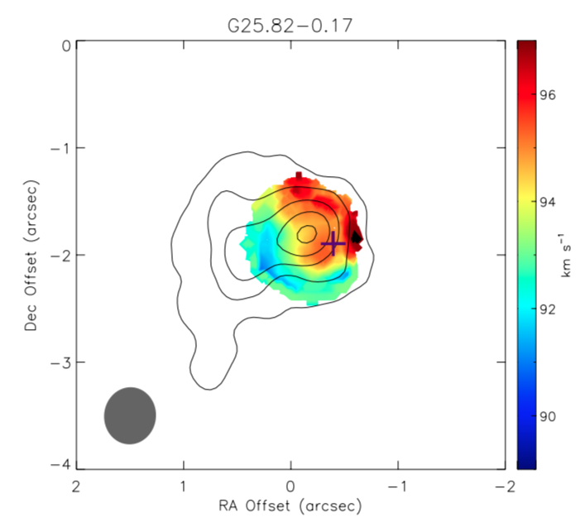
More ALMA synergy
"High-mass star formation expored with maser VLBI & thermal (ALMA, JVLA) observations", L. Moscadeli
44GHz maser
+ water maser
5000 AU
"KaVA Large Proposal for High-Mass Star-Formation Studies with Multiple Masers", T. Hirota
/55

Slide 14
Variable masers, repeating and flaring
"NGC6334I - Tracing the Gas Motion During A Contemporaneous Maser Flare Event", J. Chibueze
"Multiepoch observation of periodic methanol maser in G107.2985.63", M. Olech
/55

Slide 15
Overlapping masers, modeled as observed
"Multi-epoch VLBI of a double maser super-burst", R. Burns
"3D Models of Maser Flares", M. Gray
/55

Slide 16
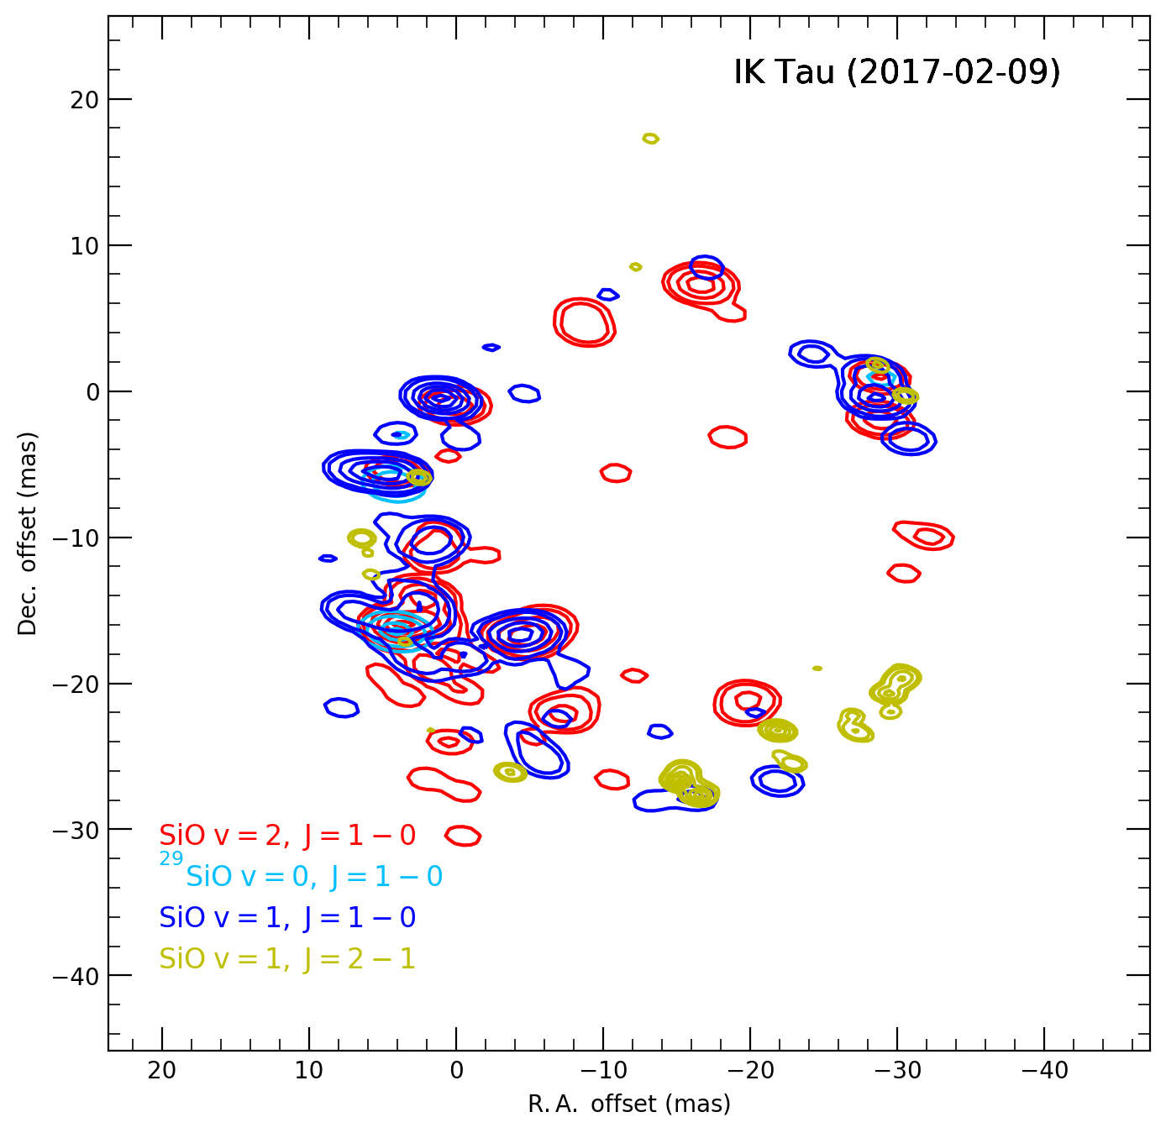
SiO rings, aligned & polarised
"A study of the physical environments of evolved stars from the SiO and H2O masers", Y. Yun
"Detailed SiO proper motion analysis: slow net expansion and a small correlation with the magnetic field", A. Richards for Assaf
/55

Slide 17
To be a planetary nebula…
"Resolving discrepancy in the pPN OH231", J.-F. Desmurs
"Short-lived episodic outflow in a water fountain star", R. Burns (on behalf of G. Orosz)
/55

Slide 18
Anna’s reminders:
44GHz MeOH
OH1720
HCN masers
HC3N
/55

