Slide 1
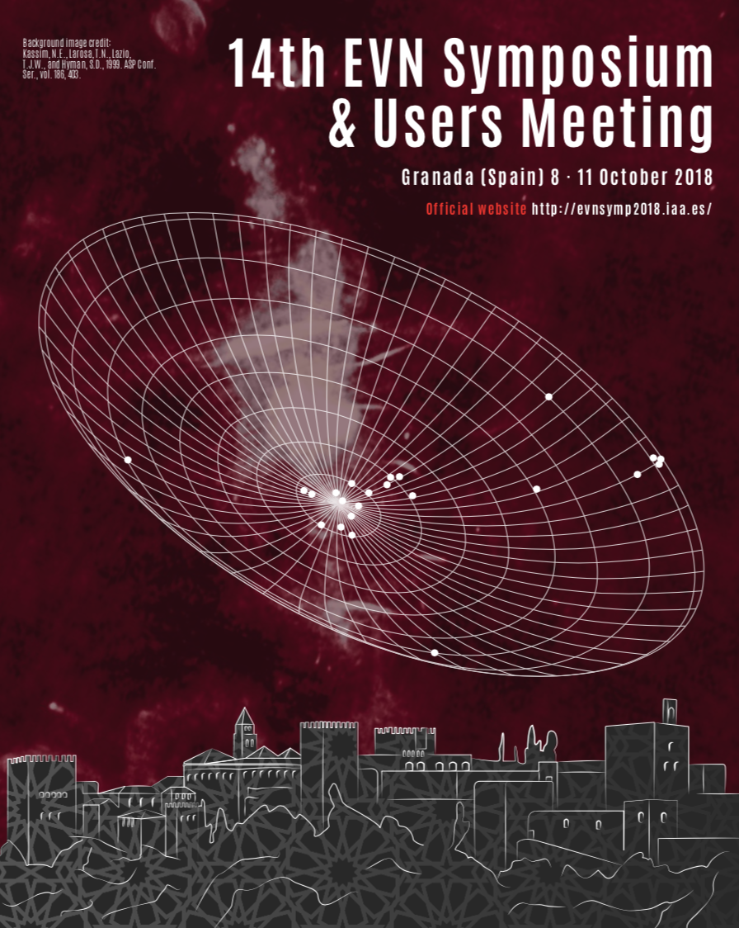
Symposium Summary
T. Venturi & H. van Langevelde

Slide 2
The Symposium in numbers
~170 participants
More than 80 presentations
11 sessions, four of them parallel (AGN/Stellar Evolution)
Compared to previous Symposia, many more results on several new topics, especially wrt to transients, multimessenger science and synergies with other bands
VLBI is becoming relevant in new areas, and it is «modernizing» itself
Impossible to acknowledge all the results!

Slide 3
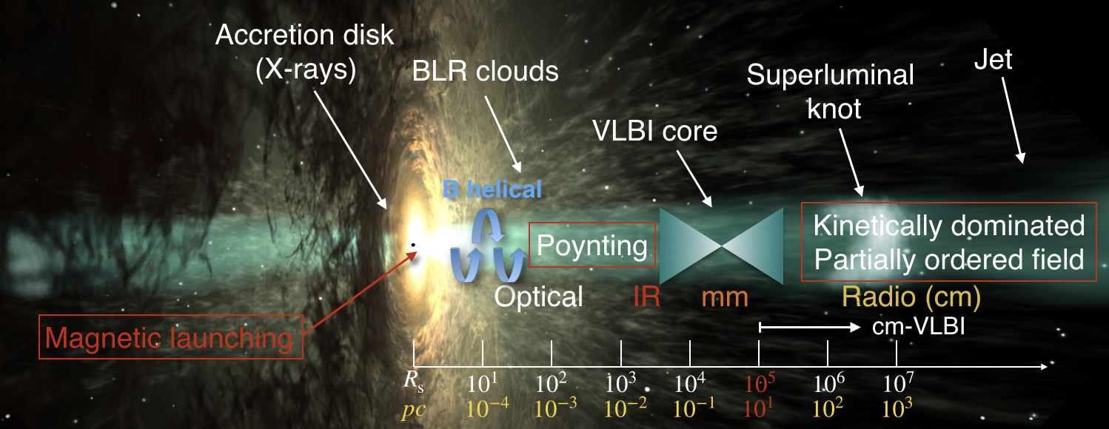
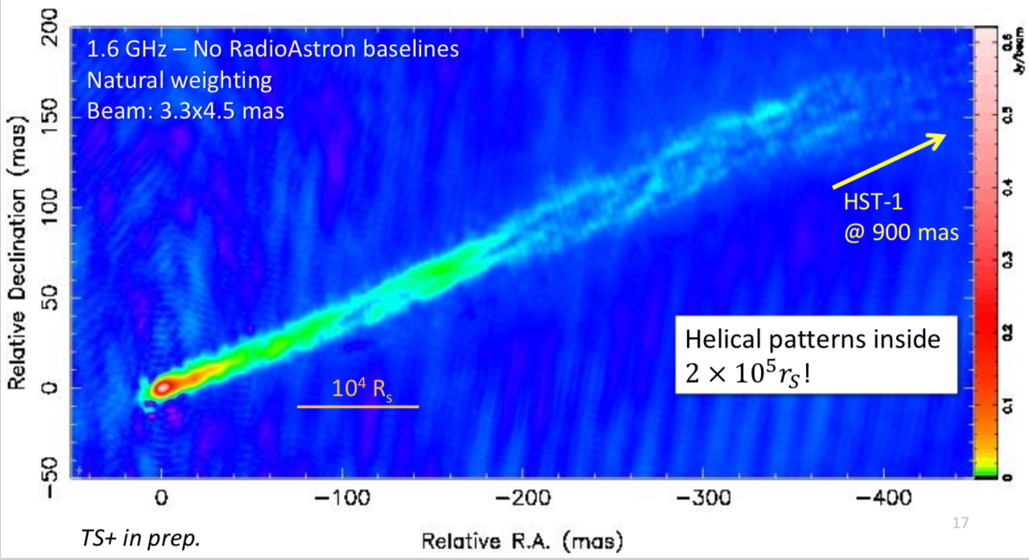
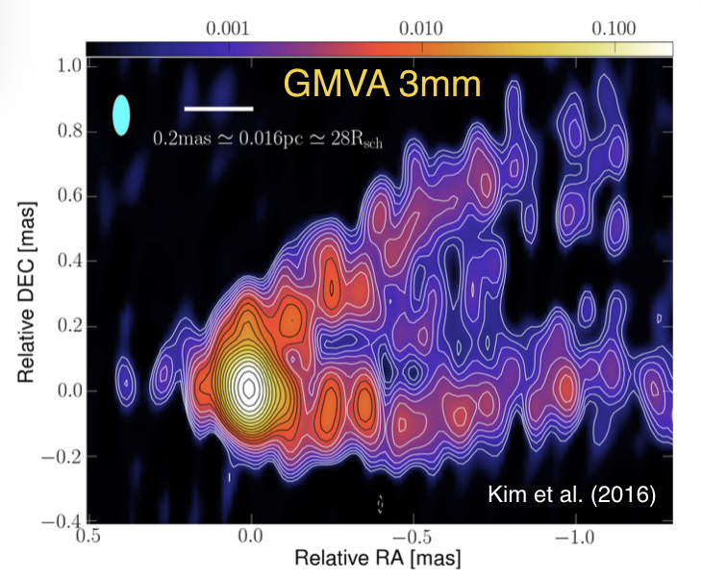
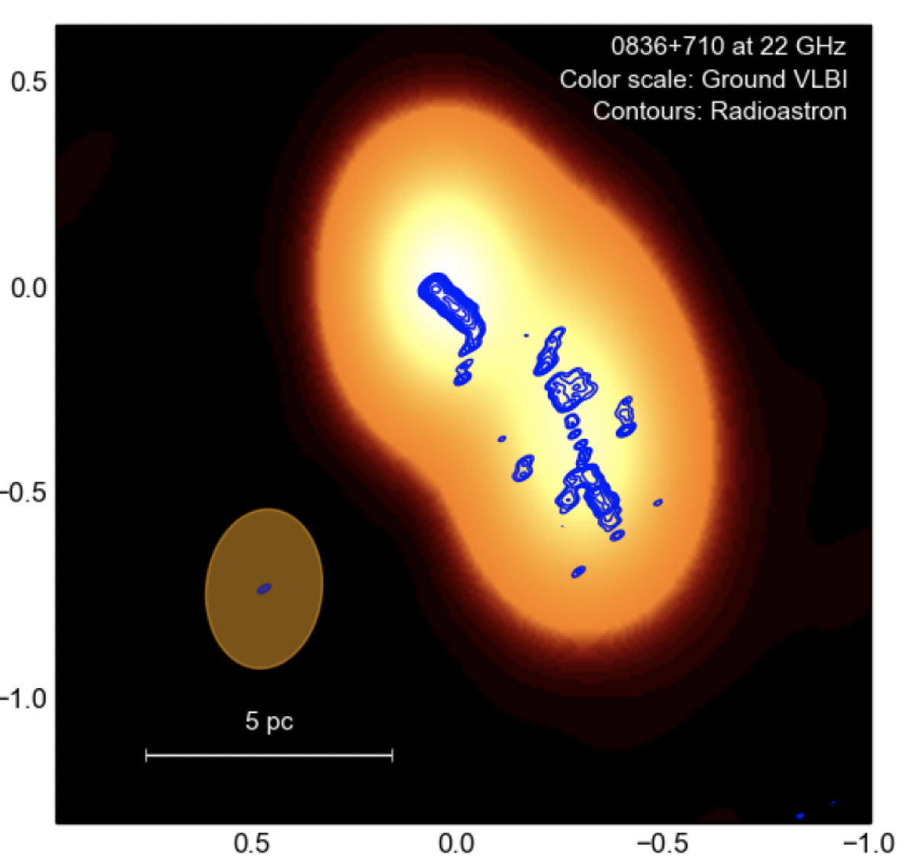
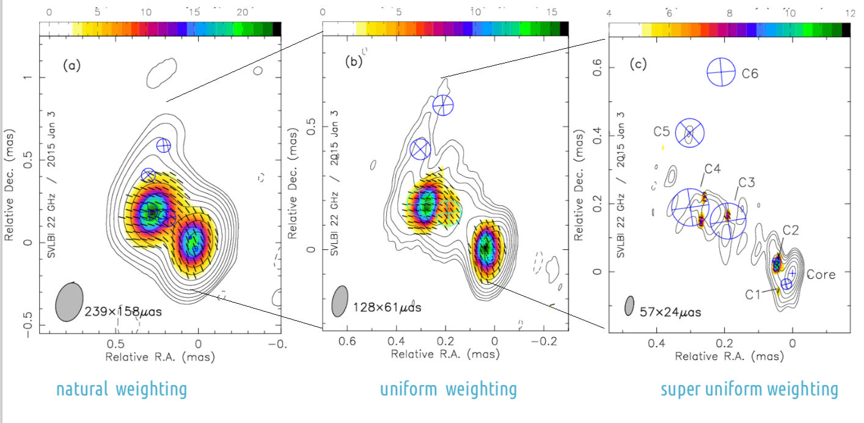
Focus on the very inner jet regions in AGNs: territory of mm-VLBI and space-VLBI!
Unveiling the AGNs very close to the VLBI cores with very high sensitivity for the first time – a lot of unexpected results - Jet structure
Savolainen
Gomez
M87 - Savolainen
M87 - Gomez
0836 - Vega Garcia
S5 0716 – Kravchenko

Slide 4
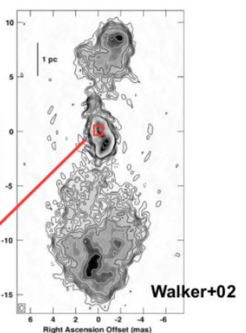
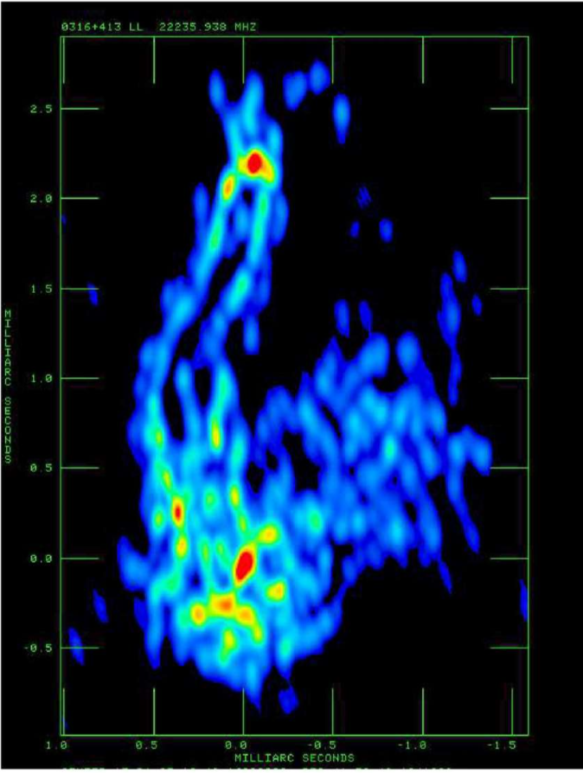
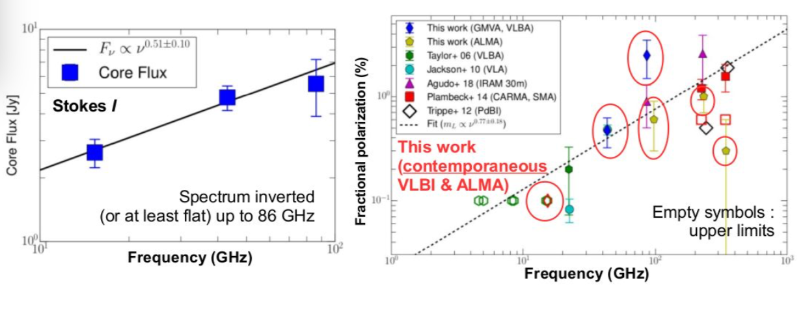
Focus on the very inner jet regions in AGNs: territory of mm-VLBI and space-VLBI!
Unveiling the AGNs very close to the VLBI cores with very high sensitivity for the first time – a lot of unexpected results - Jet structure
Savolainen
Gomez
Kim
3C84 holds the record of presentations!
New burst after the ‘80s – 90’s !!!!
Kim
3C84 - Giovannini

Slide 5
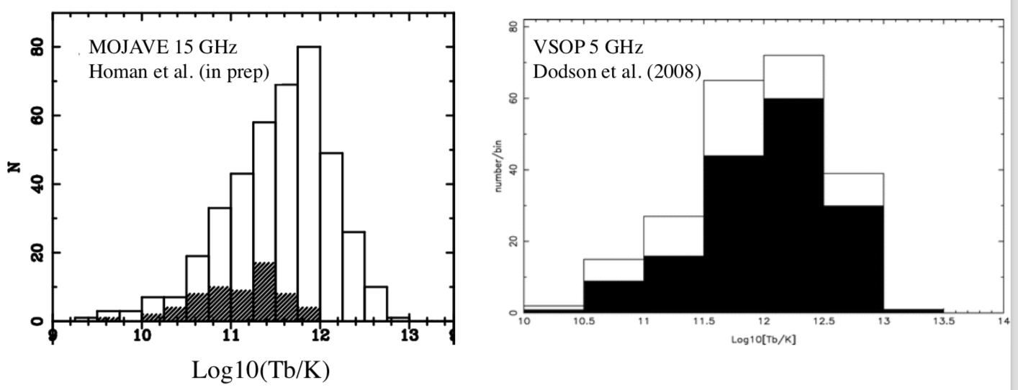
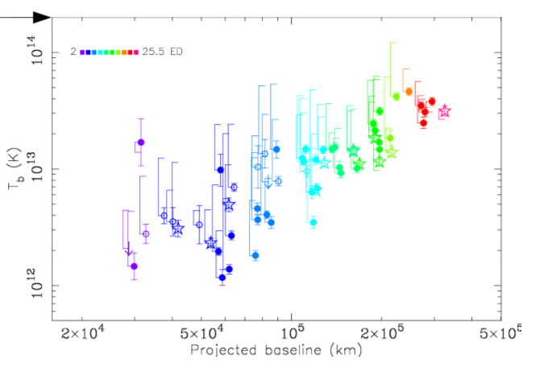
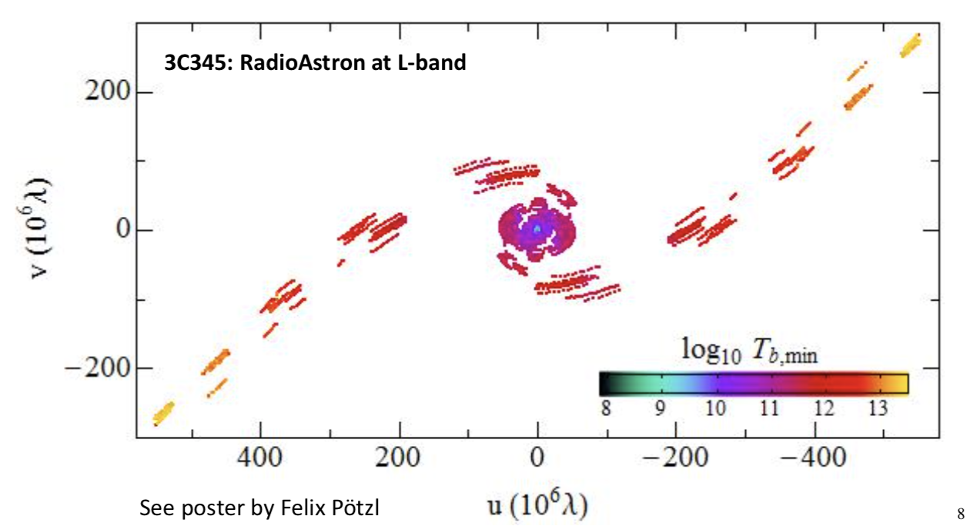
Focus on the very inner jet regions in AGNs: territory of mm-VLBI and space-VLBI!
Unveiling the AGNs very close to the VLBI cores with very high sensitivity for the first time – a lot of unexpected results – Brightness temperature and polarization
Kovalev
Lobanov/Poetzi

Slide 6
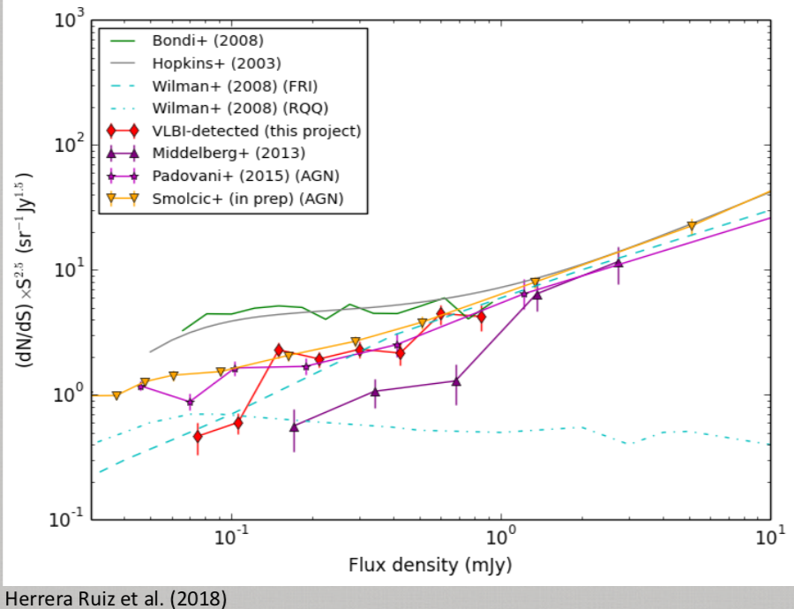
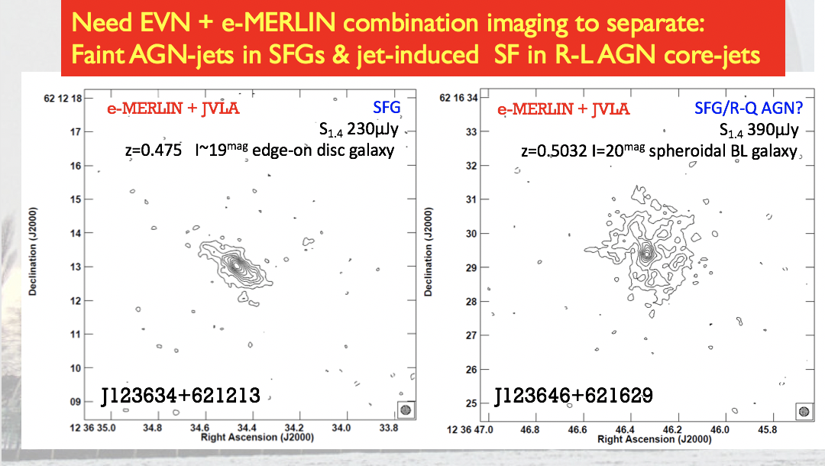
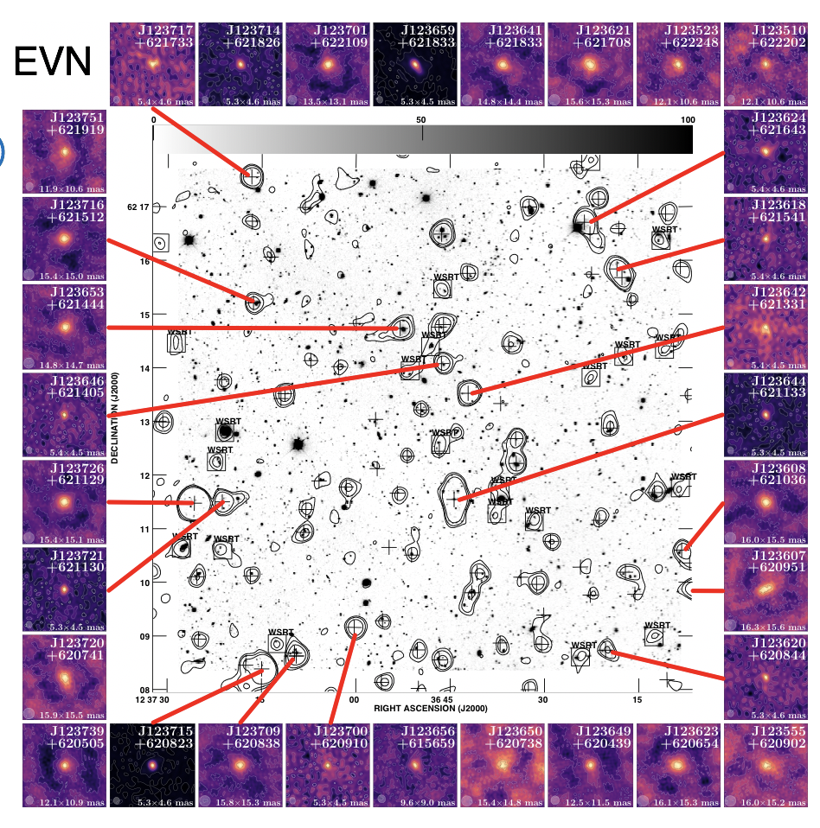
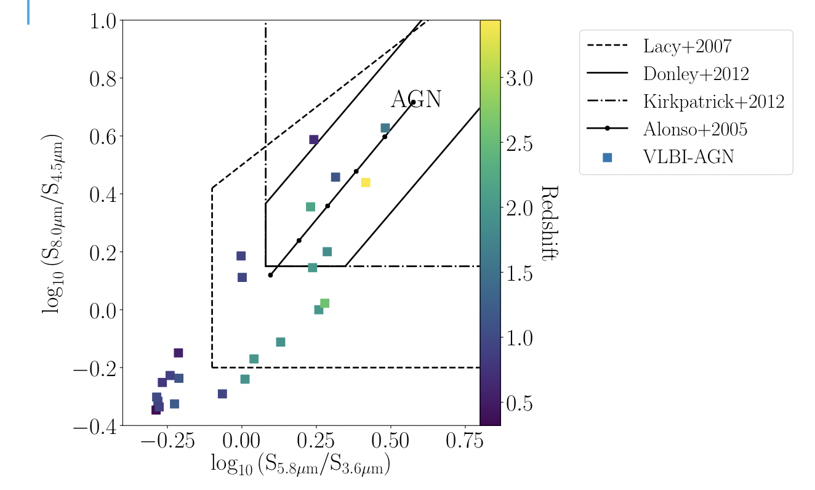
Evolution – Galaxies and AGN – Role of VLBI in disentangling SF and AGN activity and in covering the redshift space
Herrera-Ruiz
Muxlow
Radcliffe/Barthel

Slide 7
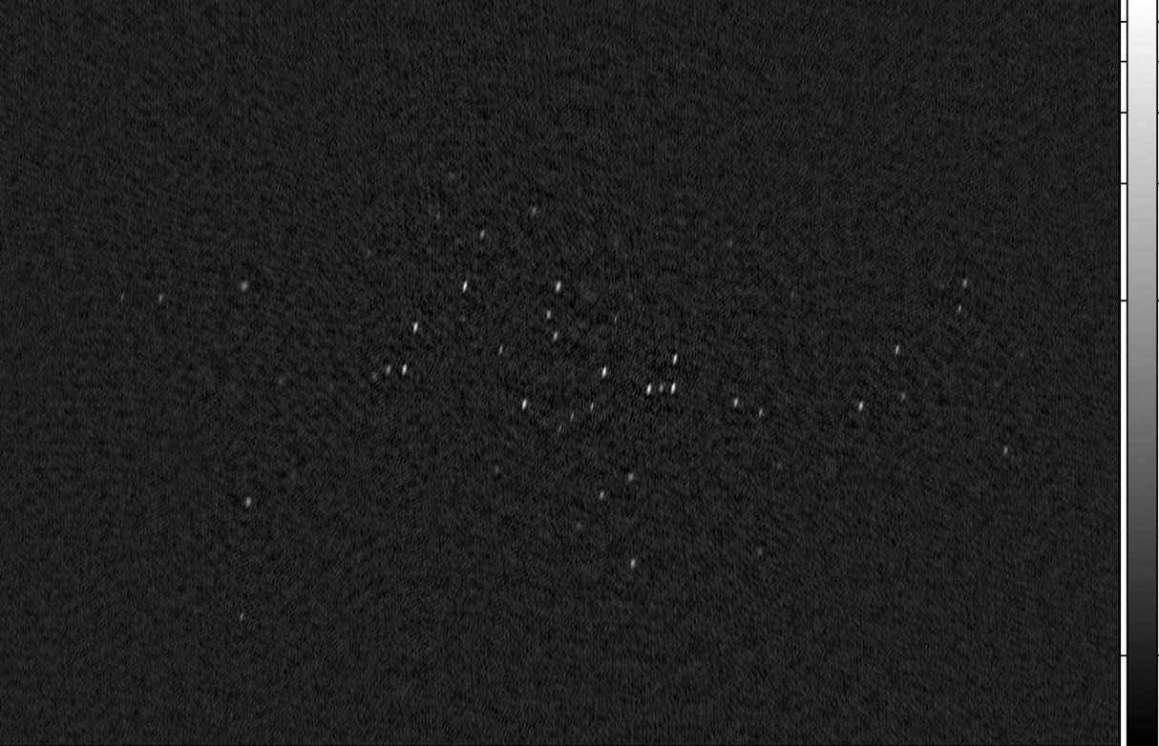
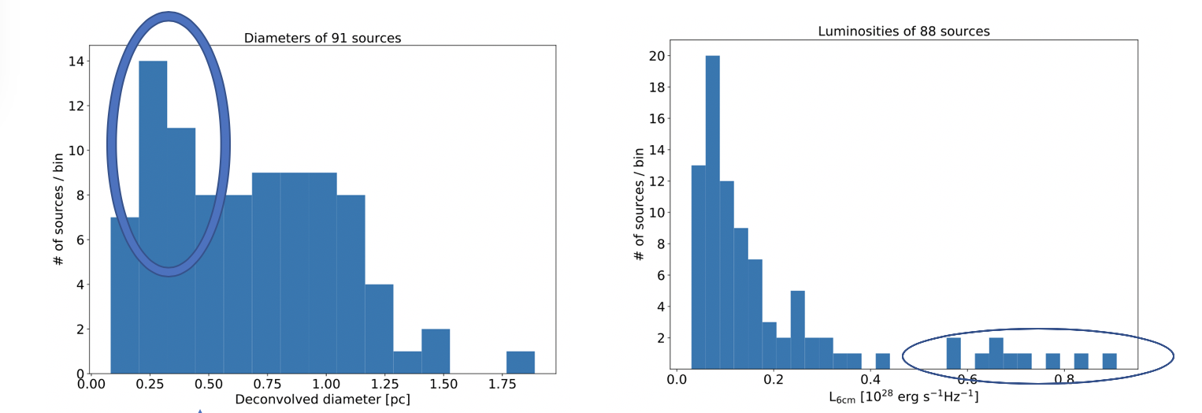
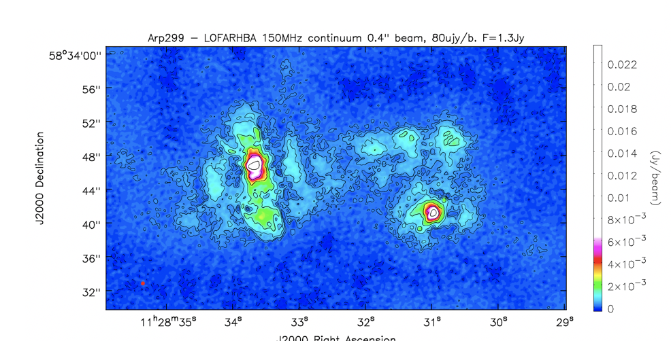
Evolution – Galaxies and AGN – Role of VLBI in disentangling SF/SB and AGN activity and in covering the redshift space
Arp220 - Conway
SN rate and direct comparison with IMF
Role of ILT in the study of ULRIG
SF outflow and feedback processes
Conway

Slide 8
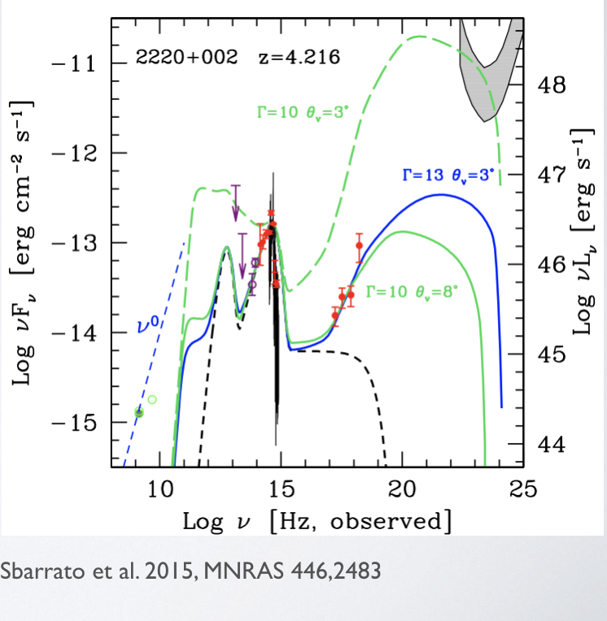
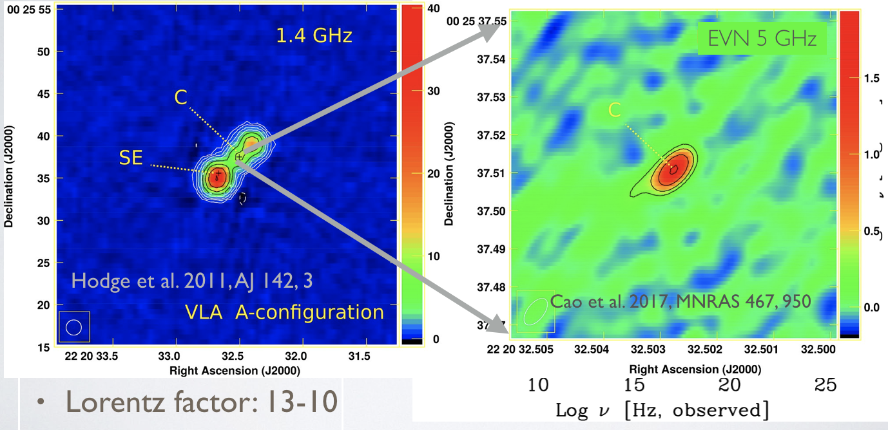
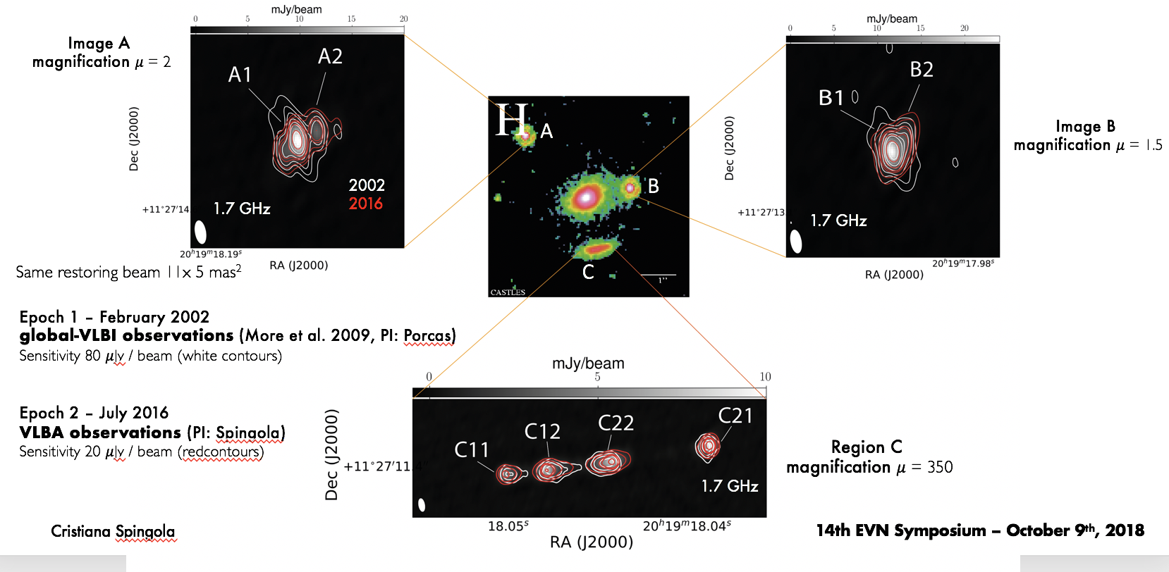
Evolution – Galaxies and AGN – Role of VLBI in disentangling SF and AGN activity and in covering the redshift space
Radio loudness at high z and blazars
Gabanyi
Gravitational lensing as tool to study magnified high-z radio galaxies and quasars
Spingola

Slide 9
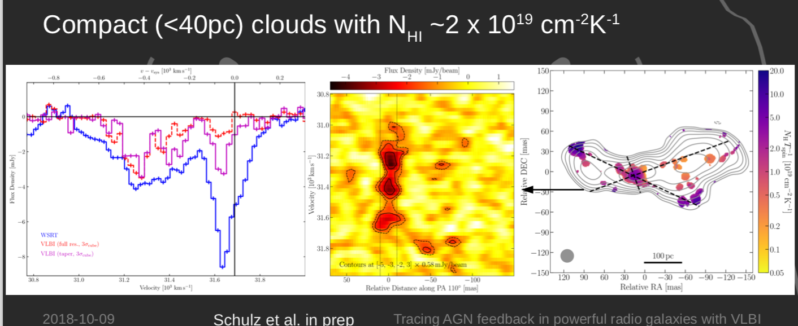
Evolution – Galaxies and AGN – Role of VLBI in inferring information on the circumnuclear environment
Schultz

Slide 10
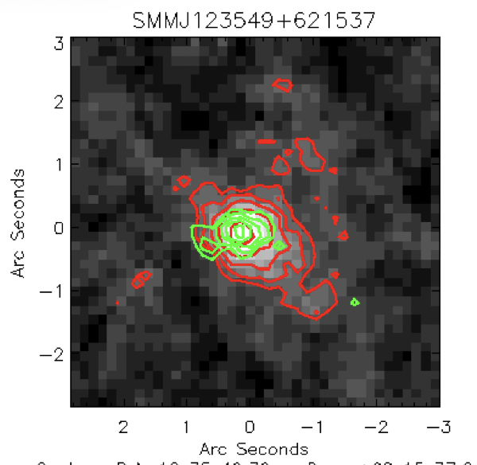
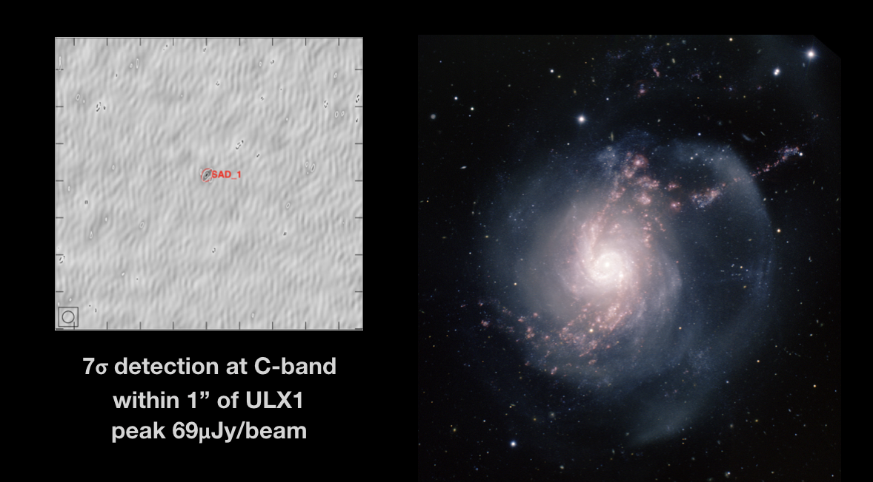
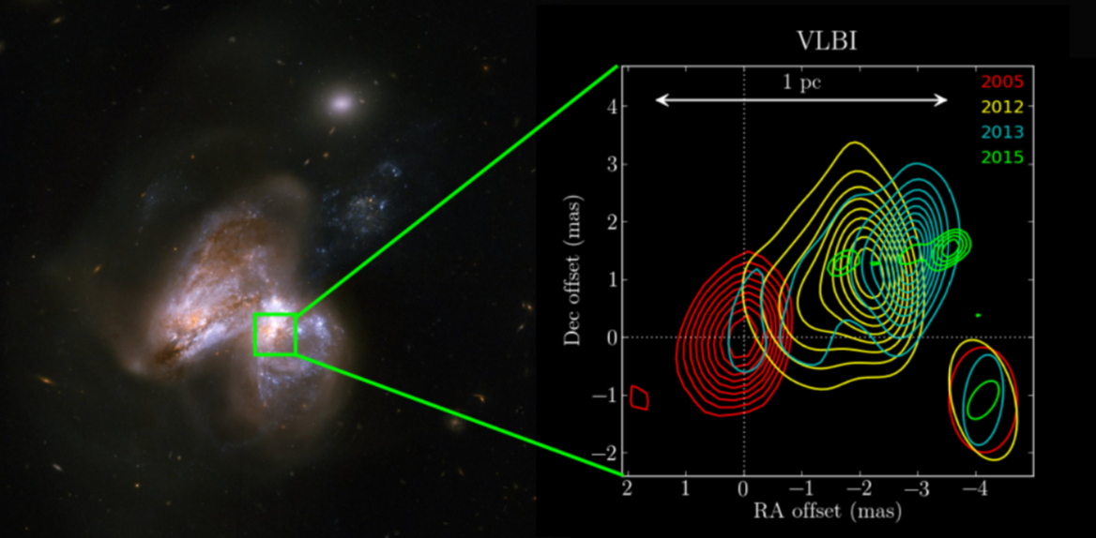
Synergies and multi-wavelength projects beyond multimessenger science:
Many new projects already involve other facilities and studies are closely related to results in other bands
Argo
VLBI & X-ray
Muxlow
cm, mm, sub-mm bands
Perez-Torres
Optical, Radio, IR

Slide 11
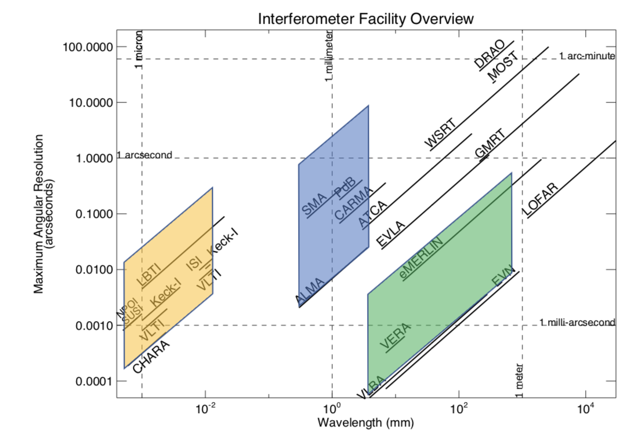
Synergies and multi-wavelength projects beyond multimessenger science:
Many new projects already involve other facilities and studies are closely related to results in other bands
Guirado
Orienti

Slide 12
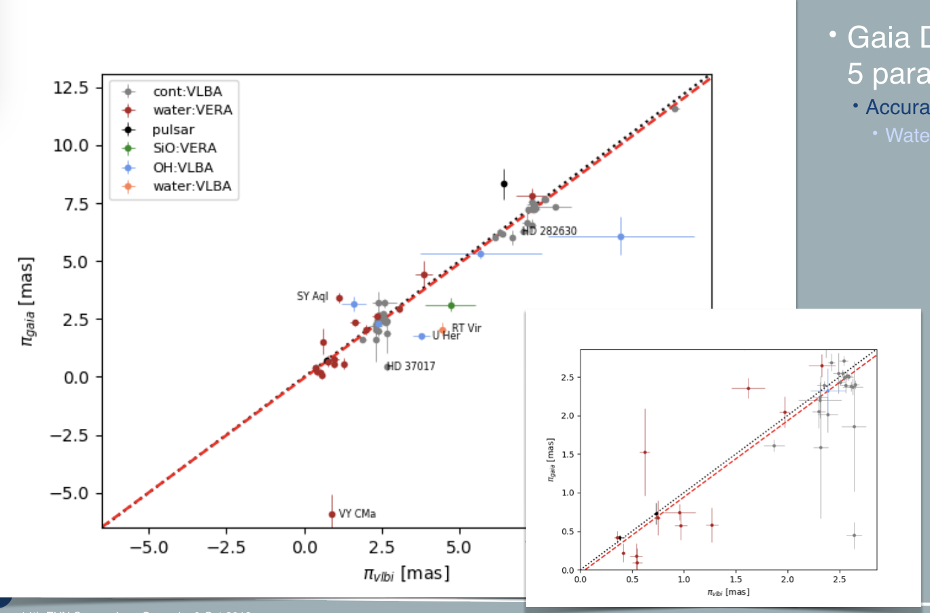
Synergies and multi-wavelength projects beyond multimessenger science:
Many new projects already involve other facilities and studies are closely related to results in other bands
VLBI & Gaia – van Langevelde

Slide 13
Synergies and multi-wavelength projects beyond multimessenger science:
Many new projects already involve other facilities and studies are closely related to results in other bands
VLBI & Gaia – Petrov/Kovalev

Slide 14
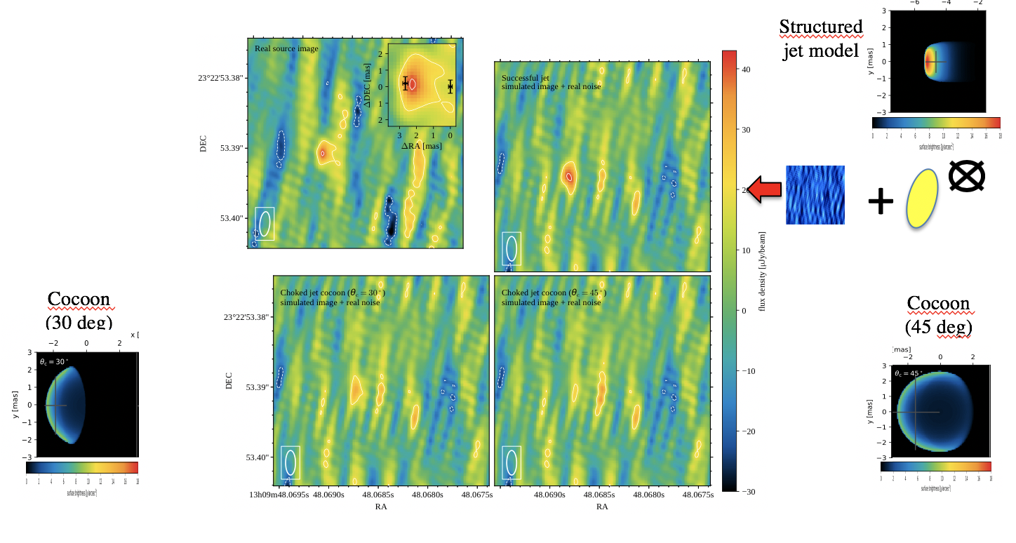
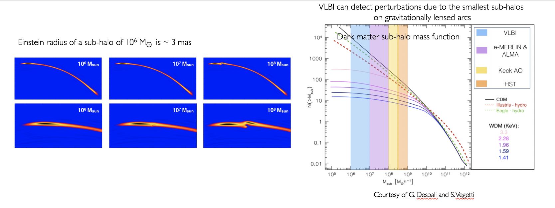
More novel use of the EVN/VLBI – GW & cosmology
Ghirlanda
Spingola

Slide 15
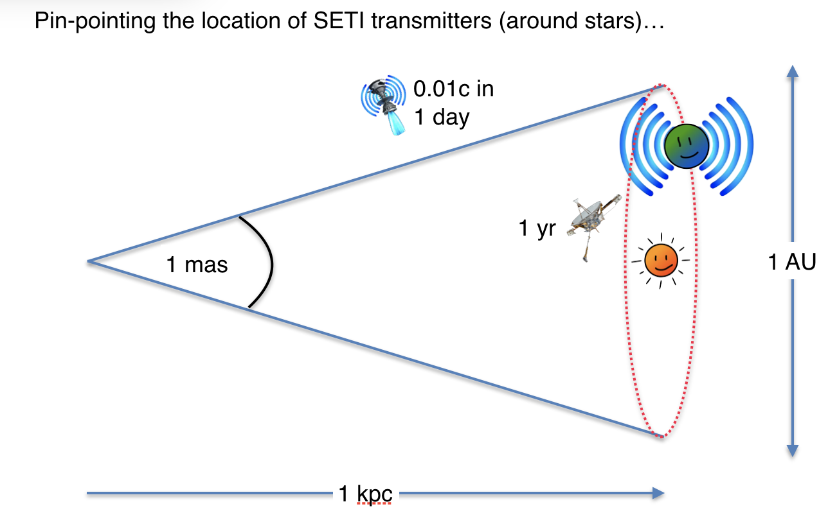
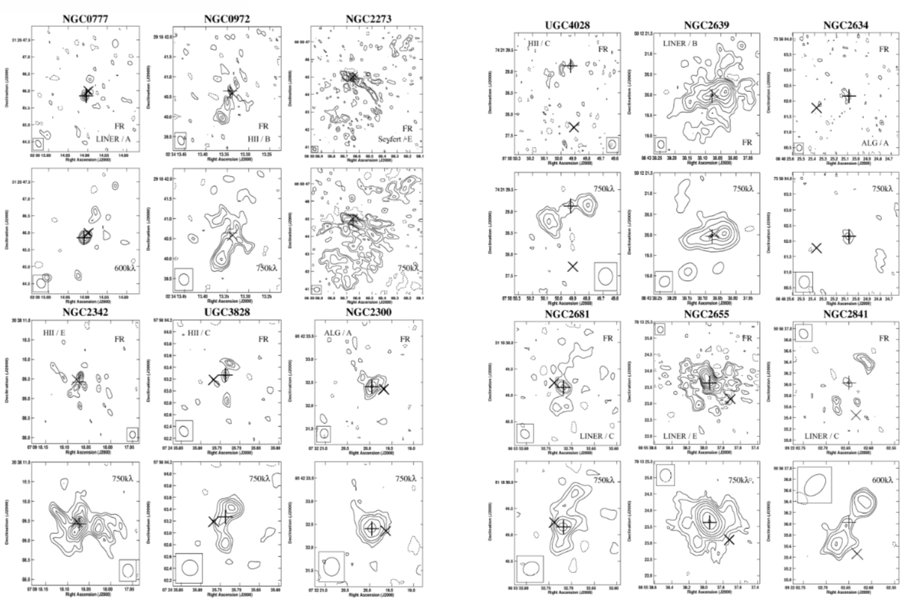
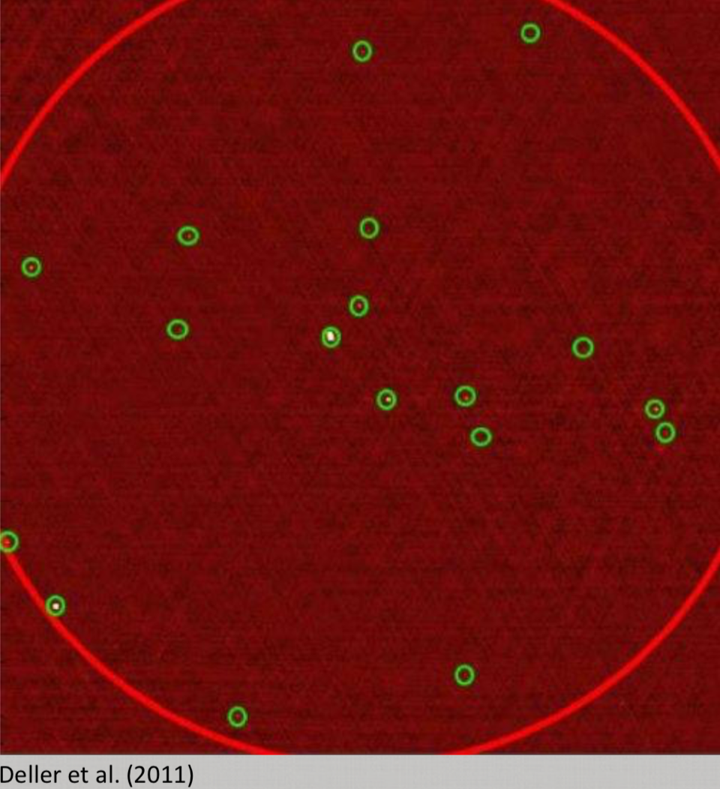
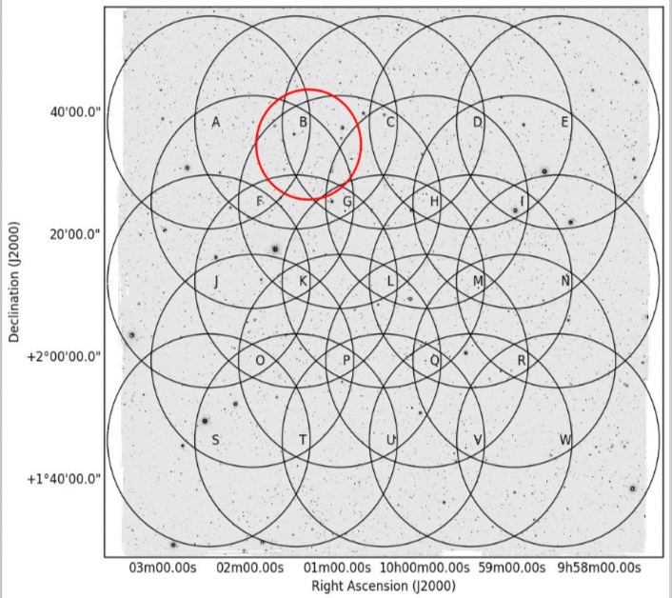
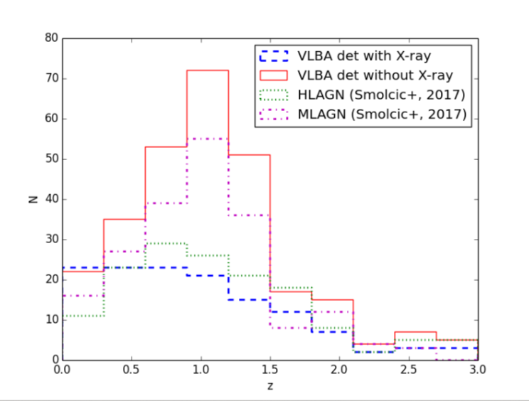
Present and future…
VLBI & SETI? Garrett
e-MERLIN+EVN: one of the most desirable achievements!
EVN-lite – Posters by Frey+ & Giroletti+
VLBI with MeerKAT – Poster by Qwabe & Deane
Beswick
Potentials of wide-field VLBI
Herrera-Ruiz

Slide 16
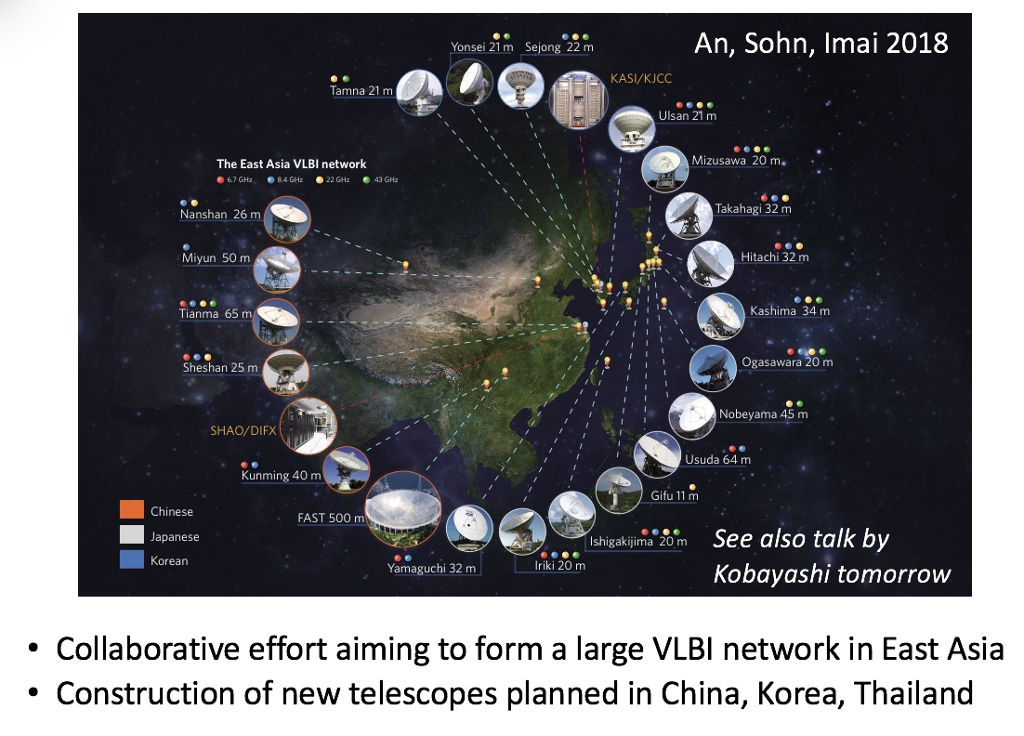
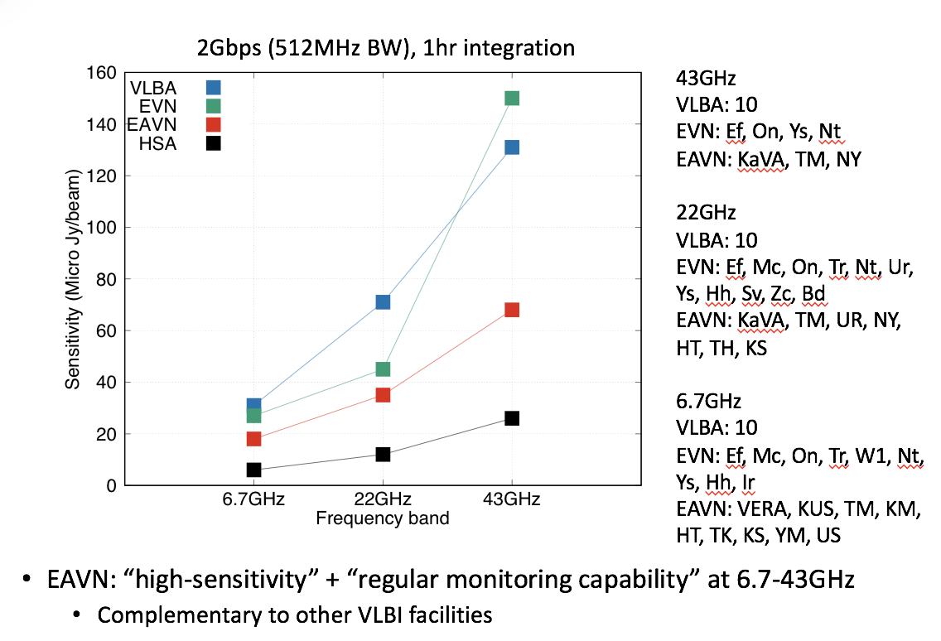
Present and future…
Thinking even more global: looking East to the EAVN
Hada

Slide 17
THANK YOU
To the LOC for the excellent organization
To the SOC for the excellent programme
To you all and all users of the EVN

