Slide 1



Comparing remote atomic clocks via VLBI networks and fiber optic links: the LIFT/MetGeSp perspective
Roberto Ricci (INAF-IRA)
F. Perini, C. Bortolotti, M. Roma, R. Ambrosini, M. Negusini, G. Maccaferri, M. Stagni, M. Nanni
Istituto Nazionale di Astrofisica, Istituto di Radioastronomia, Bologna
C. Clivati, A. Tampellini, M. Frittelli, A. Mura, F. Levi, M. Zucco, D. Calonico, P. Tavella
Istituto Nazionale di Ricerca Metrologica, Divisione di Metrologia Fisica, Torino
Giuseppe Bianco
Agenzia Spaziale Italiana (Matera)
VLBI partners: Yebes (B. Tercero, J. Gonzalez, P. de Vicente), Torun (A. Marecki, P. Wolak,
M. Gawronski), Metsahovi (J. Kallunki, J. Tammi), Effelsberg (A. Kraus, U. Bach),
Matera (G. Colucci, M. Paradiso, F. Schiavone), Noto (P. Cassaro, S. Buttaccio)

Slide 2
Overview
LIFT/MetGesp project: a brief history
EUR137: 1st VLBI exp with fiber opt link
VITA experiments (Jul 2017, Apr 2018)
Clock timing via rms phase noise
VLBI experiments: Jan-Feb 2018
Conclusions
Future developments

Slide 3
General Introduction
Atomic Clock comparison is important per se
- redefinition of SI second based on optical clock frequency standards (Riehle 2017, Nature Photonics)
- relativistic geodesy (Lisdat+ 2016, Grotti+ 2018)
in (mm-)VLBI observations:
-narrower fringe search window
- Loss of phase coherence btw stations: Δν/ν < 1/τν ≤ 10⁻¹³
- synchronization of SKA stations (He+ 2018, Optica)
ALSO better clock spectral purity from (fiber-)distributed freq standards means less LO phase noise in single-dish/VLBI obs:
LO phase noise scales as N²
N: multiplication steps from 10 MHz RF signal

Slide 4
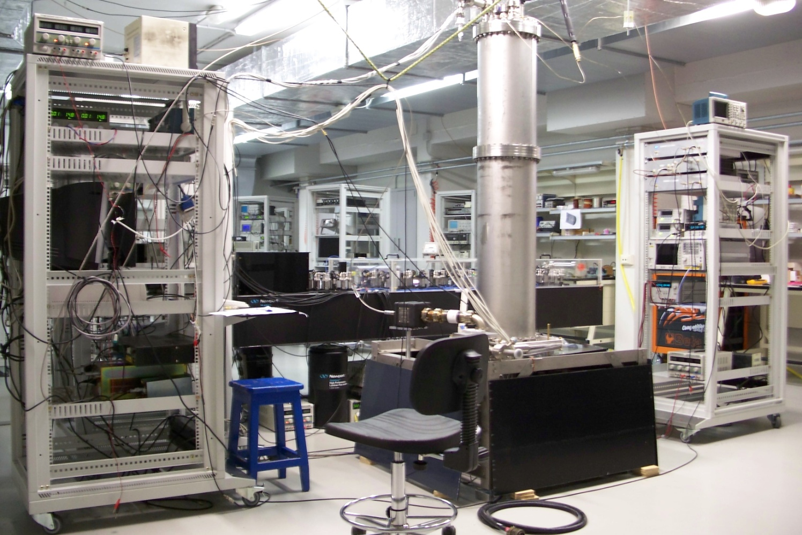
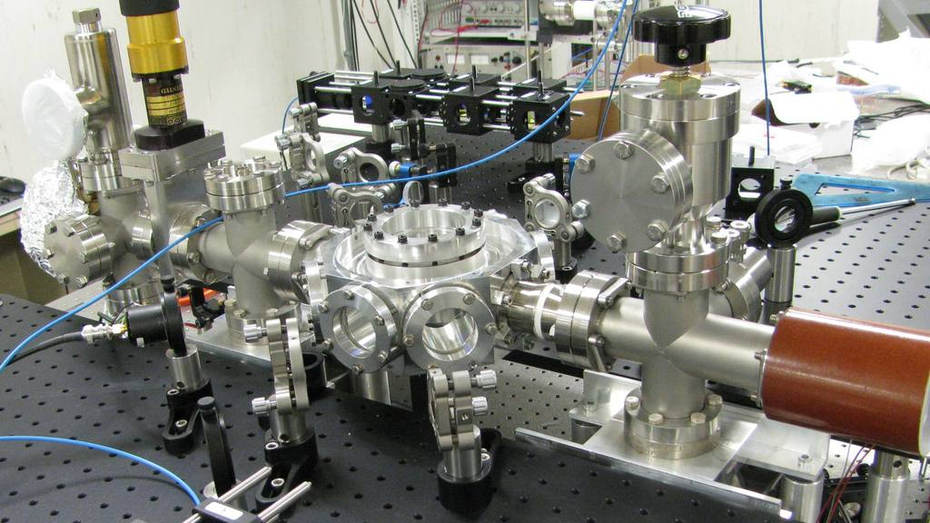


From LIFT to MetGeSp
MetGeSp = METrology for Geodesy and Space
Project goals:
Common clock Mc-Ma
Clock timing w/ VLBI
Turin
Turin
Florence
Eur Lab Non-lin Spectr
Matera
Space Geodesy
Center
Bologna
Fiber to Ma deployed
Fiber btw Mc and Bo covered w/ project funds
until 2020
Noto
Fucino Plain
Radio station
Telespazio Facility
Malta NMC

Slide 5
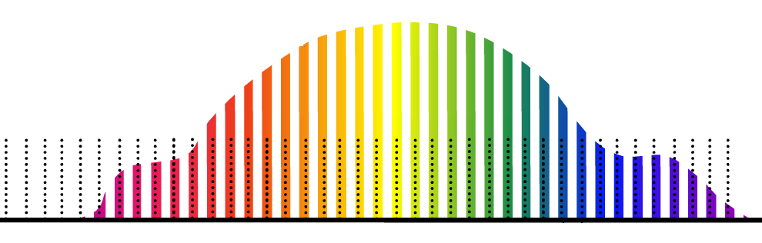




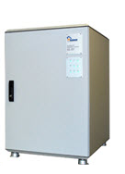
Optical Links for Metrology
Optical Frequency Comb
Medicina Radiotelescope
Noise
cancellation
Fiber laser
servo
550 km
At the telescope, this optical signal is converted to the microwave domain using an optical frequency comb.
The resulting microwave is compared to the local H-maser or directly used for VLBI
INRIM
measurement

Slide 6
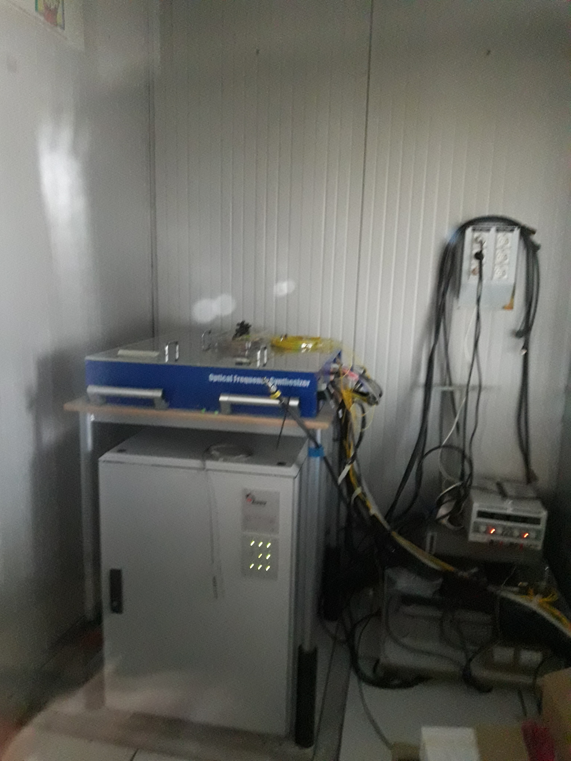
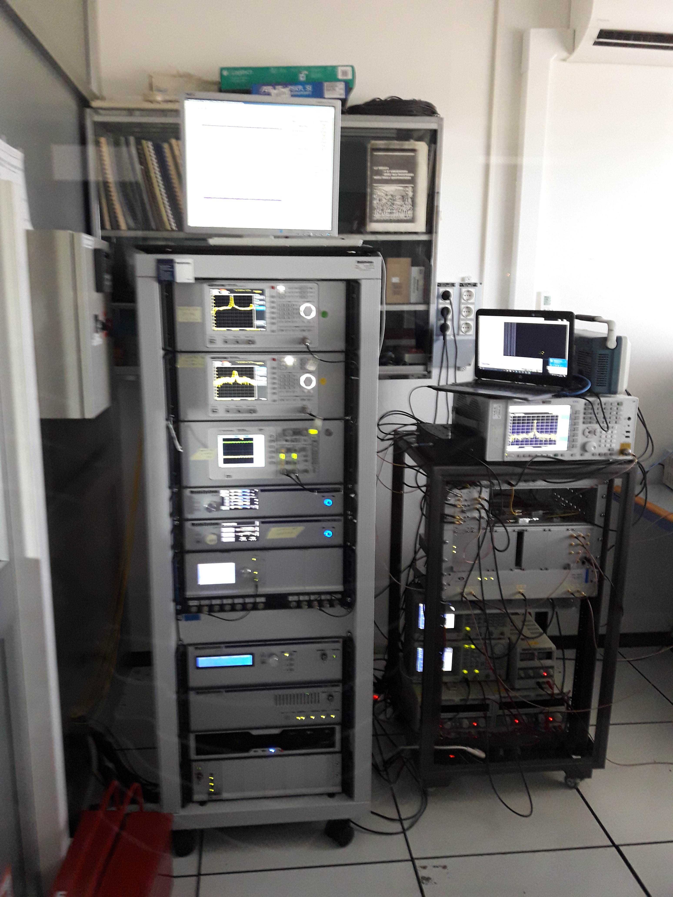
Comb + H-maser
Comb control rack

Slide 7
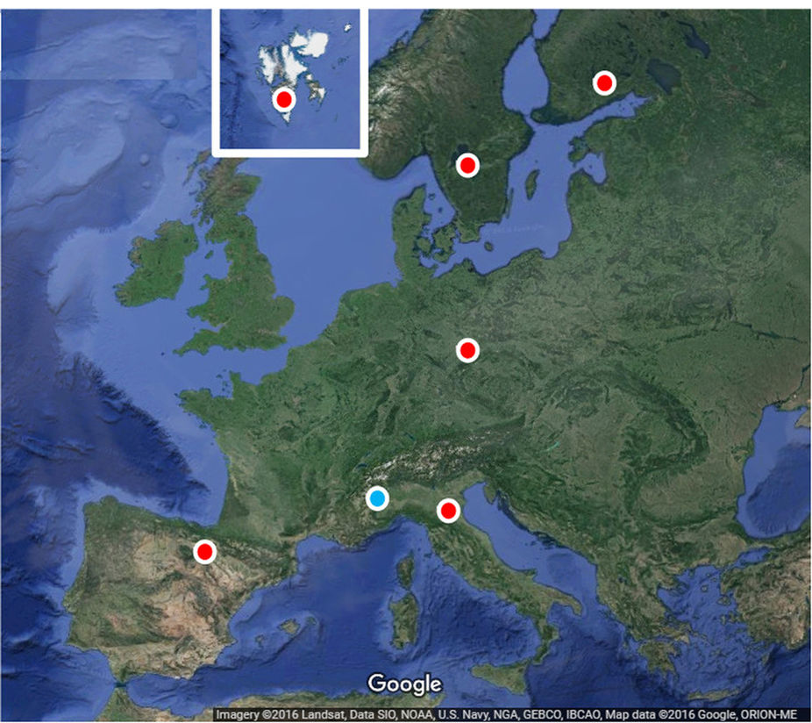
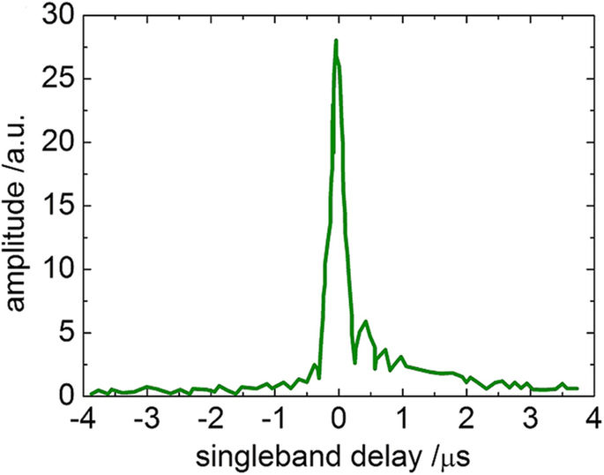
EUR137
European Geodetic VLBI exp: 24 hours in SX bands on Sep 7-8 2015
Aim: tectonic studies on the European plate
6 stations involved: DSS65A, Mh, Ny, On, Wz + Mc (in tag-along mode)
Data correlated using Bonn DiFX correlator (by A. Bertarini and T. Artz) treating Medicina (local clock) and MEDILIFT (remote clock) as separate experiments
Fringe fitting in HOPS fourfit → Calc/SOLVE/nuSolve used for analysis
Results: Clivati et al. 2017

Slide 8
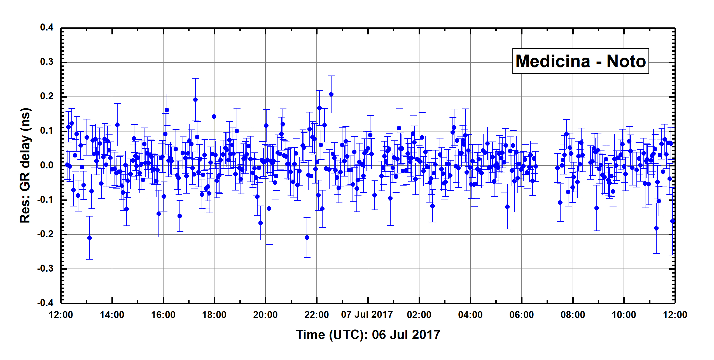
VITA004
Date: July 6-7, 2017
Precursors: VITA001…003 (tests of VLBI ITA network w/ local clocks)
Aim: remote clock infrastructure testing on 24-hr S/X-band geodetic exp
Stations involved: Ma, Nt, Mc (24 hrs w/ remote clock link on)
Data correlated using Bologna DiFX correlator by M. Stagni and RR
Fringe fitting in HOPS fourfit and analysis with CALC/SOLVE/nuSolve
→problems: a few link unlocks sanitized in post-processing
unlocks
Mc-Nt baseline Wrms= 56 ps. Full exp Wrms = 46 ps

Slide 9
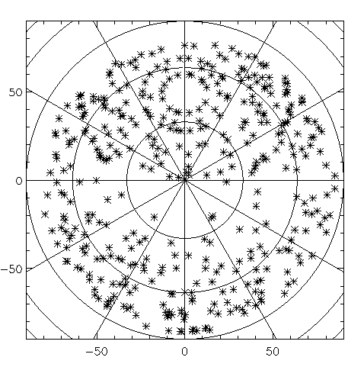
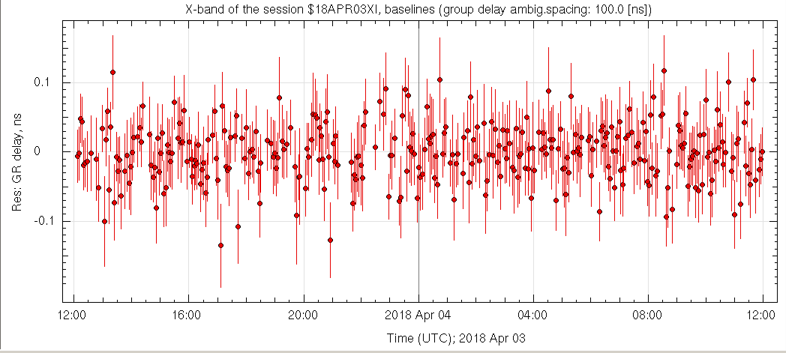
VITA005 (Apr 2018)
Standard geodetic S/X experiment with Mc, Nt, Ma (Mc with Turin remote clock)
N
W
E
Group delay wrms = 37.1 ps
96 parameters adjusted
338 /402 obs pairs used
S
Sky coverage

Slide 10
VLBI Clock Timing (VT exp’s)
Night time observations, possibly in Winter season ➔ min atm instability
Bright geodetic standard calibrator ➔ point-like source
Observing at medium/high telescope elevations ➔ min air mass
Long scan lenghts (~15 min) in 3 hr long runs
Rms phase noise statistics used to estimate clock synchronization
Reference project: Krehlik et al. (2017)
Date stations Band Mc remote clock?
VT001 2018 Jan 18th Mc, Nt, Ma, Ys, Mh S/X No
VT003 2018 Jan 24th Mc, Nt, Tr C No
VT005 2018 Feb 19th Mc, Nt, Tr C No
VT006 2018 Feb 20th Mc, Nt, Tr, Ys C Yes

Slide 11
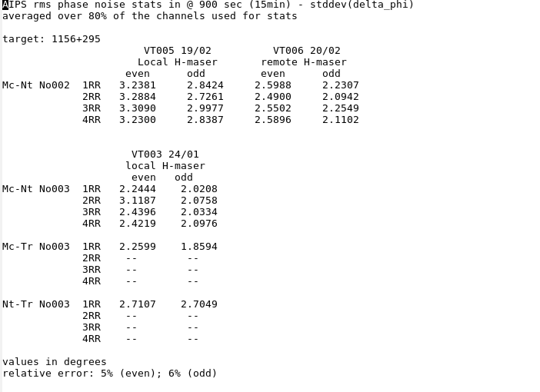
VT experiments (II)
Sampling rate: 1 sec
Even stats: 450 couples
(ph2-ph1, ph4-ph3, etc.)
Odd stats: 300 triplets
(ph2-(ph3+ph1)/2, etc.)
IF1: 4.9745 GHz
IF2: 4.9825 GHz
IF3: 4.9905 GHz
IF4: 4.9985 GHz
IF BW: 8 MHz
32 ch in each IF
No good data
Scheduling problems

Slide 12
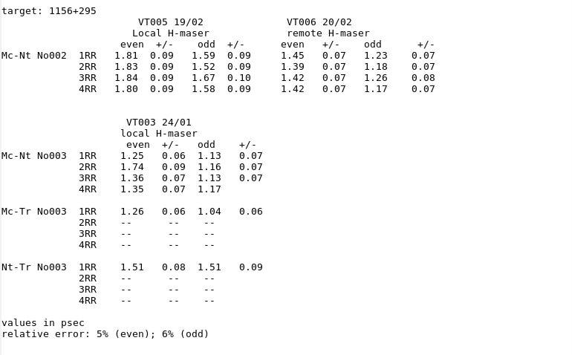
VT experiments (III)
Time synch between clocks within
1-2 psec
Good agreement with Krehlik’s results on same time scales
Similar stability to VITA004 with
Allan deviation at 1 sec
Similar stats for remote and local H-maser clock in Mc
“Even” stats systematically larger
than “odd” ones

Slide 13
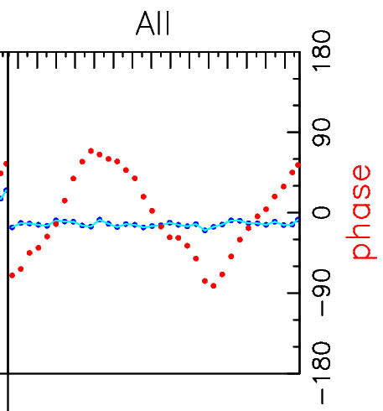
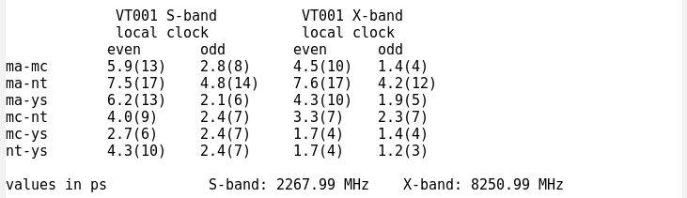
VT experiments (IV)
HOPS Fourfit analysis on VT001
Scan length: 900 seconds
Time averaging: 22 seconds
All IFs averaged together
RR pol’n only
Ma-Mc
X-band
Scan: 0417

Slide 14
Conclusions
LIFT is an infrastructure to deliver frequency standard signal from the Italian metrological Institute (INRIM) to remote locations via optical fiber link with unprecedented stability (order of 10⁻¹⁹)
Geodetic VLBI experiments are performed with remote frequency standard provided by INRIM with ten’s of ps wrms residuals in group delay: on par with exp’s utilizing local clocks
Rms interferometric phase noise statistics was succesfully used in remote and local clock timing with radio/geo VLBI technique

Slide 15
Future developments
Common clock experiment: Medicina and Matera receive remote clock frequency standard from Turin via optical fiber: comb in Matera, fiber optic infrastructure ready ➔ first experiment next winter

Slide 16
Future developments
Common clock experiment: Medicina and Matera receive remote clock frequency standard from Turin via optical fiber: comb in Matera, fiber optic infrastructure ready ➔ first experiment next winter
Optical clock comparison between Japan’s NICT and Italy’s INRIM via VLBI:
Japanese MARBLE small (2.4-m ) antennas ( one in Medicina -> INRIM and one in Koganei -> NICT) observing with 34-m antenna in Kashima hopefully this fall

Slide 17
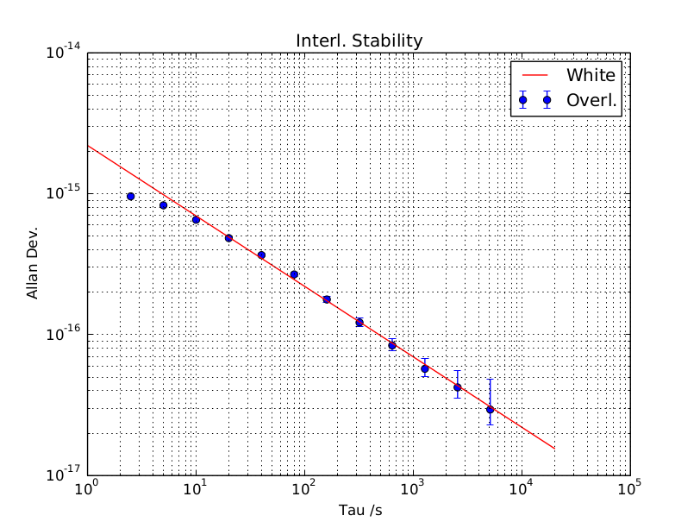
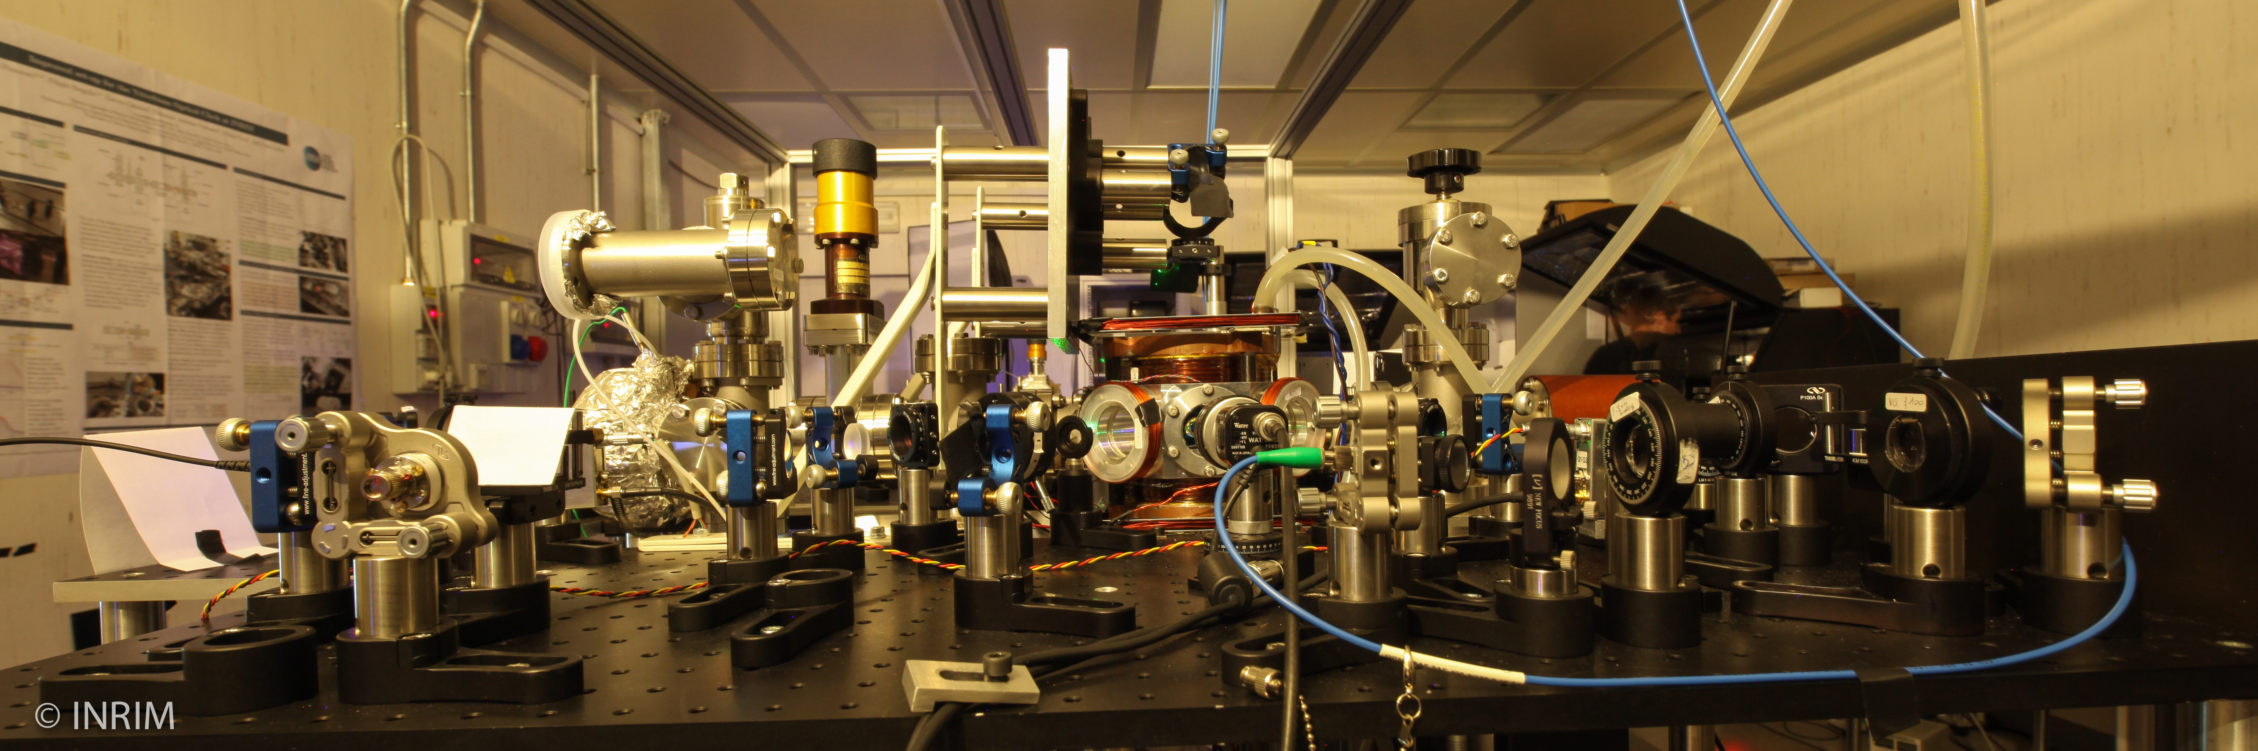
INRIM Optical Clock
Ytterbium neutral-atom optical clock
Transition at 578 nm
Stability at 6 x 10⁻¹⁷ (at 1000 sec)
Will be used for studies on relativistic gravitational potential

Slide 18
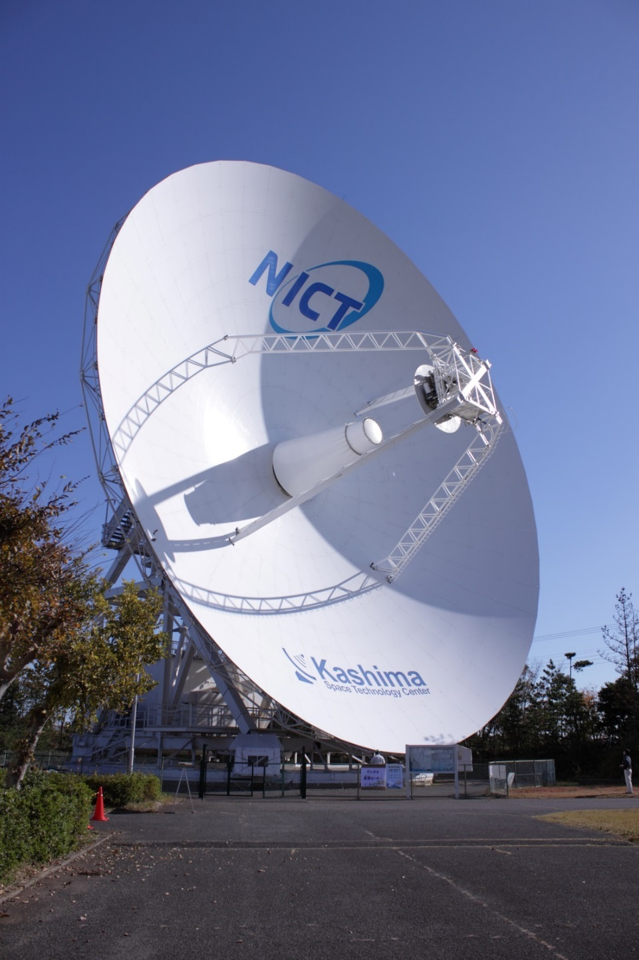
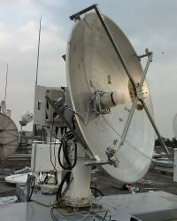
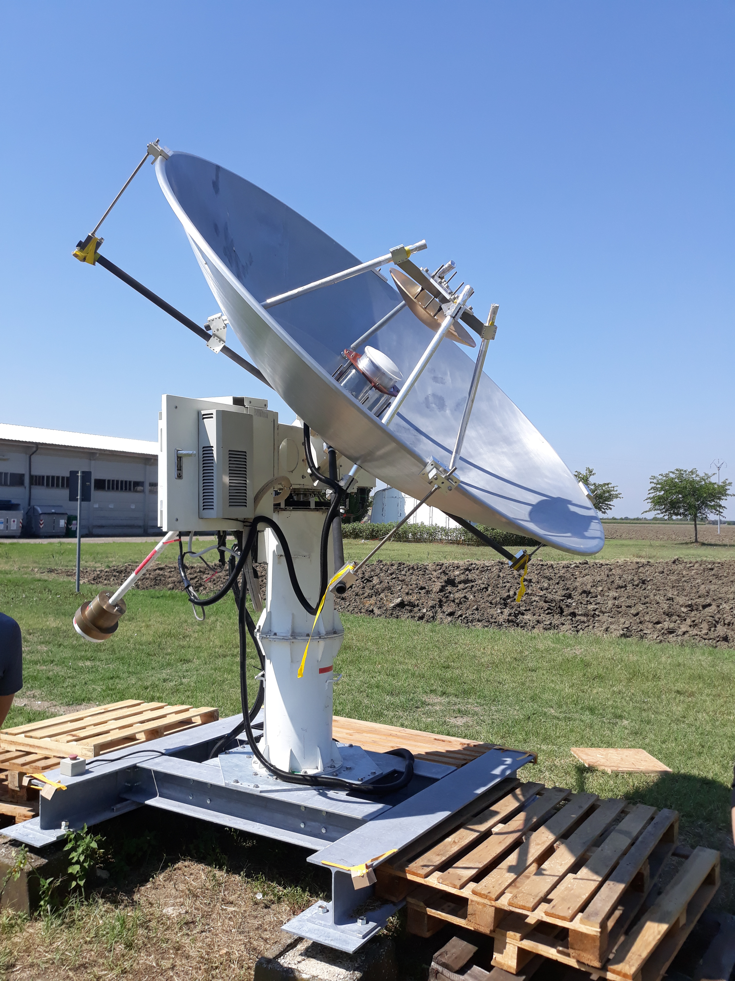
MARBLE antennas: broadband system
Kashima 34m
MARBLE-1 2.4m (Medicina)
MARBLE-2 2.4m (Koganei)
NINJA FEED (3-15 GHz) and direct sampling (no Local Oscillator)

Slide 19
Future developments
Common clock experiment: Medicina and Matera receive remote clock frequency standard from Turin via optical fiber: comb in Matera, fiber optic infrastructure ready ➔ first experiment next winter
Optical clock comparison between Japan’s NICT and Italy’s INRIM via VLBI:
Japanese MARBLE small (2.4-m ) antennas ( one in Medicina -> INRIM and one in Koganei -> NICT) observing with 34-m antenna in Kashima hopefully this fall
ASI collaboration: receiving carrier signal from interplanetary space probe. VLBI experiment Mc-Nt or Mc-Ma. Mark5B/VDIF -> RDEF -> ΔDOR (Differential One-way Ranging)
Possible future VLBI timing experiment between Medicina/Turin and Polish Torun/KM-FAMO optical clocks
Testing of White Rabbit/Precise Time Protocol technology for digital dissemination of frequency standard and clock synchronization

Slide 20
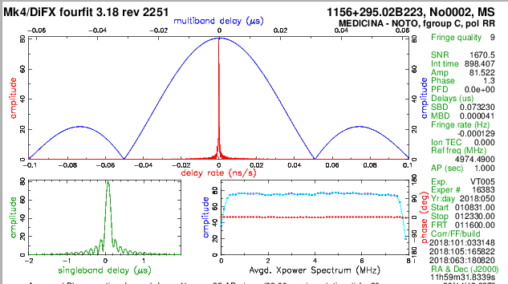
Thank you!

