Slide 1
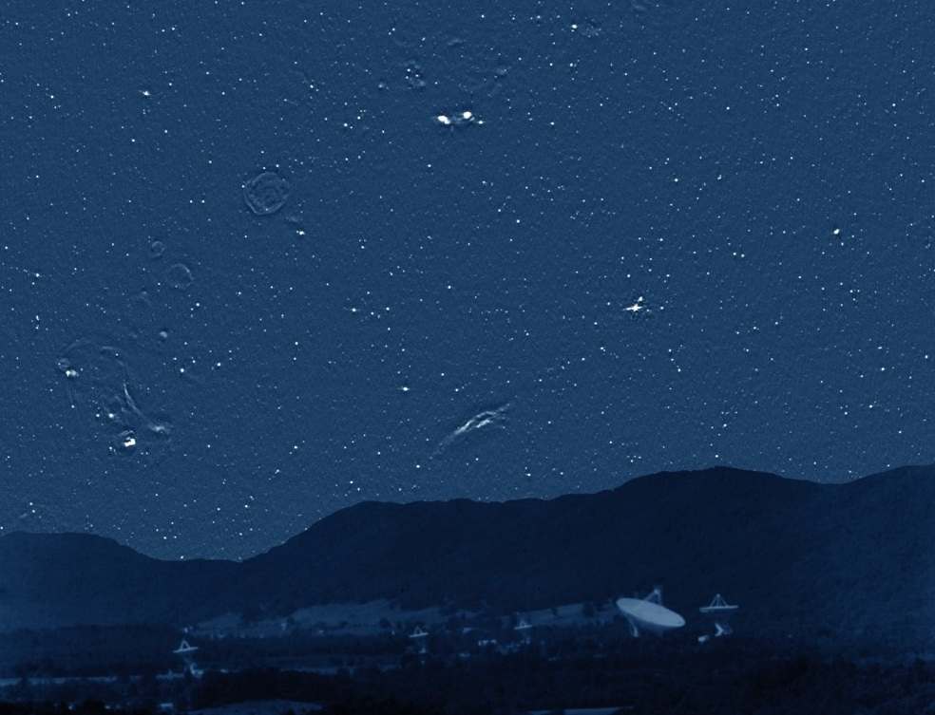
Instead of “Extragalactic wide-field surveys using the EVN” by Jack Radcliffe, you will hear the first results of his PhD research, presented by one of his supervisors …
Peter Barthel, on behalf of JR, Michael Garrett, Tom Muxlow. and Rob Beswick

Slide 2
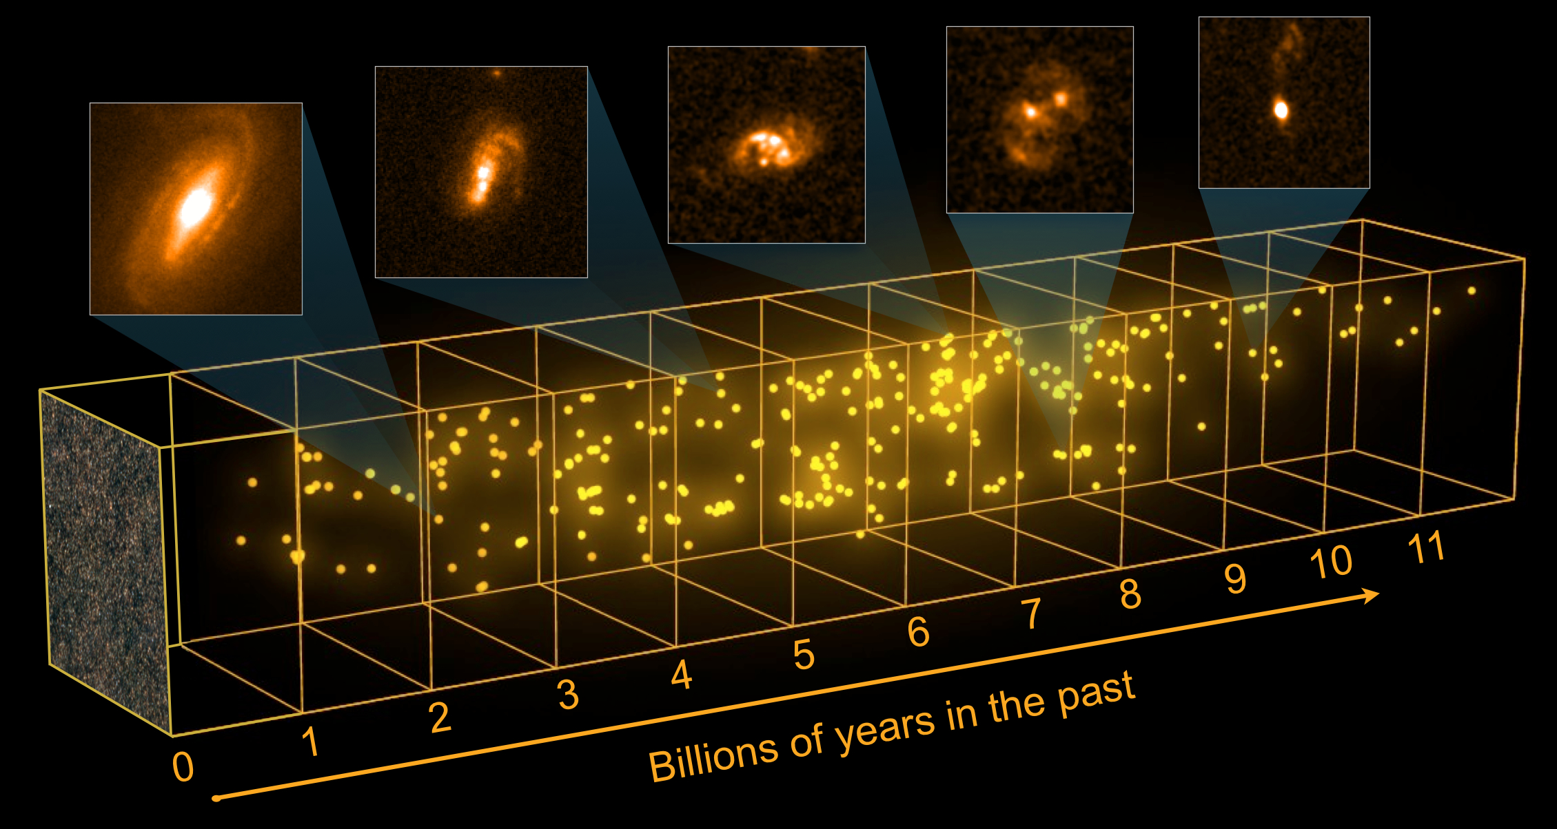
As inferred from Spitzer and Herschel: SF is strongly obscured at high z.
Wish to know SFR(z) and AGN(z)

Slide 3
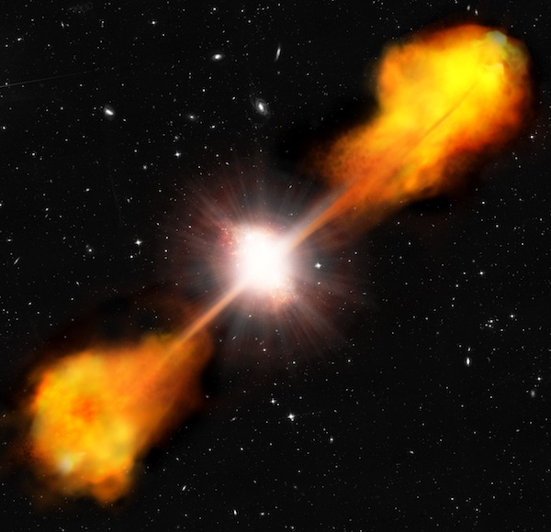
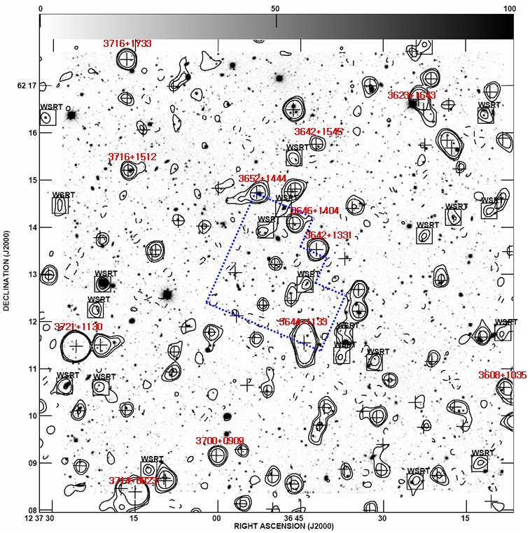
3a. Initial results from GOODS-N: Radio properties
Radio source populations
3C monster AGN: ~one per 10x10degree field (>10Jy)
NVSS source (>2.5mJy): ~one per 10x10arcmin field
GOODS-N VLA survey: ~2 radio sources per square arcmin (>2.5uJy), but what are they – AGN, starbursts, hybrid systems?
NB. Chandra detects ~1 X-ray source per square arcmin in GOODS-N. Chance that ultra-faint radio source has X-ray’s is ~1/3; chance that X-ray source has radio is ~1/2.
06/06/2018 – NRAO, NM, USA
Jack Radcliffe

Slide 4
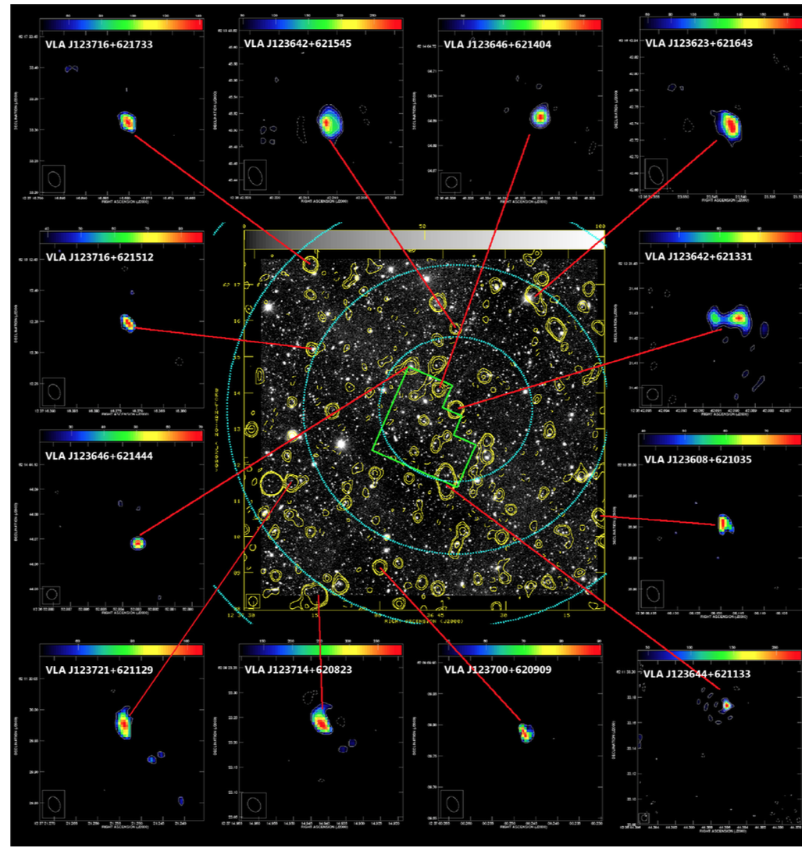
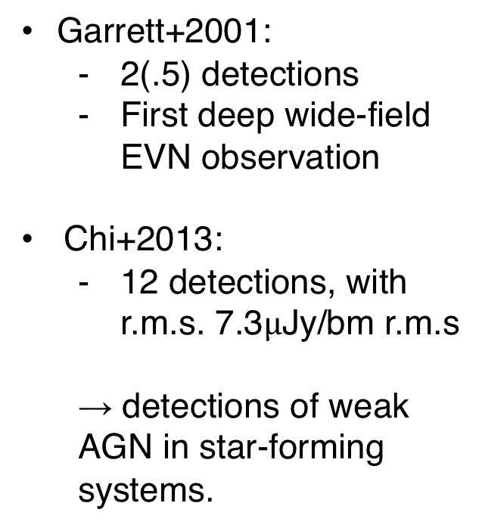
Previous GOODS-N
WF-VLBI surveys
(Garrett+01, Chi+13)
Garrett+2001:
  2(.5) detections
  First deep wide-field EVN observation
Chi+2013:
  12 detections, with r.m.s. 7.3$μ$Jy/bm r.m.s
  → detections of weak AGN in star-forming systems.
Seungyoup Chi, Barthel, Garrett 2013

Slide 5
And today…
(Radcliffe+18, in press)
EVN
24hrs, 1.6GHz
31 sources in 0.5 sq. degree, with uniform sensitivity of 10uJy
VLBI uncovers accretion driven radio cores over redshifts 0.1-3.5
06/06/2018 – NRAO, NM, USA
Jack Radcliffe

Slide 6
3a. Initial results from GOODS-N: Radio properties
Radio luminosities
(Radcliffe+18, in press)
06/06/2018 – NRAO, NM, USA
Jack Radcliffe

Slide 7
3a. Initial results from GOODS-N: Radio properties
GOODS-N is a well-studied field
06/06/2018 – NRAO, NM, USA
Jack Radcliffe

Slide 8
Key question
(Radcliffe+18 in prep.)
How well does VLBI perform, compared to other AGN classification techniques?
06/06/2018 – NRAO, NM, USA
Jack Radcliffe

Slide 9
3b. Initial results from GOODS-N: Testing AGN classifiers
AGN diagnostics I: Mid Infra-red
Star-forming galaxies dip between 1.6 μm (stellar bump) and long-wavelength emission (star-formation heated dust)
Dust near AGN reach T ~ (1-1.5)x10³ – radiate into IR band
Correlated with AGN luminosity (red to purple)
Donley+2012
06/06/2018 – NRAO, NM, USA
Notes:
The premise behind IRAC AGN selection is illustrated in Figure 1, where we plot composite AGN + starburst spectral energy distributions (SEDs) constructed using the QSO1 and M82 templates of Polletta et al. (2008). The SEDs of normal star- forming galaxies display a prominent dip between the 1.6 μm stellar bump and the long-wavelength emission from star- formation-heated dust (Tdust ∼ 25–50 K). Dust near an AGN’s central engine, however, can reach a sublimation temperature of Tdust ∼ 1000–1500 K and thus radiate into the near-infrared. If the AGN is sufficiently luminous compared to its host galaxy, the superposition of blackbody emission from the AGN-heated dust will fill in the dip in the galaxy’s SED and produce a red, power-law-like thermal continuum across the IRAC bands.
Composite SEDs constructed using the QSO1 and M82 templates of Polletta et al. (2008), scaled to give 1–10 μm AGN contributions of 0% (red in the online journal) to 95% (purple in the online journal). The final SEDs have been normalized at 1.6 μm. In the lower panel, we apply an extinction of AV = 2 to the QSO1 SED using the Draine (2003) extinction law. The four IRAC bands at z = 0 are shaded. While lum

Slide 11
3b. Initial results from GOODS-N: Testing AGN classifiers
AGN diagnostics I: Mid Infra-red
Placeholder for irac color color
Include mrk231
06/06/2018 – NRAO, NM, USA
Jack Radcliffe

Slide 12
3b. Initial results from GOODS-N: Testing AGN classifiers
AGN diagnostics I: Mid Infra-red
06/06/2018 – NRAO, NM, USA
Jack Radcliffe

Slide 13
AGN diagnostics II: X-rays
06/06/2018 – NRAO, NM, USA
Jack Radcliffe

Slide 14
3. Initial results from GOODS-N
Nota bene …
Chandra does not detect the 5mJy WAT FRI radio galaxy in GOODS-N, nor the hybrid system GN16 (submm galaxy) …
GN16 host - HST
06/06/2018 – NRAO, NM, USA
Jack Radcliffe

Slide 15
3b. Initial results from GOODS-N: Testing AGN classifiers
AGN diagnostic II: Relation to host galaxies?
06/06/2018 – NRAO, NM, USA
Jack Radcliffe

Slide 16
3b. Initial results from GOODS-N: Testing AGN classifiers
AGN diagnostic III: Radio-excess
82% radio excess
Bolometric IR luminosity preferred but require Herschel to constrain!
Lunch Talk – NRAO, NM, USA
Jack Radcliffe
06/06/2018 – NRAO, NM, USA
Lunch Talk – NRAO, NM, USA

Slide 17
3b. Initial results from GOODS-N: Testing AGN classifiers
Take-away messages
VLBI uncovers accretion-driven radio sources in galaxies of all types.
These include:
  AGN in optically obscured, Compton thick galaxies that escape X-ray detection.
  Low-power FR-I radio galaxies w/o X-rays that escape X-ray detection.
  Low power, dust poor FR-I radio galaxies that escape IR color-color selection.
However, what about the X-ray point source AGN from distant radio-quiet sources (radio emission <uJy) ?!?
06/06/2018 – NRAO, NM, USA
Jack Radcliffe

Slide 18
3. Initial results from GOODS-N
Radio-silent AGN?
Stacking the radio emission of radio-undetected X-ray AGN in GOODS-N, yields a nice signal of just over 1uJy. As also confirmed by the e-MERLIN study, the radio structures tend to be larger at lower strength: we are observing the star-forming hosts of truly radio-quiet AGN. The radio-FIR correlation agrees.
Jack Radcliffe

Slide 19
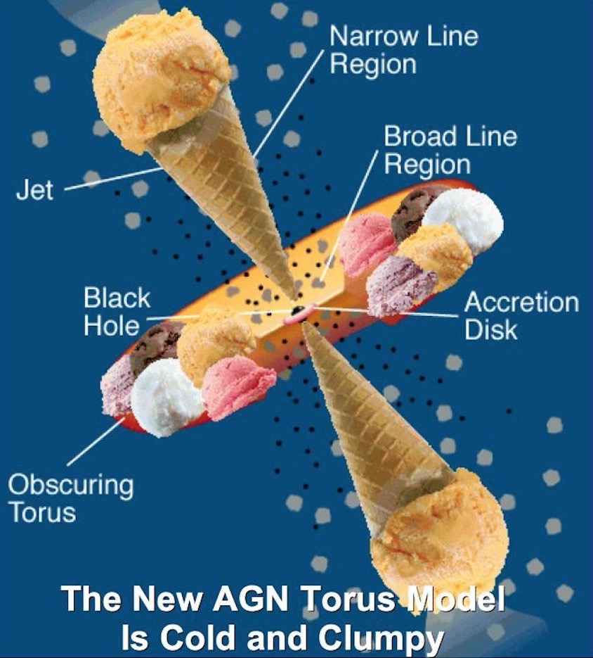
4. What next?
Final take-away message
To be enjoyed in the Granada sun !
Lunch Talk – NRAO, NM, USA
Jack Radcliffe
06/06/2018 – NRAO, NM, USA
Lunch Talk – NRAO, NM, USA

