Slide 1
Magnetic Field measurements around massive young stellar objects with the EVN
Gabriele Surcis
INAF - OACagliari
Collaborators:
W.H.T. Vlemmings (Chalmers Uni, Sweden); H.J. van Langevelde (JIVE, the Netherlands); B. Lankhaar (Chalmers Uni, Sweden) B. Hutawarakorn Kramer (MPIfR/NARIT, Germany/Thailand); A. Bartkiewicz (Nicolaus Copernicus Uni, Poland); et al., J.M. Torrelles (CSIC, Spain); J.-S. Kim (NAOJ, Japan); S.-W. Kim (KASI, Republic of Korea);
14th EVN Symposium – Granada 8-11 October 2018 Gabriele Surcis - 8th October 2018

Slide 2
Outline
Introduction
magnetic field in massive star formation
6.7-GHz methanol masers & 22-GHz water masers
Methanol Maser: the Flux-limited sample
magnetic field total sample: updated statistical results
magnetic field total sample: field strength
Water Maser: W75N EVN monitoring project
A long story*
Results after second epoch
Conclusions & Follow-ups
*made short here
14th EVN Symposium – Granada 8-11 October 2018 Gabriele Surcis - 8th October 2018

Slide 3
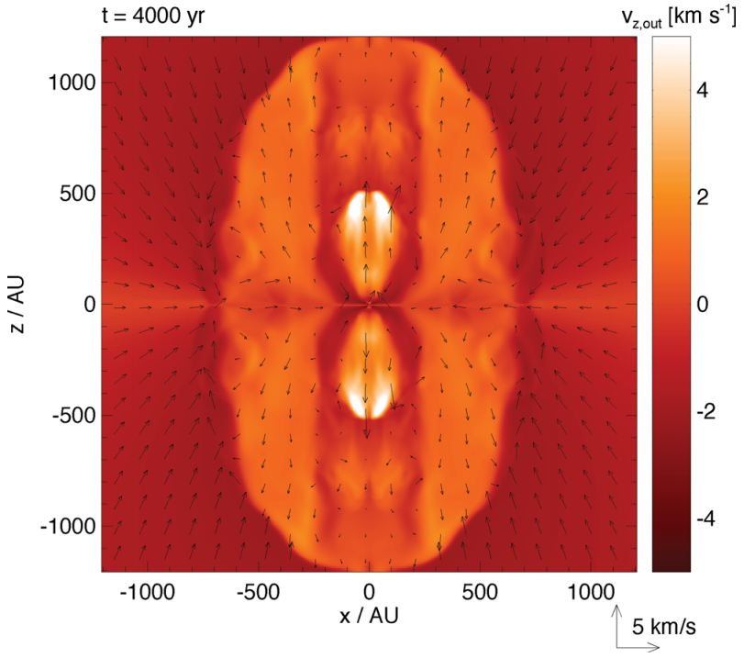
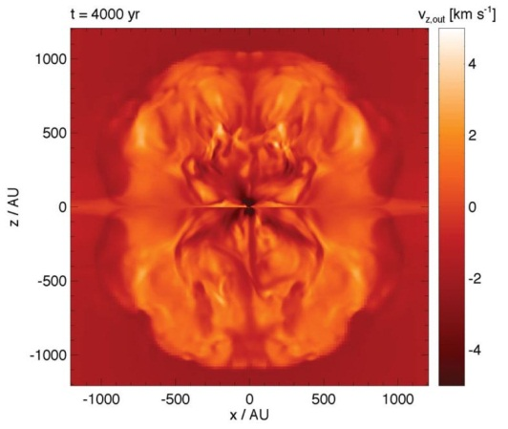
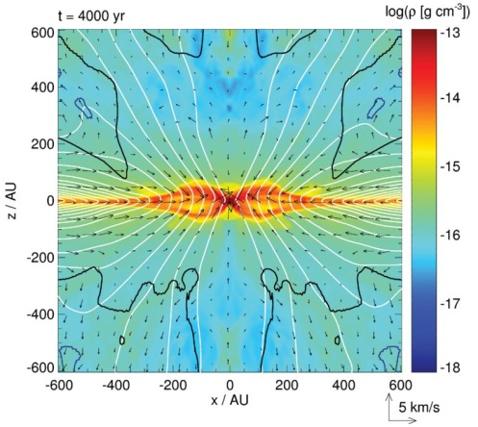
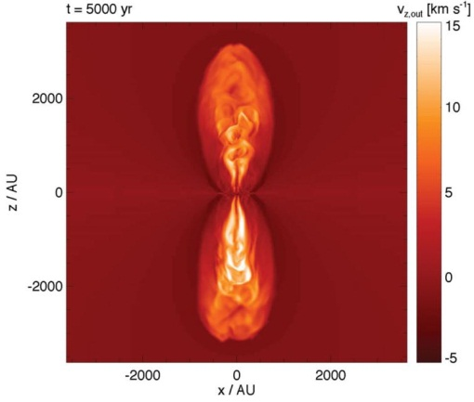
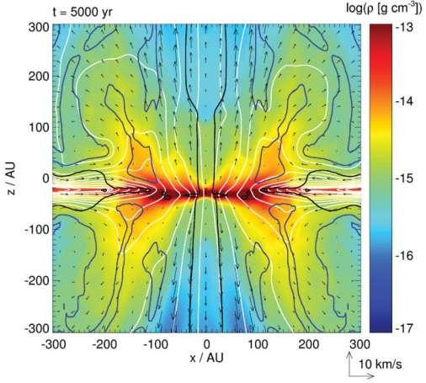
Introduction: B in massive star formation
MHD simulations
Seifried et al. 2012, MNRAS, 422, 347
strong initial
magnetic field intensities
(µ=5)
low initial
magnetic field intensities
(µ=20-120)
slow & poorly collimated
outflows
fast & collimated
outflows
After the formation of a Keplerian disk (µ=10.4)
14th EVN Symposium – Granada 8-11 October 2018 Gabriele Surcis - 8th October 2018

Slide 4
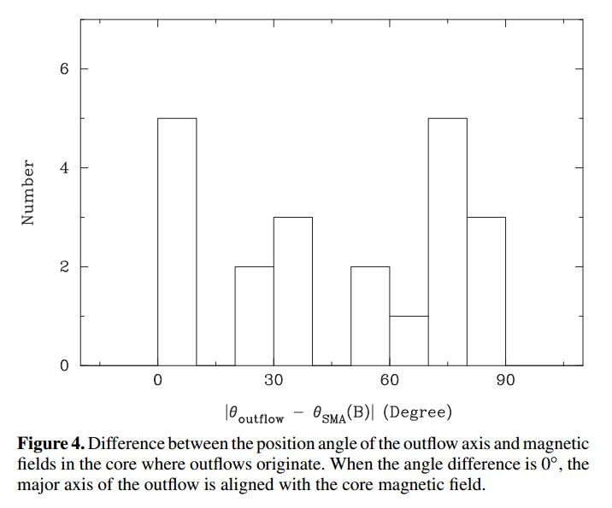
Introduction: B in massive star formation
Zhang et al. 2014
based on 21 sources (SMA obs; ̴2’’)
no correlation between outflows and B
Zhang, Q. et al. 2014, ApJ, 792, 116
14th EVN Symposium – Granada 8-11 October 2018 Gabriele Surcis - 8th October 2018

Slide 5
Introduction: masers
Polarized emission of dust infers only large scale B-field (>> 1000 AU)
BUT
We need high-density, small scale B-field tracer (10 - 1000 AU)
masers
14th EVN Symposium – Granada 8-11 October 2018 Gabriele Surcis - 8th October 2018

Slide 6
Introduction: masers
Masers are bright and have narrow spectral lines
Frequency
(GHz)
Density
(cm⁻³)
P_{l}
(%)
P_{V}
(%)
OH
non-paramagnetic molecules
ΔV_{z} < linewidth
small foreground Faraday rotation (<10º)
<20
CH₃OH
22
10⁸ < n_{H2} < 10¹⁰
<1
H₂O
6.7
10⁷ < n_{H2} < 10⁹
<12
<1
protostar
large foreground Faraday rotation
1.6/1.7
n_{H2} < 10⁸
<100
<100
14th EVN Symposium – Granada 8-11 October 2018 Gabriele Surcis - 8th October 2018

Slide 7
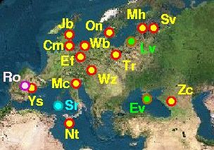
Methanol masers: observations
European VLBI Network (EVN)
Flux limited sample (total = 133 hours)
Pestalozzi et al (2005): catalogue of 6.7-GHz methanol masers
Declination > -9º; Flux_{single-dish} > 50 Jy
(total number of sources = 31)
11 massive star-forming regions observed from 2008 and 2011
+
19 massive star-forming regions observed from 2012 and 2015
25 sources analysed so far
(Surcis et al., 2009, 2011, 2012, 2013, 2014, 2015, 2018 in prep.)
14th EVN Symposium – Granada 8-11 October 2018 Gabriele Surcis - 8th October 2018

Slide 8
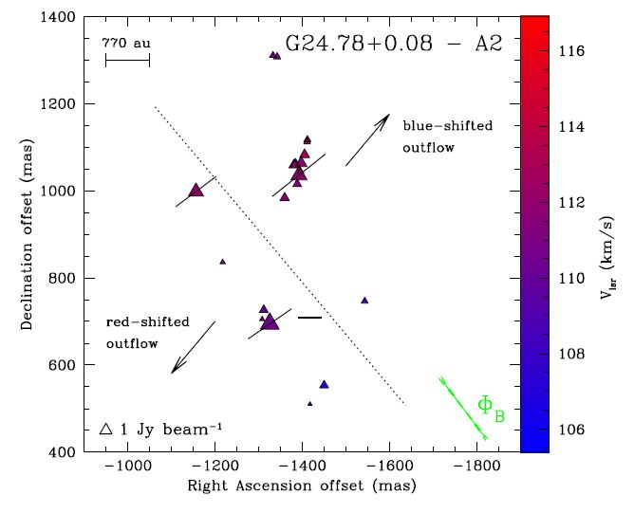
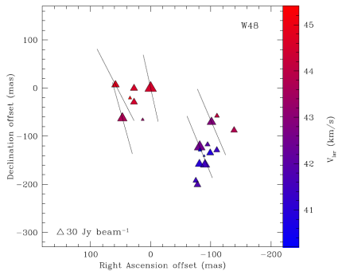
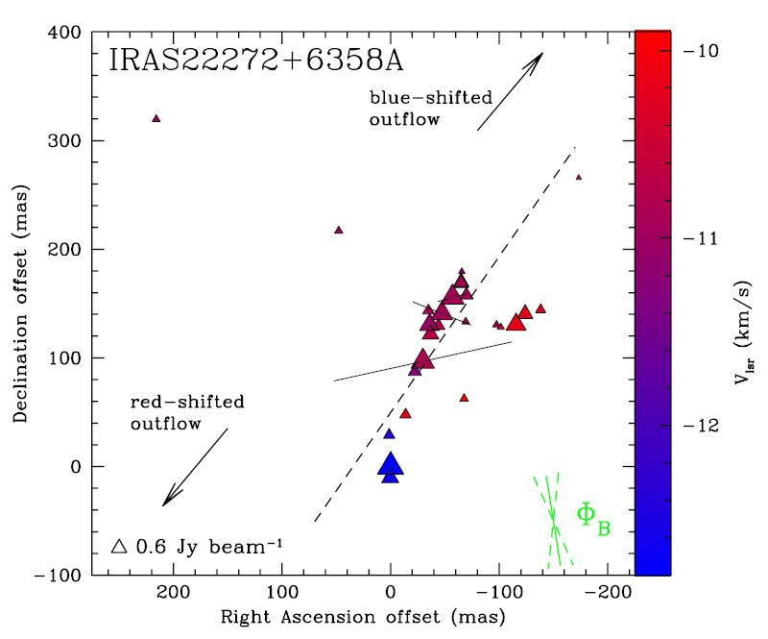
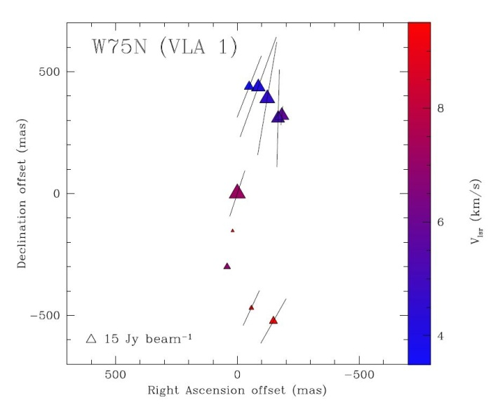
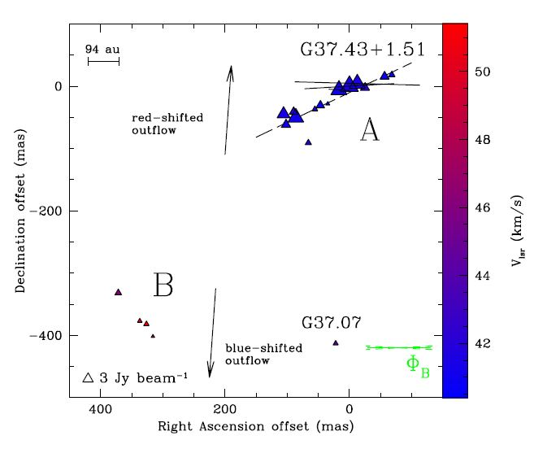
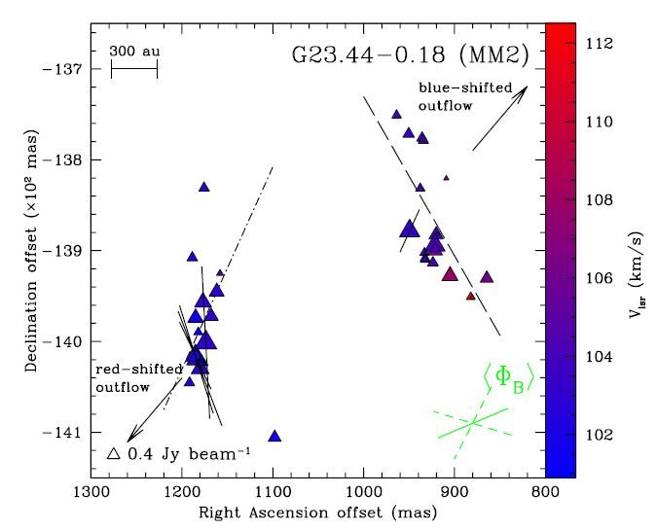
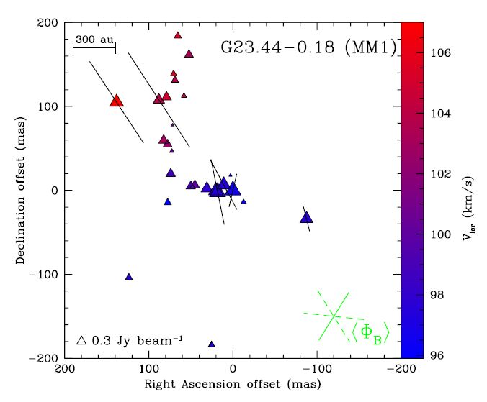
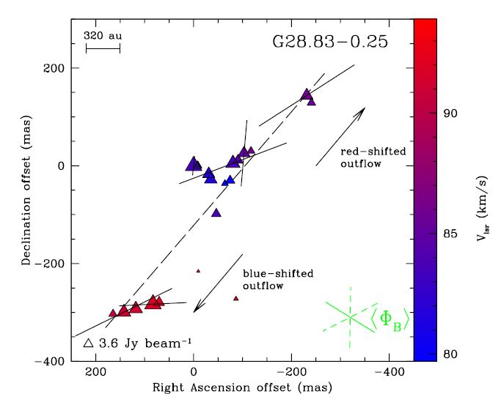
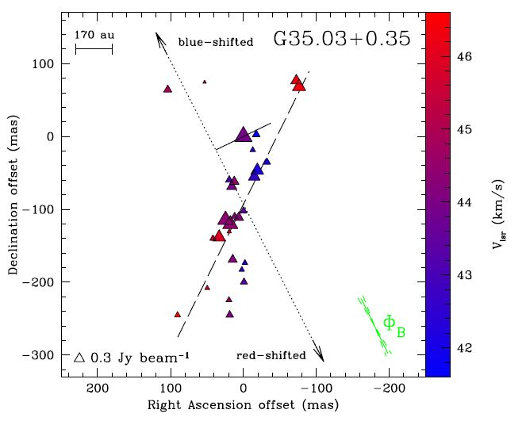
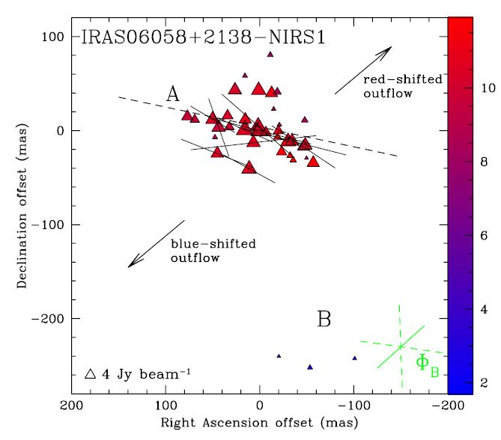
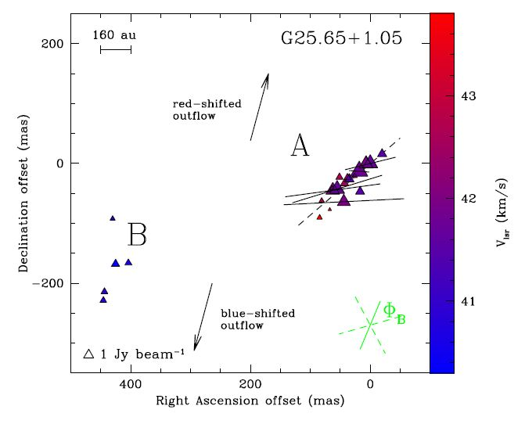
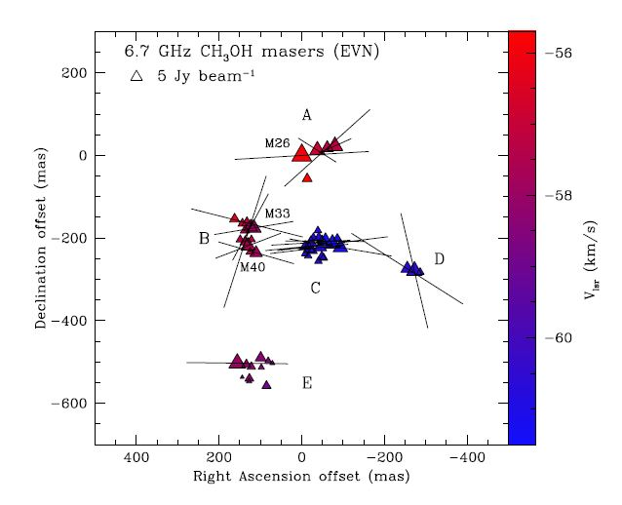
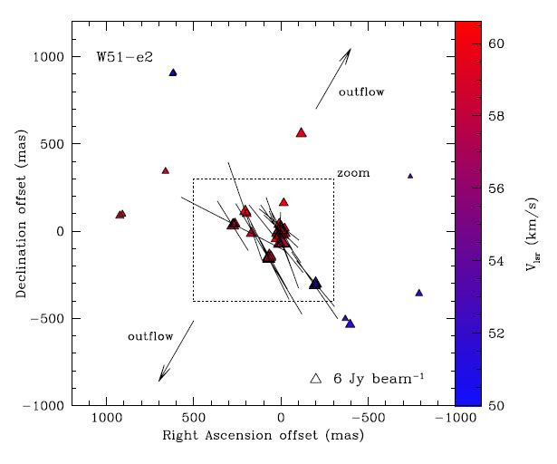
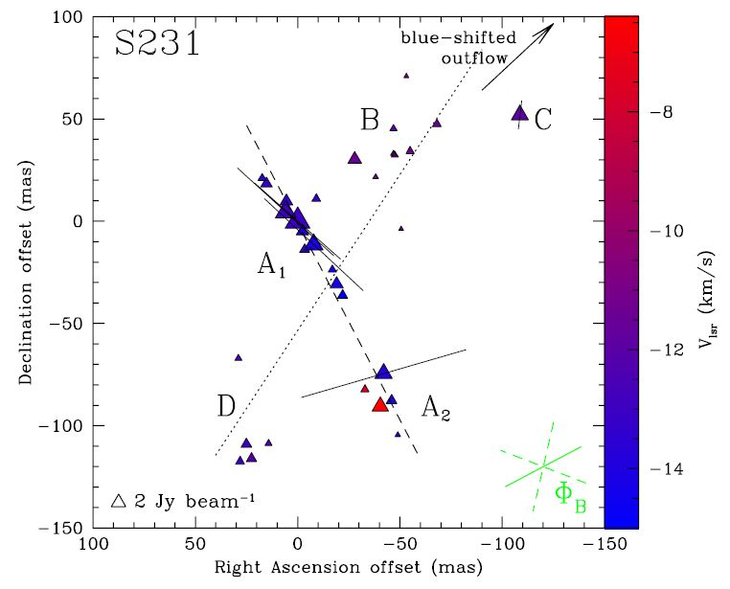
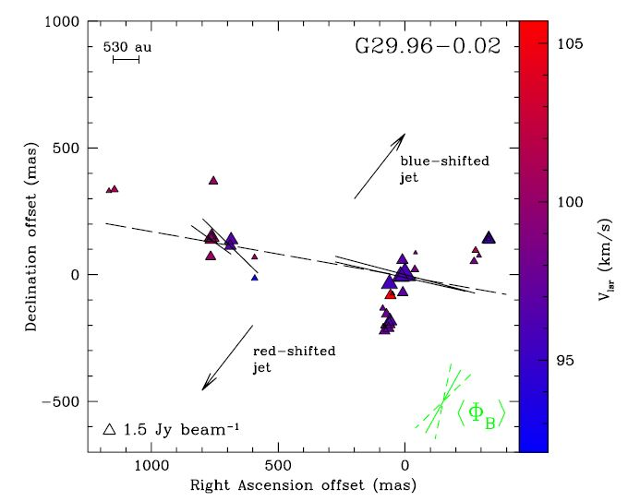
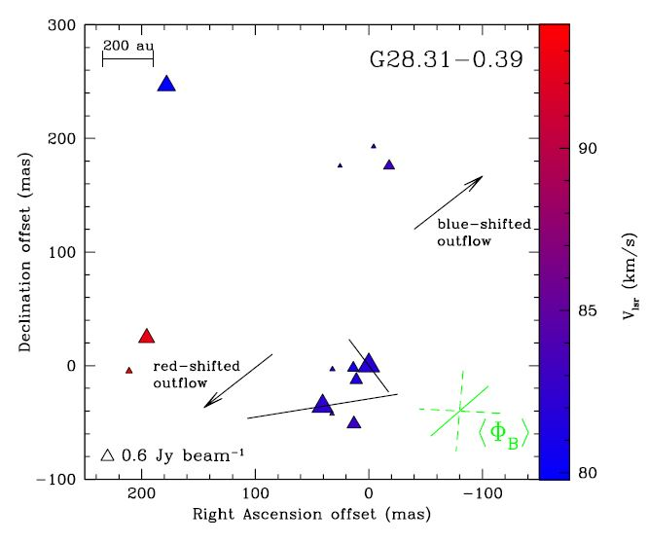
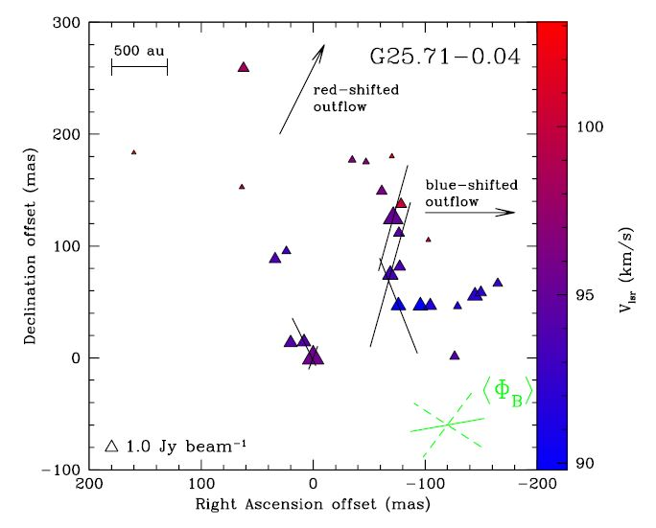
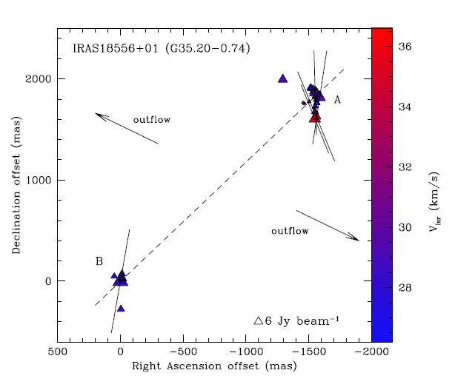
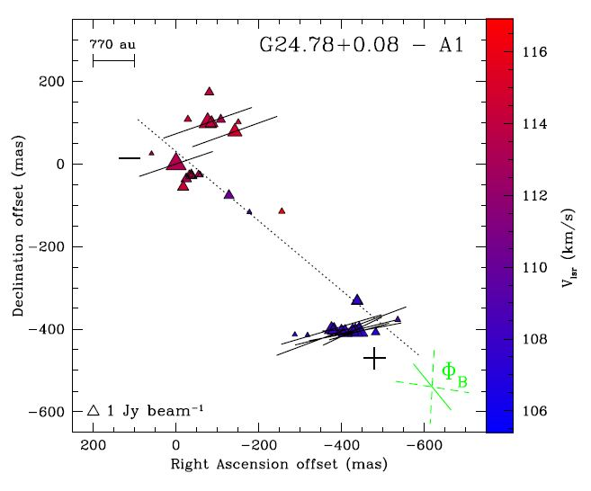
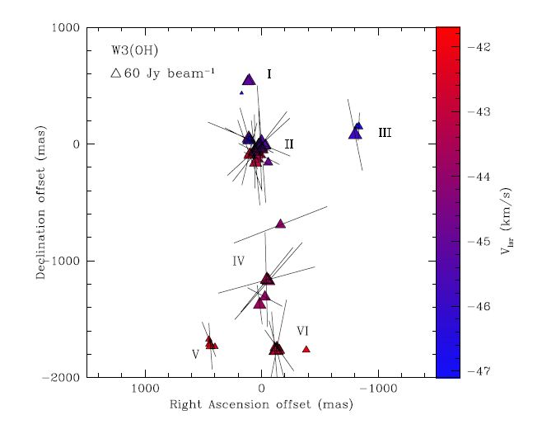
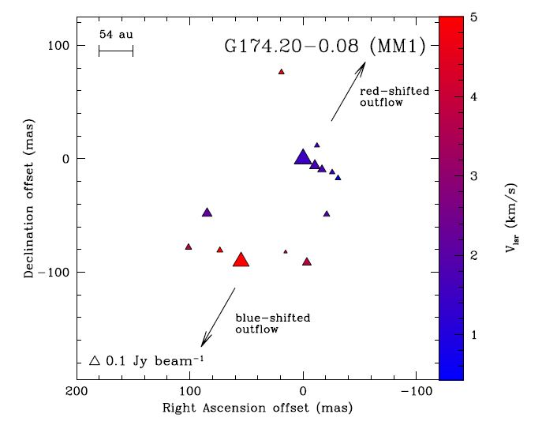
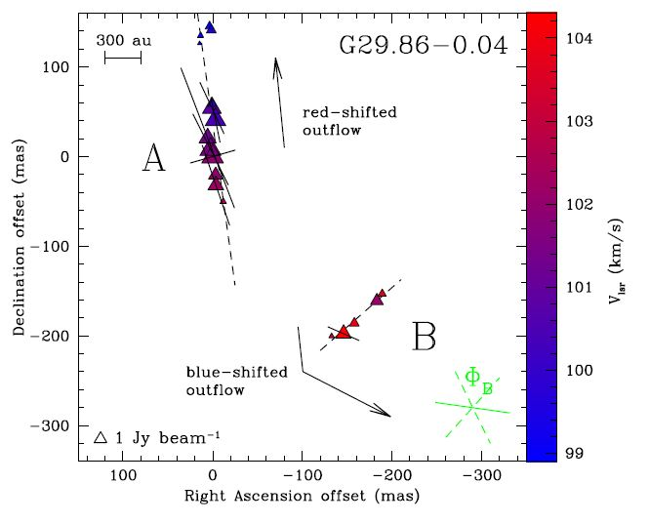
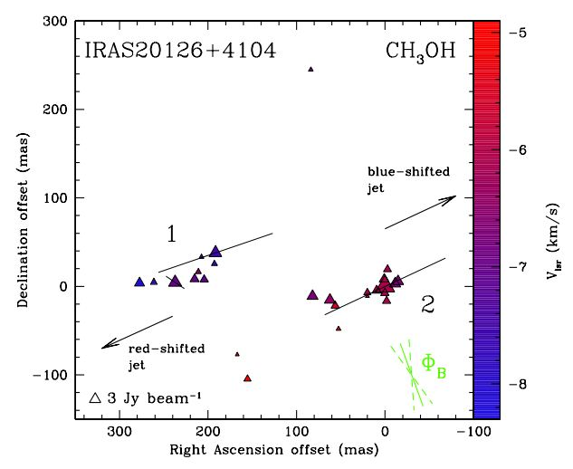
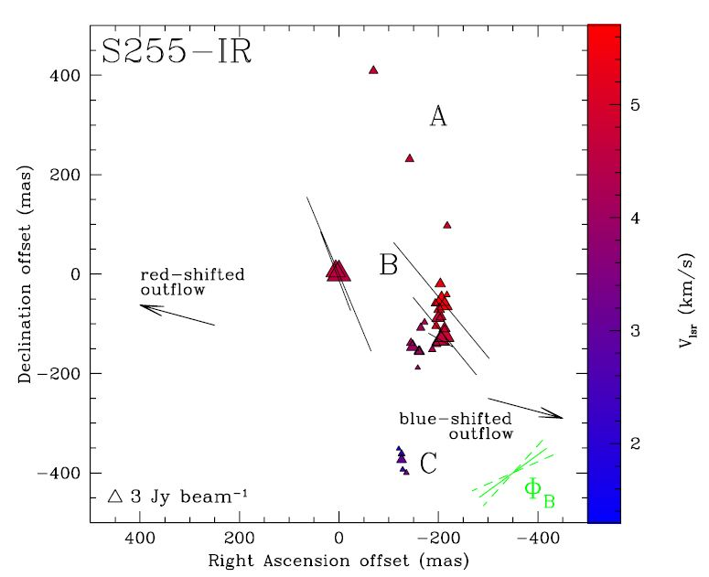
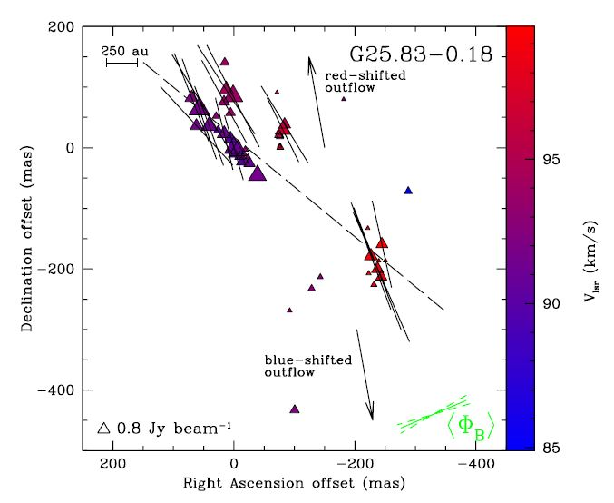
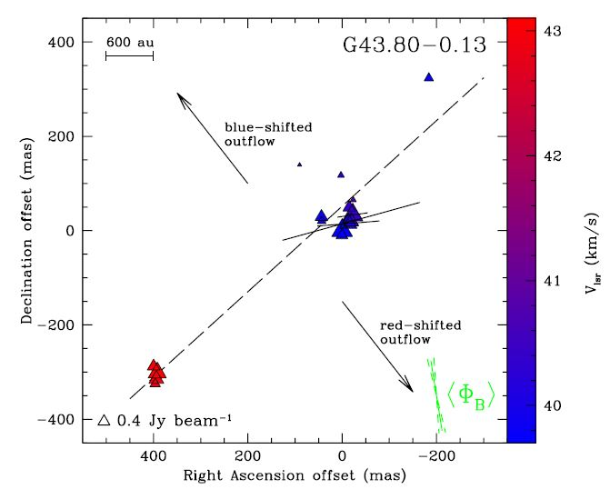
Methanol masers: results
14th EVN Symposium – Granada 8-11 October 2018 Gabriele Surcis - 8th October 2018

Slide 9
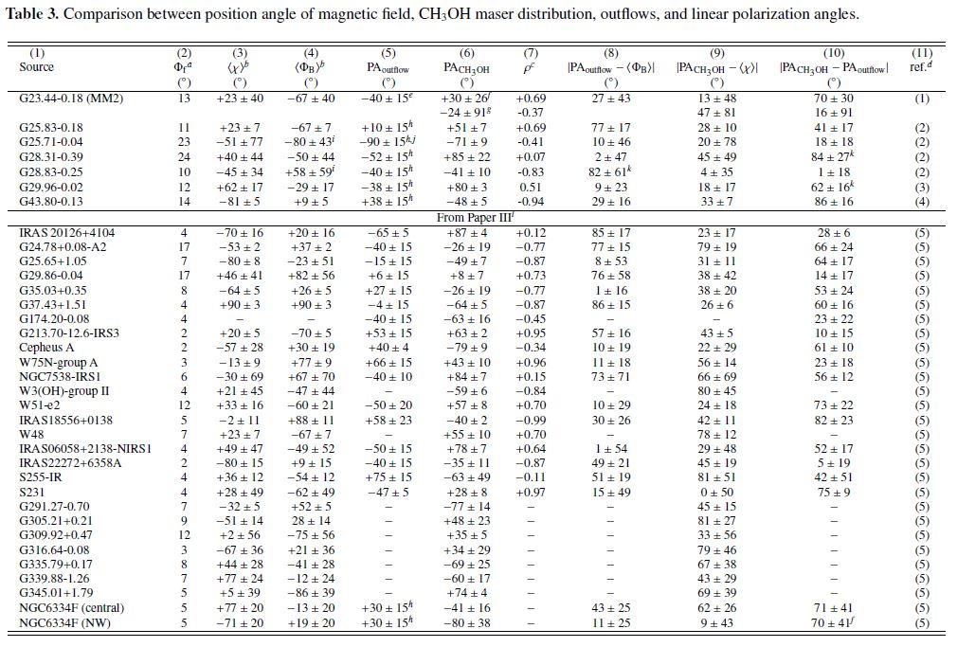
Methanol masers: updated statistics
Surcis et al. 2018, in prep.
Paper III : Surcis et al. 2015, A&A, 578A,102
14th EVN Symposium – Granada 8-11 October 2018 Gabriele Surcis - 8th October 2018

Slide 10
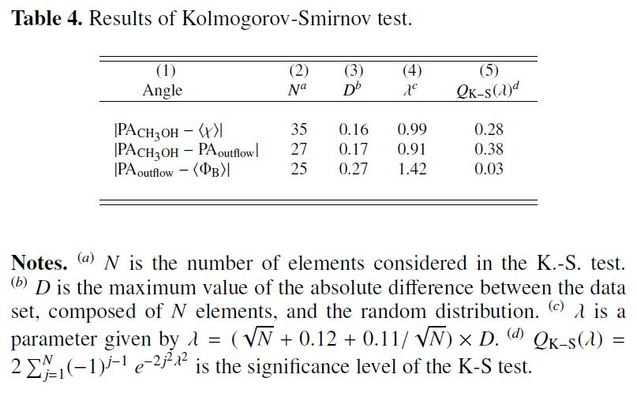
Methanol masers: updated statistics
Preliminary result:
Magnetic field oriented along the large scale molecular outflows
Probability that the angles are drawn from random distribution
3%
Surcis et al. 2018, in prep.
14th EVN Symposium – Granada 8-11 October 2018 Gabriele Surcis - 8th October 2018

Slide 11
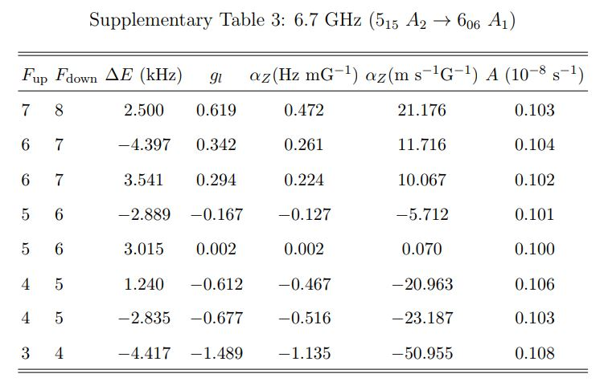
Methanol masers: B field strength
Lankhaar et al. 2018, Nature Astronomy, 2, 145
$$∆V_{Z}=α_{Z}∙B_{||}$$
$$B=B_{||}∙cosθ$$
14th EVN Symposium – Granada 8-11 October 2018 Gabriele Surcis - 8th October 2018

Slide 12
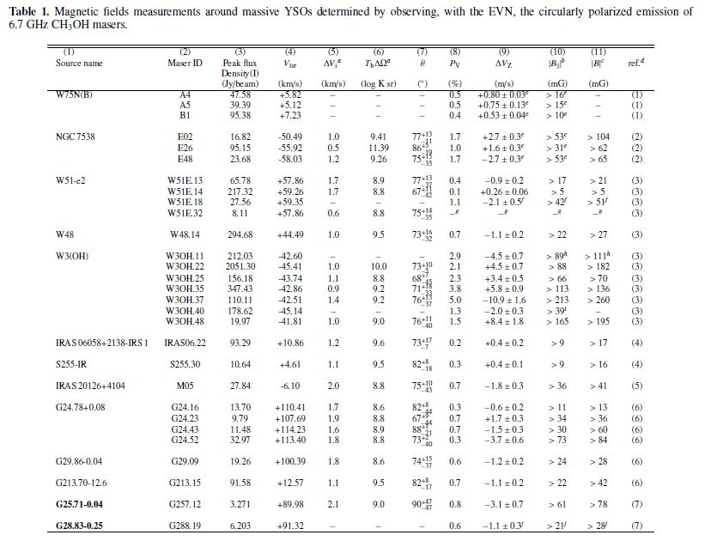
Methanol masers: B field strength
14th EVN Symposium – Granada 8-11 October 2018 Gabriele Surcis - 8th October 2018

Slide 13
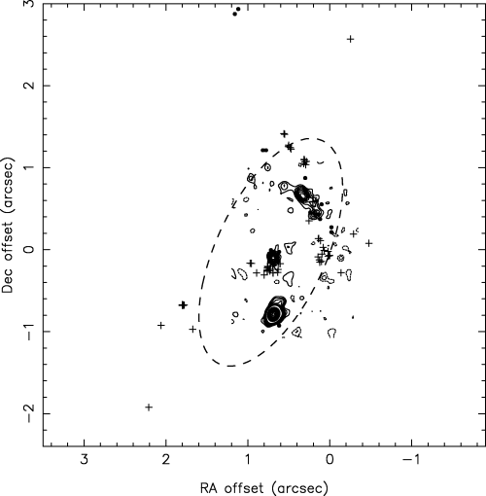
Water masers: W75N a long story
D = (1.3 ± 0.07) kpc
Separation between
VLA1 and VLA2 ̴ 900 AU
H₂O
+ OH
Rygl, K.L.J. et al. 2012, A&A, 539, 79
CO outflow
VLA 1
VLA 2
CO outflow
VLA 3
Torrelles et al., 1997, ApJ, 489, 744; Hutawarakorn et al, 2002, MNRAS, 330, 349; Shepherd et al., 2003, ApJ, 584, 882
14th EVN Symposium – Granada 8-11 October 2018 Gabriele Surcis - 8th October 2018

Slide 14
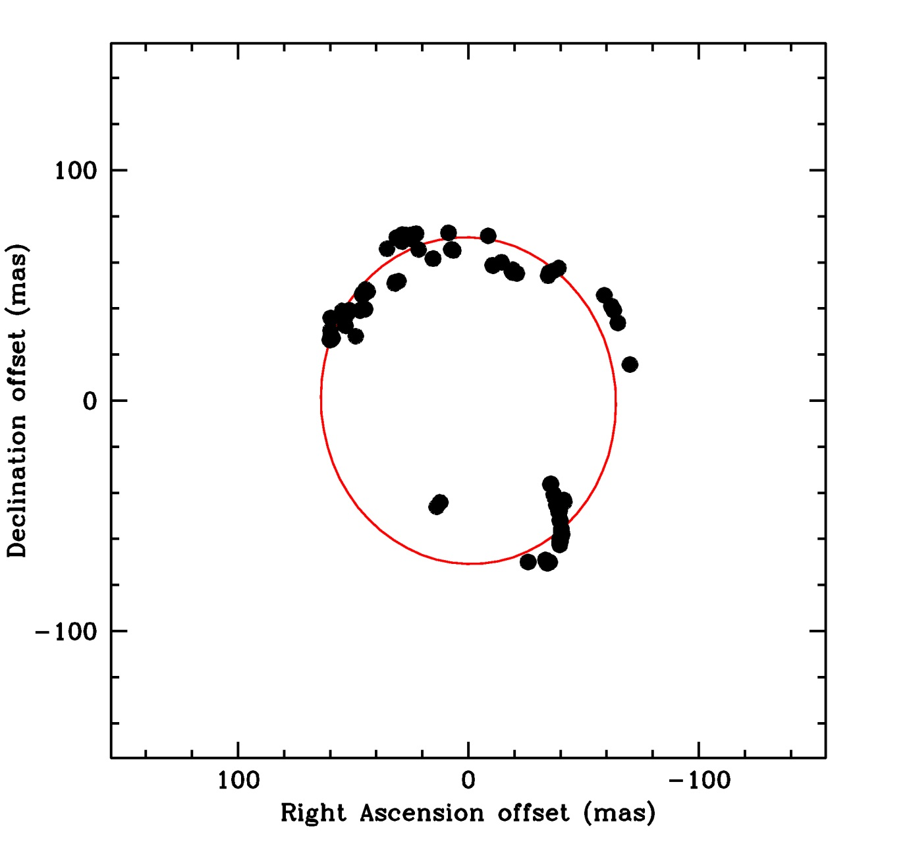
Water masers: W75N a long story
a = semi-major axis
b = semi-minor axis
a = (71± 1) mas ≈ (92 ± 1) au
b = (64 ± 1) mas ≈ (83 ± 1) au
PA = 5° ± 3°
H₂O masers
1999.25 VLBA
Torrelles, J.M. et al. 2003, ApJ, 598, L115
14th EVN Symposium – Granada 8-11 October 2018 Gabriele Surcis - 8th October 2018

Slide 15
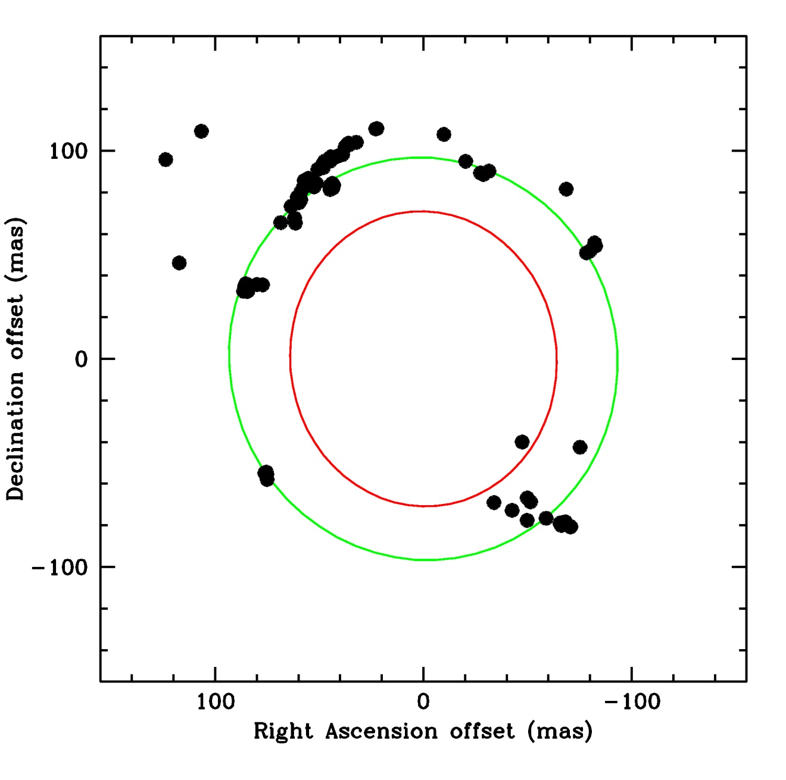
Water masers: W75N a long story
a = semi-major axis
b = semi-minor axis
a = (71± 1) mas ≈ (92 ± 1) au
b = (64 ± 1) mas ≈ (83 ± 1) au
PA = 5° ± 3°
a = (97± 3) mas ≈ (126 ± 4) au
b = (93 ± 2) mas ≈ (121 ± 3) au
PA = 15° ± 45°
H₂O masers
2005.89 VLBA
Surcis, G. et al. 2011, A&A, 527, 48
14th EVN Symposium – Granada 8-11 October 2018 Gabriele Surcis - 8th October 2018

Slide 16
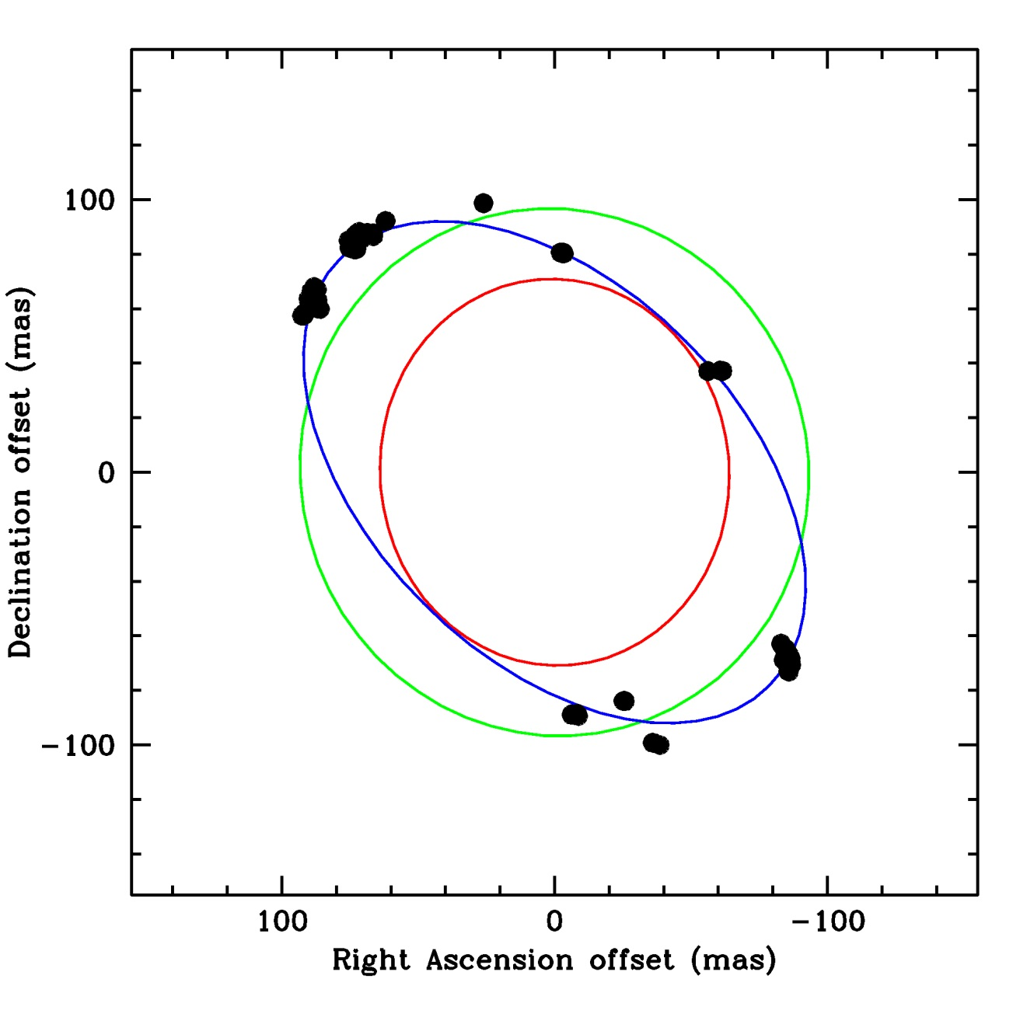
Water masers: W75N a long story
a = semi-major axis
b = semi-minor axis
a = (71± 1) mas ≈ (92 ± 1) au
b = (64 ± 1) mas ≈ (83 ± 1) au
PA = 5° ± 3°
a = (97± 3) mas ≈ (126 ± 4) au
b = (93 ± 2) mas ≈ (121 ± 3) au
PA = 15° ± 45°
a = (111± 1) mas ≈ (144 ± 1) au
b = (68± 1) mas ≈ (88 ± 1) au
PA = 45° ± 1°
H₂O masers
2007.41 VERA
V = (24 ± 3) km/s
V = (57 ± 3) km/s
Kim, J.-S. et al. 2013, ApJ, 767, 86
14th EVN Symposium – Granada 8-11 October 2018 Gabriele Surcis - 8th October 2018

Slide 17
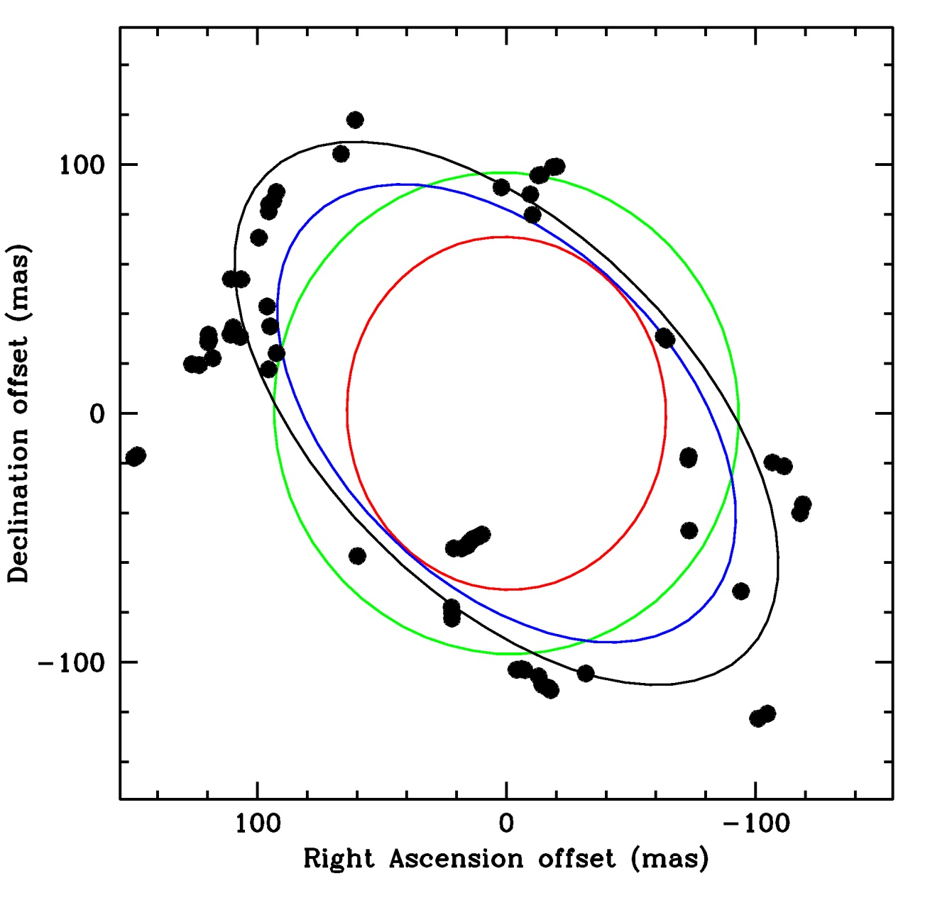
Water masers: W75N a long story
a = semi-major axis
b = semi-minor axis
a = (71± 1) mas ≈ (92 ± 1) au
b = (64 ± 1) mas ≈ (83 ± 1) au
PA = 5° ± 3°
a = (97± 3) mas ≈ (126 ± 4) au
b = (93 ± 2) mas ≈ (121 ± 3) au
PA = 15° ± 45°
a = (111± 1) mas ≈ (144 ± 1) au
b = (68± 1) mas ≈ (88 ± 1) au
PA = 45° ± 1°
a = (136± 4) mas ≈ (177 ± 5) au
b = (73± 2) mas ≈ (95 ± 3) au
PA = 45° ± 2°
H₂O masers
2012.54 VLBA
V = (24 ± 3) km/s
V = (57 ± 3) km/s
V = (30 ± 3) km/s
Surcis, G. et al. 2014, A&A, 565, L8
14th EVN Symposium – Granada 8-11 October 2018 Gabriele Surcis - 8th October 2018

Slide 18
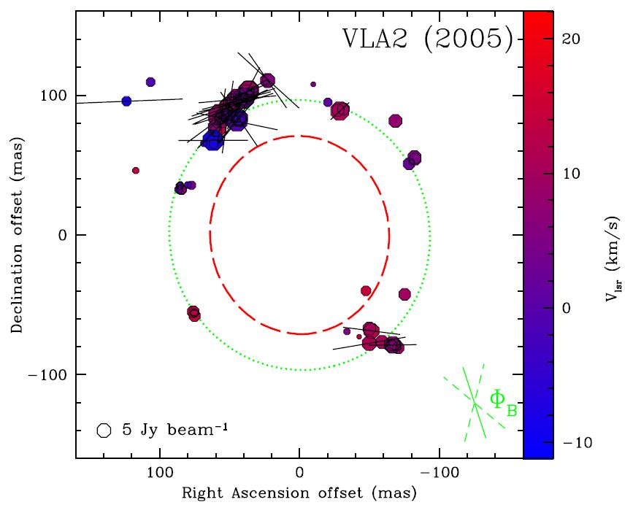
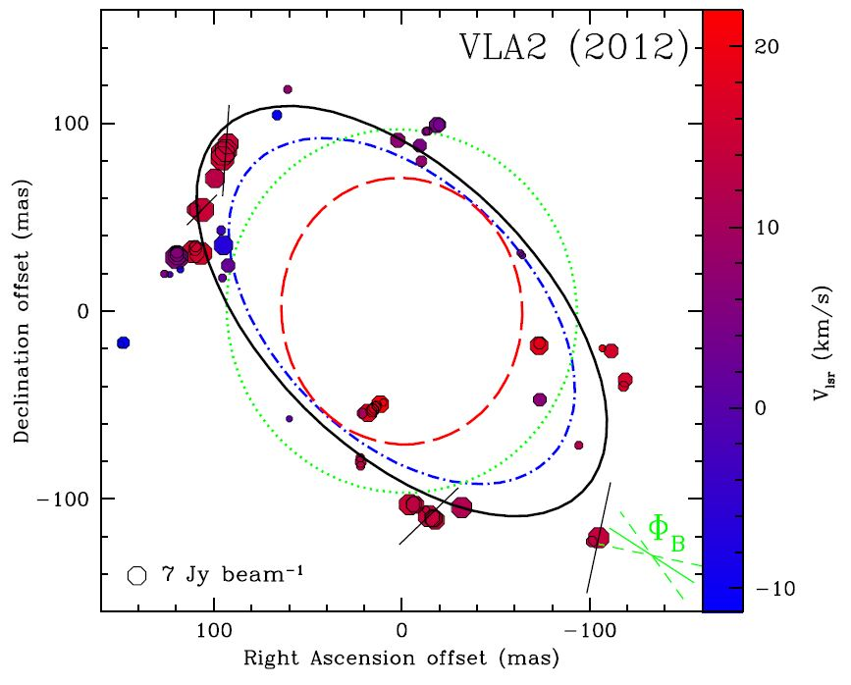
Water masers: W75N a long story
Surcis, G.et al. 2011, A&A, 527, 48
Surcis, G.et al. 2014, A&A, 565, L8
14th EVN Symposium – Granada 8-11 October 2018 Gabriele Surcis - 8th October 2018

Slide 19
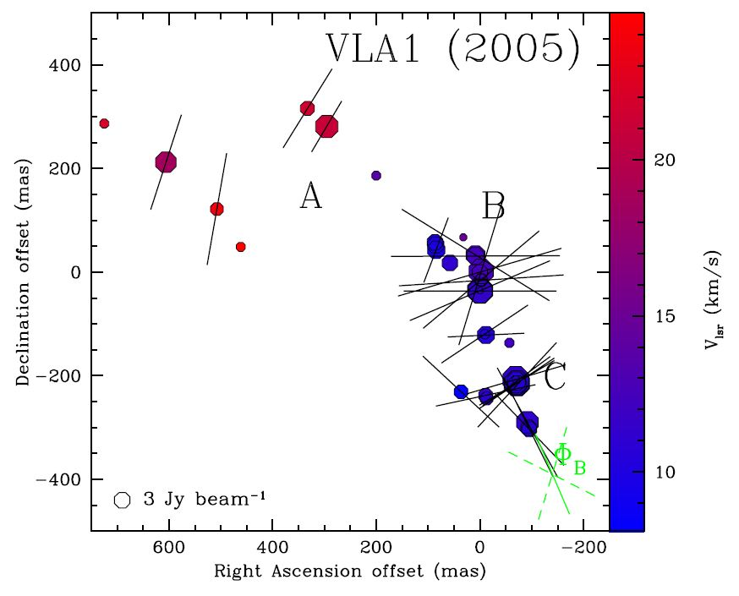
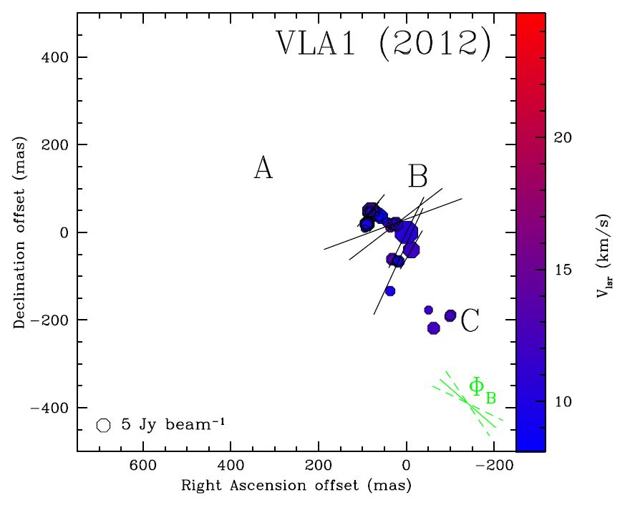
Water masers: W75N monitoring
Surcis, G.et al. 2011, A&A, 527, 48
Surcis, G.et al. 2014, A&A, 565, L8
14th EVN Symposium – Granada 8-11 October 2018 Gabriele Surcis - 8th October 2018

Slide 20
Water masers: W75N monitoring
European VLBI Network (EVN)
Monitoring Project (total = 48 hours)
4 epochs separated by 2 years
@K-band in full polarization mode
Epoch 1: 17th June 2014 analysed
Epoch 2: 12th June 2016 analysed
Epoch 3: 10th June 2018 observed
Epoch 4: ?? June 2020 scheduled
14th EVN Symposium – Granada 8-11 October 2018 Gabriele Surcis - 8th October 2018

Slide 21
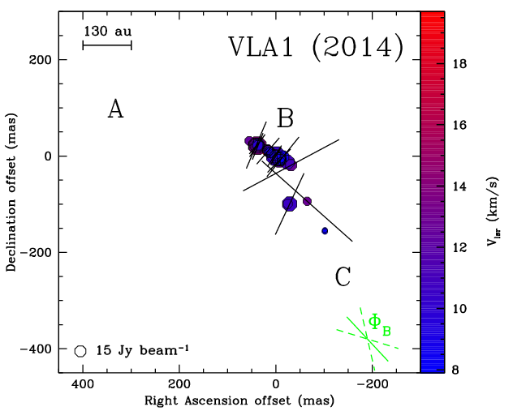
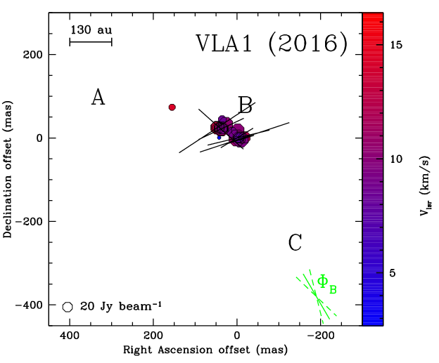
Water masers: W75N monitoring
2016.45
676 mG
VLA 1
Surcis, G. et al. 2020 (?)
14th EVN Symposium – Granada 8-11 October 2018 Gabriele Surcis - 8th October 2018

Slide 22
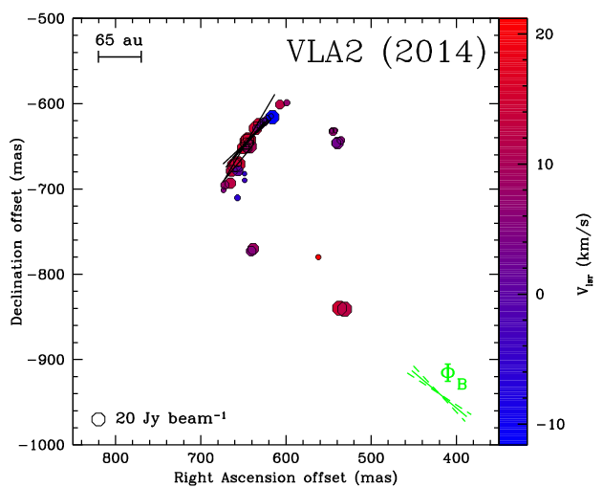
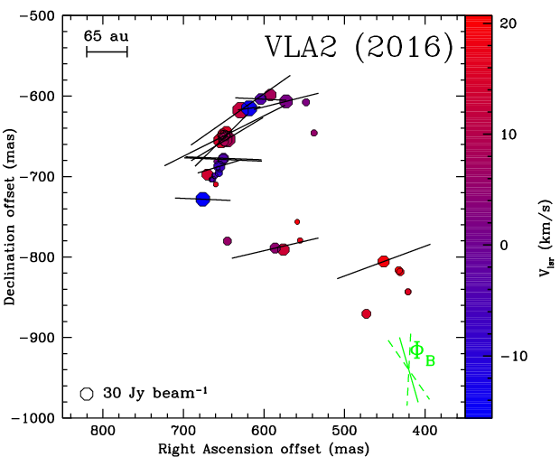
Water masers: W75N monitoring
2016.45
1962 mG
Surcis, G. et al. 2020 (?)
14th EVN Symposium – Granada 8-11 October 2018 Gabriele Surcis - 8th October 2018

Slide 23
Water masers: W75N monitoring
Surcis, G. et al. 2020 (?)
14th EVN Symposium – Granada 8-11 October 2018 Gabriele Surcis - 8th October 2018

Slide 24
Conclusions
From CH₃OH masers we found that the probability that magnetic fields are aligned with the large-scale outflows in massive YSO may be significant;
The magnetic field around W75N(B)-VLA2 has changed its orientation according to the direction of the major-axis of the maser distribution and it is aligned with the magnetic field in W75N(B)-VLA1.
Follow ups
To reduce and analyse the remaining sources of the flux-limited sample (5 massive YSOs)
Finish the observations and analysis of the monitoring project of the H₂O masers in W75N(B) (2 epochs left) with the EVN in full polarization mode.
14th EVN Symposium – Granada 8-11 October 2018 Gabriele Surcis - 8th October 2018

Slide 25
THANK YOU
14th EVN Symposium – Granada 8-11 October 2018 Gabriele Surcis - 8th October 2018

Slide 26
Extra Slide 1
$$\frac{M}{Φ}$$
Mass of the core
Magnetic flux
$$μ=\frac{M/Φ}{\left(M/Φ\right)crit}$$
Column density
$$μ<1$$
Magnetic field
Prevent collapse
$$\frac{M}{Φ}∝\frac{N(H_{2})}{|B|}$$
Magnetic field
Gravity overwhelms
the magnetic field
$$μ>1$$
$${\left(M/Φ\right)}_{crit}≈\frac{0.12}{\sqrt{G}}$$
Gravitational constant
14th EVN Symposium – Granada 8-11 October 2018 Gabriele Surcis - 8th October 2018

Slide 27
Extra Slide 2
B
θ
φ_{B}
lin. pol.
vector
Goldreich, P et al. 1973, ApJ, 179, 111
φ_{B} = 0°
φ_{B} = 90°
14th EVN Symposium – Granada 8-11 October 2018 Gabriele Surcis - 8th October 2018

Slide 28
Extra Slide 3
14th EVN Symposium – Granada 8-11 October 2018 Gabriele Surcis - 8th October 2018

Slide 29
Extra Slide 4
14th EVN Symposium – Granada 8-11 October 2018 Gabriele Surcis - 8th October 2018

Slide 30
Extra Slide 5
Non – Zeeman effects
RULED
OUT!
instrumental effects
propagation of strong linear polarization when B changes direction along maser propagation path
rotation of the axis of simmetry for the molecular quantum states
anisotropic resonant scattering
(Vlemmings et al. 2011)
measurements confirmed by using different instruments (single-dish & VLBI)
(Vlemmings et al. 2011)
for a smooth change of ~1 rad m_{V} = (m_{l})²/4
for m_{l}< 0.04 ≡ 4% m_{V} < 4· 10⁻⁴ ≡ 0.04%
Small
Contribution!
Only for
The most saturated!
following Houde (2014) we estimate that P_{l} produces P_{V} when B > 100 mG
Unlikely!
14th EVN Symposium – Granada 8-11 October 2018 Gabriele Surcis - 8th October 2018

Slide 31
Extra Slide 6
14th EVN Symposium – Granada 8-11 October 2018 Gabriele Surcis - 8th October 2018

Slide 32
Extra Slide 7
14th EVN Symposium – Granada 8-11 October 2018 Gabriele Surcis - 8th October 2018

Slide 33
Extra Slide 8
Epoch 2016.45
Surcis, G. et al. 2020 (?)
14th EVN Symposium – Granada 8-11 October 2018 Gabriele Surcis - 8th October 2018

Slide 34
Extra Slide 9
14th EVN Symposium – Granada 8-11 October 2018 Gabriele Surcis - 8th October 2018

Slide 35
Extra Slide 10
Carrasco-González, C. et al. 2015, SCIENCE, 348, 114
14th EVN Symposium – Granada 8-11 October 2018 Gabriele Surcis - 8th October 2018

Slide 36
Extra Slide 11
Foreground Faraday Rotation
Ф[°] = 4.22 x 10⁶ D[kpc] n_{e}[cm⁻³] B||[mG] ν⁻²[GHz]
W75N
where n_{e}≈ 0.012 cm⁻³ B||≈2x 10⁻³ mG D=1.3 kpc
Ф_{water}[°] ≈ 0.3° Ф_{meth}[°] ≈ 3.0°
14th EVN Symposium – Granada 8-11 October 2018 Gabriele Surcis - 8th October 2018

Slide 37
Extra Slide 12
14th EVN Symposium – Granada 8-11 October 2018 Gabriele Surcis - 8th October 2018

Slide 38
14th EVN Symposium – Granada 8-11 October 2018 Gabriele Surcis - 8th October 2018

