Slide 1
KaVA Large Proposal for
High-Mass Star-Formation Studies with Multiple Masers
NAOJ
Tomoya Hirota (NAOJ), Kee-Tae Kim (KASI),
on behalf of KaVA Star-formation Science WG

Slide 2

Collaborators
Co-PI
  T. Hirota (NAOJ) and K. T. Kim (KASI)
Core members ~ 17, including 3 students
  D. Y. Byun, J. O. Chibueze, K. Hachisuka, B. Hu, E. Hwang, J. Hwang, J. H. Kang, J. Kim, J. S. Kim, M. K. Kim, T. Liu, N. Matsumoto, K. Motogi, C. S. Oh, K. Sugiyama, K. Sunada, Y. W. Wu (~17, including 3 students)
Other members ~ 40
New members and collaborator are always welcome!

Slide 3
KaVA large program (LP)
KaVA: KVN and VERA Array
  Three LPs since 2015
    AGN (M. Kino & B. W. Sohn)
    Late-type stars (S. H. Cho and H. Imai)
    SFR (T. Hirota & K. T. Kim)
  Allocation of ~200 hrs/yr/project
  Long-term program (3-4 years)
  EAVN operation since 2018
See related talks
  K. Hada, S. T. Han, H. Kobayashi, S. S. Lee, J. Park, Y. Yun
  And more posters
M87 at 22 GHz (Hada+2017)
SiO masers in WX Psc (Yun+2016)

Slide 4
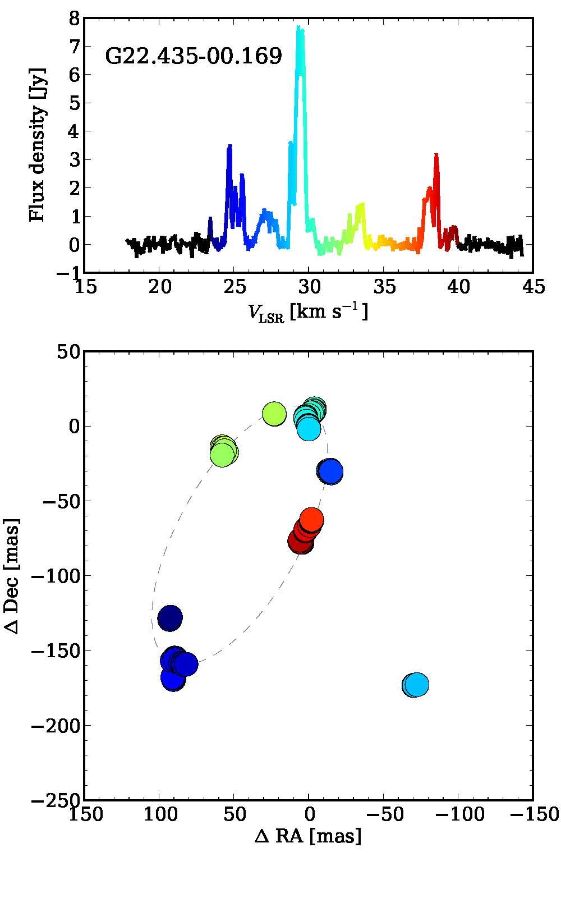
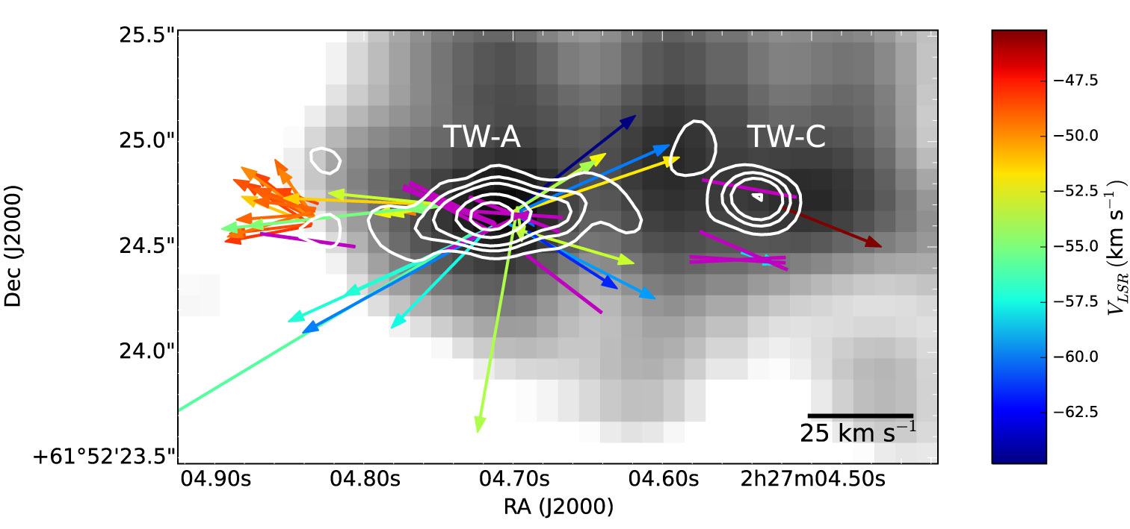
KaVA SFRs LP
Understanding high-mass star formation through KaVA observations of water and methanol masers
  Statistical VLBI monitoring/survey to reveal
  3D velocity and spatial structures of
  22GHz H₂O/44GHz CH₃OH masers
  associated with high-mass young stellar
  objects (HM-YSOs)
22 GHz H₂O masers; high-velocity outflow and jet (Goddi+2017)
44 GHz Class I CH₃OH masers; low-velocity outflow (Cyganowski+2009)
6.7 GHz Class II CH₃OH masers; disk, toroid or outflow (Bartkiewicz+2016)

Slide 5
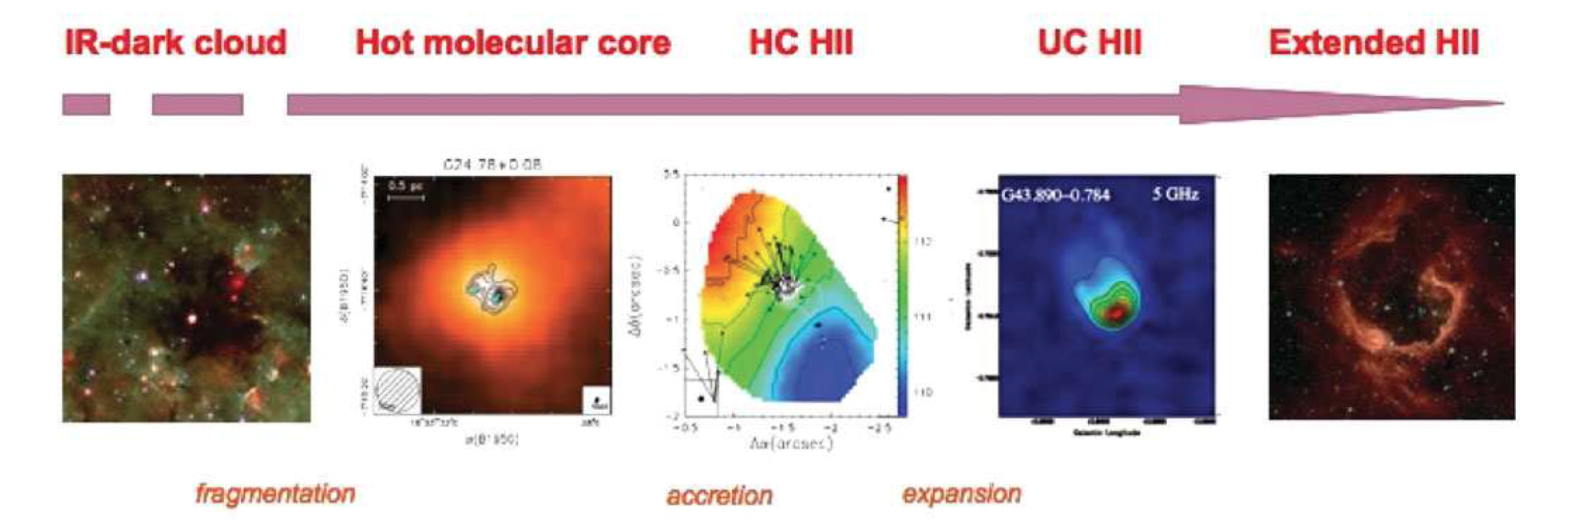
Why HM-YSOs?
Major impact on astronomy
  Strong influence on formation and evolution of stars,
  clusters, ISM, and galaxies
Less understood in comparison with low-mass YSOs
  Initial condition? Accretion process? Feedback process? Initial mass function? First star?
Evolutionary sequence of high-mass young star (Beltran 2011)

Slide 6
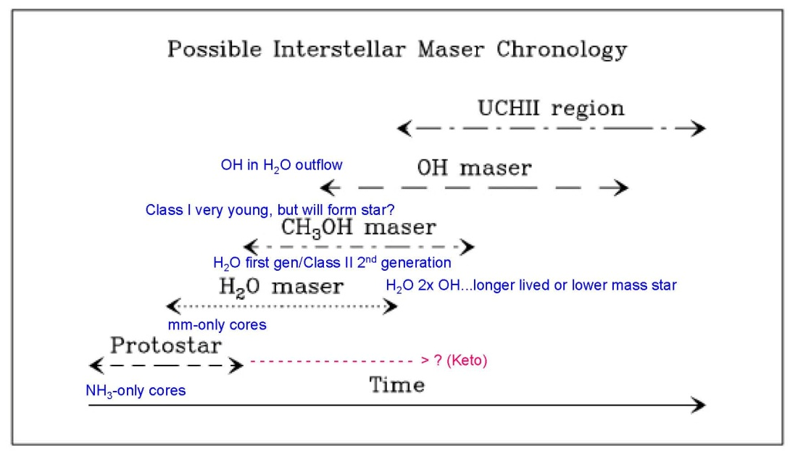
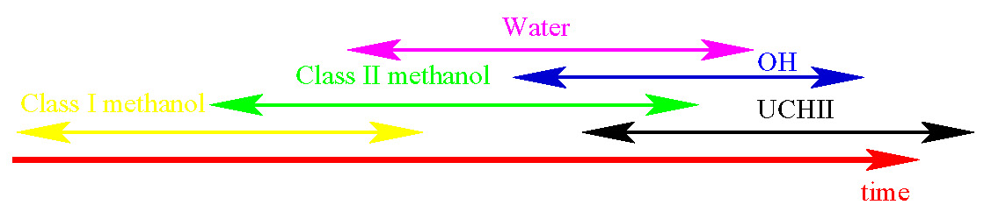
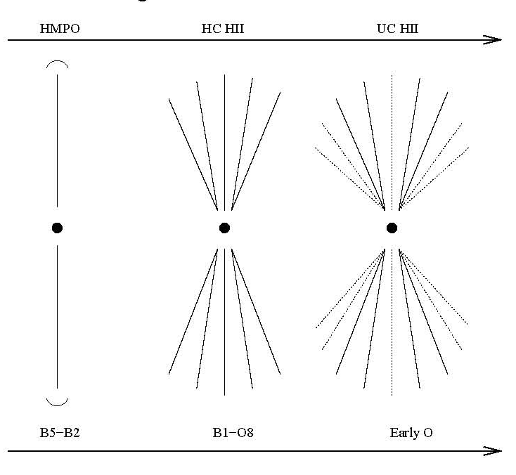
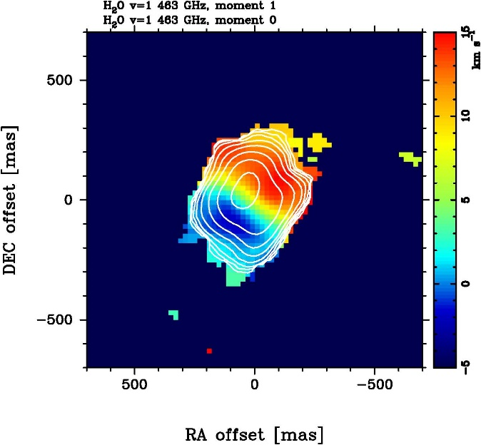
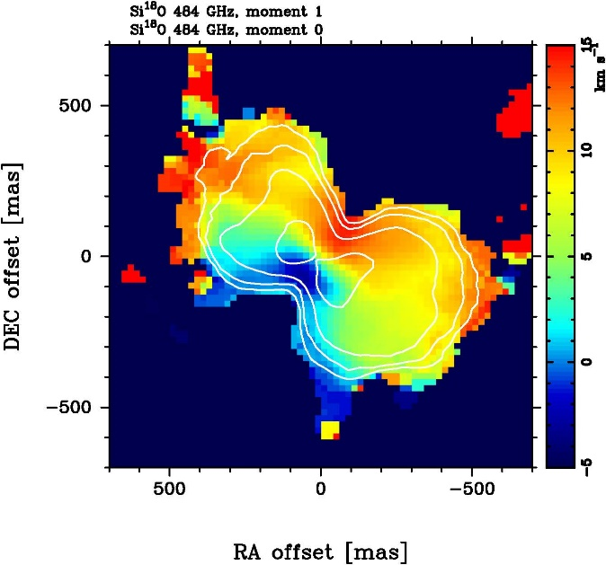
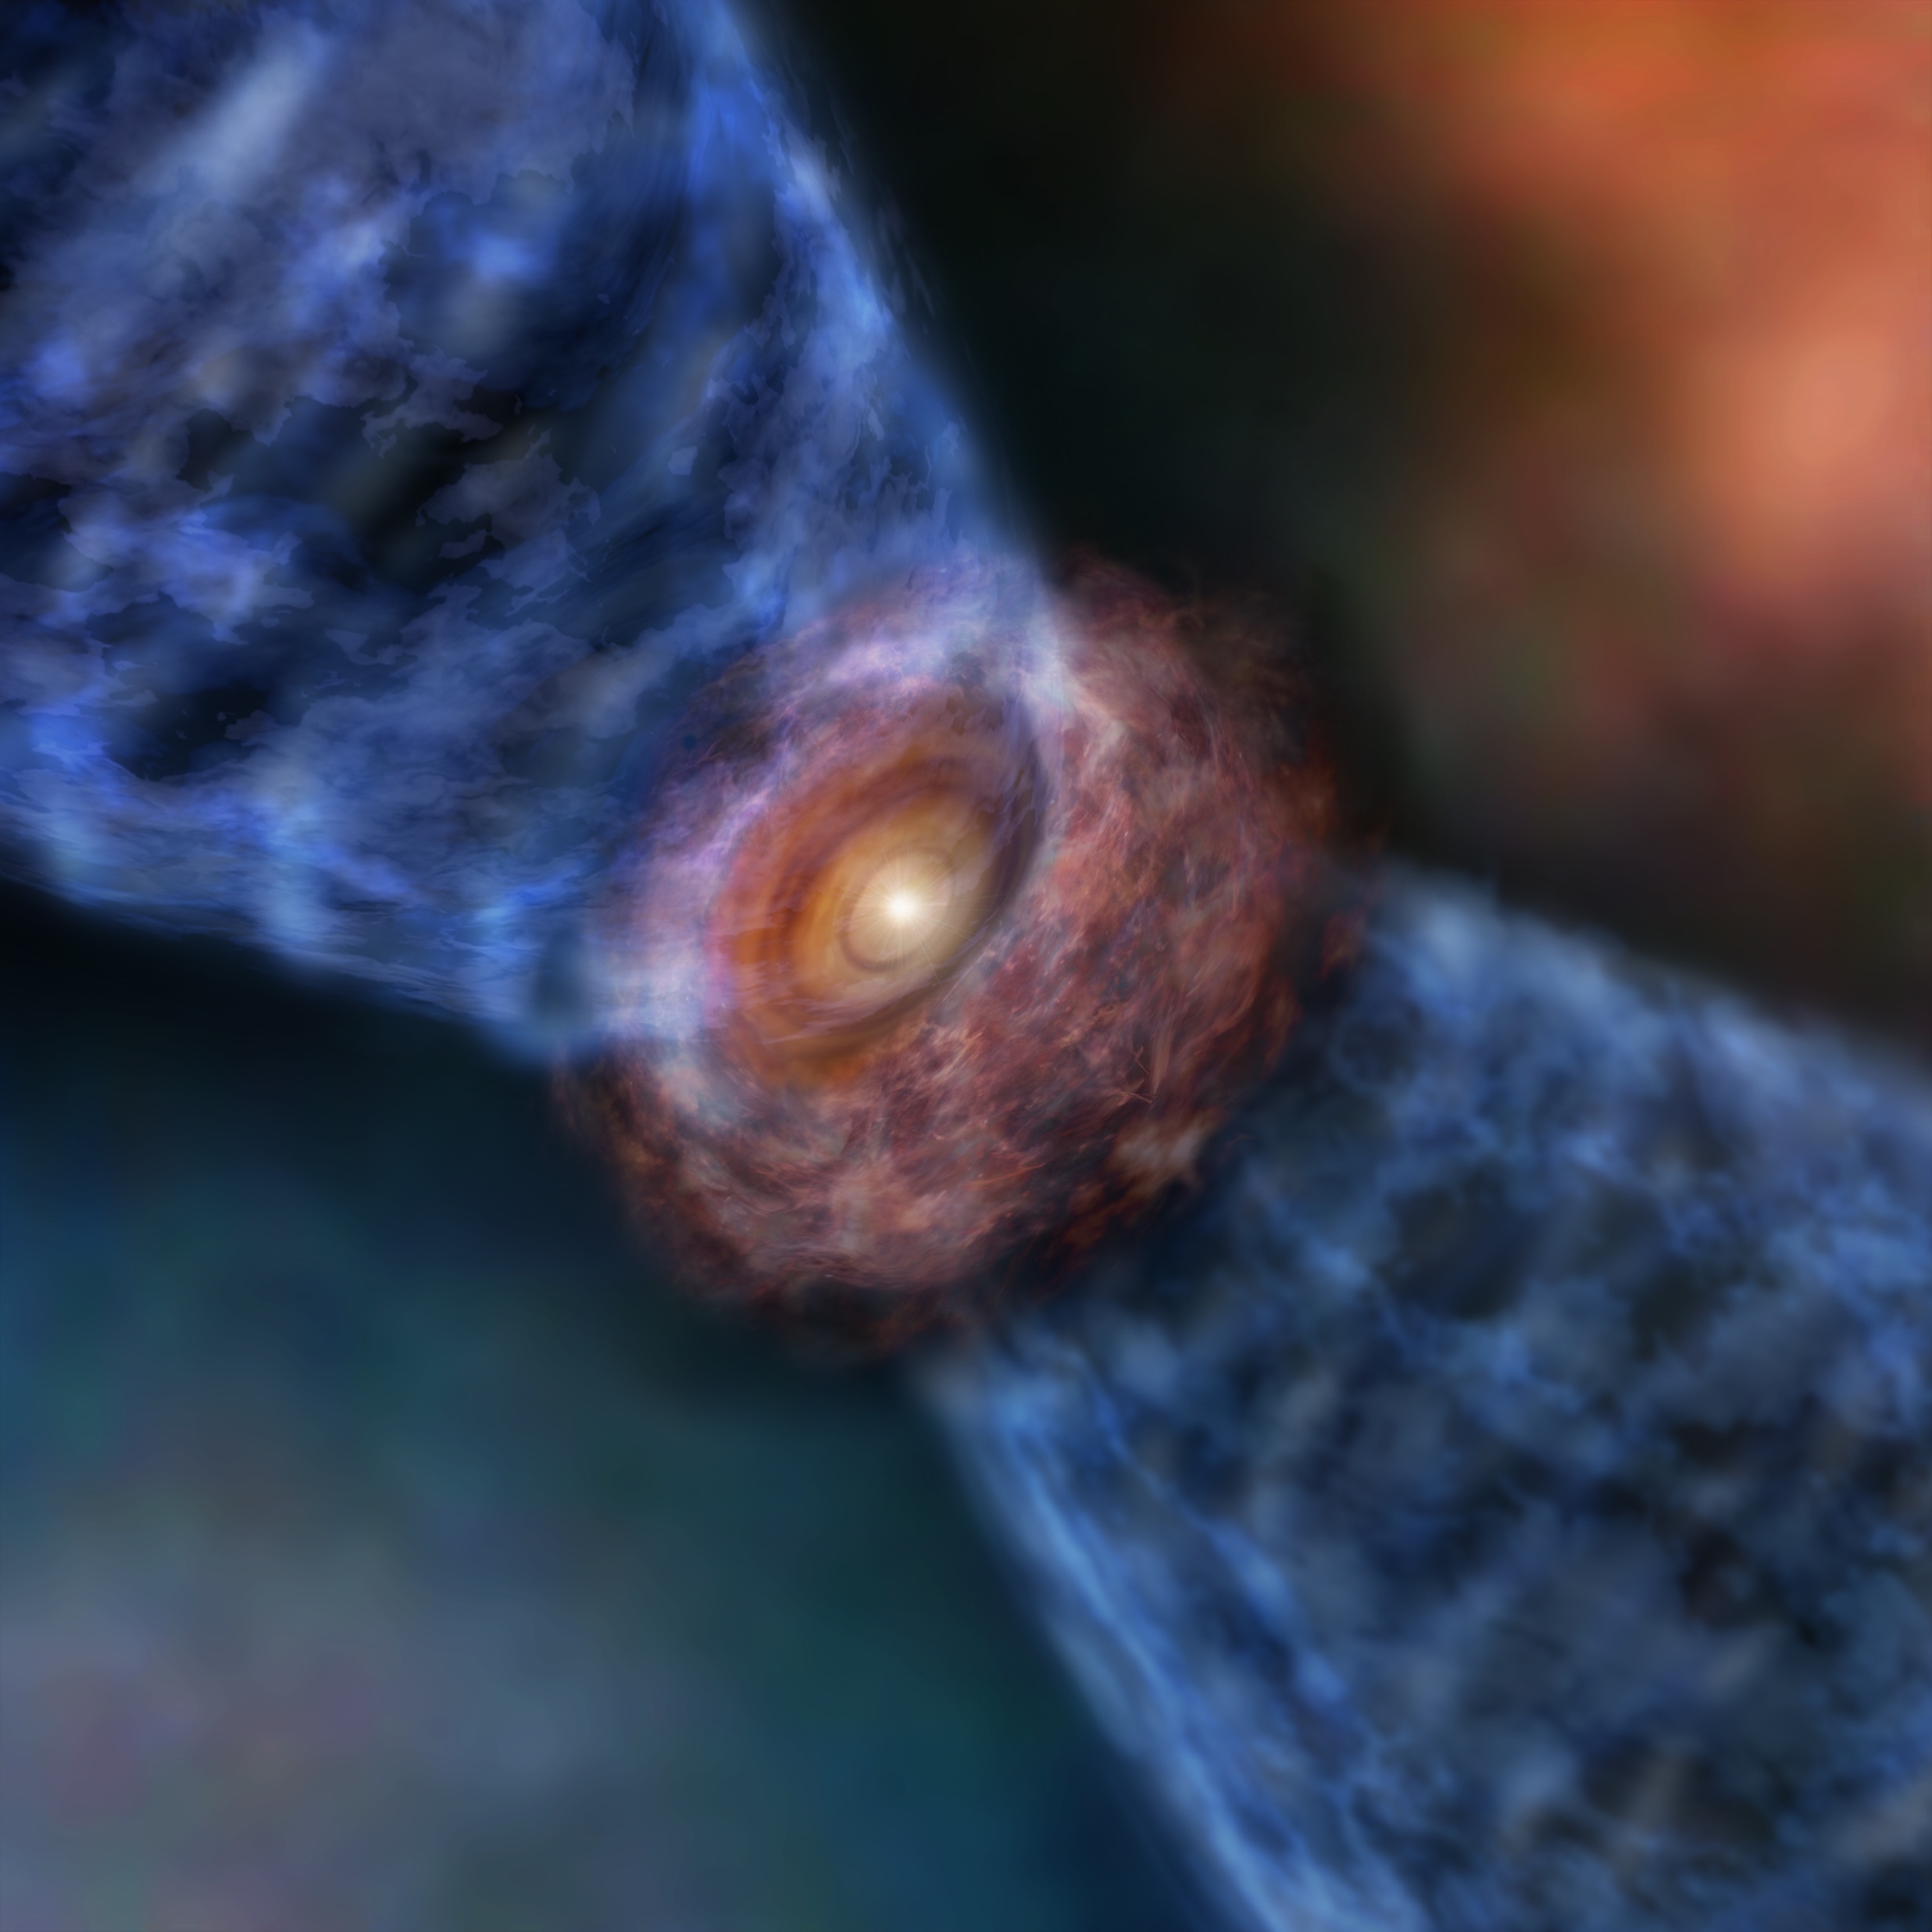
Science goals
Dynamics of disks/outflows traced by proper motions of multiple masers
  Only by using VLBI
Their evolutionary scenario
  Need statistical samples
Maser chronology by Reid 2007 vs Ellingsen 2007
ALMA band 8 observations of SiO and H2O lines (Hirota+2017)
Evolution of outflow (Beuther & Shepherd 2005)

Slide 7
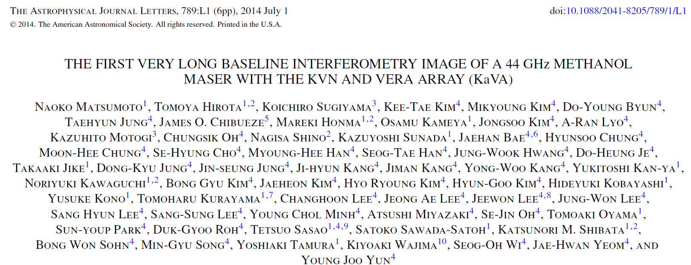
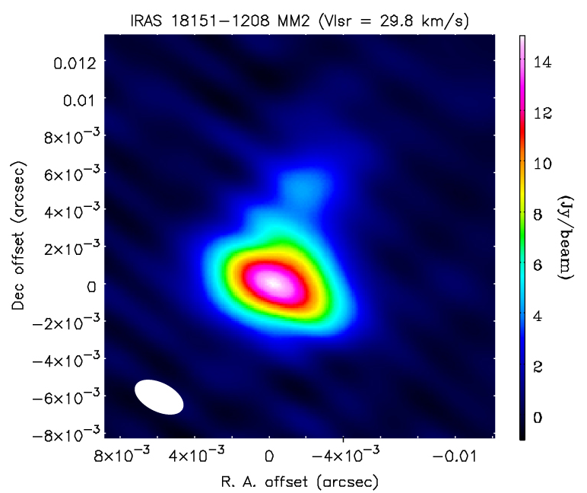
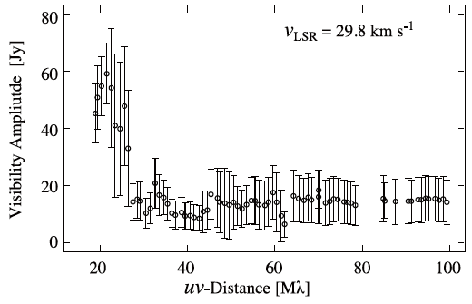
Unique capability of KaVA
First VLBI image of 44 GHz methanol maser
  Advantage to obtain both extended and compact components
First science paper from KaVA (Matsumoto+2014)

Slide 8
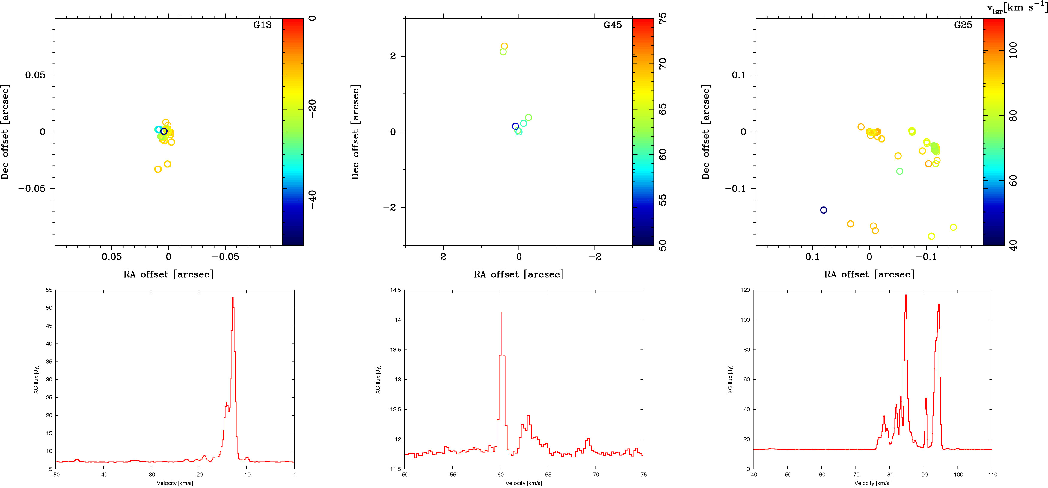
H₂O maser survey
Search for good targets from 87 HM-YSO samples
  Mainly based on KVN survey results (see poster by K. T. Kim)
  Snap-shot imaging in 25 HM-YSOs in the first year (2016-2017)
  Monitoring of 16 selected sources in the second year (2018-)
  More sources in the third year and from VERA archive data
200 AU
8000 AU
200 AU
Some examples from preliminary results of the 22 GHz H₂O maser survey

Slide 9
CH₃OH maser survey
Search for good targets from 87 HM-YSO samples
  Mainly based on KVN survey results (see poster by K. T. Kim)
  Preparatory studies with KaVA (Matsumoto et al. 2014)
  First VLBI imaging in
  16 HM-YSOs in the first
  year (2016-2017)
  Monitoring of 3 selected
  sources in the second
  year (2018-)
Preliminary results of the 44 GHz CH₃OH maser survey

Slide 10
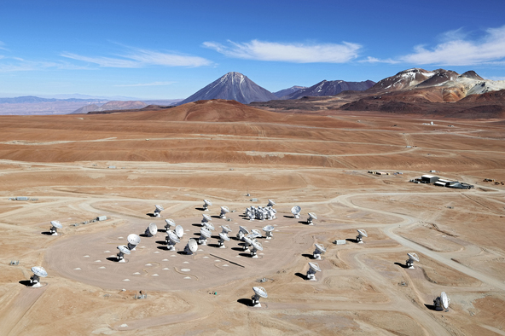
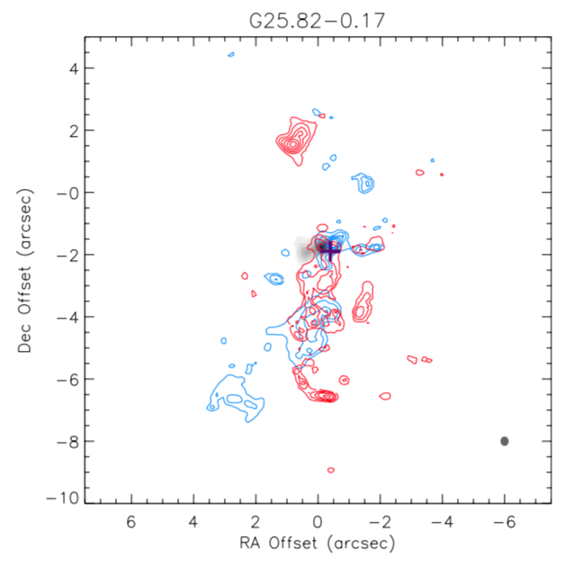
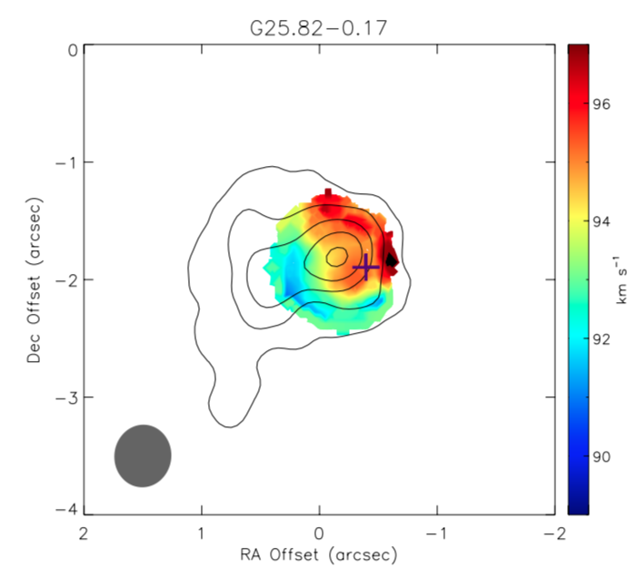
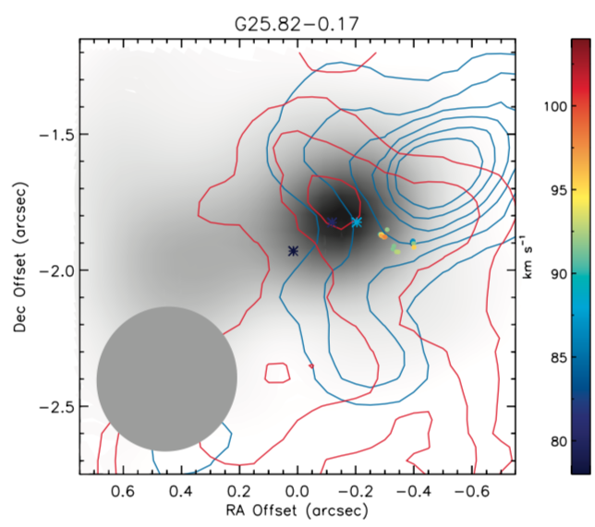
Follow-up observations with ALMA
Continuum, SiO, CH₃OH, etc. at Band 6
  Cycle 3 for CH₃OH samples (Mikyoung Kim)
  Cycle 6 for H₂O samples (Jungha Kim)
  Physical/chemical properties of HM-YSOs
  Direct comparison of spatial/velocity structure by filling the gaps of sparse maser distributions
Clem & Adri Bacri-Normier (wingsforscience.com)/ESO
+ water maser
+ water maser
1000 AU
10000 AU
5000 AU
SiO (left), CH₃OH (middle), and 22 GHz H2O maser maps (Kim, J., et al. in prep.)

Slide 11
Summary and future
KaVA LPs have started since 2016 and still on-going
  Monitoring observations of selected H₂O and CH₃OH maser sources will be finished in 2019 May
  Further monitoring/survey will be continued after 2019
Follow-up observations are also on-going
  VERA astrometry for accurate distances
  ALMA cycle 6 for thermal lines and continuum
  JVLA/EAVN for 6.7 GHz methanol masers
  Single-dish projects for larger-scale structure
New members and collaborator are always welcome!
  We are very happy to exchange information about other similar projects for future collaboration.

