Slide 1
Expanding VLBI in East Asia and AGN Science
Kazuhiro Hada (NAOJ)
On behalf of the KaVA/EAVN AGN Science Working Group

Slide 2
The East Asian VLBI Network (EAVN)
An, Sohn, Imai 2018
See also talk by Kobayashi tomorrow
Collaborative effort aiming to form a large VLBI network in East Asia
Construction of new telescopes planned in China, Korea, Thailand

Slide 3
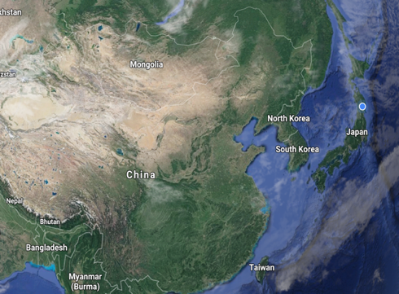
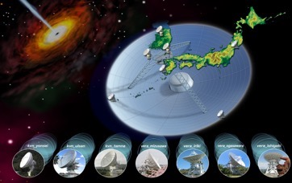
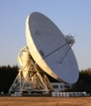
EAVN open-use has just started
Urumqi26
NRO45
KaVA
KaVA
(KVN+VERA)
Urumqi
Tianma
Nobeyama
Tianma65
First EAVN open-use observations starting from Oct/2018
22GHz: KaVA+Tianma+Nobeyama+Urumqi
43GHz: KaVA+Tianma+Nobeyama
1Gbps, single pol, 100hr/semester (250hr for KaVA), biweekly slots
Next proposal deadline: Nov/1st

Slide 4
Array sensitivity
2Gbps (512MHz BW), 1hr integration
43GHz
VLBA: 10
EVN: Ef, On, Ys, Nt
EAVN: KaVA, TM, NY
22GHz
VLBA: 10
EVN: Ef, Mc, On, Tr, Nt, Ur, Ys, Hh, Sv, Zc, Bd
EAVN: KaVA, TM, UR, NY, HT, TH, KS
6.7GHz
VLBA: 10
EVN: Ef, Mc, On, Tr, W1, Nt, Ys, Hh, Ir
EAVN: VERA, KUS, TM, KM, HT, TK, KS, YM, US
EAVN: “high-sensitivity” + “regular monitoring capability” at 6.7-43GHz
  Complementary to other VLBI facilities

Slide 5
An, Sohn, Imai 2018

Slide 6
Promote AGN science with EAVN
Apart from individual open-sky programs, AGN science with KaVA/EAVN is promoted by the EAVN-AGN Science WG
  A projected-led, joint CN-JP-KR-TW team
  Leaders: M. Kino (JP) and BW Sohn (KR)
  20 core members (4 students, 4 post-docs)
Intensive monitoring of M87/SgrA, tie-up with EHT
Regular monitoring of γ-ray blazars and radio galaxies
Expansion of array capability for better AGN science
  EAVN+global baselines (Italy/Australia/Yebes)
  Full polarization
  K/Q simultaneous receiving system
  Wideband (>2Gbps) recording
  Low-frequency VLBI including FAST

Slide 7
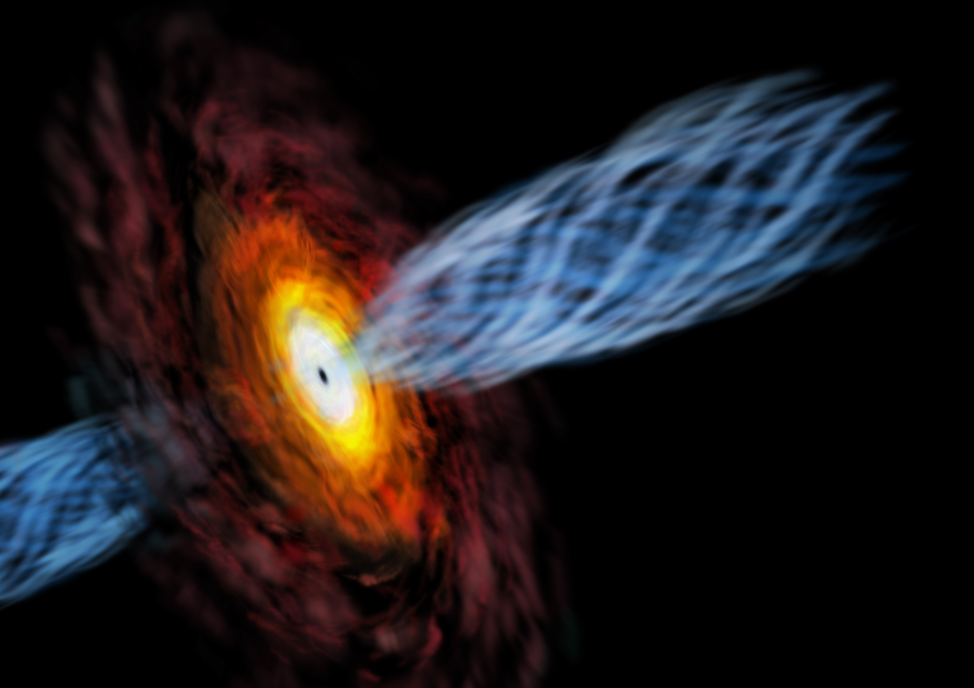
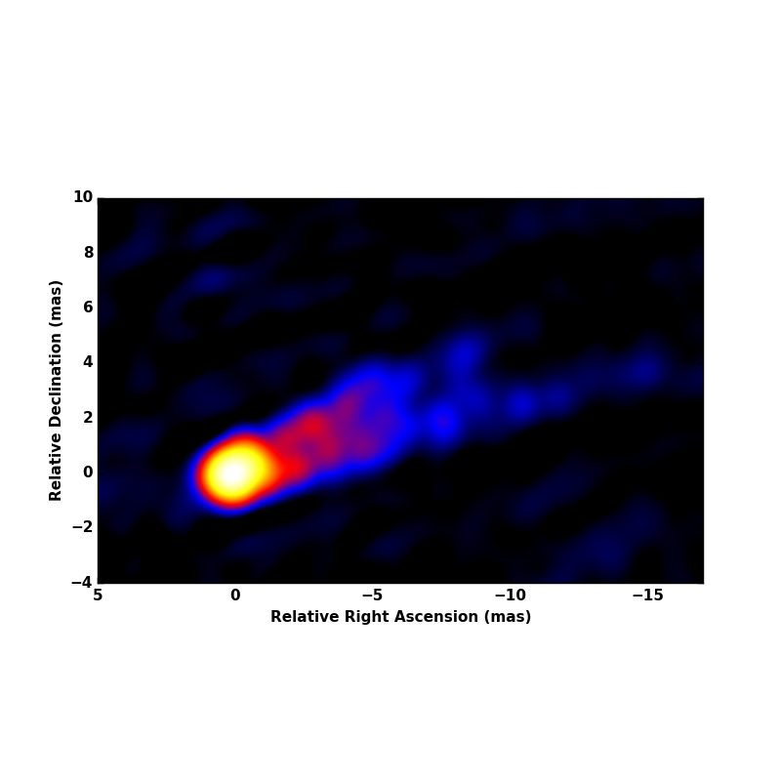
Intensive monitoring of M87/SgrA
EAVN
EHT
Broderick+
EHT will see the first horizon-scale images of SMBHs (SgrA/M87) very soon
Centimeter-VLBI plays key roles in many aspects:
  Connect the horizon scales to large-scales (accretion flows, jet collimation)
  Subsequent evolution/propagation of ejected jet (jet acceleration, shock)
  Spectral information of synchrotron plasma (B-field, U_{e}/U_{B})
  Scattering screen towards SgrA
EAVN is a suitable facility to complement EHT

Slide 8
EAVN M87/SgrA around EHT-2017
Obs. Code | Date | UT time | Target | Freq. | KaVA | Tianma | Urumqi | NRO | Hitachi | Kashima | Sejong | Medicina(M87) | Noto (M87)
a17071a | 3/12 | 18:55 – 00:55 | SgrA | Q | ● | ●
a17077a | 3/18 | 12:45 – 19:45 | M87 | K | ● | ● | ● |  | ● | ●
a17078a | 3/19 | 11:40 – 18:40 | M87 | Q | ● | ●
a17086a | 3/27 | 13:10 – 23:10 | M87+SgrA | Q | ● | ●
a17093a | 4/3 | 13:20 – 23:20 | M87+SgrA | K | ● | ● | ● |  | ● | ● |  | ● | ●
a17094a | 4/4 | 12:35 – 22:40 | M87+SgrA | Q | ● | ●
a17099a | 4/9 | 12:20 – 22:20 | M87+SgrA | Q | ● | ● |  | ●
a17104a | 4/14 | 12:00 – 22:00 | M87+SgrA | Q | ● | ●
a17107a | 4/17 | 11:45 – 18:45 | M87 | K | ● | ● | ● |  | ● | ● | ● | ● | ●
a17108a | 4/18 | 11:40 – 21:45 | M87+SgrA | Q | ● | ●
a17114a | 4/24 | 09:20 – 16:20 | M87 | K | ● | ●
a17115a | 4/25 | 09:15 – 16:15 | M87 | Q | ● | ●
a17116a | 4/26 | 15:55 – 21:55 | SgrA | Q | ● | ● |  |  |  |  | ●
a17130a | 5/10 | 08:20 – 17:20 | M87 | K | ● | ● |  |  |  |  |  | ●
a17131a | 5/11 | 08:15 – 17:15 | M87 | Q | ● | ●
a17145a | 5/25 | 14:00 – 20:00 | SgrA | Q | ● | ●
a17146a | 5/26 | 07:15 – 16:15 | M87 | Q | ● | ●
EHT 2017
- 13 stations from EA plus 2 more from Italy (EATING VLBI)
- EAVN was the only cm-VLBI that regularly monitored M87/SgrA during EHT-2017

Slide 9
EAVN M87/SgrA around EHT-2018
Obs. Code | Date | UT time | Target | Freq. | KaVA | Tianma | Urumqi | NRO | Hitachi | Takahagi | Medicina (M87)
a18068a | 3/9 | 13:20 – 20:20 | M87 | K | ● | ● | ● |  |  |  | ●
a18069a | 3/10 | 12:15 – 19:15 | M87 | Q | ● | ●
a18085a | 3/26 | 12:45 – 19:45 | M87 | K | ● | ● | ● |  |  |  | ●
a18087a | 3/28 | 11:05 – 18:05 | M87 | Q | ● | ●
a18088a | 3/29 | 17:45 – 23:50 | SgrA | Q | ● | ●
a18100a | 4/10 | 10:45 – 22:45 | M87+SgrA | K | ● | ● | ● | ● | ●
a18101a | 4/11 | 10:40 – 17:40 | M87 | Q | ● | ●
a18110a | 4/20 | 10:35 – 22:35 | M87+SgrA | K | ● | ● | ● | ● | ● | ● | ●
a18111a | 4/21 | 10:00 – 22:00 | M87+SgrA | Q | ● | ●
a18117a | 4/27 | 09:35 – 21:35 | M87+SgrA | Q | ● | ● |  | ●
a18118a | 4/28 | 10:00 – 22:00 | M87+SgrA | K | ● | ● | ● |  | ● | ● | ●
a18123a | 5/3 | 09:15 – 21:15 | M87+SgrA | Q | ● | ●
a18124a | 5/4 | 08:10 – 16:10 | OJ+CenA | Q | ● | ●
a18127a | 5/7 | 08:25 – 20:30 | M87+SgrA | Q | ● | ● |  | ●
a18128a | 5/8 | 08:25 – 20:25 | M87+SgrA | K | ● | ● |  |  | ● | ● | ●
a18140a | 5/20 | 14:30 – 20:30 | SgrA | Q | ●
a18141a | 5/21 | 07:40 – 14:40 | M87 | K | ● |  |  |  | ● | ●
a18143a | 5/23 | 02:00 – 22:05 | Mrk501+ | K | ● |  |  |  | ● |  | ●
TeV flare
M87
EHT 2018
- 12 stations from EA plus 1 more from Italy (quasi-regular global VLBI!)
- Correlation in progress

Slide 10
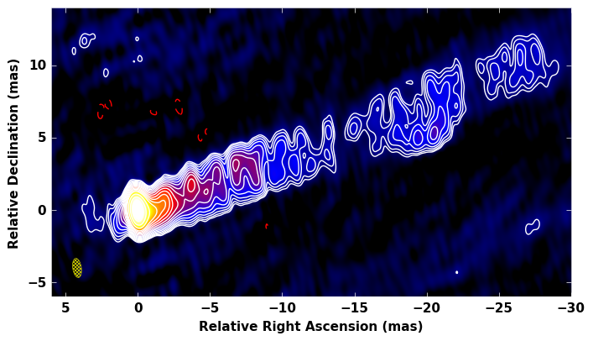
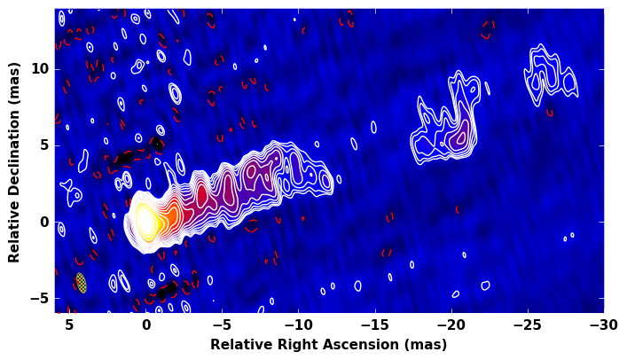
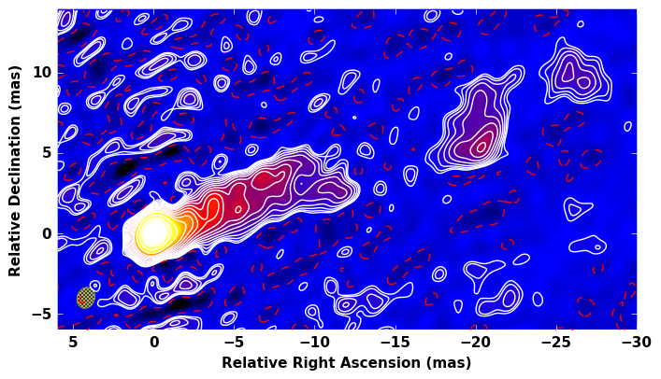
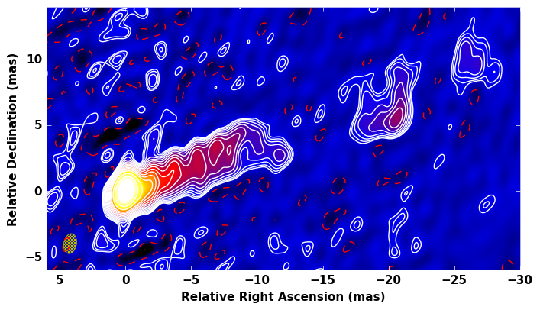
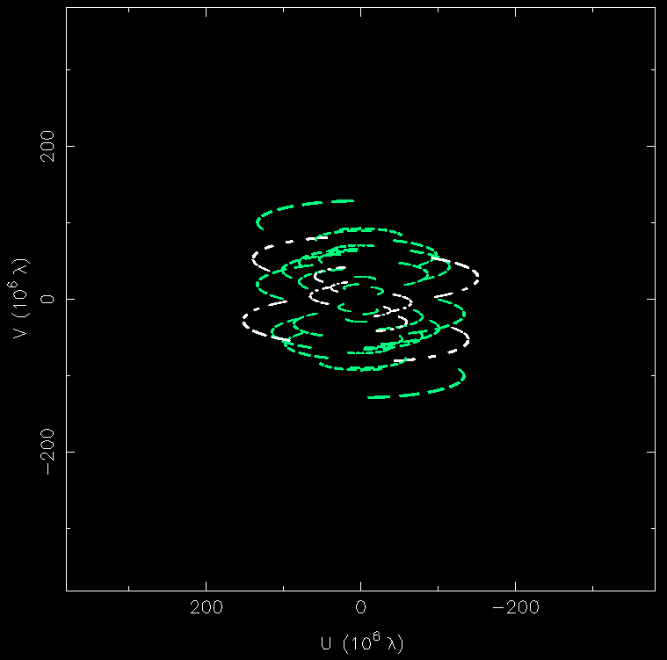
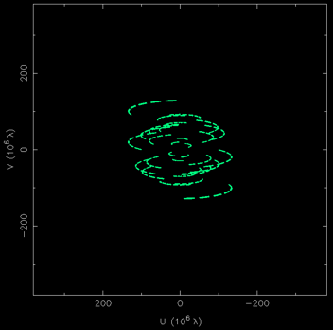
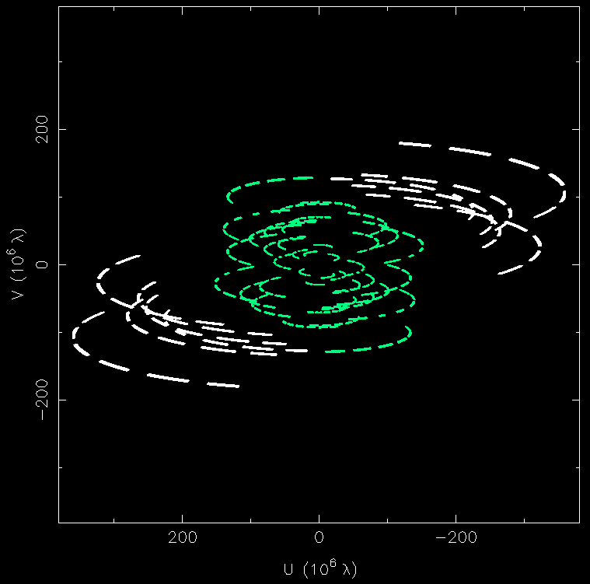
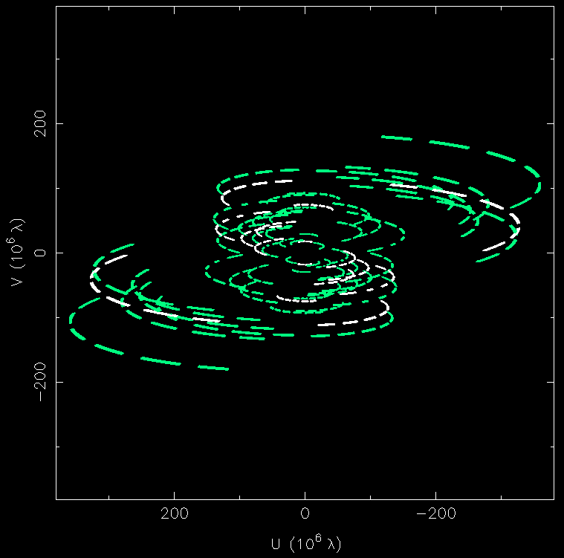
M87
KaVA
+TM
+UR
+HT
2017 March 18 (22GHz)
More results on EAVN-M87-2017 (22/43, spectra, kinematics, jet base)
=> Poster by Yuzhu Cui

Slide 11
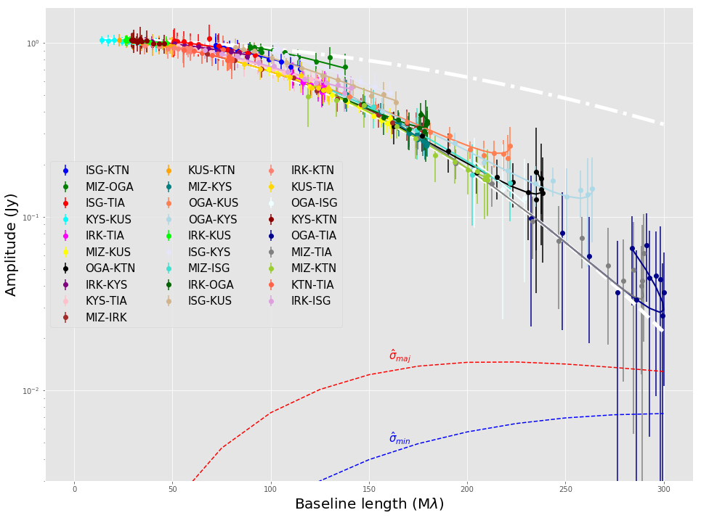
SgrA*
Zhao+ in prep
KaVA+Tianma@43GHz
EAVN: Very dense uv-coverage for SgrA
First 300Mλ detection at 43GHz (Tianma - Ogasawara)
Non-gaussianity?
Contemporaneous 22GHz data => scattering properties
Millimeter-regime core-shift with KVN
More SgrA results
=> Posters by Guangyao Zhao & Ilje Cho

Slide 12
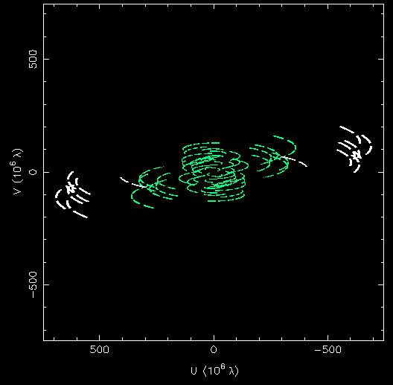
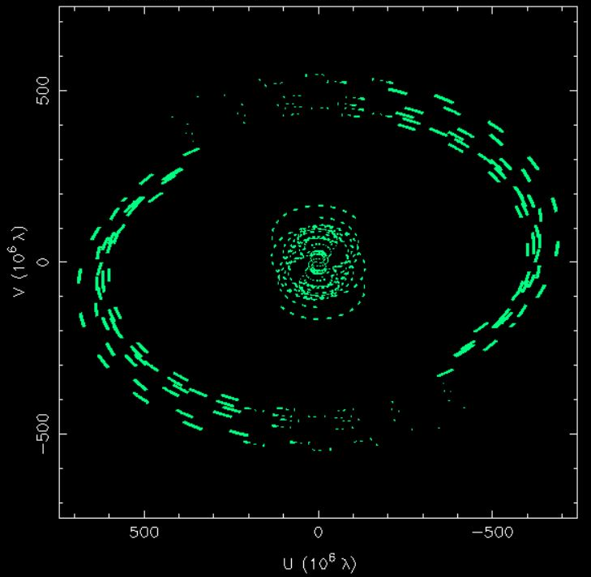
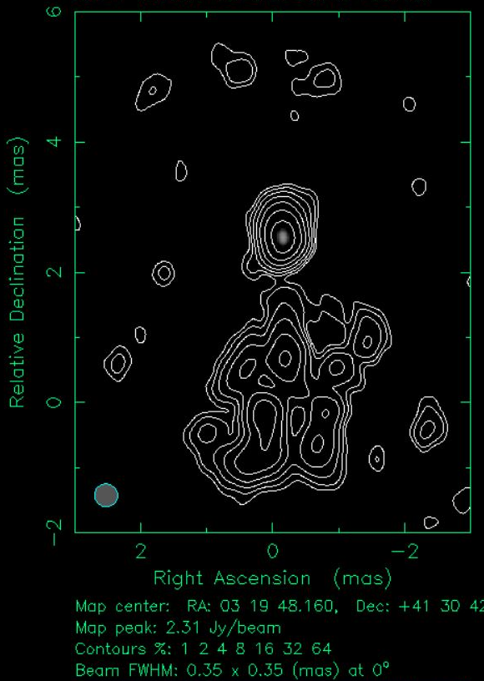
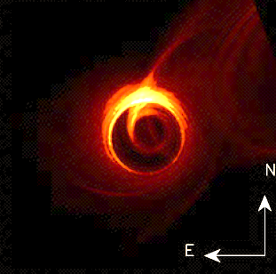
East Asia To Italy: Nearly Global VLBI
M87: Dec +12 °
3C84: Dec +41°
KaVA+TM+UR+HT+Medicina
@22GHz
KaVA+
Medicina+Noto @22GHz
Resolution
~20Rs
10000km baselines @22/43GHz
Global VLBI with regular monitoring capability
Resolution
~19Rs
?
?
More EATING results => Poster by Bong Won Sohn
Moscibrodzka+2016

Slide 13
More results are being produced
Jet-ambient interaction (Kino+2018)
γ-ray active blazars (T. Kim+, see poster)
z > 5 quasars (Zhang+2018)
NLSy1 (Wajima+)
GL blazars (Hada+)

Slide 14
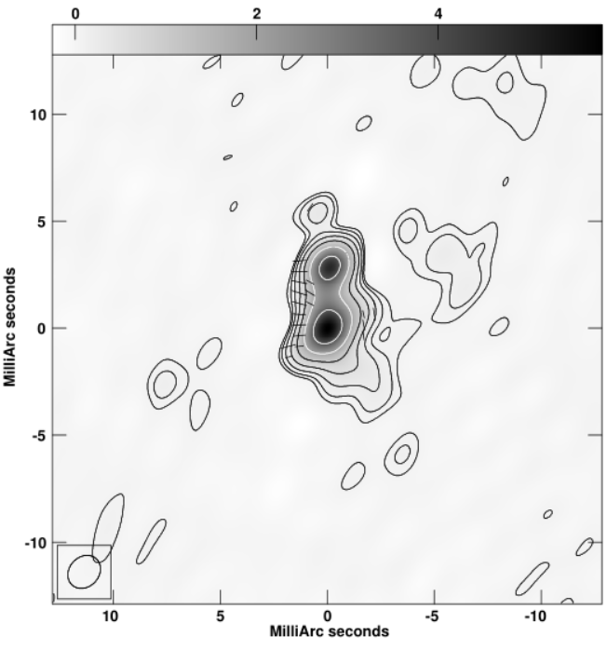
More to come
3C84
KVN+Miz+Irk@22GHz
KaVA/EAVN polarization commissioning (K & Q) actively ongoing
KVN/CVN ready, VERA 2 stations complete. The other 2 VERA stations will be ready within 1-2yr
Phase vs time, baselines to Mizusawa
See Poster
by Sohn BW
Expansion of K/Q Quasi-optics to KaVA
  Extension of coherence time at high ν
  Simultaneous AGN spectra
  Astrometry, core-shift
Further QO array expansion ongoing
  +Yebes, Nobeyama, Tianma, Sejong…
Zhao, Jung+ submitted
Red: raw 43GHz phase
Blue: FPT calibrated 43GHz phase using 22GHz

Slide 15
Summary
VLBI collaboration in EA is rapidly expanding, forming the East Asian VLBI Network
  Much higher sensitivity, imaging quality, resolution with regular monitoring capability
Intensive KaVA/EAVN monitoring of SgrA/M87, complement EHT
Regular monitoring of various interesting sources
Rapid expansion of array capability for AGN studies
  EATING VLBI, polarization, K/Q QO, wideband, VLBI-FAST
More and more results are emerging, stay tuned
We wish to collaborate with you!

Slide 17
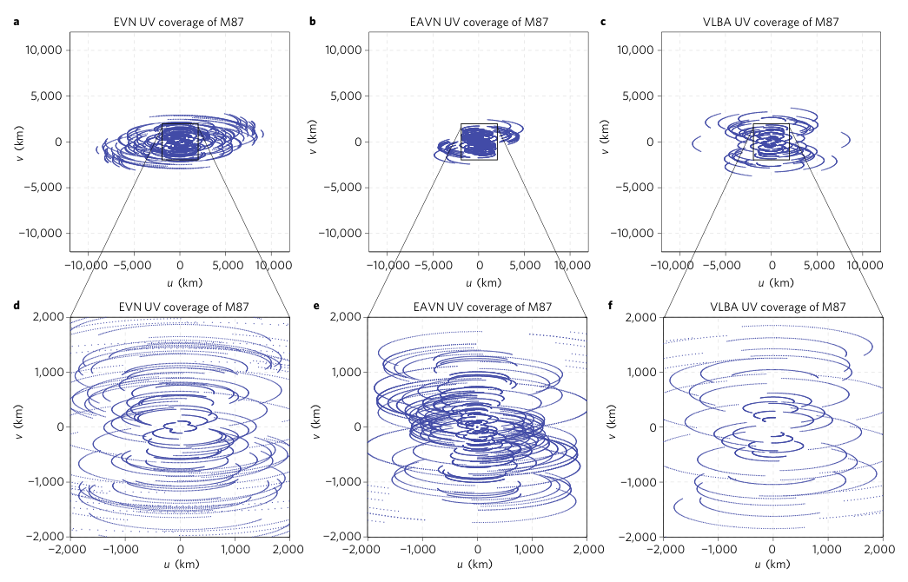
An, Sohn, Imai 2018

