Slide 1
A study of the physical environments of evolved stars from the SiO and H₂O masers
Youngjoo Yun, Se-Hyung Cho, María J. Rioja, Richard Dodson
and KVN evolved stars working group members
14th EVN Symposium & Users Meeting
Granada, October 8-11 2018

Slide 2
A study of the physical environments of evolved stars from the SiO and H₂O masers
(using KVN)
Youngjoo Yun, Se-Hyung Cho, María J. Rioja, Richard Dodson
and KVN evolved stars working group members
14th EVN Symposium & Users Meeting
Granada, October 8-11 2018

Slide 3
Outline
Introduction to KVN and stellar masers
Results of KVN for the masers
Summary and future works

Slide 4
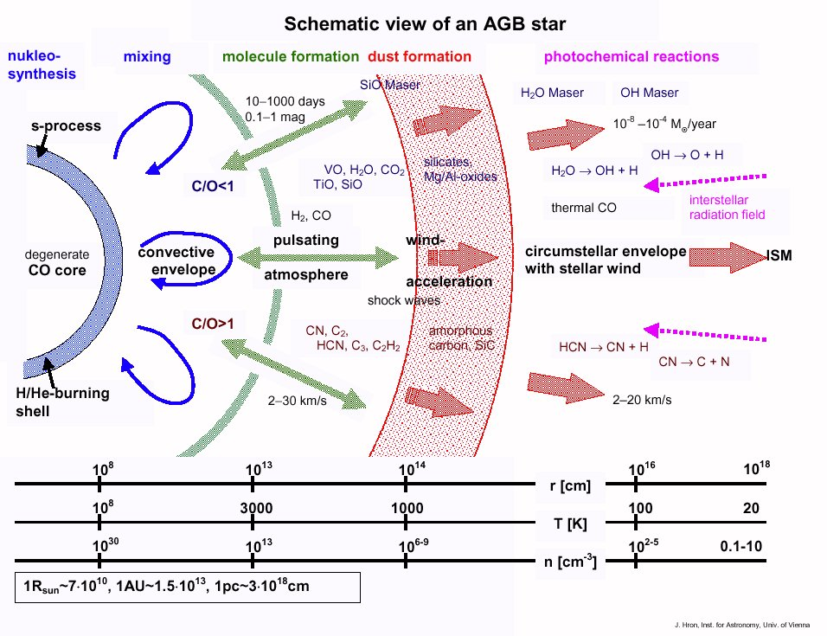
Physical environments of AGB stars
Credit: J. Hron

Slide 5
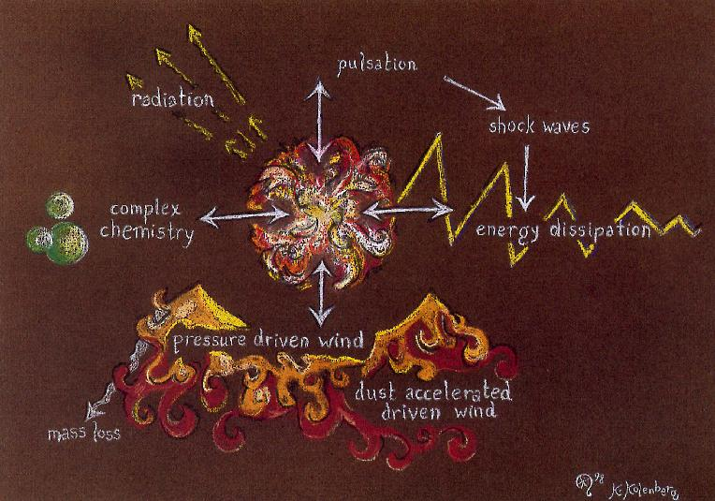
Physical environments of AGB stars
Figure from J. Alcolea, 7th EVN Symp.

Slide 7
Physical environments of AGB stars
Credit: J. Hron

Slide 8
Physical environments of AGB stars
Mass-loss phenomena are crucial to study the AGB evolution.
How can we see the mass-loss during the period ABG to PN?
MASER is an unique tool to study the physical environments of AGB stars
So many AGBs show maser emission (statistical analysis can be done)
Different characteristics of the maser (distribution, variability, intensity) for each source
Different masing regions according to the different molecules and transitions in the same source → enable us to trace the physical characteristics of CSEs along the distance from the central star
The highest spatial resolution → enable us to get the dynamical information of the very local area → initiate-region of pulsation and outflow motion
Credit: J. Hron

Slide 9
Masers in CSEs of evolved stars
Different species of maser can occur at the same source.
→ probe different regions
SiO maser v=1, J=1-0 (43 GHz)
T_{k} ~ 1500 K
n (H₂) ~ 10⁹ – 10¹¹ cm⁻³
Water maser (22 GHz)
T_{k} ~ 400 – 1000 K
n (H₂) ~ 10⁸ – 10¹⁰ cm⁻³
OH maser (1665/7 MHz)
T_{k} ~ 100 K
n (H₂) ~ 10⁵ cm⁻³
Credit: J. Hron

Slide 10
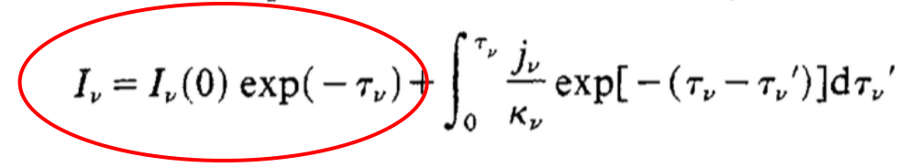
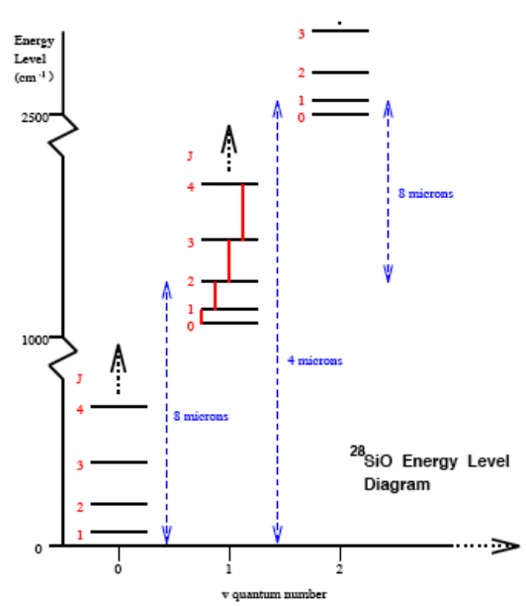
Astrophysical masers
Microwave Amplification by Stimulated Emission of Radiation
Population inversion → exponential amplification along the path (when unsaturated)
Pumping condition: collisional or radiative
Highly beamed (not isotropic)
Narrow line width in spectra
Temporal variability
Can be polarized

Slide 11
Stellar masers show us their
Morphology, spatial distribution
  Ring-like structures, spoke-like features
  Bipolar outflow feature
  The degree of clumpiness
Temporal variability
Kinematics
Polarization

Slide 12
Stellar masers show us their
Morphology, spatial distribution
  Ring-like structures, spoke-like features
  Bipolar outflow feature
  The degree of clumpiness
Temporal variability
Kinematics
Polarization
→ Monitoring VLBI observation is the best way to trace the maser story along the stellar evolution.

Slide 13
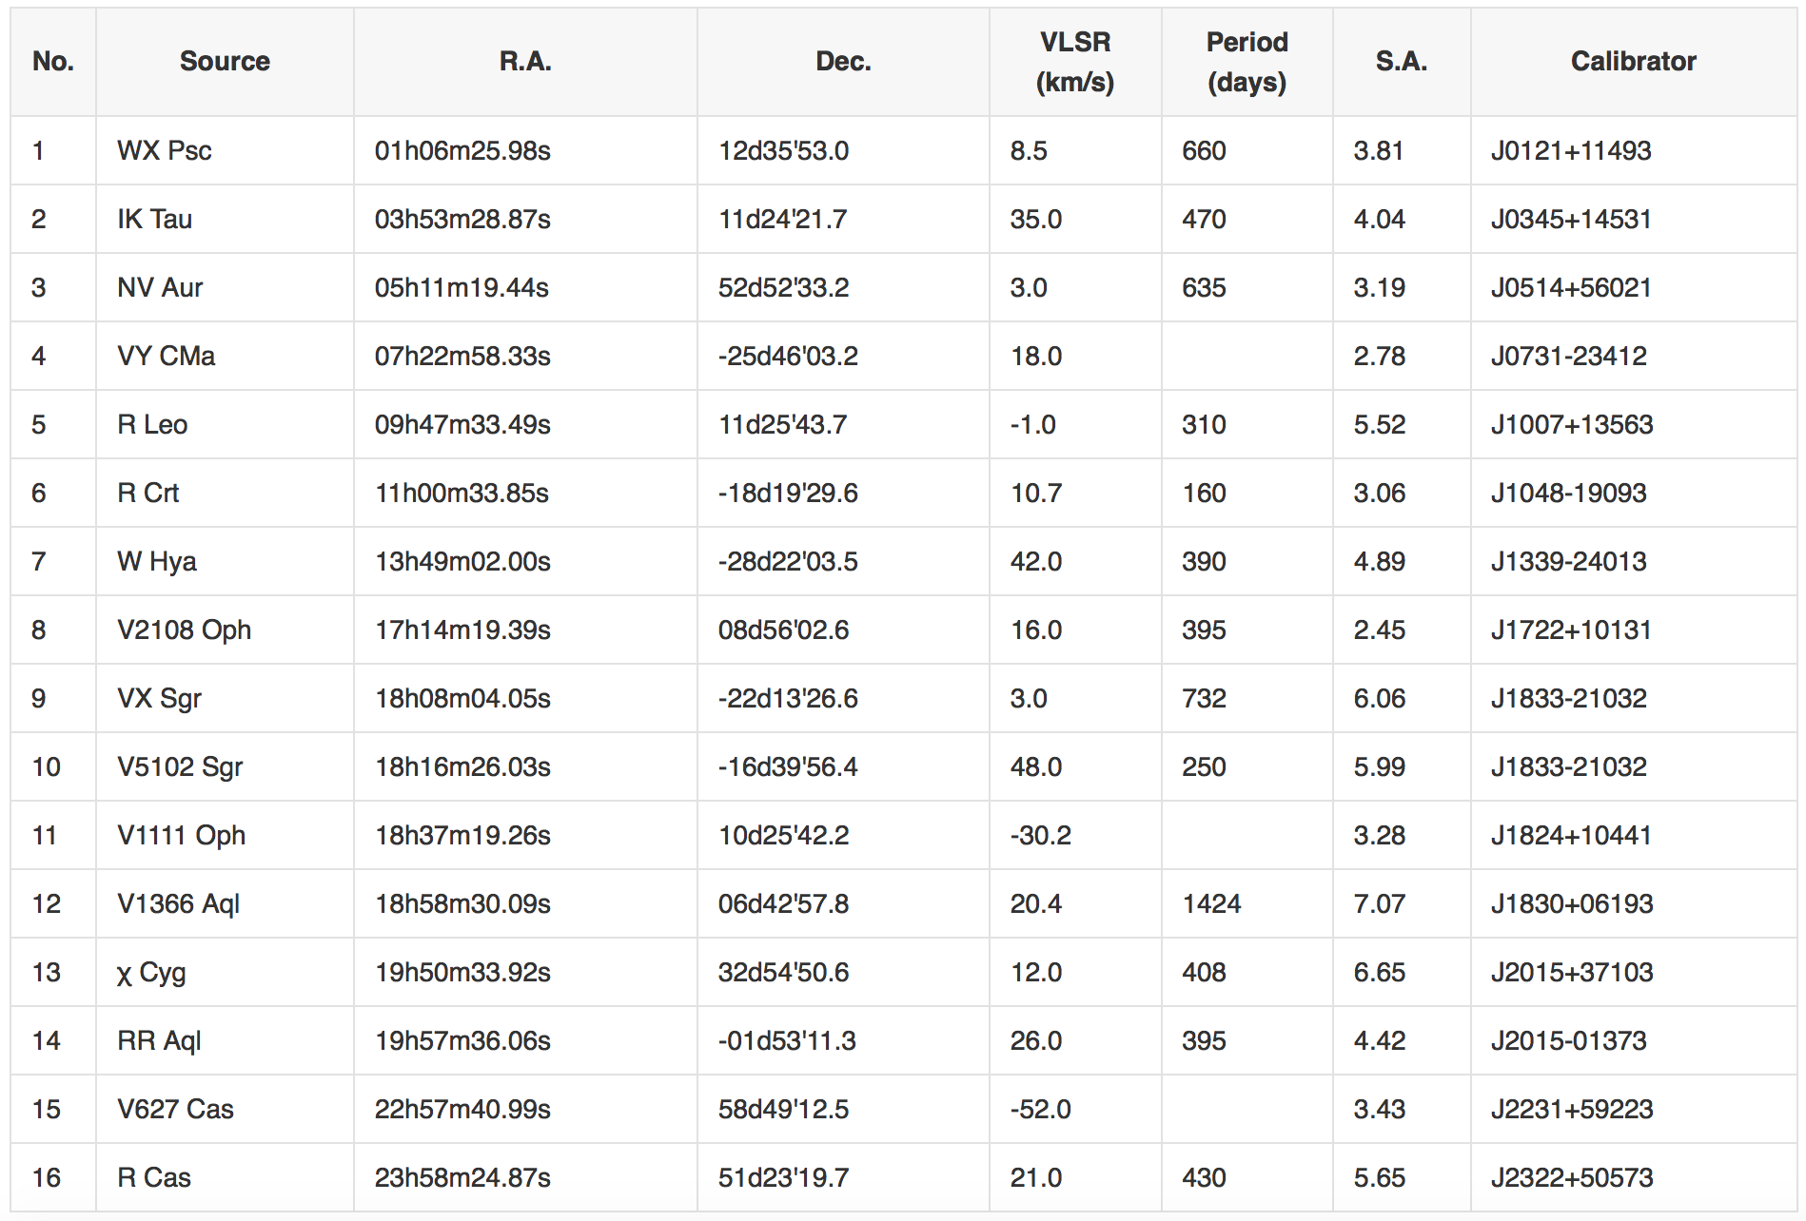
KVN key science project (KSP)

Slide 14
KVN key science project (KSP)

Slide 15
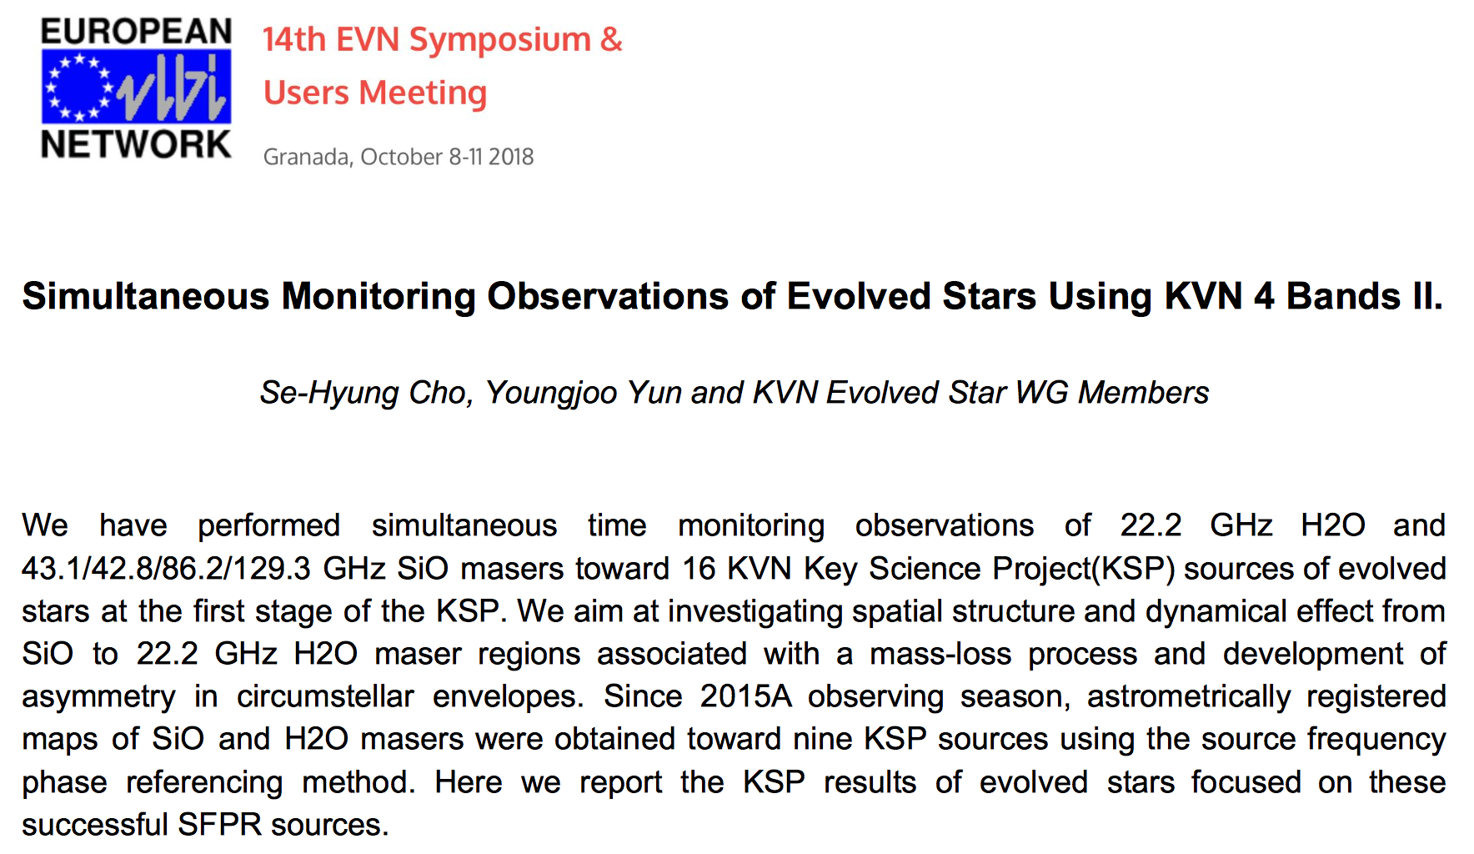
Please, visit …
More details for KVN observations in Dr. Se-Hyung Cho’s poster

Slide 16

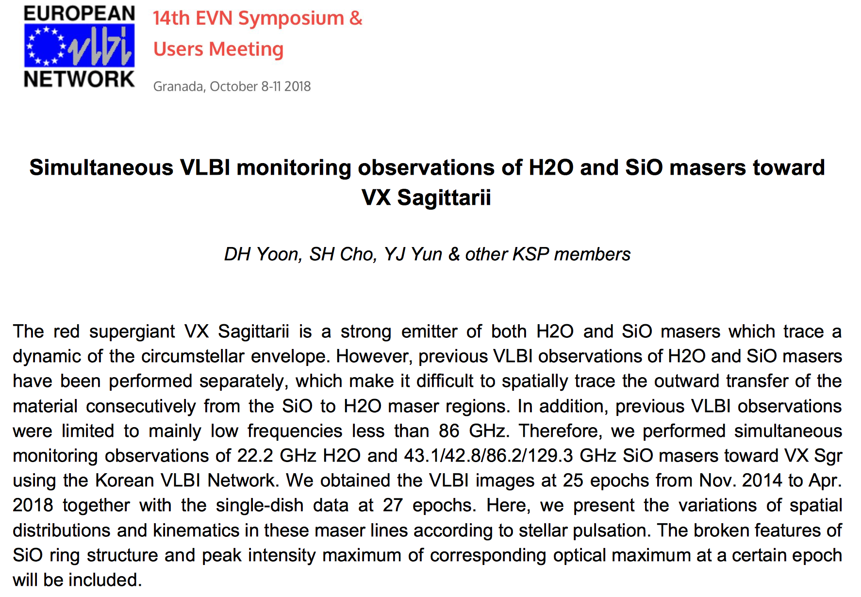
Four bands astrometry for VX Sgr by Dong-Hwan Yoon
Please, don’t miss his poster session.

Slide 17
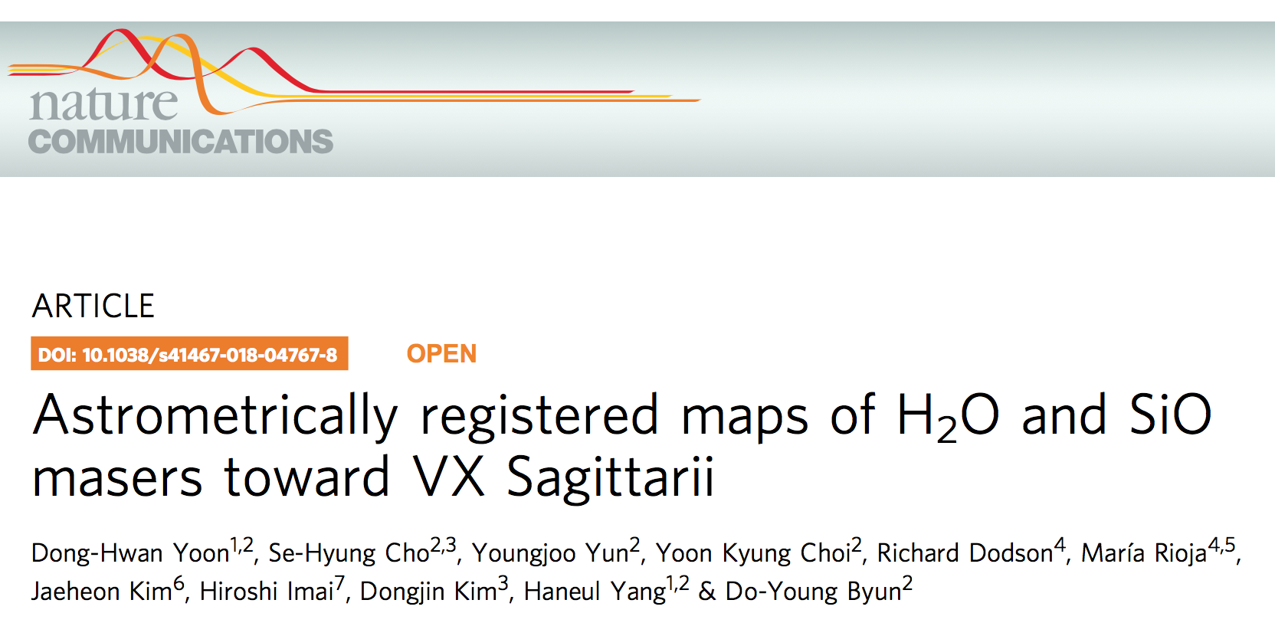
Four bands astrometry for VX Sgr by Dong-Hwan Yoon

Slide 18

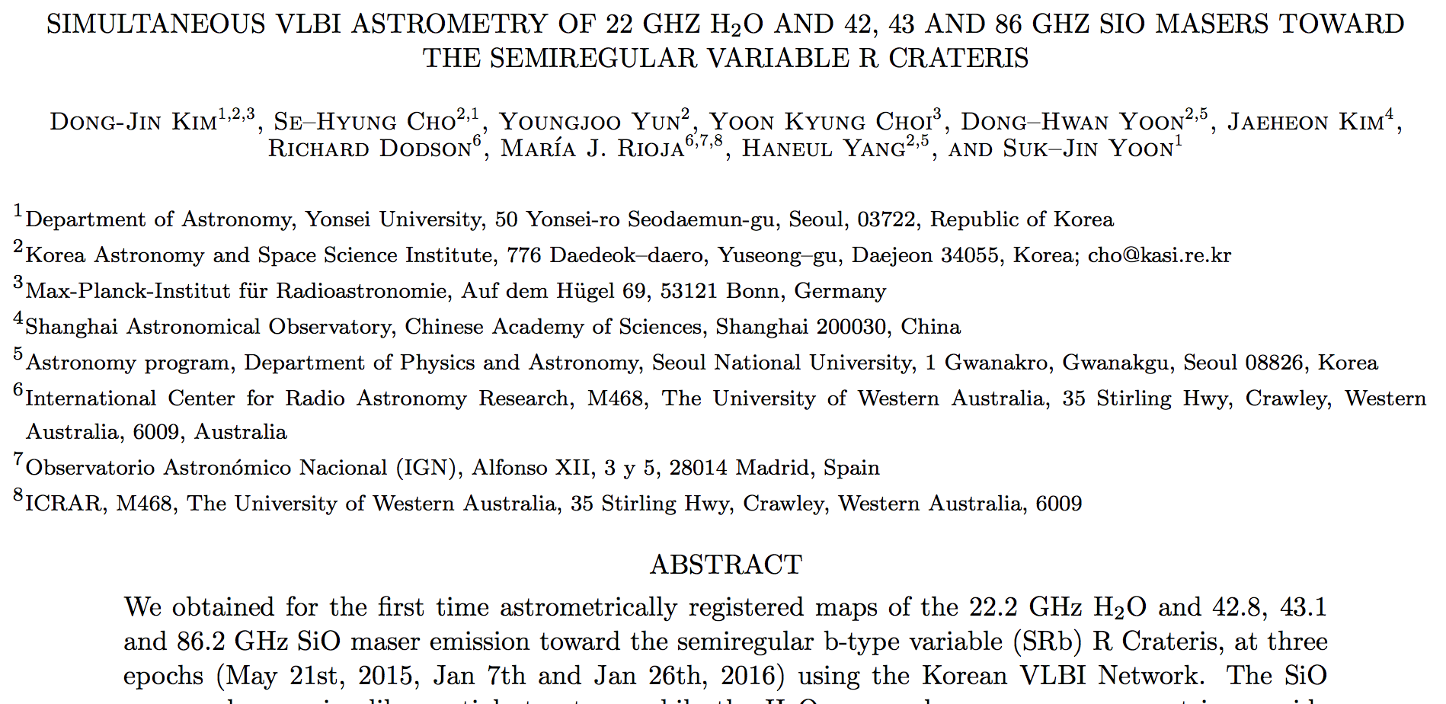
Interesting results of R Crt by Dong-Jin Kim,
accepted in ApJL

Slide 19
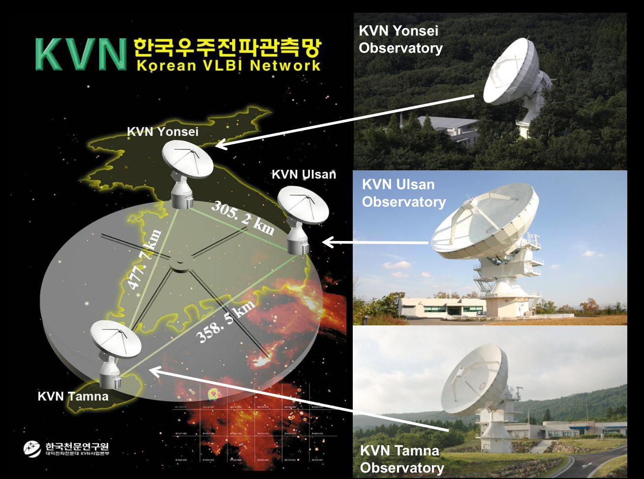
Multi-frequency simultaneous observations of KVN
+ ?

Slide 20
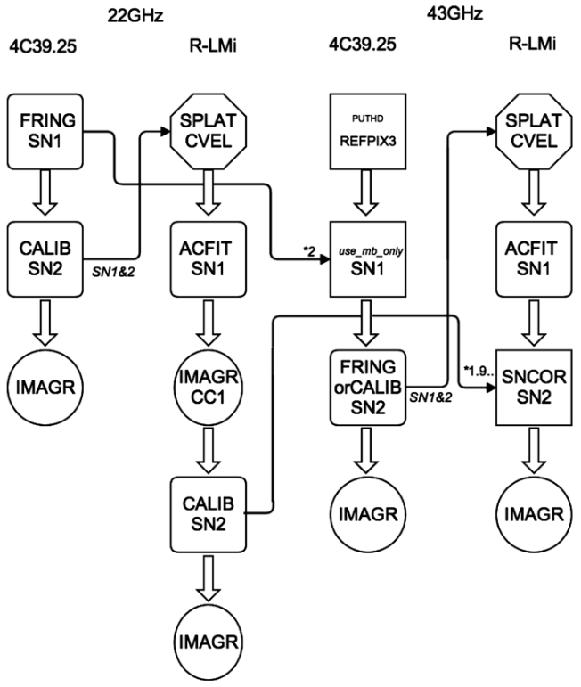
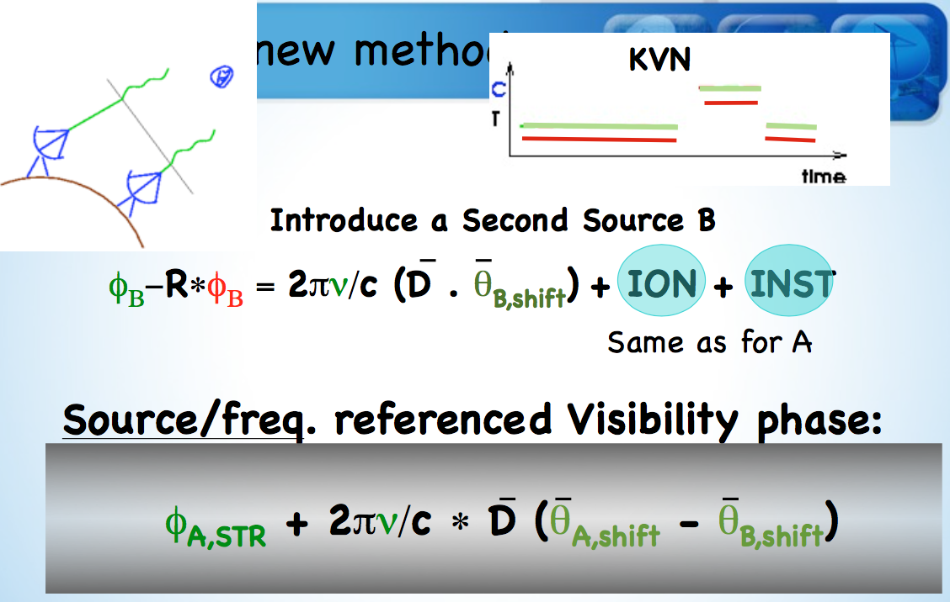
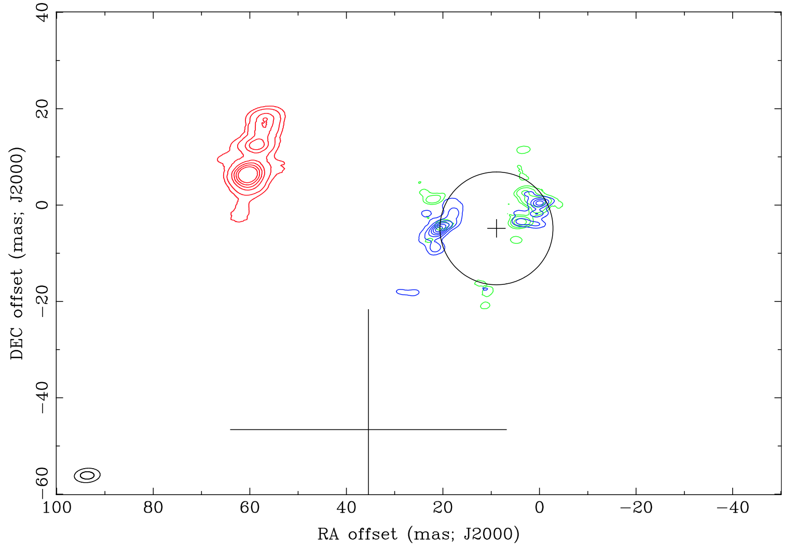
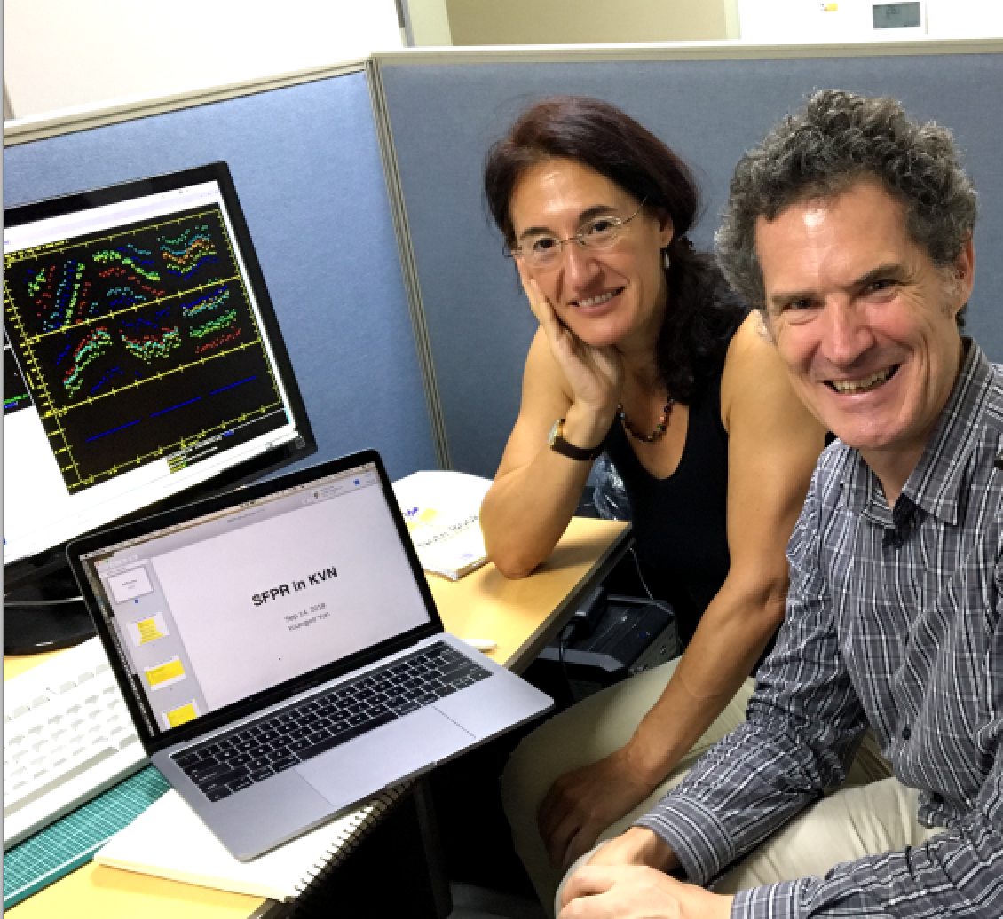
Source Frequency Phase Referencing (SFPR)
May the SFPR
be with you!
Richard Dodson and Maria J. Rioja (2014)

Slide 21
Introduction to KVN pipeline
It has been developed since 2016
to deal with KVN four frequency-bands data.
SFPR method for KVN astrometry is completely implemented.
  SFPR method is complicated and needs AIPS-external processes.
Fully-automated procedures of pipeline save a huge amount of time for human eye inspection.
  Best set of calibration solutions can be found automatically.
Consistency and repeatability of data reduction can be achieved by the pipeline processes along the multi-epoch observations.
Execution time ∼ 2 hours (for data with 4 bands, 256 MHz bandwidth, 16 IFs, 512 channels, 8 hours)

Slide 22
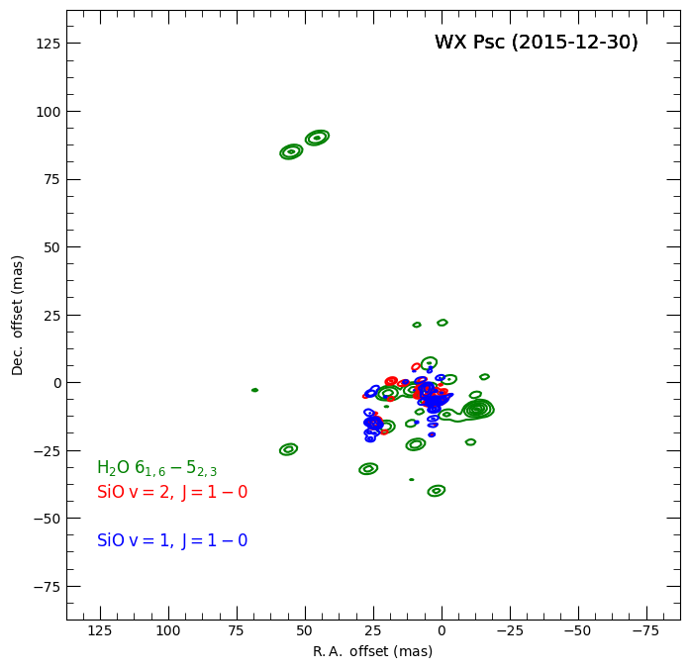
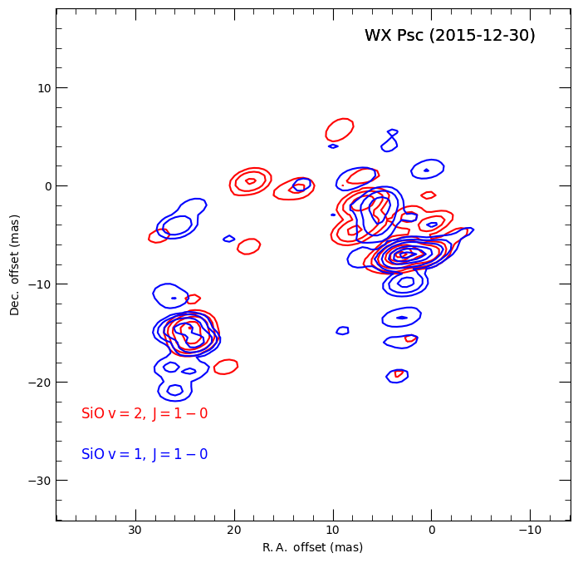
KVN results: IRC+10011 (WX Psc)
Asymmetric spatial distribution of water maser@22 GHz
Typical ring-like structures of SiO masers
Partially-overlapped similar spatial distributions of SiO masers
Opened in southern part of the ring

Slide 23
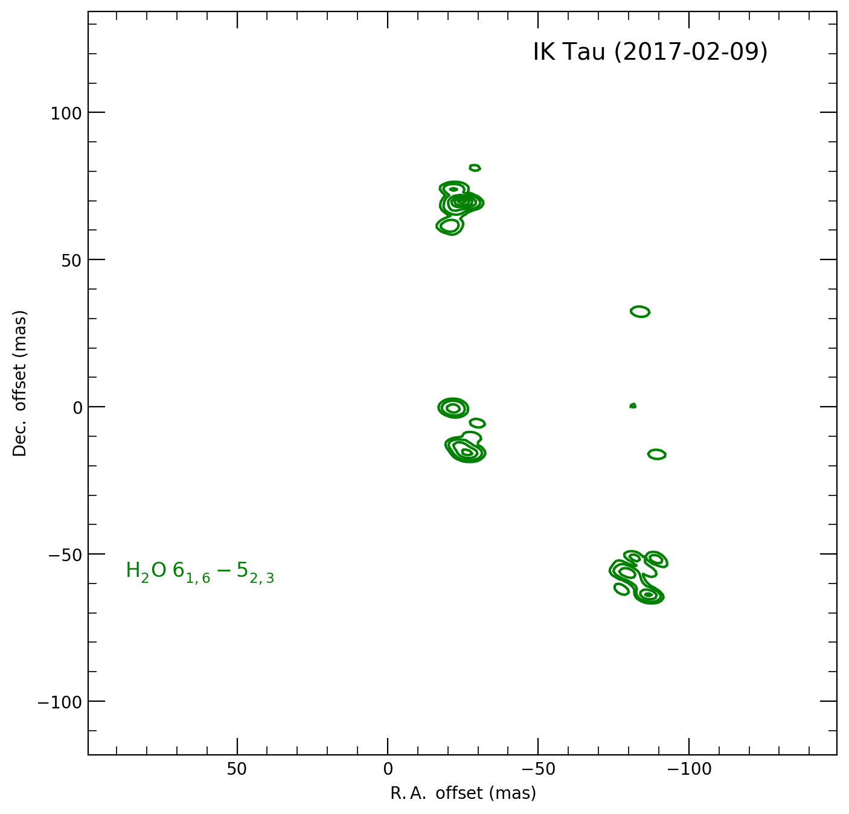
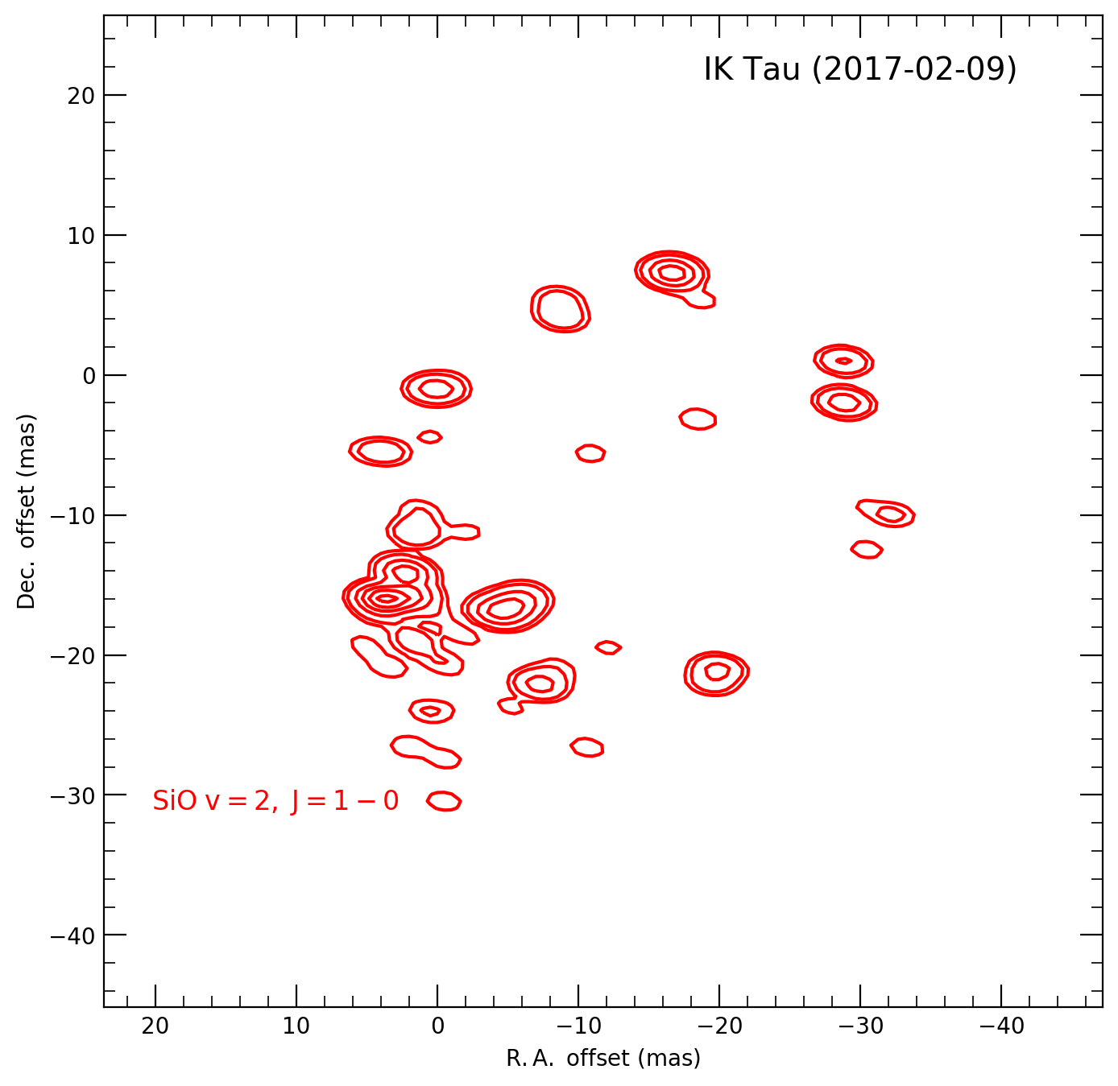
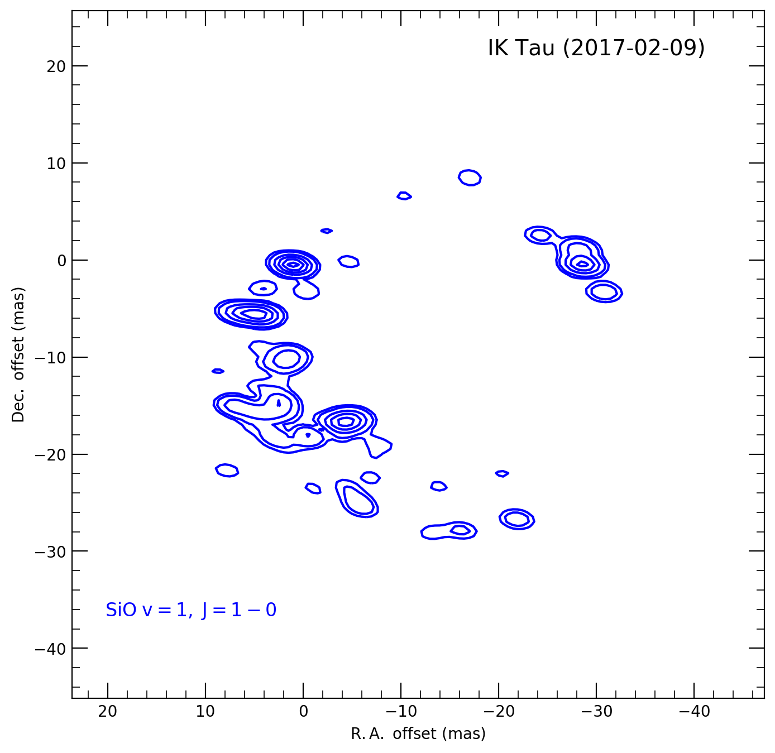
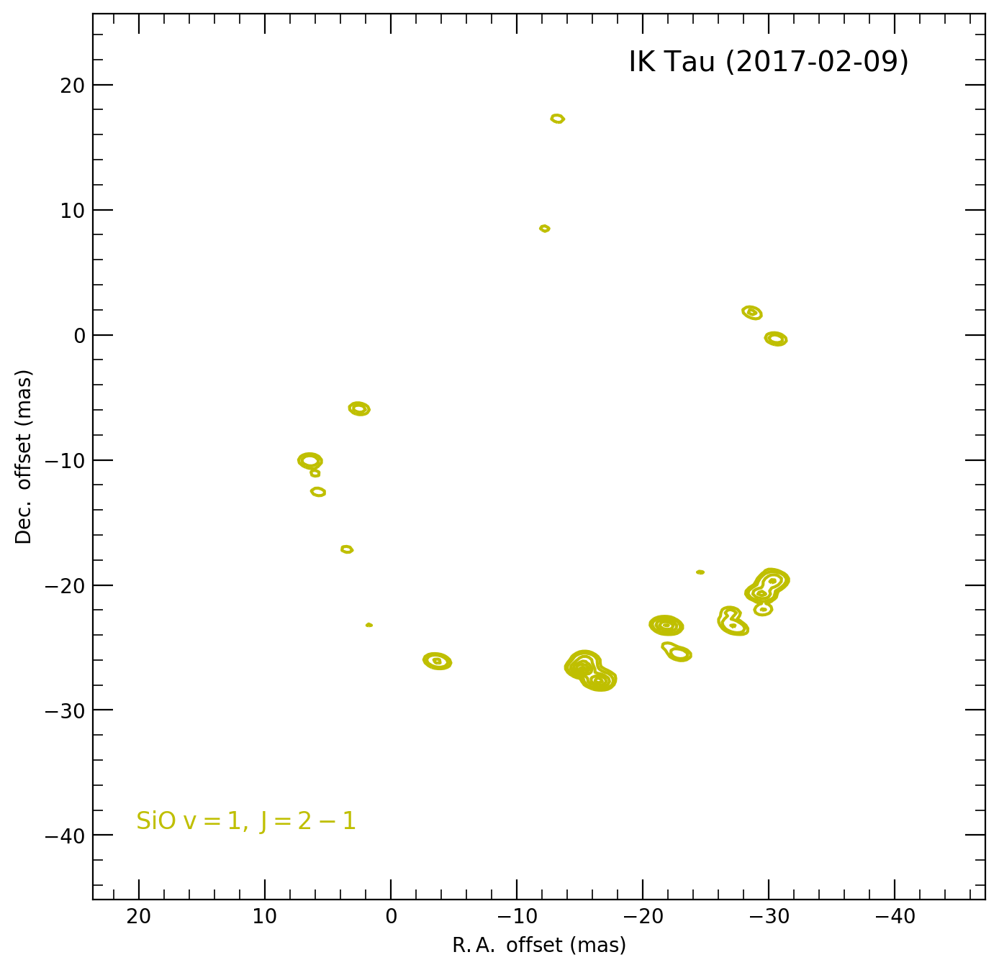
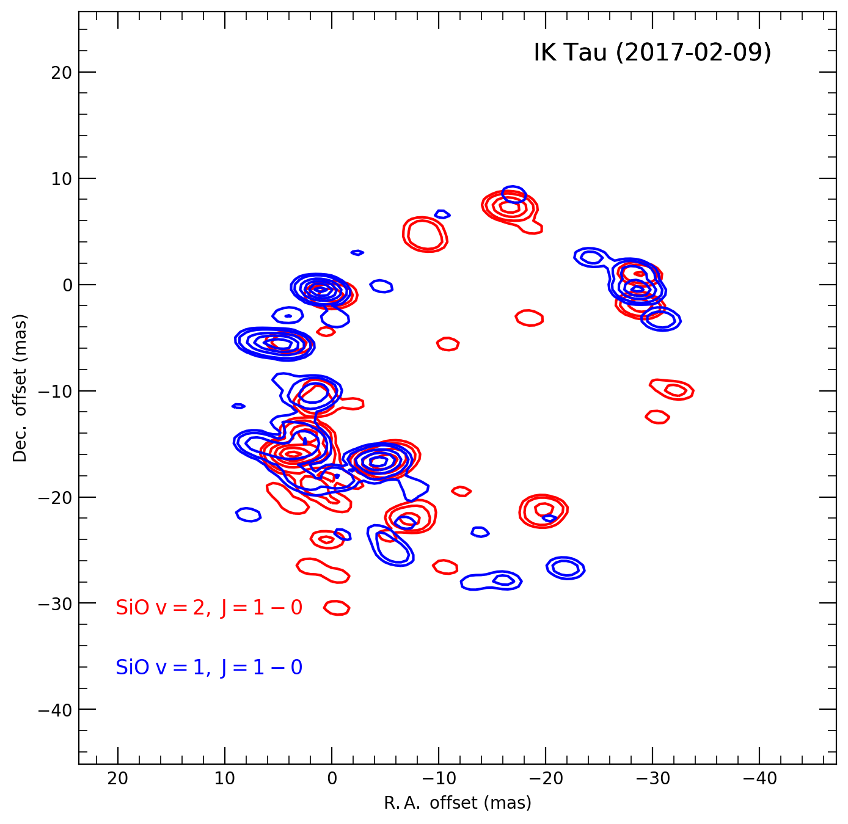
KVN results: IK Tau
22 GHz
42 GHz
43 GHz
86 GHz
42 GHz + 43 GHz
Crowded in SE part
of 7 mm SiO masers
Crowded in SE part
of 7 mm SiO masers
Crowded in SW part
of 3 mm SiO maser

Slide 24
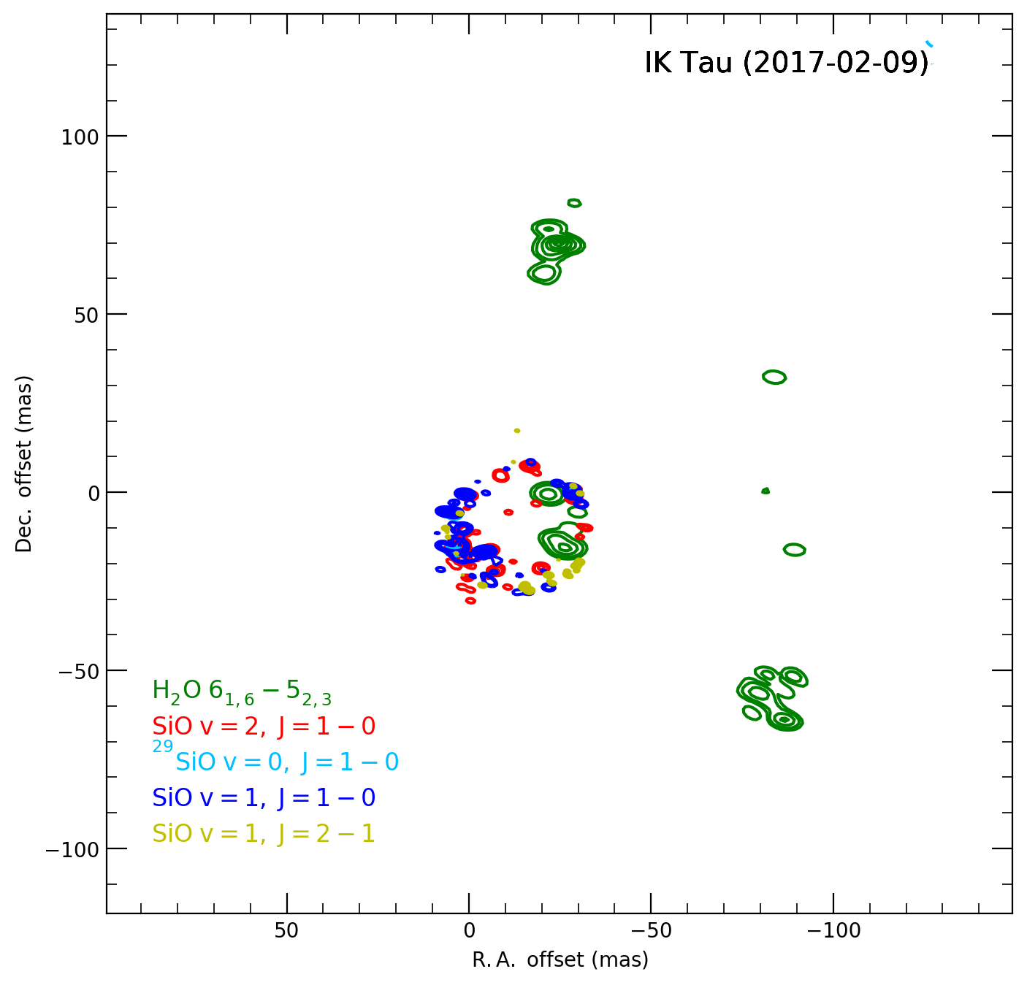
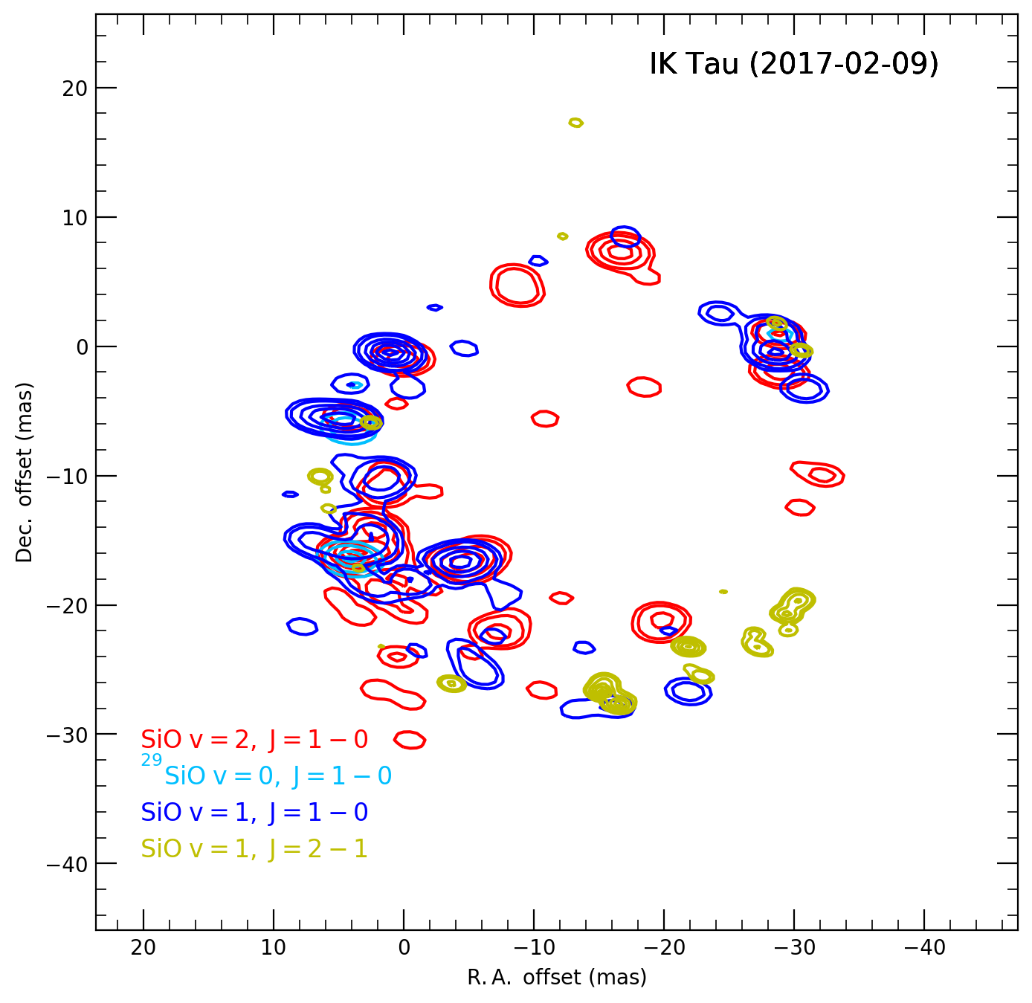
KVN results: IK Tau
Asymmetric spatial distribution of water maser@22 GHz
Typical ring-like structures of SiO masers

Slide 25
KVN results: IK Tau
Strong and crowded
Largely overlapped
SiO v=1 J=1-0
SiO v=2 J=1-0
SiO v=1 J=2-1
29SiO v=0 J=1-0
Clearly separated

Slide 26
KVN results: IK Tau
22 GHz
Bipolar outflow feature ?

Slide 27
KVN results: IK Tau
42 GHz
Similar velocity distribution of 7 mm SiO masers
43 GHz

Slide 28
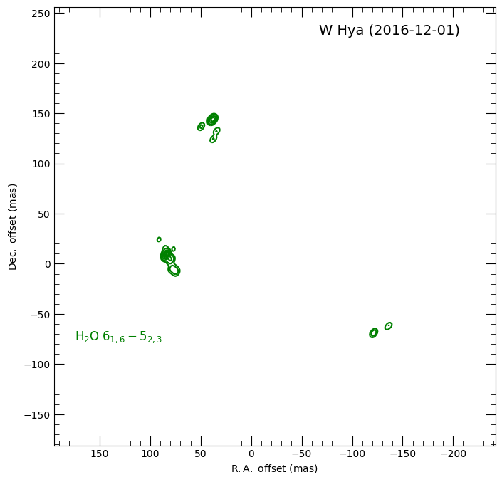
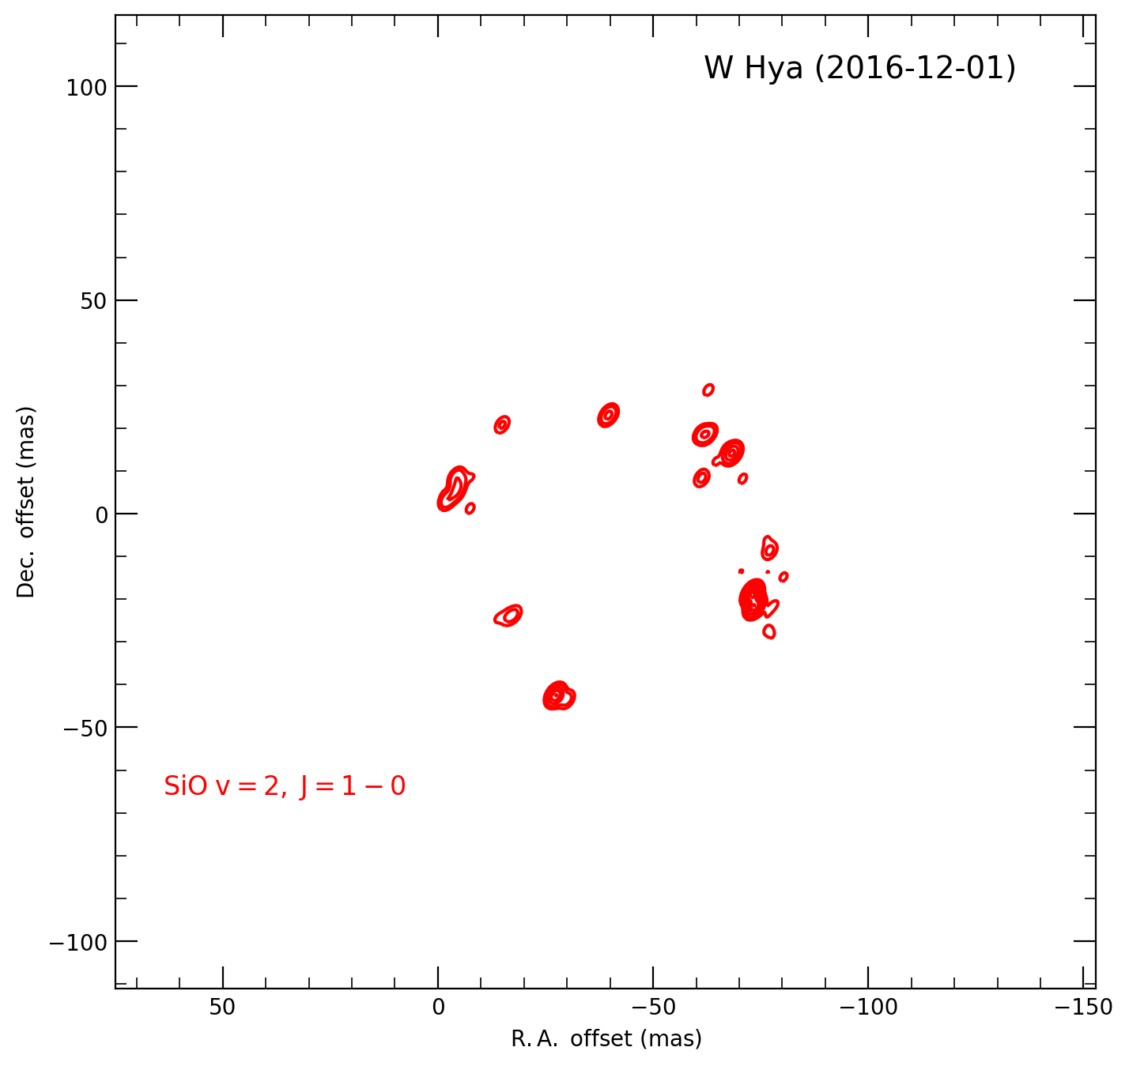
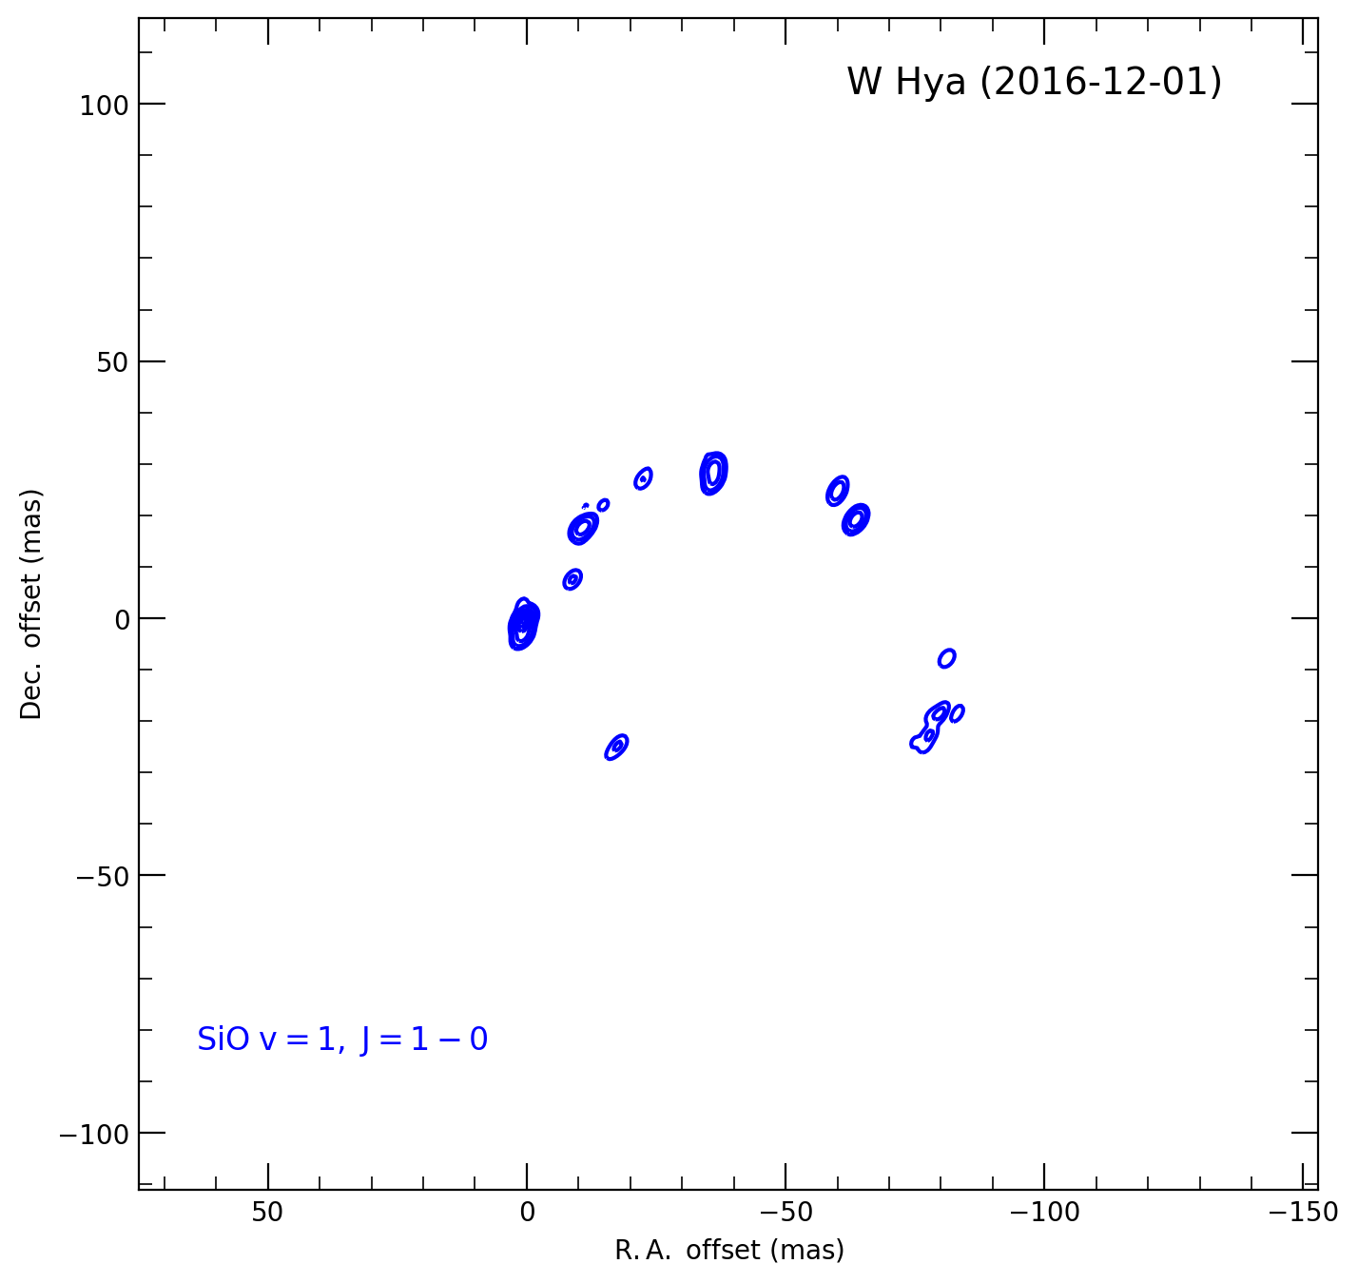
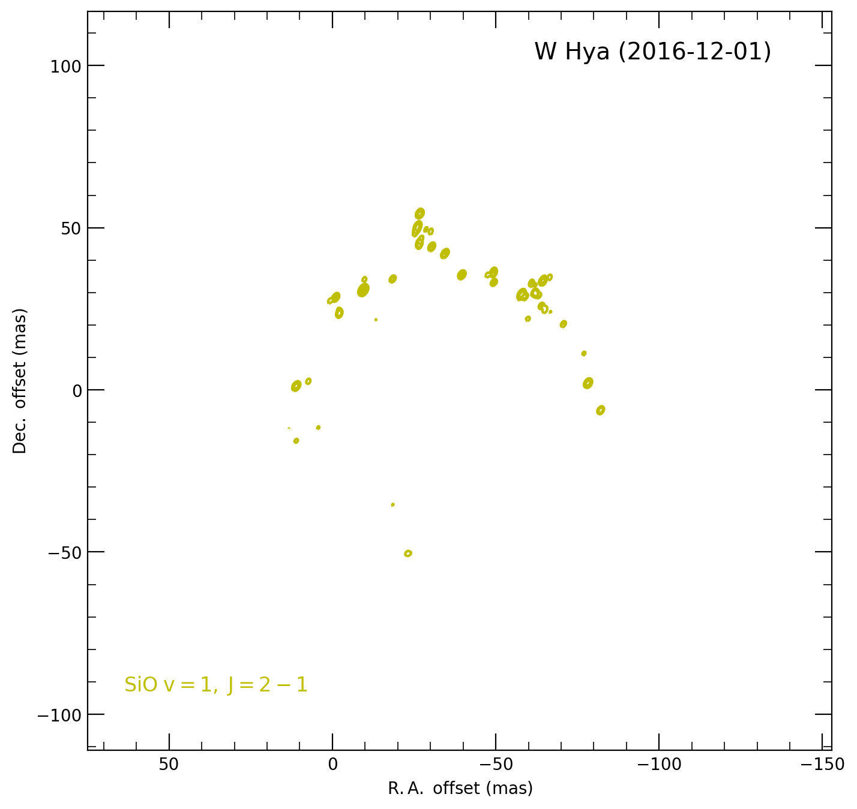
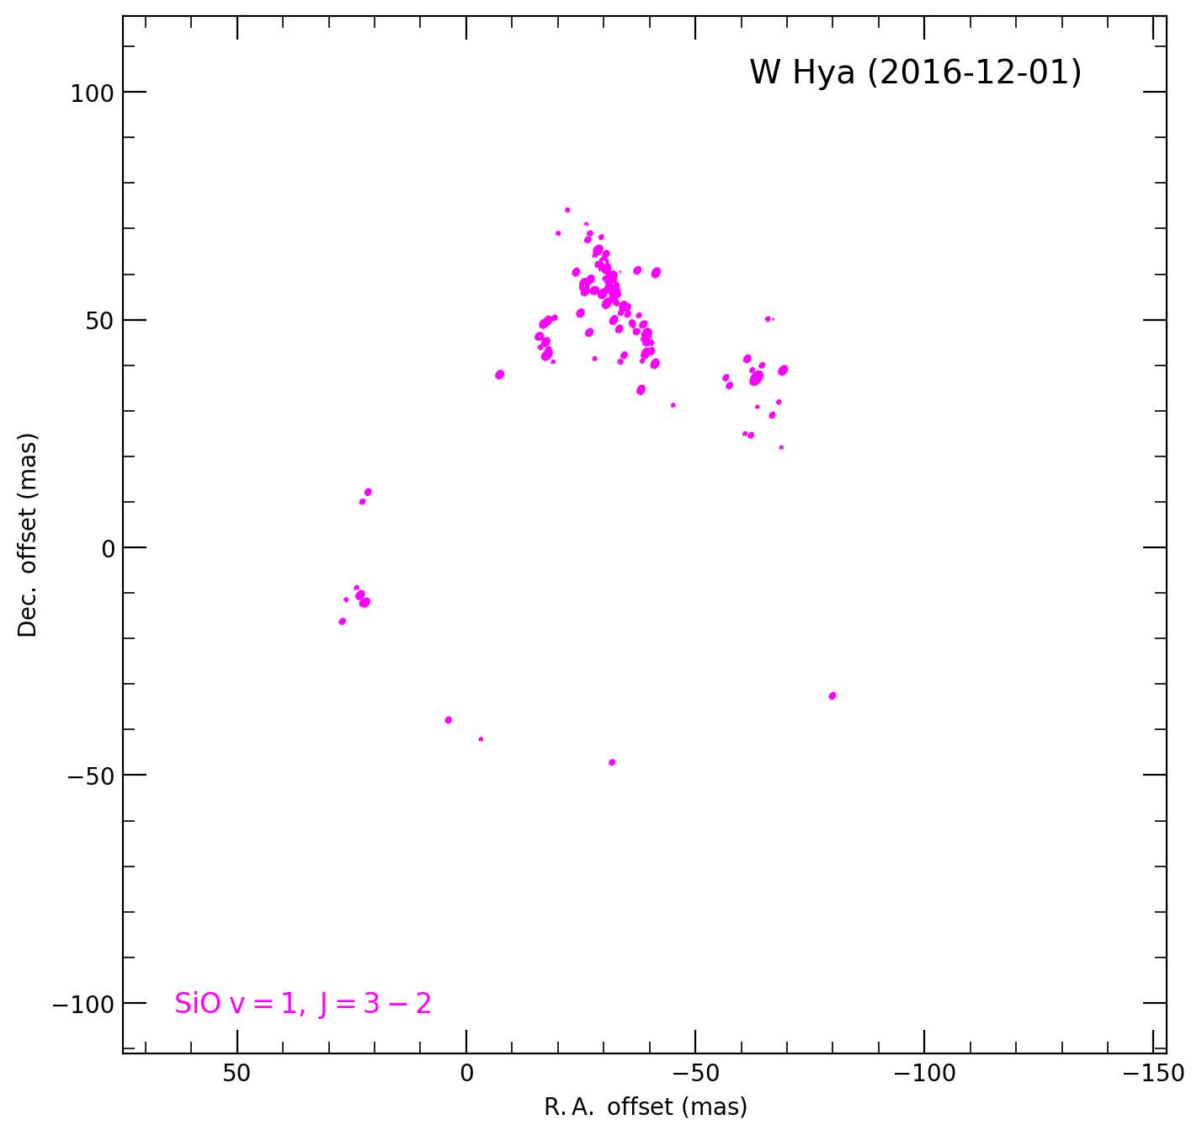
KVN results: W Hya
22 GHz
42 GHz
43 GHz
86 GHz
129 GHz
Ring with bumps
in 3 mm and 2 mm
SiO masers

Slide 29
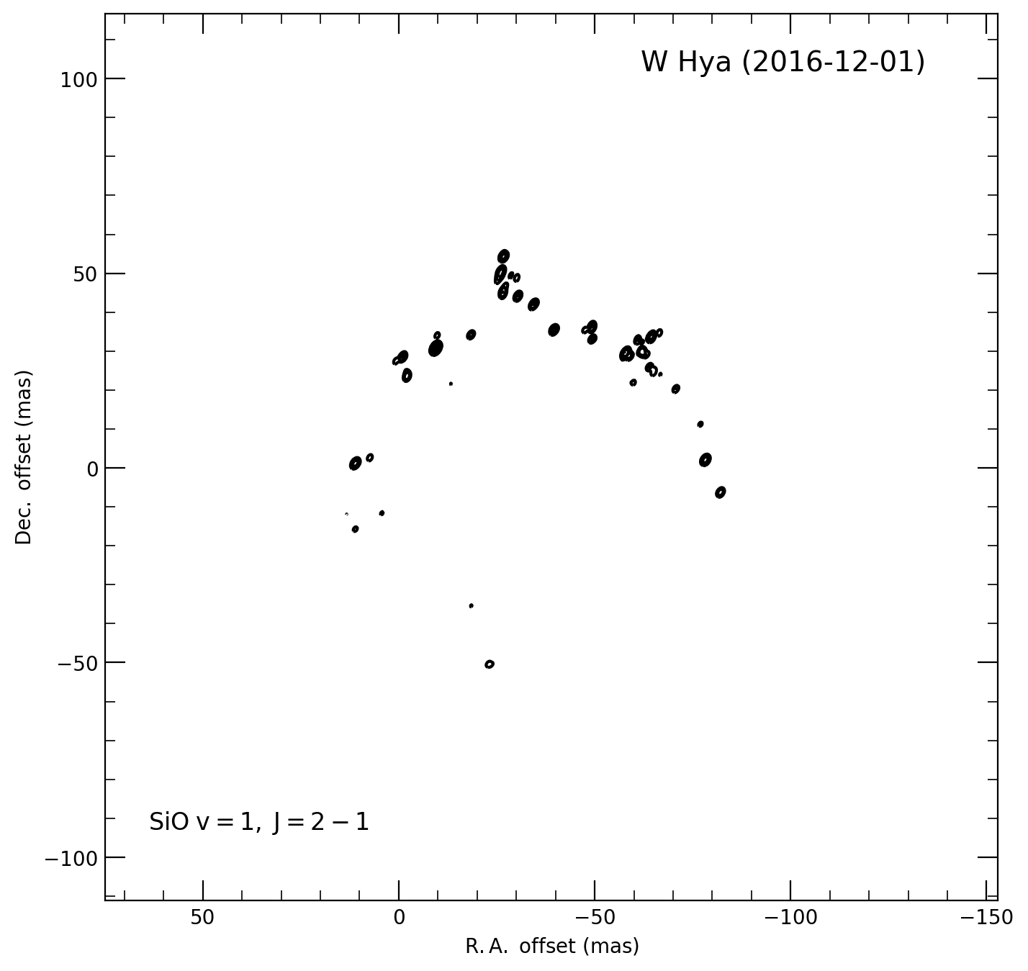
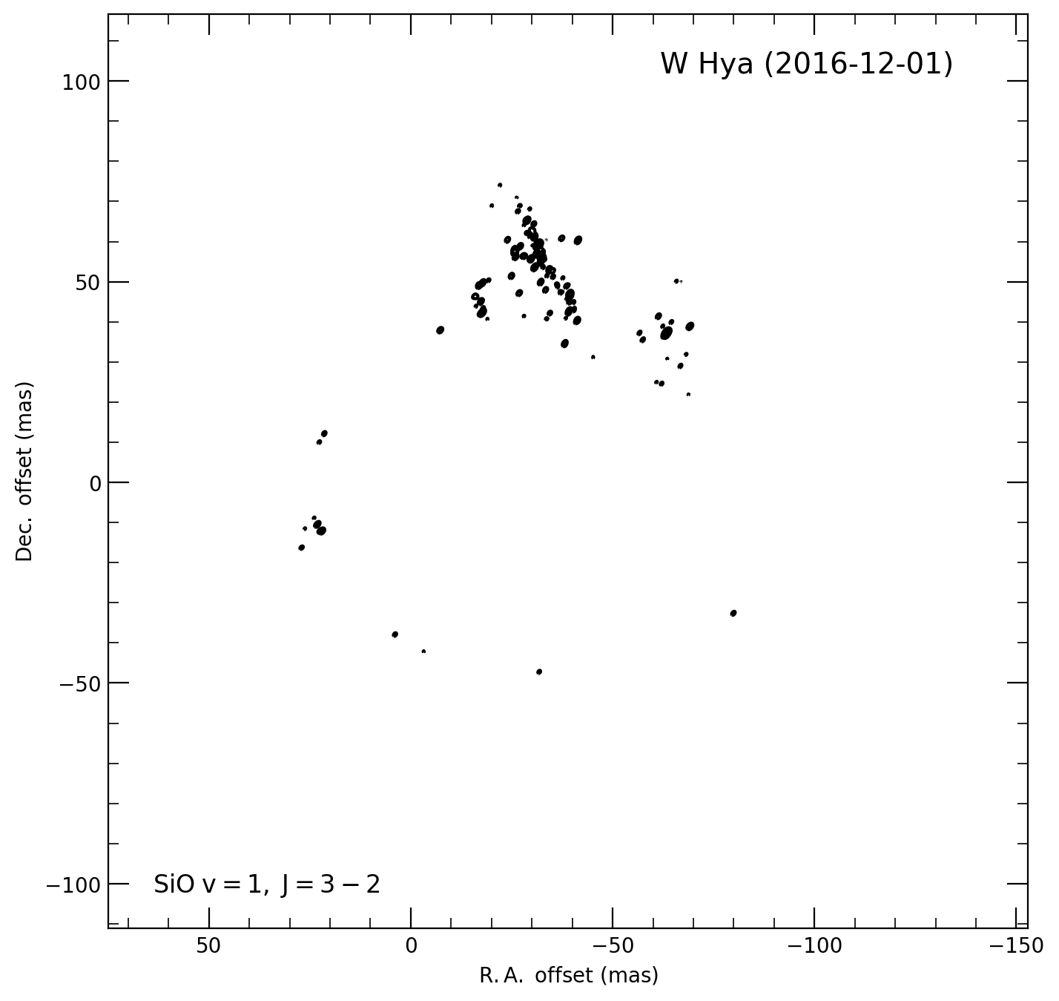
KVN results: W Hya
86 GHz
129 GHz
Beautiful ring with bumps in the northern part of 3 mm SiO maser
Strong and bumped features in the northern part of 2 mm SiO maser

Slide 30
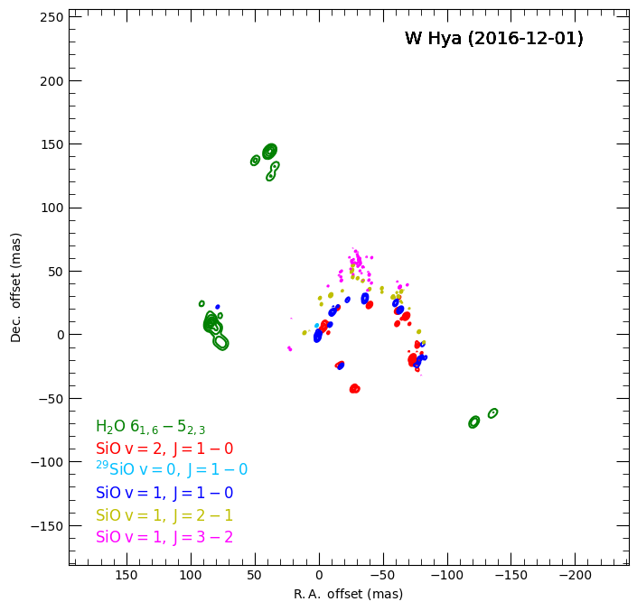
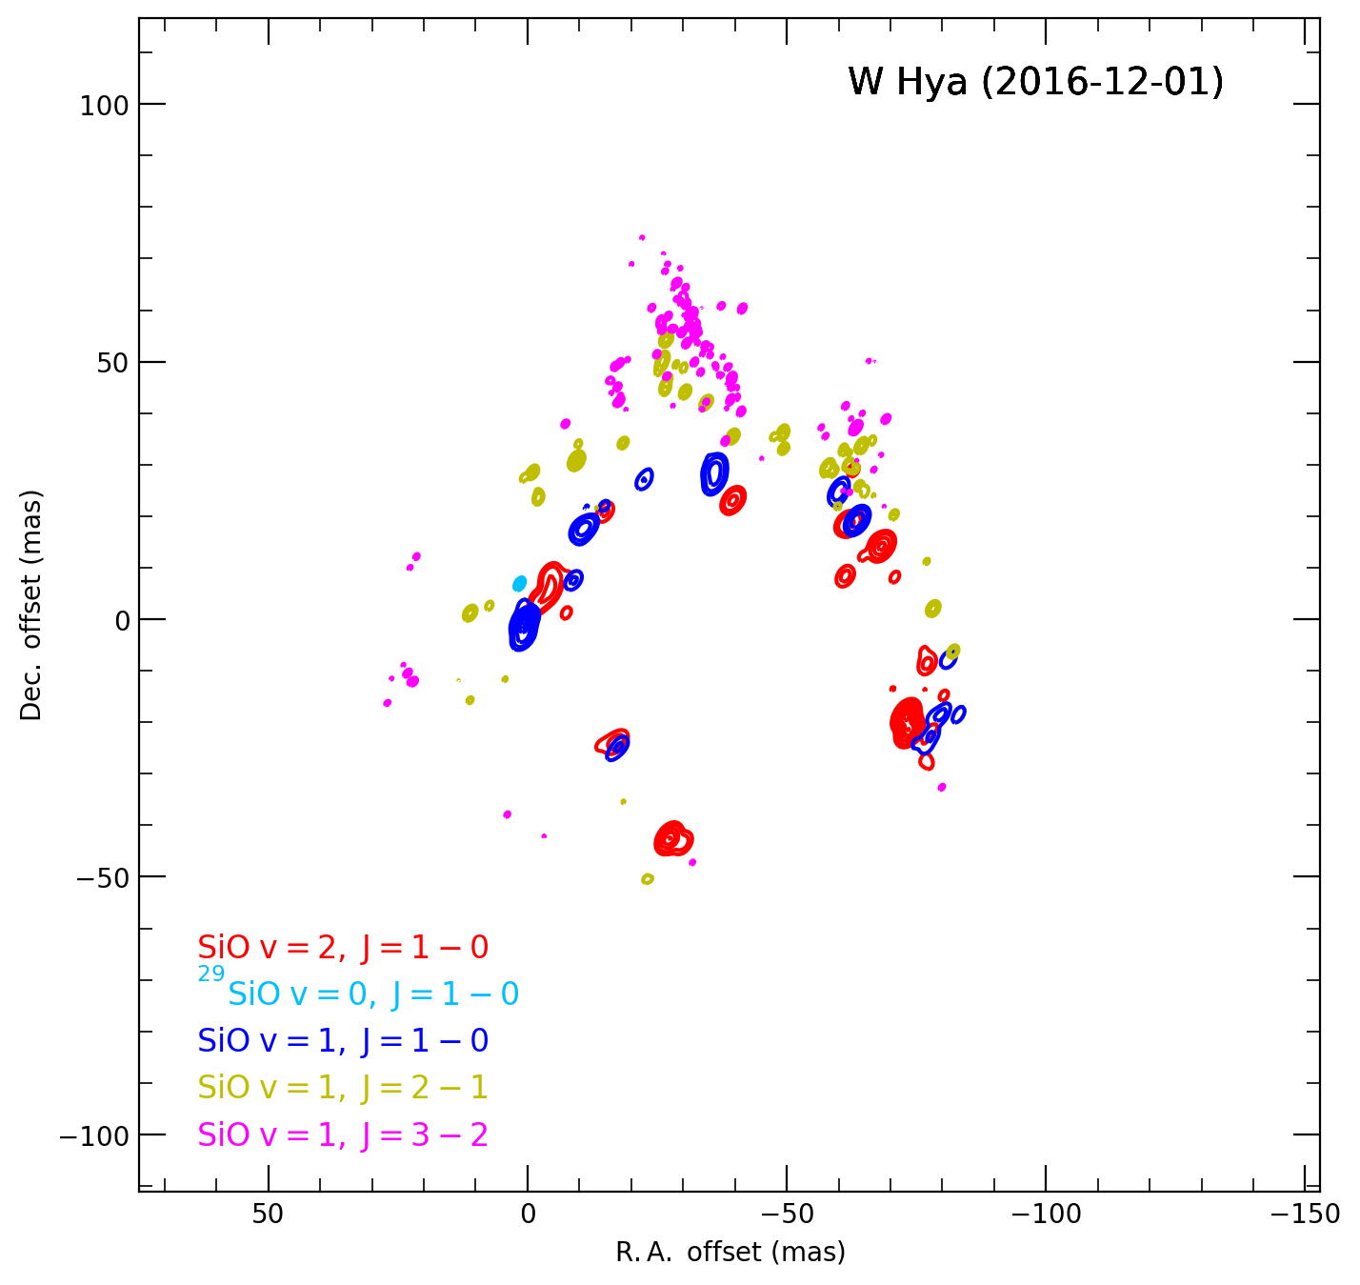
KVN results: W Hya
Locally-violent mass ejection like a flare
Considering the clumps in the line of sight
Also considering rotating motion
2 mm SiO masr is located at the most outer part.
Preliminary
Asymmetric spatial distribution of water maser
SiO masers are located in the middle of water maser (projection effect).
Closely distributed
Largely separated

Slide 31
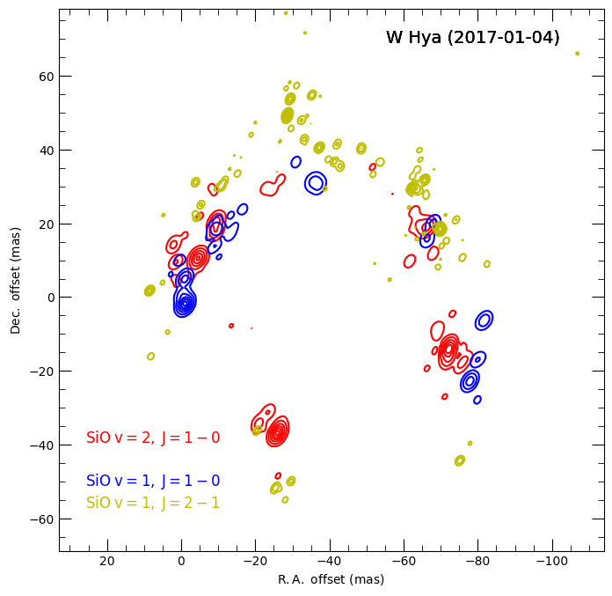
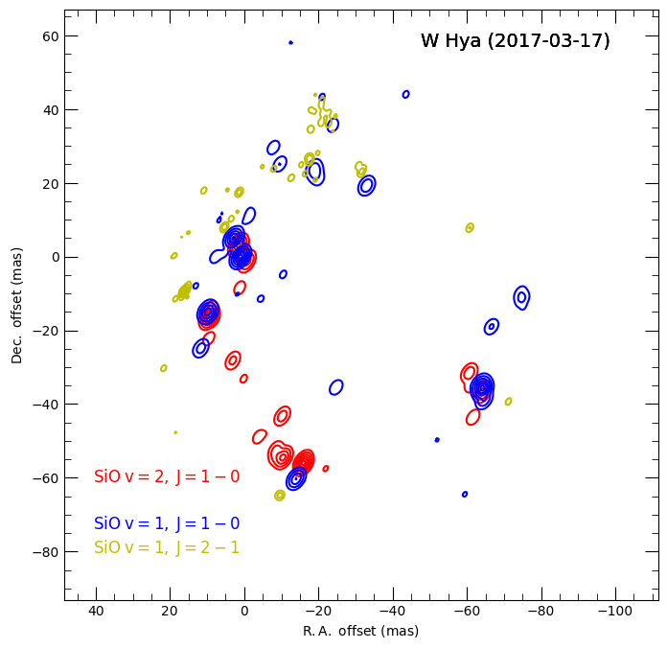
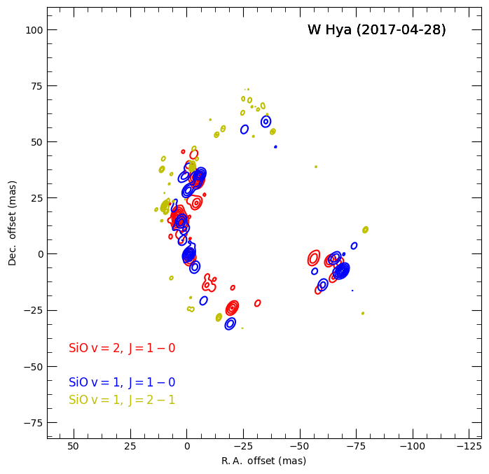
KVN results: W Hya
30 days
70 days
40 days
The observations of 2 mm SiO maser were failed.
7 mm SiO maser follows and catches up the 3 mm SiO maser.
Weakened and disappearing bumped features of SiO masers
Episodic mass-loss phenomena in CSEs ?

Slide 32
KVN results: W Hya
More like radial direction
86 GHz
More like the line of sight components
129 GHz

Slide 33
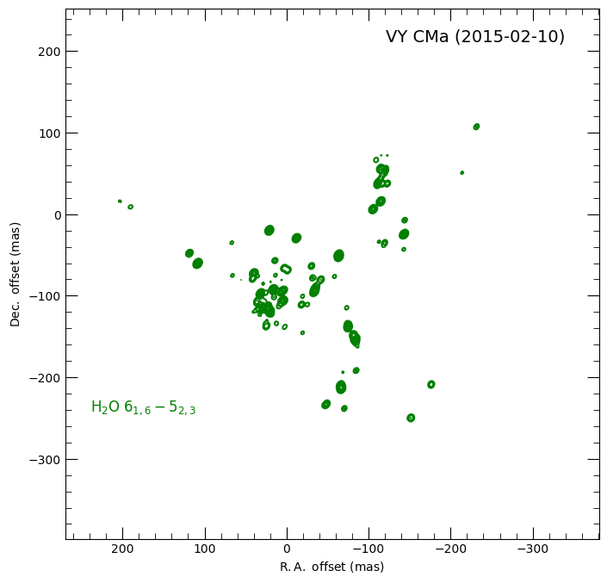
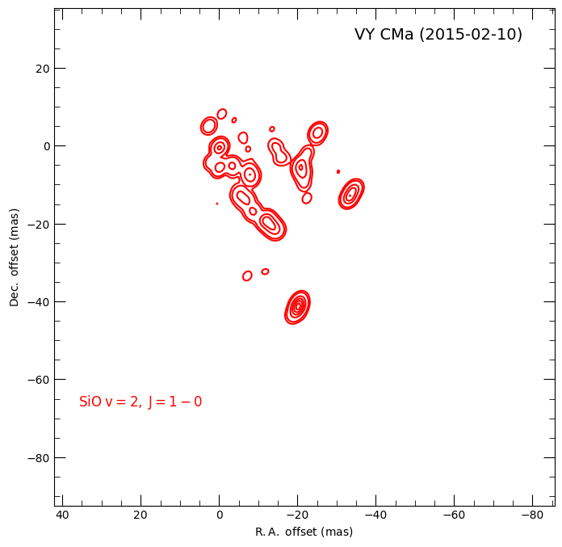
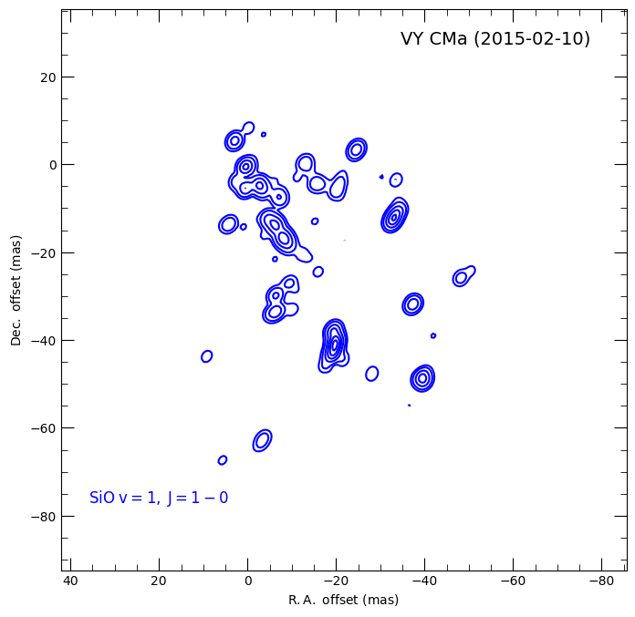
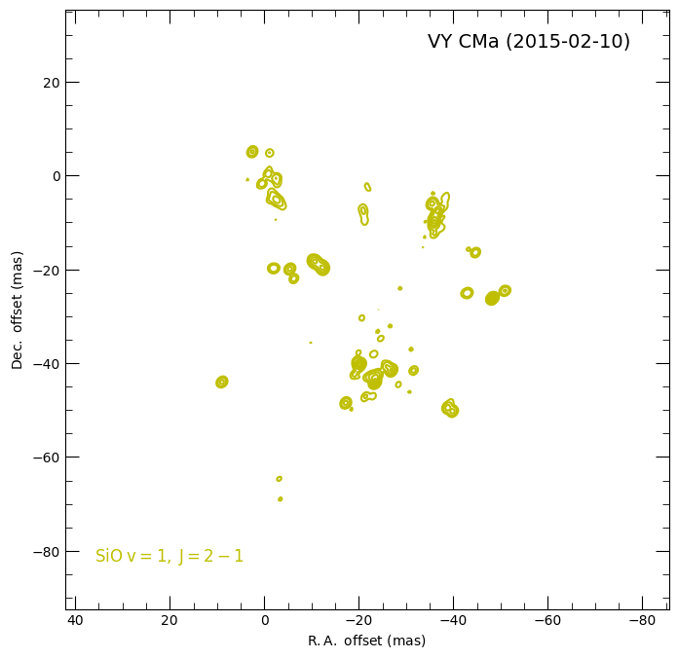
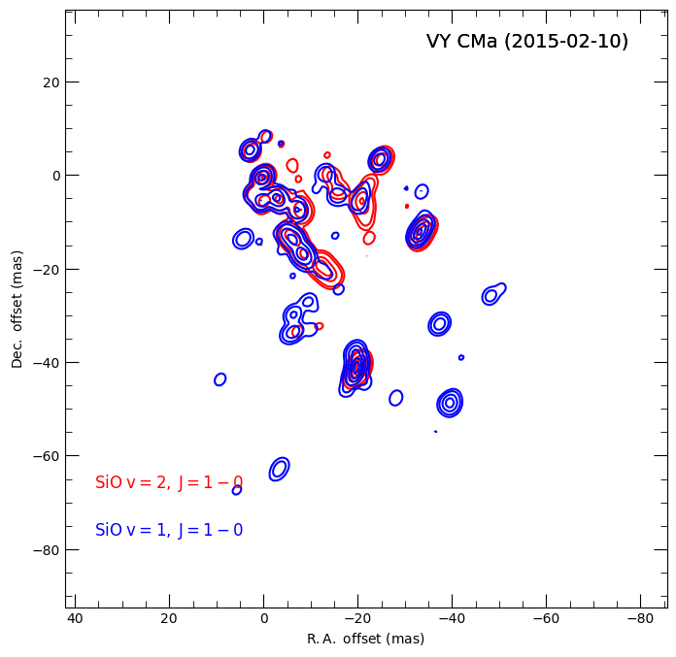
KVN results: VY CMa
22 GHz
42 GHz
43 GHz
86 GHz
42 GHz + 43 GHz
Asymmetric spatial distribution of water maser
Typical spoke-like or snail trail features of SiO maser
Mostly overlapped in NE part and no emission of v=2 SiO maser in SW part

Slide 34
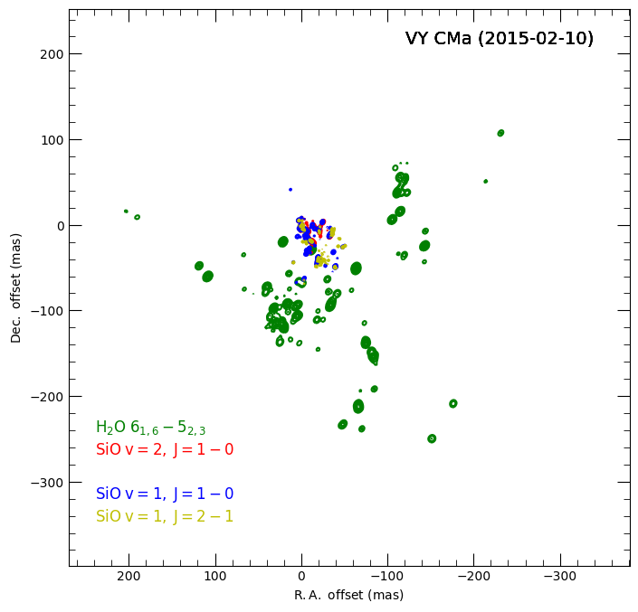
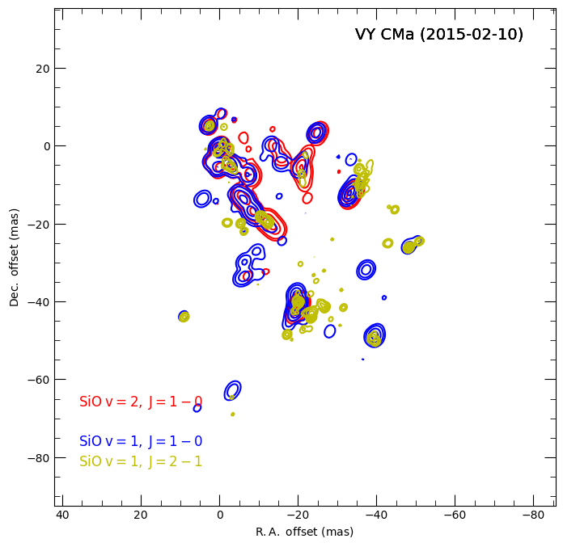
KVN results: VY CMa
The 3 mm SiO maser is spatially overlapped with the 7 mm SiO masers in most parts.

Slide 35
KVN results: VY CMa
22 GHz

Slide 36
KVN results: VY CMa
42 GHz
Motions with a large inclination angle
43 GHz

Slide 37
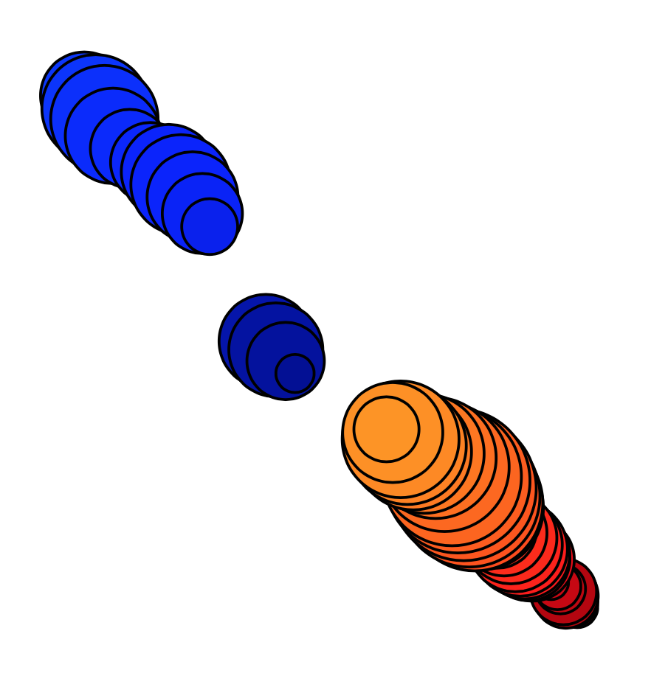
KVN results: VY CMa
Approaching
Receding

Slide 38
KVN results: VY CMa
86 GHz

Slide 39
The results of multi-epoch observations
Eight epochs
2015-02-10
2015-03-16
2016-01-11
2016-02-27
2016-04-29
2016-12-01
2017-01-04
2017-02-11

Slide 40
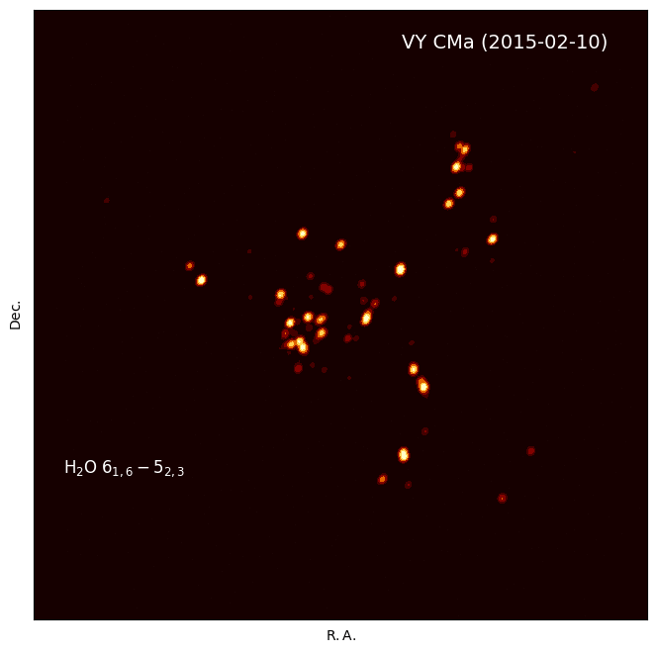

Slide 41
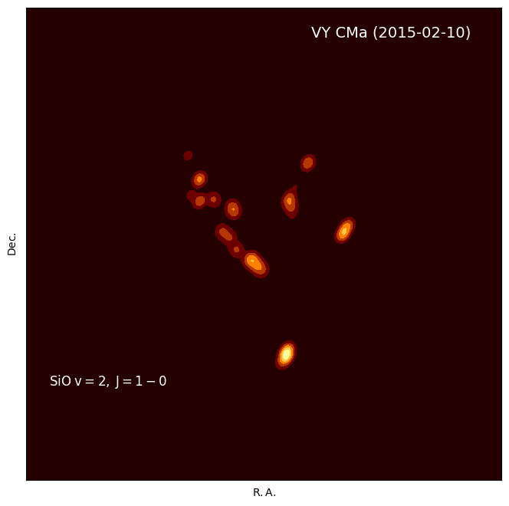

Slide 42
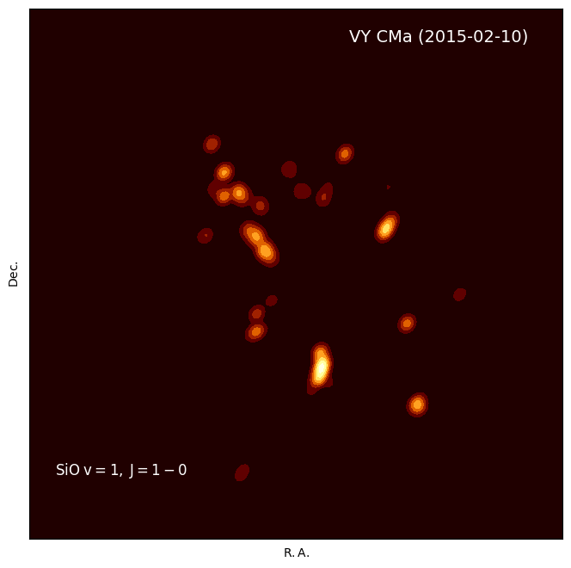

Slide 43
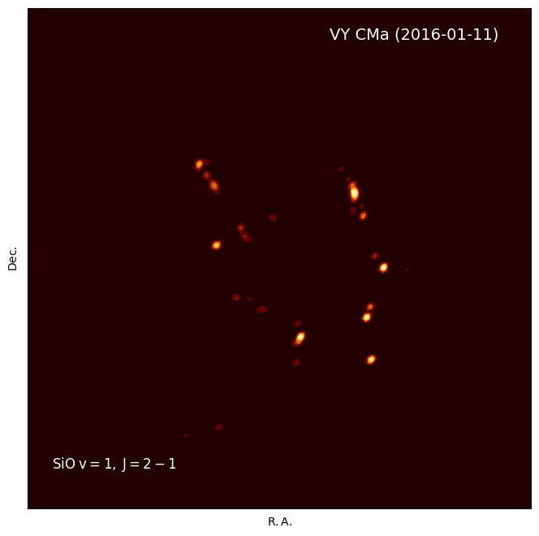

Slide 44
Summary and future works
KVN monitoring observations toward the evolved stars have been carried out since 2014.
  Started with 16 sources and the observations of 9 sources are ongoing.
SFPR method has been successfully applied to KVN observations and yielded the bona fide astrometric results.
Multi-frequency observations of KVN show many interesting features of stellar masers for each source.
  Individual maser: change of morphology, temporal variability
  Several masers: relative spatial distribution
Paper works are initiated using a large amount of the accumulated KVN data.
KVN pipeline has been developed and presented the efficient and consistent ways of data reduction.
Polarization observations will be included in KVN monitoring observations.

Slide 45
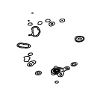
Thank you for your attention!
More beautiful in a distance

